Slide 1
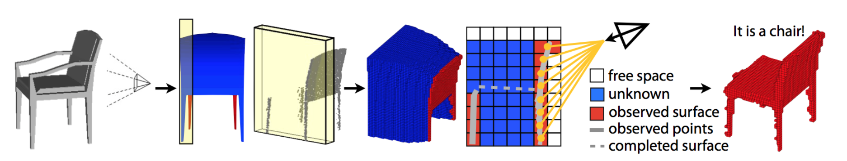
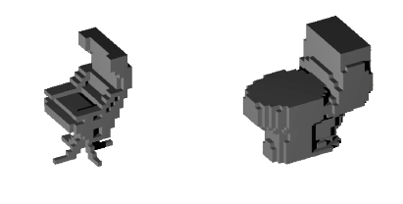
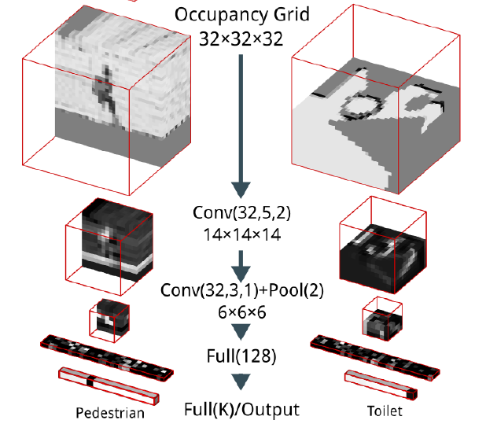
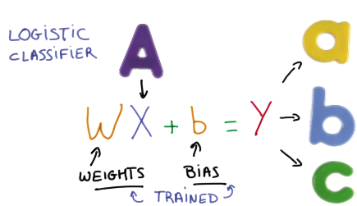
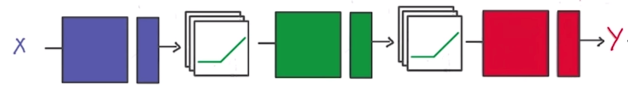

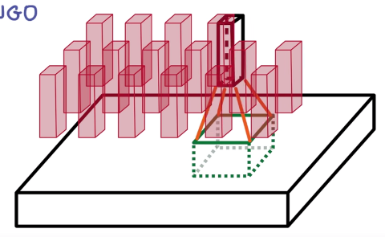
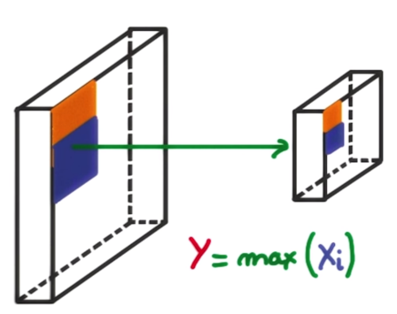
3D Object Recognition with Deep Networks
Students: Adrian Schneuwly, Johannes Oswald, Tobias Grundmann
Supervisors: Martin Oswald, Pablo Speciale
1 Goal of our work: Reimplement Voxnet [1]
3D information / Point cloud of object | Occupancy Grid | Object Recognition
2 Method Overview
3 Voxnet and Implementation
Input Data / Preparation
ModelNet10/40 dataset - 3D CAD models of 10/40 common object categories with 100 unique models each (.mat files)
A 3D shape is represented as 32 x 32 x 32 voxel grid (Fig. 2).
Contribution: Converted multiple .mat files to a single highly compressed hdf5 file, which contains the complete dataset.
Deep Convolutional Neural Networks
Task: Object Recognition as a Classification Problem
1. Neural Network: Non-Linear Activation
Function applied to Input to create
Non-Linear Output
Deep Neural Network: Multiple Connected Layers of weights,
which are trained
Convolutional Nets: Convoluting multiple voxel of one layer into a stack of voxel or a activation map
Max-Pooling: Non-linear down sampling by choosing maximum values of rectangles created from segmenting the volume
Sequence of Multiple Convolutional Layer, Max Pooling Layers, followed by Fully Connected Layers
CNN more then 900k Parameter
Activation: Leaky ReLu
Contributed:
Reimplementation of
Convolutional Neural Network
Model with Keras in Python,
supports rotation e.g. different
views of same object
Contribution : The Keras framework with Theano backend in Python were used to implement the neural network.
4 Training & Results
Training
The training process takes around 9 to 20 hours on a NVIDIA GTX 980TI (6GB) GPU depending on the size of the dataset
Results
Contribution : The Keras framework with Theano backend in Python were used to implement the neural network.
ETH VoxNet: reimplemented method achieves same result as orignal
Algorithm | ModelNet10 Classification (Accuracy) | Modelnet40 Classification (Accuracy)
VoxNet [1] | 83% | 92%
3DShapeNets [2] | 77% | 83.5%
ETH VoxNet | 81.8 | 82.3
5 Conclusion
Succesfully reimplemention of Voxnet [1] in Python with Deep Learning Library Keras for Theano and Tensorflow,
Accuracy results coincide with original authors approach in ModelNet10, for Modelnet40 a significant overfitting was regarded.
The difference could be explained as Data was not augmented for Multiresolution, since training time was limited.
6 References
[1] D. Maturana and S. Scherer. Voxnet: A 3d convolutional neural network for real-time object recognition. International Conference on Intelligent Robots and Systems (IROS2015), 2015.
[2] Z. Wu, S. Song, A. Khosla, F. Yu, L. Zhang, X. Tang and J.Xiao. 3D ShapeNets: A Deep Representation for Volumetric Shape; Proceedings of 28th IEEE Conference on Computer Vision and Pattern Recognition
[3] http://sun.cs.princeton.edu/

