Slide 1
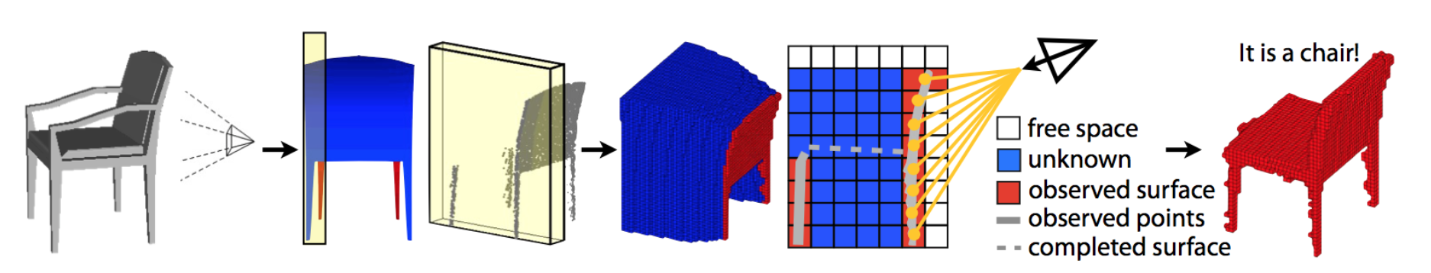
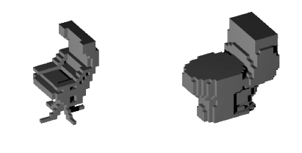
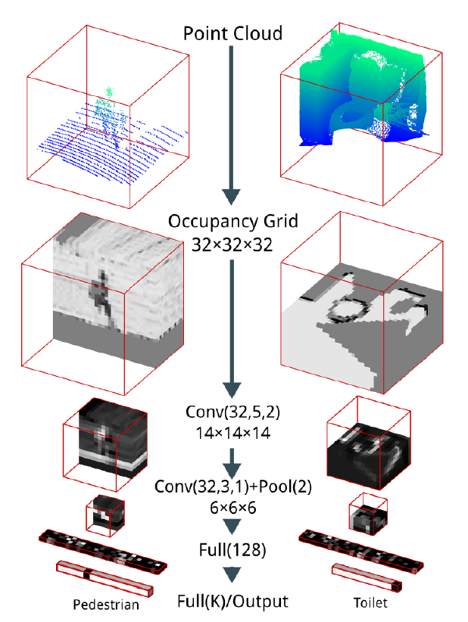
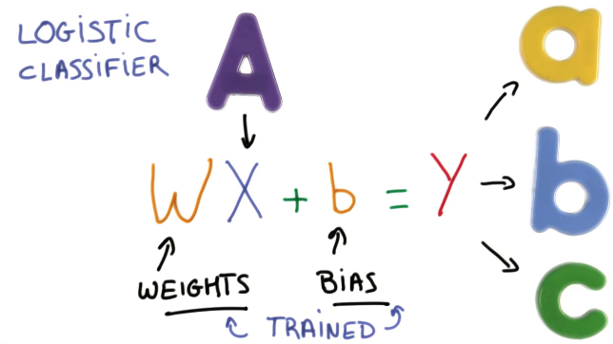
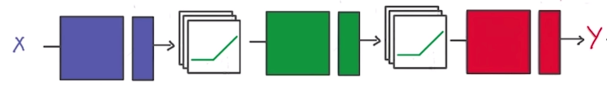

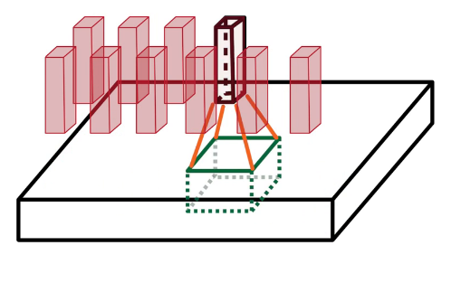
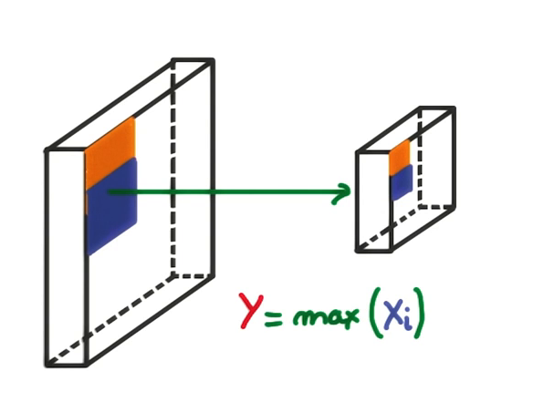
3D Object Recognition with Deep Networks
Students: Adrian Schneuwly, Johannes Oswald, Tobias Grundmann
Supervisors: Martin Oswald, Pablo Speciale
1 Goal of our work: Reimplement Voxnet [1]
3D information / Point cloud of object | Occupancy Grid | Object Recognition
2 Method Overview
3 Voxnet & Implementation
Input Data / Preparation
ModelNet10/40 dataset - 3D CAD models of 10/40 common object categories with 100 unique models each (.mat files)
A 3D shape is represented as 32 x 32 x 32 voxel grid (Fig. 2).
Contribution: Converted multiple .mat files to a single highly compressed hdf5 file, which contains the complete dataset.
Deep Convolutional Neural Networks
Task: Object Recognition as a Classification Problem (Fig. 3)
Neural Network: Non-linear activation function applied to input to create non-linear output (Fig. 4)
Deep Neural Network: Multiple Connected Layers of weights, which are trained
Convolutional Nets: Convoluting multiple voxel of one layer into a stack of voxel or a activation map (Fig. 5a)
Max-Pooling: Non-linear down sampling by choosing maximum values of rectangles created from segmenting the volume (Fig. 5b)
Sequence of multiple
Convolutional layers,
Max Pooling layers followed
by Fully Connected layer
CNN ~ 900k parameters
Activation: Leaky ReLu
Contribution:
The Convolutional Neural Network was re-implemented in Python using the Keras framework with Theano backend.
Fig. 2: voxelized models; Source: Voxnet paper [1]
Fig. 6: VoxNet layers; Source: VoxNet paper [1]
4 Results & Conclusion
Training
The training process takes around 9 to 20 hours on a NVIDIA GTX 980TI (6GB) GPU depending on the size of the dataset
Results
Our implementation (ETH VoxNet) achieves similar result as the original VoxNet[1] (Table 1).
Classification accuracy coincide with the original authors approach for ModelNet10, but for Modelnet40 a significant overfitting was observed.
A possible explanation for the bad performance could be that the data was not augmented for multiresolution, since the training time was limited.
Fig. 3: Classification problem; Source: Udacity [4]
Fig. 4: Relu; Source: Udacity [4]
Algorithm | ModelNet10 | Modelnet40
VoxNet [1] | 83% | 92%
3DShapeNets [2] | 77% | 83.5%
ETH VoxNet | 81.8% | 82.4%
Table 1: Classifation accuracy
(a)
5 References
(b)
[1] D. Maturana and S. Scherer. Voxnet: A 3d convolutional neural network for real-time object recognition. International Conference on Intelligent Robots and Systems (IROS2015), 2015.
[2] Z. Wu, S. Song, A. Khosla, F. Yu, L. Zhang, X. Tang and J.Xiao. 3D ShapeNets: A Deep Representation for Volumetric Shape; Proceedings of 28th IEEE Conference on Computer Vision and Pattern Recognition
[3] http://sun.cs.princeton.edu/
[4] Udacity Deep Learning course
Fig. 5: (a) Convolution, (b) Max-Pooling; Source: Udacity [4]

