Slide 1
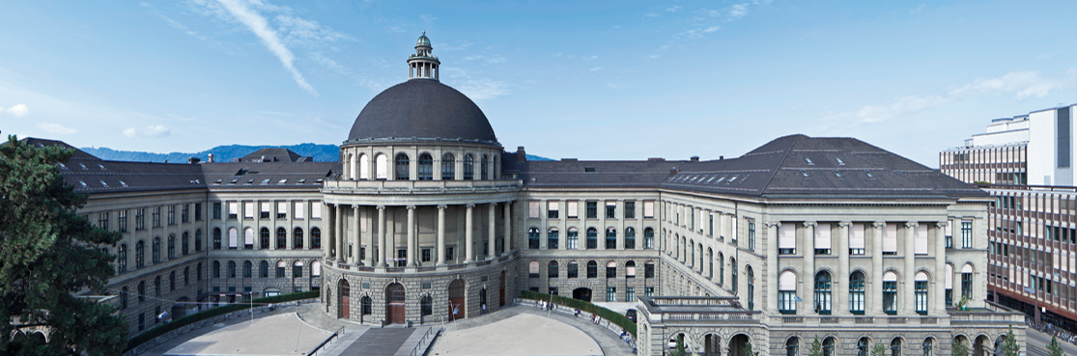
3D Object Recognition with Deep Networks
3D Vision – CVG – ETH Zurich
Instructors: Prof. Marc Pollefeys, Dr. Torsten Sattler
Teaching Assistant: Yagiz Aksoy, Johnasses Schönberger, Thomas Schöps, Peidung Liu
Supervisors: Martin Oswald, Pablo Speciale
Students: Adrian Schneuwly, Johannes Oswald, Tobias Grundmann

Slide 2
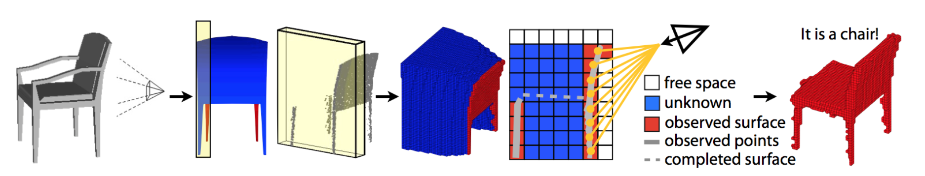
3D Objects in Voxilized Format (32x32x32)
Object
Occupancy Grid
Depth Data of particular view point
It’s a chair!
Source: Z. Wu, S. Song, A. Khosla, F. Yu, L. Zhang, X. Tang and J. Xiao; 3D ShapeNets: A Deep Representation for Volumetric Shapes; Proceedings of 28th IEEE Conference on Computer Vision and Pattern Recognition

Slide 3
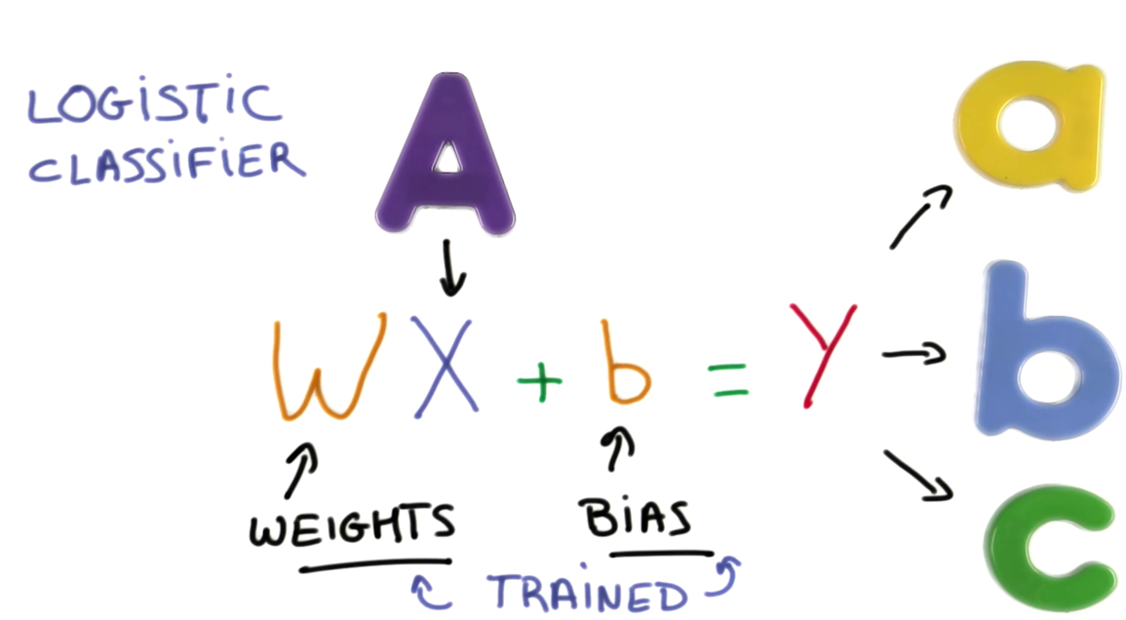
Object Recognition as a Classification Problem
Source: Udacity – Deep Learning

Slide 4
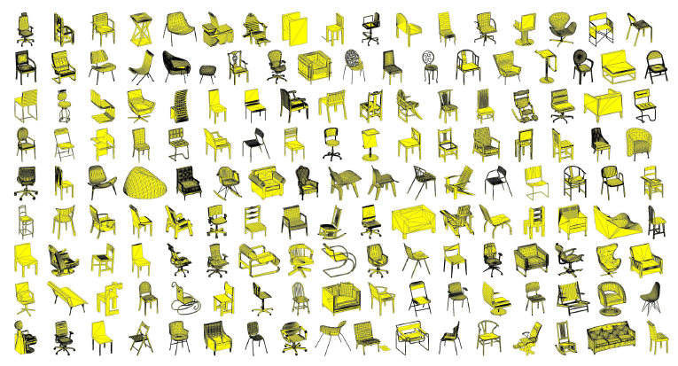
Training, Test Data - ModelNet
ModelNet40
40 Objects
100 CAD Models per Object
Rotational Invariance through Data Augmentation
CNN Training through Stochastic Gradient Decent with Momentum
Source: Z. Wu, S. Song, A. Khosla, F. Yu, L. Zhang, X. Tang and J. Xiao; 3D ShapeNets: A Deep Representation for Volumetric Shapes; Proceedings of 28th IEEE Conference on Computer Vision and Pattern Recognition

Slide 5
First Timeline
March
April
May
Understand 2D Object Recognition with Deep Networks
Get familiar with Machine Learning, Tensorflow, Papers‘ Approaches
Implement Neural Network
Turn 2D into 3D, Achieve Rotational Invariance
Train Neural Network (Time Intensive)
Fine Tuning & Evaluation
Build Application for Live Demo (Project Tango Data)
✔
✔
✔
✔

Slide 6
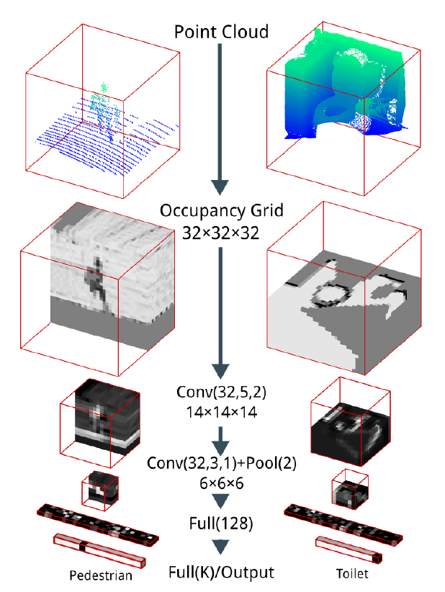
Progress and Outline
✗
First attempt: Implement via Tensorflow
No 3D layers
Second attempt: Implementation via Keras
all needed layers construced
data preparation done ( Matlab -> Numpy)
data loader implemented
hdf5 files for compression
Finished training with small data set
2 Classes (out of 40)
Next Steps / Challanges
Start Training and Testing on big data set
on GPU (and/ cluster with elephas)
Fine tuning
Live demo application
✔
Notes:
Foto ist auf der rechten Seite, damit wir zeigen können wo das Problem bei Tensorflow wo was wir jetzt durch Keras behoben haben.

Slide 7
Current Timeline
March
April
May
Understand 2D Object Recognition with Deep Networks
Get familiar with Machine Learning, Tensorflow, Papers‘ Approaches
Implement Neural Network
Fine Tuning & Evaluation
Build Application for Live Demo (Project Tango Data)
Turn 2D into 3D,
Train Neural Network on small data
Begin training on big data set and on gpu (eventually on cluster with elephas – current build failing)
✔
✔
✔
✔
✔

