Slide 1
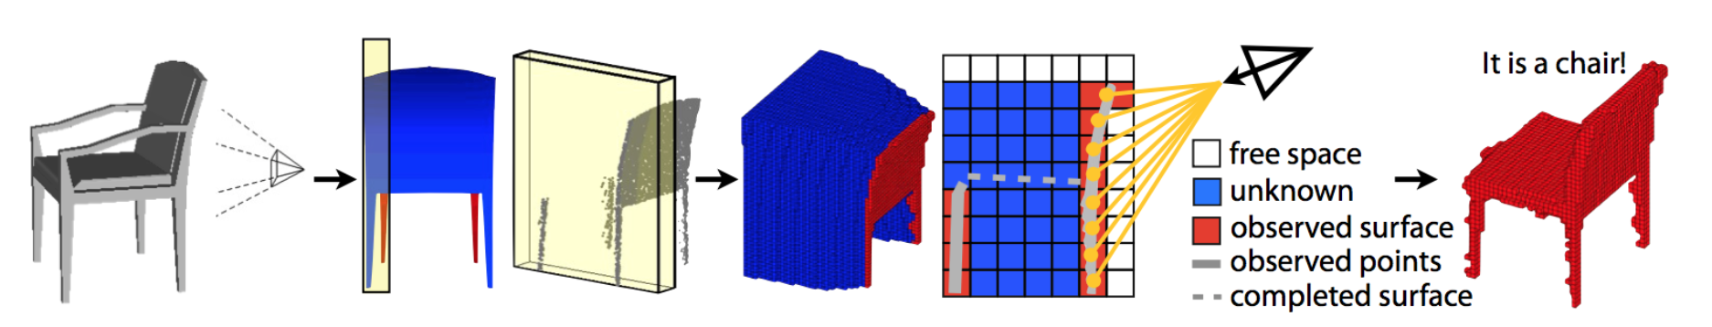
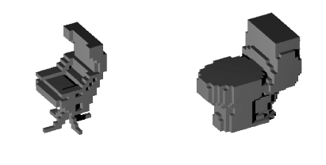
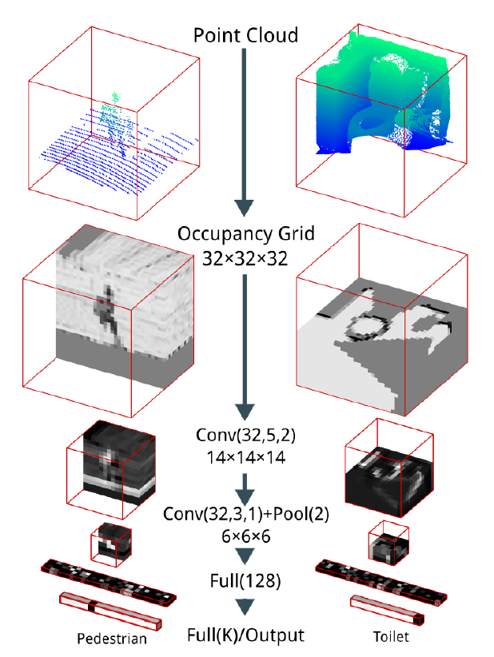
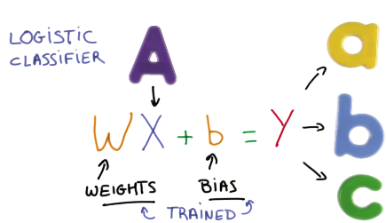
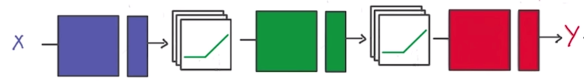

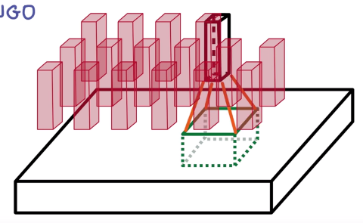
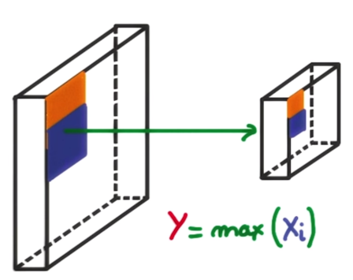
3D Object Recognition with Deep Networks
Students: Adrian Schneuwly, Johannes Oswald, Tobias Grundmann
Supervisors: Martin Oswald, Pablo Speciale
1 Goal of our work: Reimplement Voxnet [1]
3D information / Point cloud of object | Occupancy Grid | Object Recognition
2 Method Overview
3 Voxnet & Implementation
Input Data / Preparation
ModelNet10/40 dataset - 3D CAD models of 10/40 common object categories with 100 unique models each (.mat files)
A 3D shape is represented as 32 x 32 x 32 voxel grid (Fig. 2).
Contribution: Converted multiple .mat files to a single highly compressed hdf5 file, which contains the complete dataset.
Deep Convolutional Neural Networks
Task: Object Recognition as a Classification Problem (Fig. 3)
Neural Network: Non-linear activation function applied to input to create non-linear output (Fig. 4)
Deep Neural Network: Multiple Connected Layers of weights, which are trained
Convolutional Nets: Convoluting multiple voxel of one layer into a stack of voxel or a activation map (Fig. 5)
Sequence of Multiple
Convolutional Layer,
Max Pooling Layers, followed
by Fully Connected Layers
CNN ~ 900k Parameter
Activation: Leaky ReLu
Contributed:
Reimplementation of
Convolutional Neural
Network Model with Keras
in Python, supports rotation
e.g. different views of same object
The Keras framework with Theano backend in Python were used to implement the neural network.
Fig. 2: voxelized models; Source: Voxnet paper [1]
Fig. 6: VoxNet layers; Source: VoxNet paper [1]
4 Results & Conclusion
Training
The training process takes around 9 to 20 hours on a NVIDIA GTX 980TI (6GB) GPU depending on the size of the dataset
Results
Our implementation (ETH VoxNet) achieves similar result as the original VoxNet[1] (Table 1).
Classification accuracy coincide with the original authors approach for ModelNet10, but for Modelnet40 a significant overfitting was observed.
A possible explanation for the bad performance could be that the data was not augmented for multiresolution, since the training time was limited.
Fig. 3: Classification problem; Source: Udacity [4]
Fig. 4: Relu; Source: Udacity [4]
Algorithm | ModelNet10 | Modelnet40
VoxNet [1] | 83% | 92%
3DShapeNets [2] | 77% | 83.5%
ETH VoxNet | 81.8% | 82.4%
Table 1: Classifation accuracy
5 References
Fig. 5: Convolution; Source: Udacity [4]
[1] D. Maturana and S. Scherer. Voxnet: A 3d convolutional neural network for real-time object recognition. International Conference on Intelligent Robots and Systems (IROS2015), 2015.
[2] Z. Wu, S. Song, A. Khosla, F. Yu, L. Zhang, X. Tang and J.Xiao. 3D ShapeNets: A Deep Representation for Volumetric Shape; Proceedings of 28th IEEE Conference on Computer Vision and Pattern Recognition
[3] http://sun.cs.princeton.edu/
[4] Udacity Deep Learning course

