Slide 1
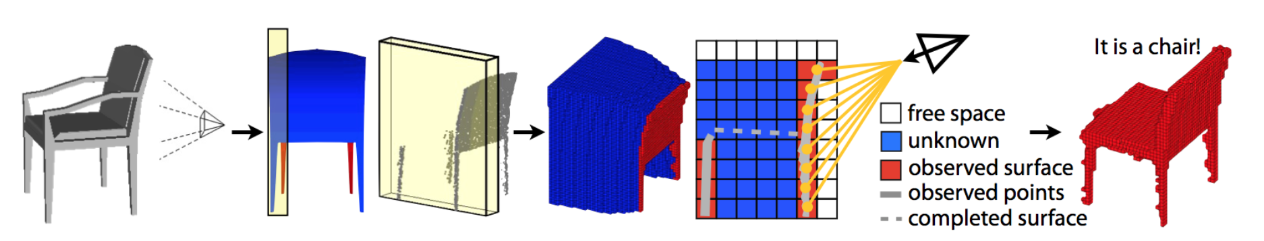
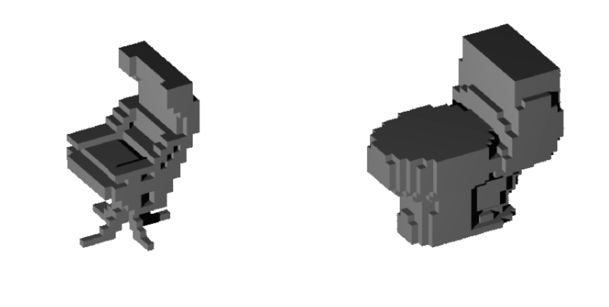
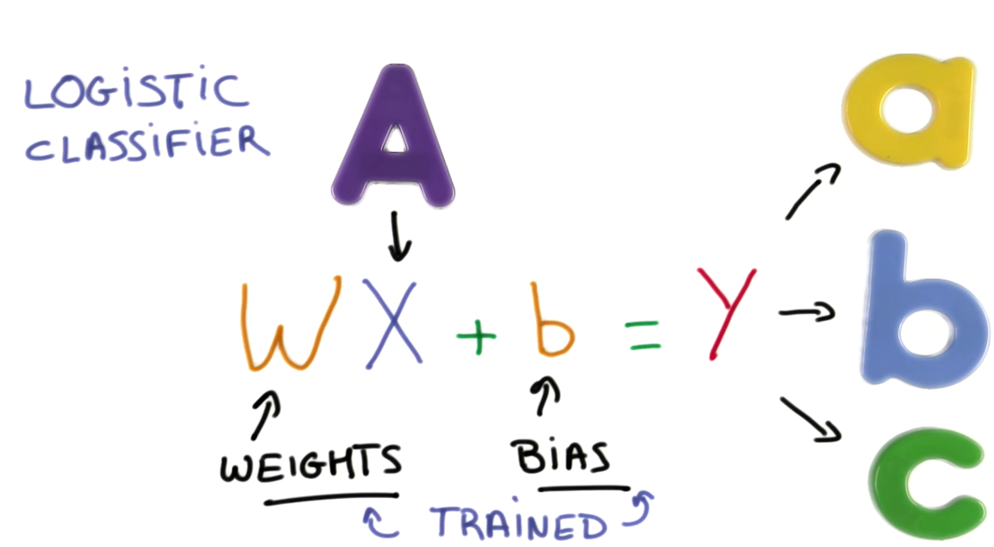
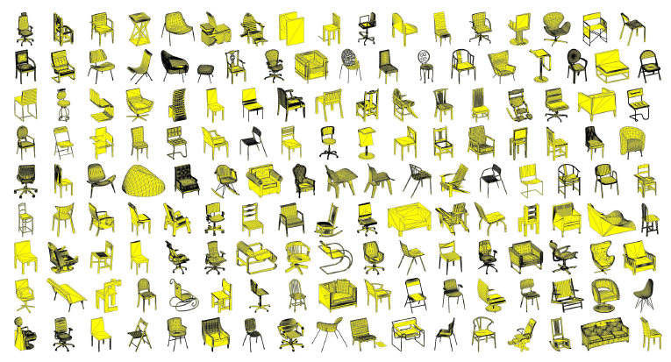
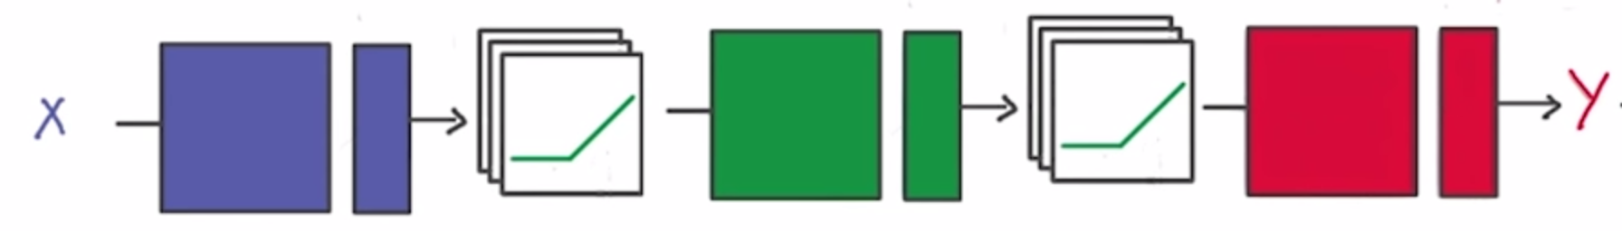

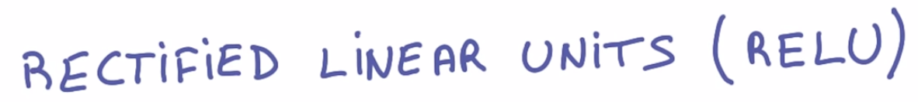
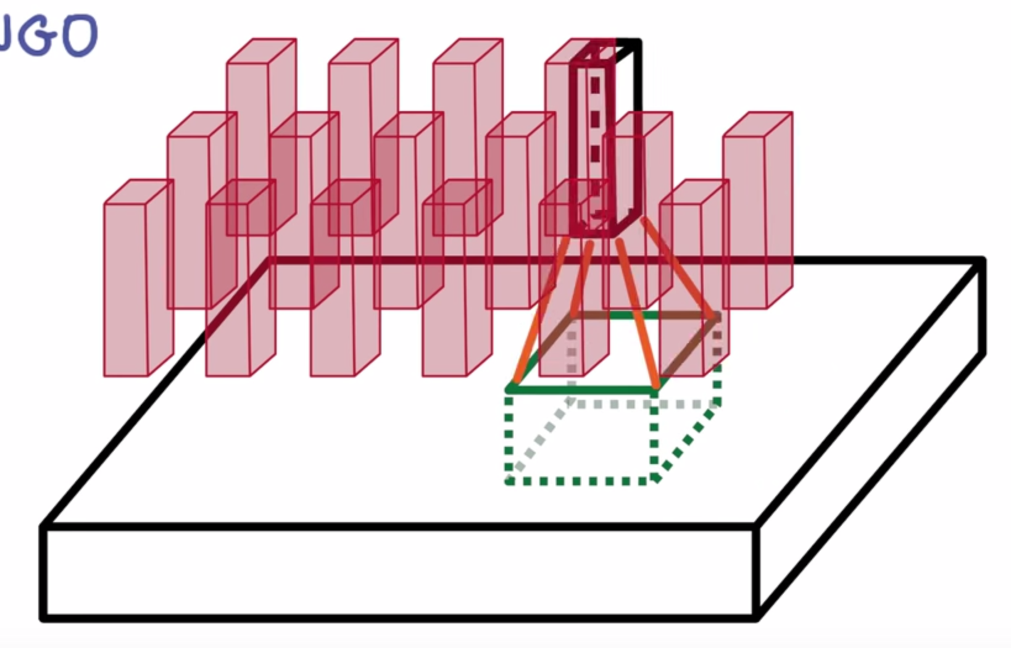
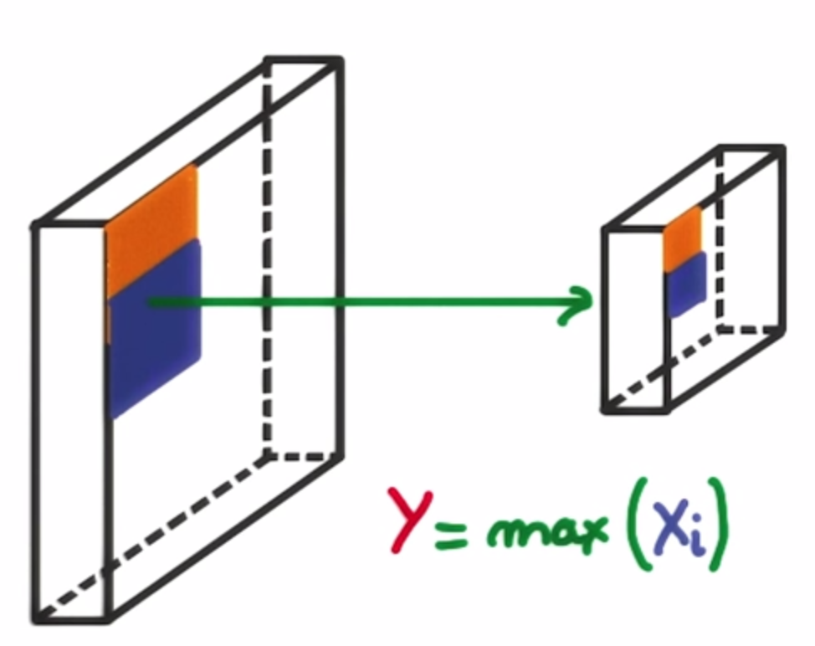
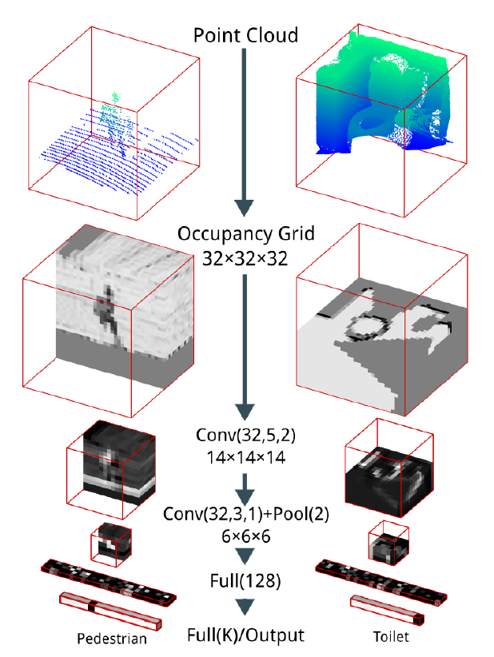
3D Object Recognition with Deep Networks
Students: Adrian Schneuwly, Johannes Oswald, Tobias Grundmann
Supervisors: Martin Oswald, Pablo Speciale
1 Goal of our work: Reimplement Voxnet [1]
3D information / Point cloud of object | Occupancy Grid | Object Recognition
2 Method overview
3 DataSet / Princeton ModelNet [2]
Input Data / Preparation
Data: ModelNet10/40 - CAD Models of
10/40 Object categories (.mat files)
Given: For every object, a 30 x 30 Voxel Grid and 2.5D view point data every 30°
Contributed: Created train & test set from given .mat files – save as highly compressed hdf5 binary data format
Deep Convolutional Neural Networks
General:
Object Recognition
as a Classification Problem
2. Non-linearize system and get more
parameters through getting deeper:
Instead of matrix multiplication of our Input, we deepen our network
by using convolutions and max-pooling which make use of the
spatial information of 3D data.
Convolution: Shrink/Blur Max Pooling: Non-linear down-sampling
Result in VoxNet Case:
CNN of ~ 900t parameters
Contributed:
Reimplementation of
Convolutional Neural Network
Model with Keras in Python,
supports rotation e.g. different
views of same object
Model Details:
Multiple 3D Convolutions
3D Max Pooling
Dense, LeakyRelu, etc.
Clean collection of 3D CAD models for objects
Building procedure
compilation of list of most common object categories, using statistics obtained from SUN database [3]
collection of 3D CAD models for each object category using online search engines by querying for each object category term
human clean up through
Amazon Mechanical Turk to
decide whether each CAD
model belongs to specified
cateogries
manually alignment of
orientation of CAD models
4 Training & Results
Training
Contributed:
Setup and implementation on ETH Cluster ~ 20.000 cores [4]
Trained ModelNet10/40 for Xh / 12h on ???
Results
ETH VoxNet: reimplemented method achieves same result as orignal
Algorithm | ModelNet10 Classification (Accuracy) | Modelnet40 Classification (Accuracy)
VoxNet [1] | 83% | 92%
3DShapeNets [2] | 77% | 83.5%
ETH VoxNet | ?% | ?%
5 Conclusion
Succesfully reimplemention of Voxnet [1] in Python with Deep Learning Library Keras for Theano and Tensorflow
Accuracy results coincide with original authors approach
6 References
[1] D. Maturana and S. Scherer. Voxnet: A 3d convolutional neural network for real-time object recognition. International Conference on Intelligent Robots and Systems (IROS2015), 2015.
[2] Z. Wu, S. Song, A. Khosla, F. Yu, L. Zhang, X. Tang and J.Xiao. 3D ShapeNets: A Deep Representation for Volumetric Shape; Proceedings of 28th IEEE Conference on Computer Vision and Pattern Recognition
[3] http://sun.cs.princeton.edu/
[4] https://ivc-support.ethz.ch/VisualLab/VL02Servers01Euryale

