Slide 1
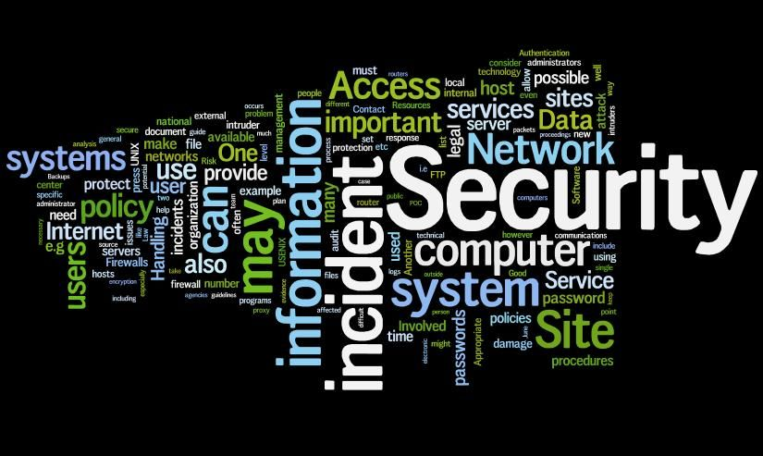
AKAMAI IT SECURITY:
Company Novatech:

Slide 2
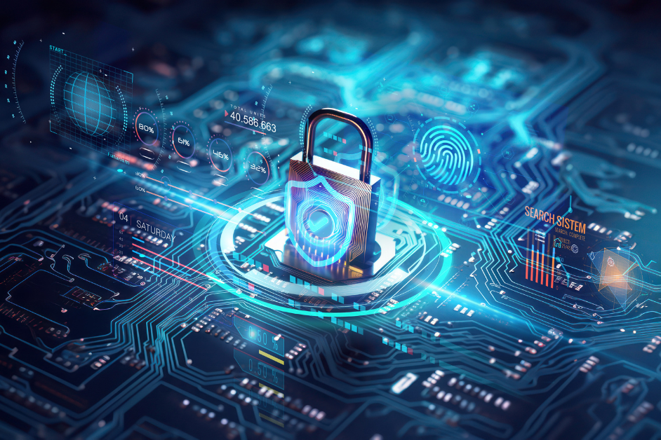
Company IT security intro:
company's security — the risk of insider threats and how we can work together to prevent them.

Slide 3
Security Risk: Insider Threats
insider threat :when an employee, contractor, or trusted individual intentionally or unintentionally causes harm to our company's security.
This could be stealing data, exposing sensitive information, or sabotaging systems etc.

Slide 4
Risk
External user also can penetrate the system .
HOWEVER,
insider threats is from within the organization. This can happen if someone with access misuses their authorities, either maliciously or due to negligence. For instance a case can be, an employee who might access confidential data they don’t need for their job or accidentally share sensitive information (expose to public)

Slide 5
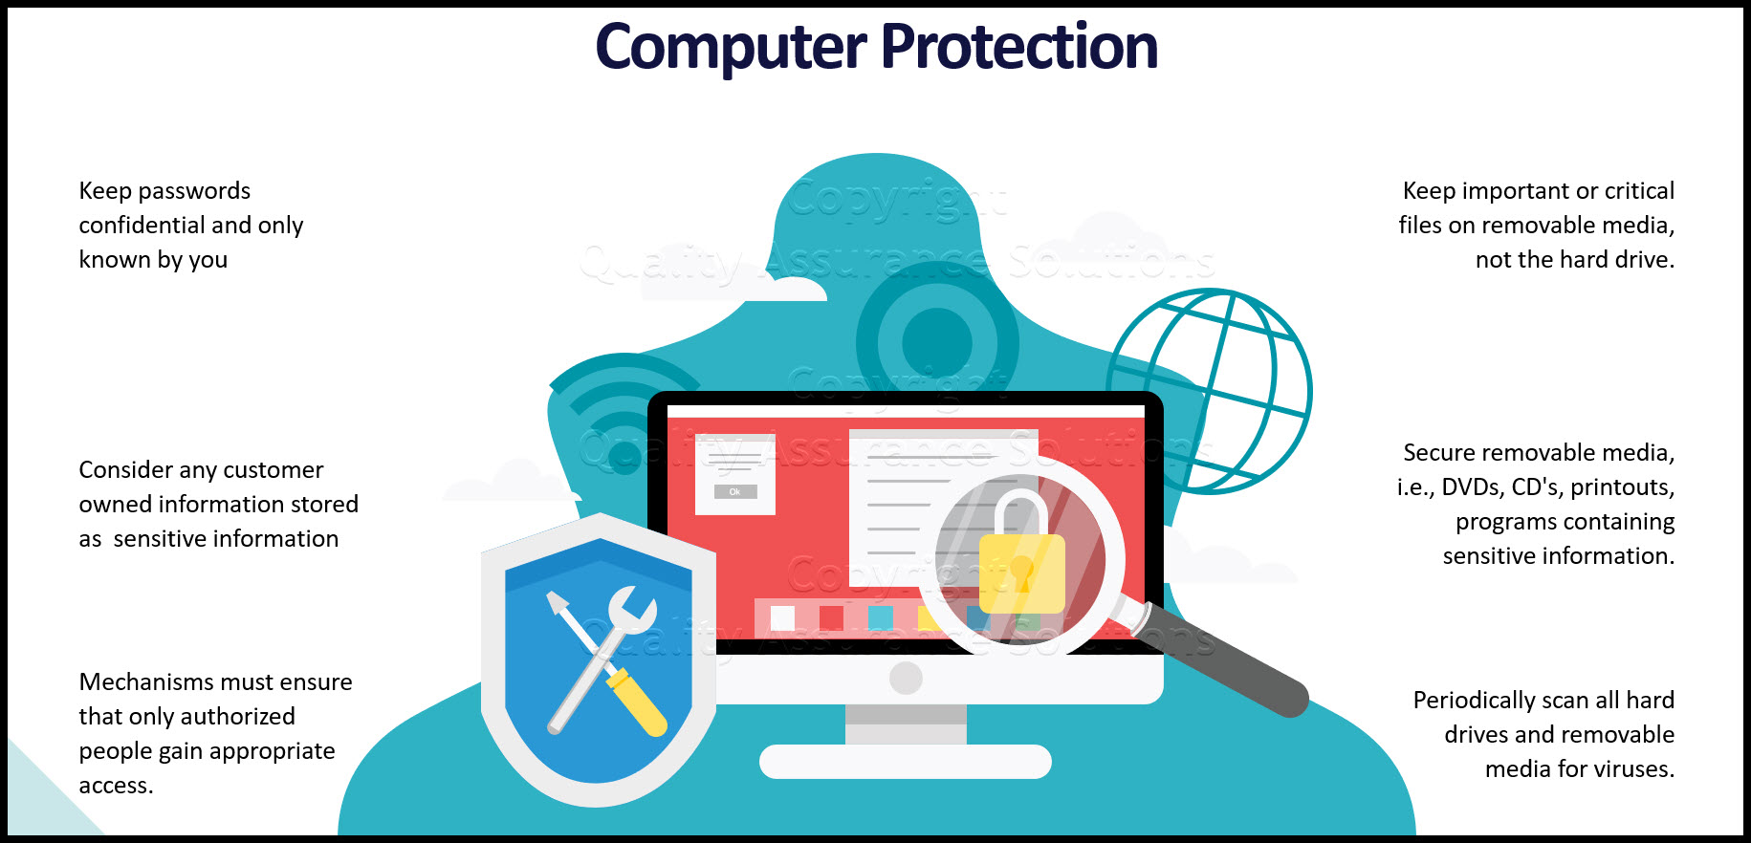
Protection:

Slide 6
concern
Insider threats have a significant risk as insiders already have authorized access. Their actions can lead to data breaches, financial losses, damage to reputation, or legal consequences. Even a single careless mistake can have serious repercussions.

Slide 7
Mitigation Strategies
Implement Role-Based Access Control (RBAC): Ensure employees only have access to information necessary for their role.
Monitor and Audit User Activity: Utilize security tools to trace access and detect unusual behavior or activities.

Slide 8
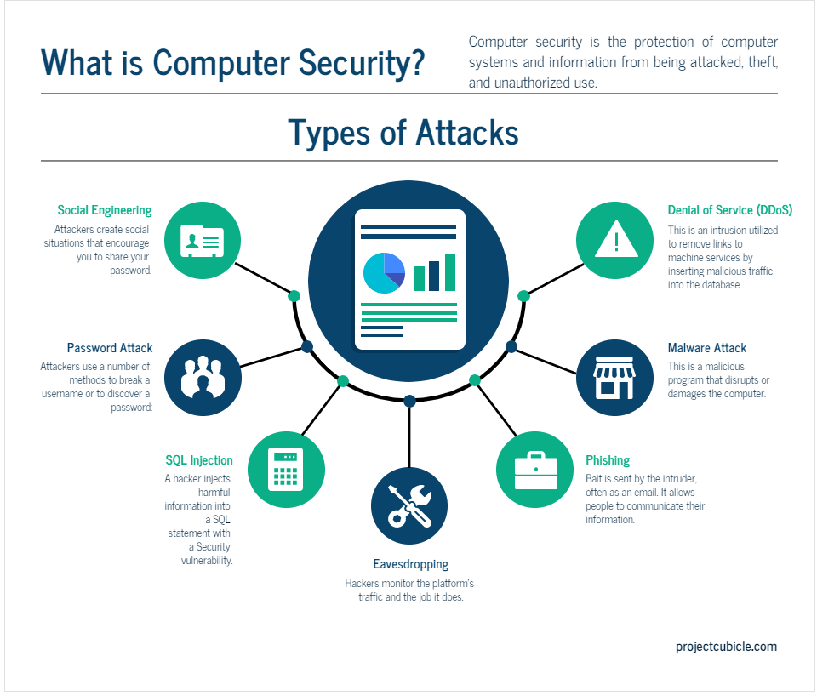
Security:

Slide 9
Actions to Reduce Insider Threats:
Encourage a Culture of Security: Promote open communication where employees feel comfortable reporting concerns or suspicious activity.
Enforce Strong Passwords and Multi-Factor Authentication: Protect accounts from unauthorized access. Such as high reputed companies(google) which has two factor authintication system.

Slide 10
Conclusion
In summary, insider threats are a serious security concern but can be effectively mitigated through proper access controls, monitoring, and ongoing training.
By having proper plan and following security best practices, we could protect our company's assets, sentive data and reputation, etc.

