Slide 1
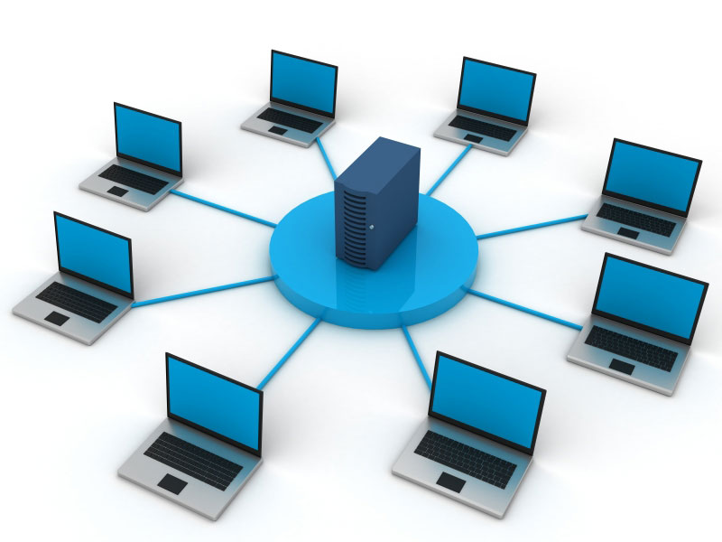
Task A: akamai Network:
Company Name:
NOVATECH

Slide 2
Internal Network Design:
Task B:
Devices on the Network:
Employee computers (2-4 desktops/laptops)
2-3 Printers
Network-attached storage (NAS)
Public web server ( internally-externally)

Slide 3
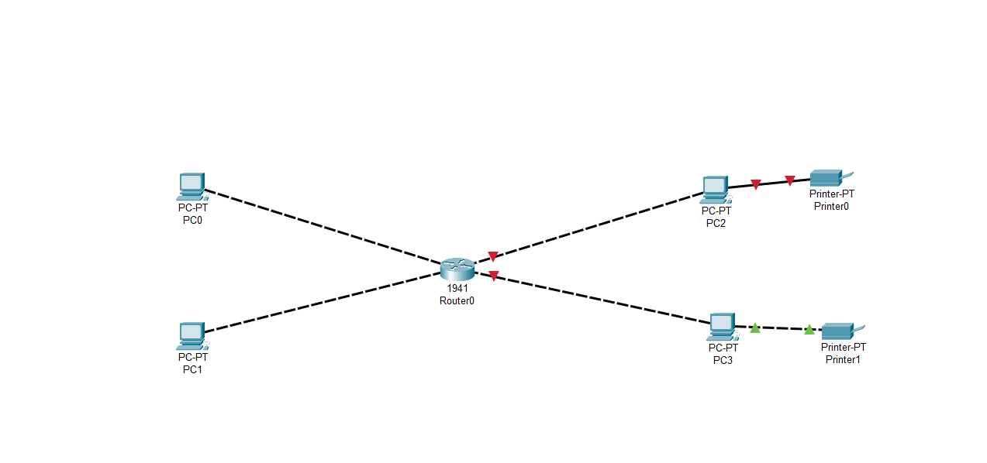
Connection:

Slide 4
Connection to LAN:
Employee devices and network
connect via Ethernet cables for efficient and speed,
Higher Perfomance for workstations and servers.
Wireless access points (WAPs)
mobile devices, guest access, or other regions.

Slide 5
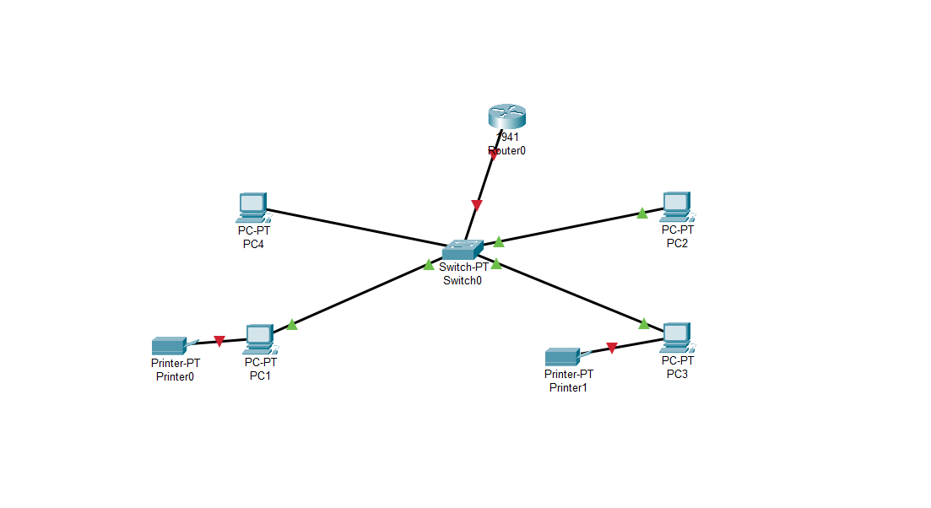
Architecture & Internal Design:

Slide 6
Wired or Wireless:
Wired system
For- primary and sensetive company asset data devices
(computers, servers, printers)
Wireless system
For employee laptops,
mobile devices, and guest access

Slide 7
IP Addressing Scheme:
private IP range, e.g., 192.168.1.0/24
IPs to servers, network devices, printers, as well as other infrastructure.
The secondary infrastructure:
DHCP to have dynamic IPs to employee devices and guest devices

Slide 8
Network Segments:
Office LAN (employee workstations, printers, equipment)
Server Network (web server, file server, NAS)
Guest Wi-Fi (Public External Secured VLAN for guests)
Management/Network Infrastructure (routers, switches, firewalls)

Slide 9
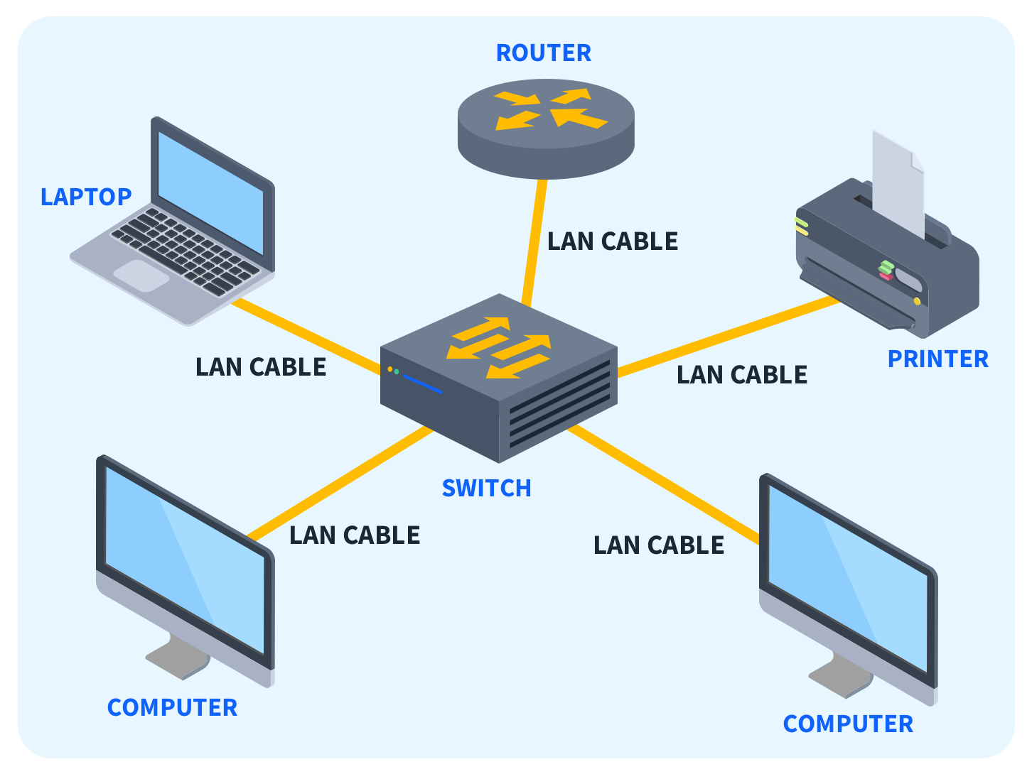
DESIGN:

Slide 10
Segmentation with Routers:
routers
Layer 3 switches for internal & external
VLANs
Other VLANS ; for guest access and internal servers for security.

Slide 11
Internet Connection:
Connect the internal network to the Internet via a seperate router or NAT router (a firewall or devices)
The router based on NAT (Network Address Translation) for outbound traffic & firewall policies.

Slide 12
DHCP
DHCP on the main router or a designated DHCP server to have dynamic IP assignment to employee devices and guests
Based on authorities and type of usage

Slide 13
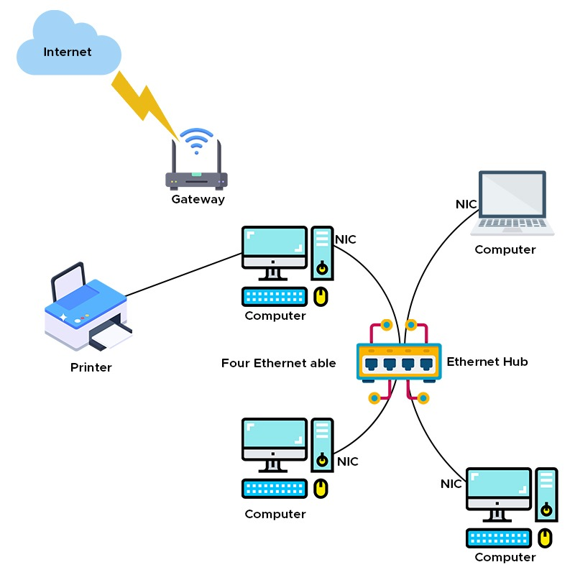
Network & Gateway:

Slide 14
DNS:
internal DNS server for internal hostnames (e.g., file-server.novatech)
External DNS for internet resolution, provided by ISP or a public DNS service

Slide 15
Packet Sniffing:
Use for network monitoring and troubleshooting, via a designated devices or software like Wireshark on a designated management workstation.
Ensure appropiriate permissions and security policies based system.

