Slide 1

Task A: akamai operation system:
Company Name:
techno-recursion

Slide 2
Task B: File Server Setup
1. Authentication System
Usernames:
Employees:
User 1
User 2
Admins:
AD1
AD2

Slide 3
Account Customization:
Set expiration dates for admins accounts (ad1 - ad2) to automatically login.
Set upgrade pages and features of a web.
File structure:
Data Types to Store:
Company files
Project files
Admin logins dates
Employess login dates
Code directories :
Directories:
/company_data
/company_data/employees login date
/company_data/admin logins dates
company_data/admin project & doc files

Slide 4
Security code:
Security:
employees (for full employee access)
interns (for admins access)
Assign directory permissions based on authorities to secure system.

Slide 5
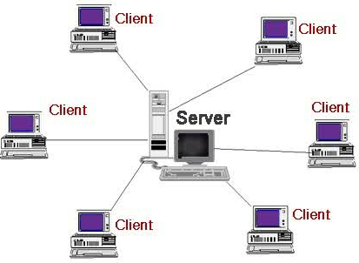
Authorities:

Slide 6
Files accessability:
Files/Permissions:
Hidden files (config- sensetive data )
Files with encrypted & asset data of a company
Files with specific access code (allowenece – entry – login to web , servers etc)

Slide 7
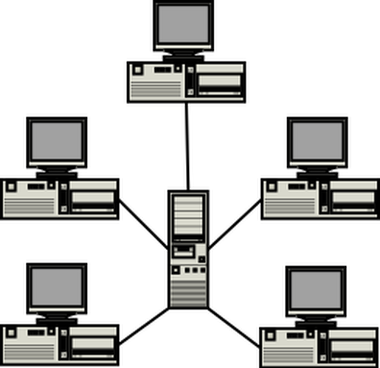
Access code:internal server

Slide 8
Backups:
Backup Files: on daily , mounth basis
Create a script to backup /company_data directory, saving them in short formatted data.
Save backup as /backups/company_backup_$(date +%F).tar.gz.
Protect asset & sensitive data of a corporation
Code:
/usr/local/bin/backup_script.sh

Slide 9
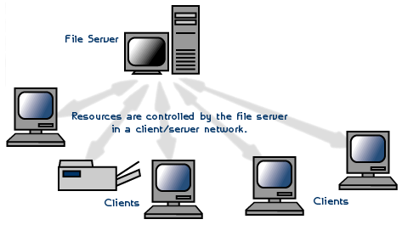
Main server:backups

Slide 10
Virtual Machine & Users
sudo useradd -m -c "Employee user1" em1
sudo useradd -m -c "Employee user2" em2
sudo useradd -m -c "admin 1" or ad1
sudo useradd -m -c "admin2" or ad2

Slide 11
Account access:
Codes: protection based access
sudo chage -E $(date -d "x months" +%Y-%m-%d) em1
sudo chage -E $(date -d "x months" +%Y-%m-%d) em2

Slide 12
Directories:
sudo mkdir -p /company_data/user
sudo mkdir -p /company_data/admins
sudo chown -R root:employees /company_data/user
sudo chown -R root:admin /company_data/admin

Slide 13
Access coded system:
sudo groupadd users
sudo groupadd ads
sudo usermod -aG user1
sudo usermod -aG user2
sudo usermod -aG interns ad1
sudo usermod -aG ad2
sudo chmod 770 /company_data/users
sudo chmod 770 /company_data/ads

Slide 14
Company projects:
touch /company_data/employees/sample_employee.docx
touch /company_data/admins/sample_admins_project.txt

Slide 15
Backups:
#!/bin/bash
tar -czf /backups/company_backup_$(date +%F).tar.gz /company_data
sudo chmod +x /usr/local/bin/backup_script.sh

Slide 16
Conclusion:
The company called tecno-recursion : to protect its asset and project data, there should be backup , access code, permision prrocess , monitoring and analysis process to keep its data protected and avoid any confilict and problems in the corporation.

