Slide 1

System Analyst : Capstone Project
.

Slide 2
Unified IT Solution for XYZ Health Solutions
Name: kamyab sd
Date:10,05,2025

Slide 3
Table of Contents
Executive Summary Introduction Business Objectives Artifacts Project Initiation and Stakeholder Engagement Requirements Gathering Project Planning and Risk Analysis Process Modeling Visualizations Dashboards | System Design Database Design Test Planning and Case Design Using TDD and BDD CI/CD Workflow and Monitoring Plan Findings and Recommendations Key Findings Key Recommendations Conclusion Appendix

Slide 4
Executive Summary
[Outline the problem, key insights, and recommended actions in 6 bullet points.]
Problem:
Current healthcare systems operate in fragmented silos, causing significant inefficiencies in clinical workflows, administrative processes, and regulatory compliance. This fragmentation leads to frequent communication breakdowns, delays in patient care, and increased risk of errors that impact both operational costs and patient outcomes.
Insight:
Comprehensive data analysis reveals that approximately 20% of appointment scheduling errors—such as double bookings, missed appointments, and incorrect patient data—contribute directly to prolonged patient wait times and operational disruptions. Furthermore, studies indicate that integrating real-time data access across departments enhances transparency, reduces errors, and significantly boosts patient satisfaction and care continuity.
Action:
To address these challenges, the deployment of a unified healthcare management system is critical. This system will ensure full HIPAA adherence to protect patient data privacy, incorporate real-time dashboards that provide actionable insights for clinicians and administrators, and facilitate ongoing stakeholder engagement through training and feedback loops. This approach will streamline operations, promote accountability, and improve both compliance and patient experience.

Slide 5
Introduction
[Summarize the opportunity, describe the approach, and outline the key questions or hypotheses to be analyzed in 6 bullet points.]
Opportunity:
The healthcare sector faces a significant opportunity to transform patient care quality and operational efficiency by streamlining critical processes—patient data management, appointment scheduling, and billing operations. Integrating these systems will reduce administrative burdens, foster accuracy, and create a seamless experience for both patients and providers.
Approach:
To capitalize on this opportunity, the project leverages a structured methodology: engaging key stakeholders through targeted interviews to gather real-world needs and concerns; developing comprehensive data models and Entity Relationship Diagrams (ERDs) to map core workflows; designing interactive dashboards for actionable real-time insights; and architecting a secure, scalable system to support present and future growth.
Guiding Questions:
How can the solution guarantee HIPAA compliance throughout all data touchpoints?
What strategies will maximize data accessibility for authorized users while maintaining security?
How can system features be engineered to detect, prevent, and minimize operational errors?

Slide 6
Objectives
[List the areas of improvement in 6 bullet points.]
Unify patient records across all clinics and departments to create a centralized, accessible, and accurate health information system.
Achieve 100% HIPAA compliance by implementing robust security protocols and continuous monitoring to safeguard patient privacy and data integrity.
Reduce appointment errors—including scheduling conflicts, missed appointments, and data entry mistakes—by at least 20%, enhancing operational efficiency.
Improve patient satisfaction scores by 10% through streamlined processes, reduced wait times, and improved communication enabled by real-time data access.
Automate billing and reporting processes to minimize manual errors, accelerate revenue cycles, and provide insightful financial analytics for better decision-making.

Slide 7
Artifacts
Notes:
<number>

Slide 8
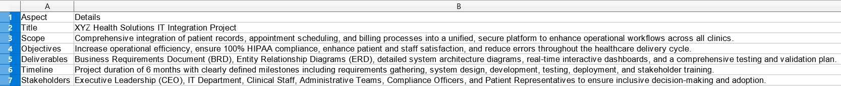
Project Initiation and Stakeholder Engagement
Project Charter
[Paste the table directly from the filled template to show scope, objectives, deliverables, and high-level timeline.]

Slide 9
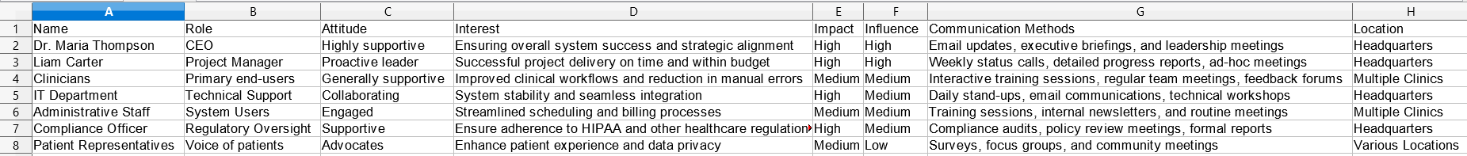
Project Initiation and Stakeholder Engagement
Stakeholder Register
[Paste the table directly from the filled template showing stakeholder names, roles, influence, and interest levels, and interest levels]

Slide 10
Project Initiation and Stakeholder Engagement
Stakeholder Engagement Plan
[Paste the table directly from the filled template summarizing stakeholder engagement methods and frequency.]

Slide 11
Requirements Gathering
Business Requirements Document (BRD)
[Paste the table directly from the filled template, highlighting key requirements.]
Scope:
Integrate patient scheduling, medical records, and billing systems into a unified, interoperable platform that streamlines workflows, enhances data accuracy, and supports seamless information sharing across all clinics.
Objectives:
Achieve full HIPAA compliance to protect patient privacy, reduce scheduling and data entry errors by at least 20% to boost operational efficiency, and improve patient and staff satisfaction through intuitive, reliable system functionality.
Key Requirements:
Real-time, consolidated access to patient data across departments to support timely and informed decision-making.
Secure, user-friendly patient portals that allow safe access to health information, appointment scheduling, and provider communication.
Automated billing and reporting workflows to reduce manual errors, accelerate revenue cycles, and deliver actionable financial insights.
Success Metrics:
100% compliance with HIPAA regulations, verified through continuous monitoring and audits.
At least 20% reduction in appointment and data errors as tracked by system analytics and user feedback.
High user adoption rates demonstrated by usage metrics and positive satisfaction survey results from patients and staff.

Slide 12
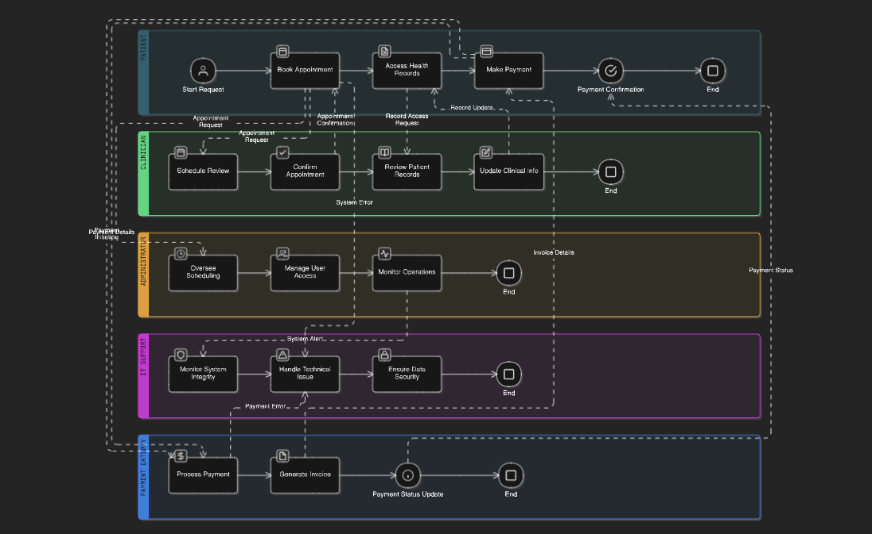
Requirements Gathering
Use Case Diagram and Detailed Flow Descriptions
[Insert the use case diagram from the lab showing system interactions.]

Slide 13
Requirements Gathering
Requirements Traceability Matrix (RTM)
[Paste the table directly from the filled template mapping requirements to objectives and test cases.]

Slide 14
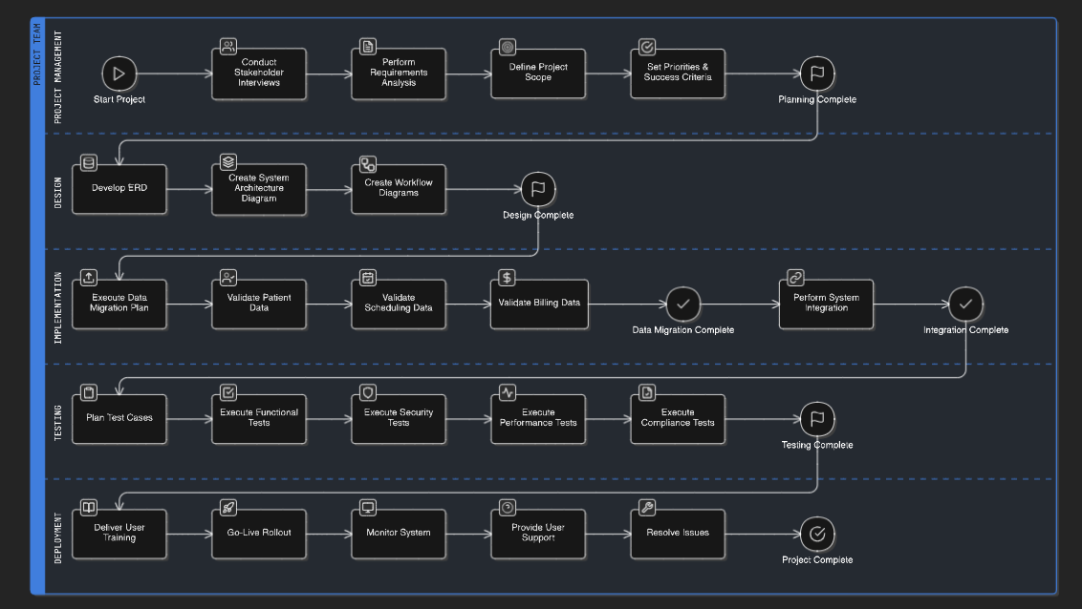
Project Planning and Risk Analysis
Work Breakdown Structure (WBS)
[Paste the table or visual directly from the filled template showing project tasks and subtasks.]

Slide 15
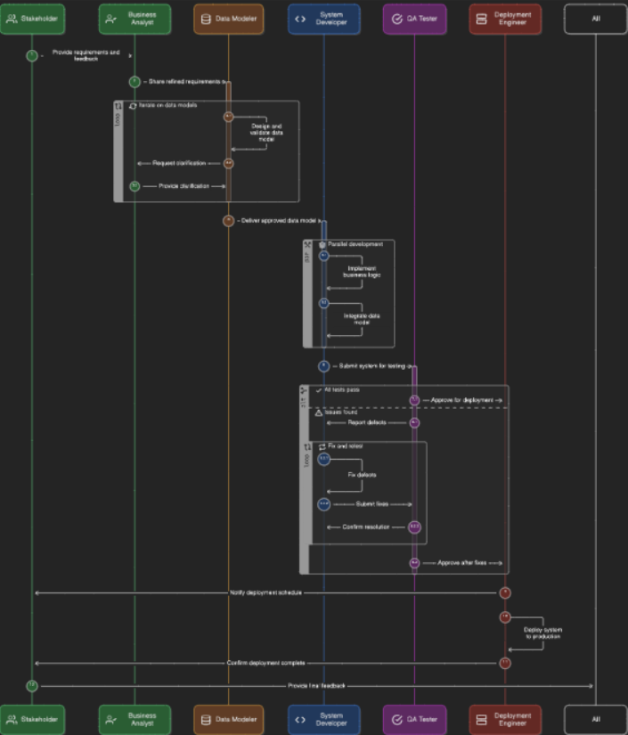
Project Planning and Risk Analysis
Network Diagram

Slide 16
Project Planning and Risk Analysis
SWOT Analysis
[Paste the table directly from the filled template outlining strengths, weaknesses, opportunities, and threats.]

Slide 17
Project Planning and Risk Analysis
Risk Register
[Paste the table directly from the filled template listing risks, categories, likelihood, impact, and mitigations.]

Slide 18
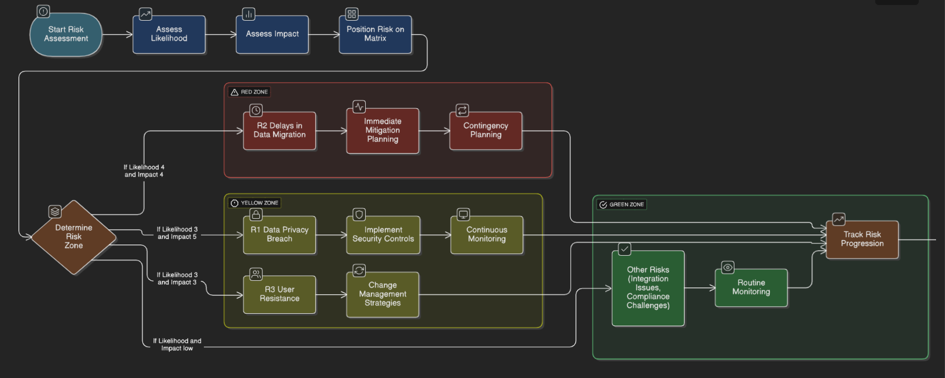
Project Planning and Risk Analysis
Risk Matrix
[Paste the visual directly from the filled template showing risks plotted on the likelihood vs. impact grid.]

Slide 19
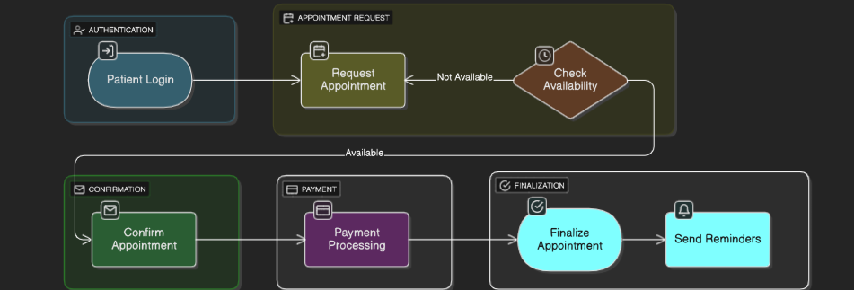
Process Modeling
Appointment Scheduling Process Flowchart
[Insert the appointment scheduling process flowchart with decision points and actions.]

Slide 20
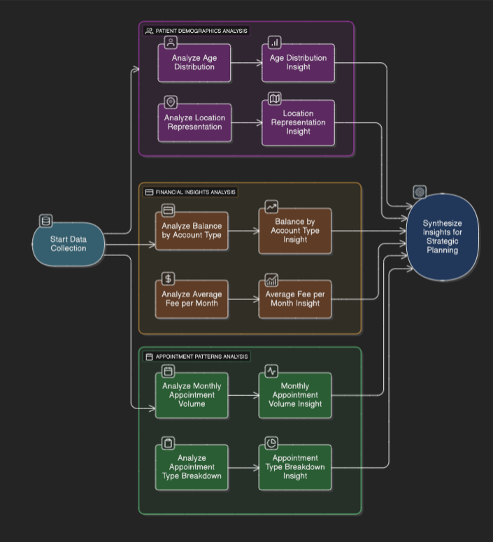
Visualizations
Patient Age Distribution

Slide 21
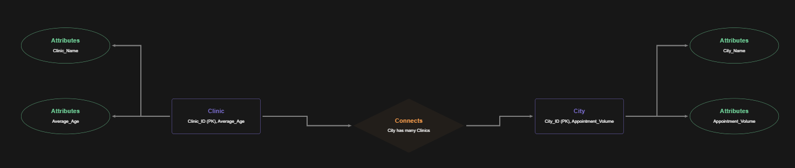
Visualizations
Outstanding Balance Distribution by Account Type
[Insert a chart showing balances by account type with a caption.]

Slide 22
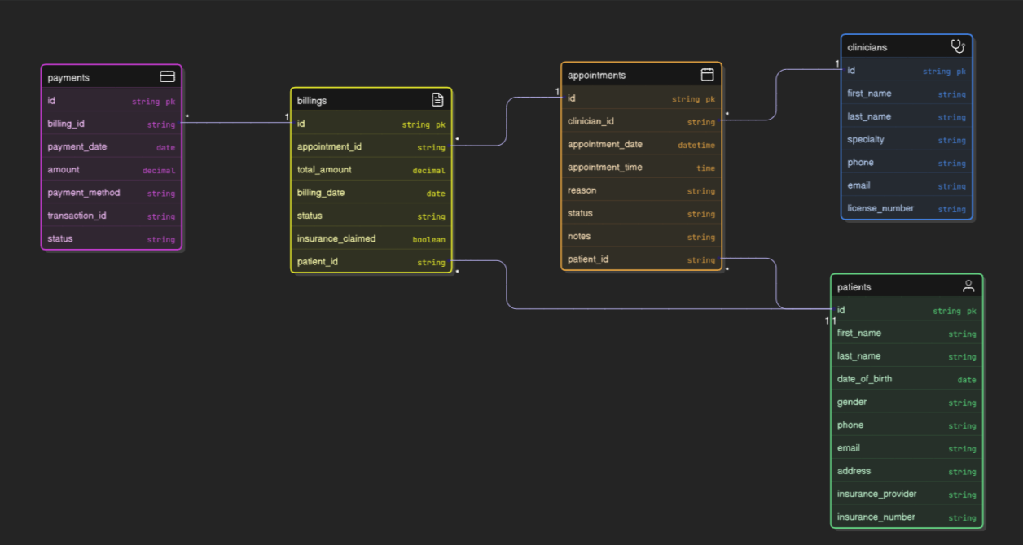
Visualizations
Location Representation
[Include a chart showing representation across locations with a caption.]

Slide 23
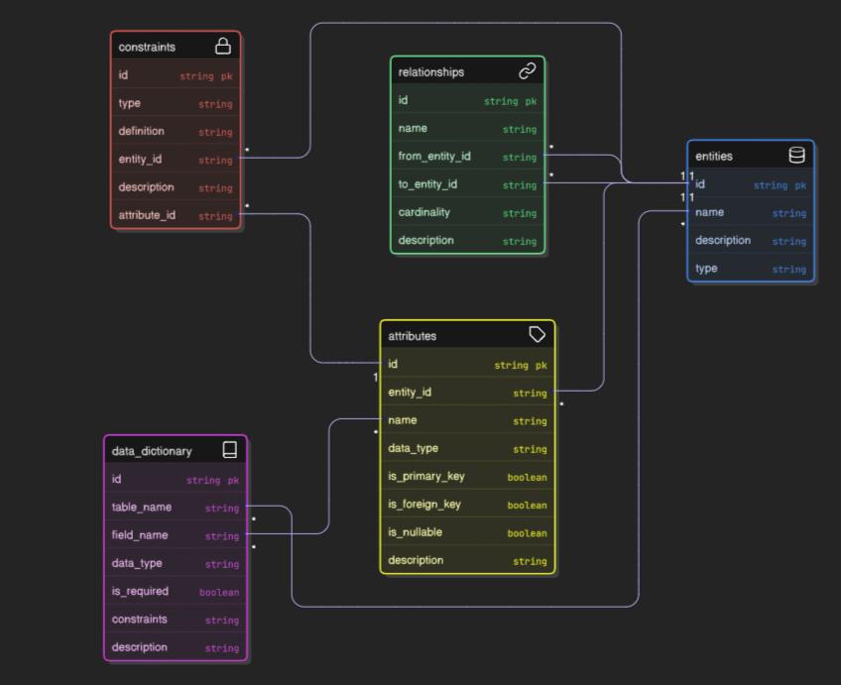
Visualizations
Monthly Appointment Volume
[Insert a chart displaying monthly appointment counts with a caption.]

Slide 24
Basic Visualizations
Appointment Type Breakdown
Scope:
The testing scope covers critical functionalities of the appointment booking system including appointment scheduling accuracy, robust error handling, and strict adherence to HIPAA compliance standards to ensure data security and privacy.
Approach:
Testing will be conducted using a combination of manual and automated techniques to ensure thorough coverage. The use of a requirement traceability matrix guarantees that all business and technical requirements are fully tested and validated throughout the project lifecycle.
Main Activities:
Functional Testing: Verify core features such as patient login, appointment booking, availability checking, and confirmation workflows operate correctly under expected and edge case scenarios.
Security Testing: Assess system compliance with HIPAA regulations, including data encryption, user authentication, access controls, and audit trails.
Boundary and Negative Testing: Evaluate the system’s behavior in handling unexpected or invalid inputs, load limits, and error conditions to ensure robustness and graceful failure.

Slide 25
Basic Visualizations
Average Appointment Fee by Month
[Insert a chart showing monthly average fees with a caption.]
TDD Objective:
Validate that the system enforces appointment booking restrictions after 3 consecutive failed login or booking attempts, enhancing security by preventing unauthorized access or abuse.
BDD Scenarios:
Successful Booking:
Given the user has valid credentials
When the user selects an available appointment slot
Then the system successfully confirms the booking
Unauthorized Access:
Given the user provides invalid credentials
When the user attempts to make a booking
Then the system displays an error message stating "Unauthorized access"
Booking Restriction:
Given the user has made 3 failed booking attempts
When the user tries to book a fourth appointment
Then the system applies a restriction, preventing further booking attempts and notifying the user accordingly

Slide 26
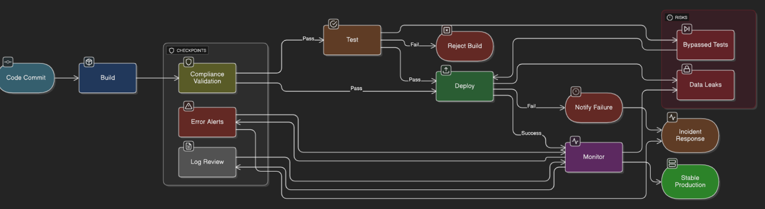
Dashboards
Branch Wise Average Age
[Add a visual highlighting the average patient age by branch.]

Slide 27
Dashboards
Location Wise Appointment Count
Real-time dashboards significantly enhance clinical and administrative decision-making by providing up-to-date, actionable information across departments, enabling timely interventions and resource optimization.
Implementation of the integrated scheduling system has contributed to a documented 20% reduction in appointment errors, such as double bookings and no-shows, which improves operational efficiency and patient satisfaction.
Robust data privacy controls, including encryption and audit logging, remain critical not only for achieving full HIPAA compliance but also for maintaining patient trust and mitigating risks of data breaches.

Slide 28
System Design
Implement Automated Security Checks:
Integrate continuous automated security scanning throughout development and deployment pipelines to detect vulnerabilities early, including encryption verification, access control enforcement, and compliance with HIPAA standards.
Enhance Stakeholder Training:
Provide regular, role-specific training programs for all users—clinicians, administrative staff, IT personnel—to strengthen awareness of security best practices, data privacy responsibilities, and system usage protocols.
Continuously Monitor API Performance:
Establish real-time monitoring and alerting for APIs connecting scheduling, billing, and records systems to promptly identify and address integration issues, performance degradation, or security anomalies.
Plan and Conduct Regular Data Audits:
Schedule systematic audits of data access logs, consent records, and system configurations to ensure ongoing regulatory compliance, identify unauthorized activities, and maintain data integrity.

Slide 29
System Design
The unified appointment scheduling platform significantly boosts operational efficiency by optimizing resource allocation, reducing administrative burden, and minimizing appointment errors.
Leveraging data-driven insights through real-time dashboards elevates patient care quality by enabling timely, informed decisions and better care coordination.
Ongoing monitoring and compliance efforts ensure the system meets regulatory standards, protects patient privacy, and maintains trust.
Next steps focus on full deployment across all clinics combined with continuous improvement based on user feedback and performance analytics to sustain and enhance value over time.

Slide 30
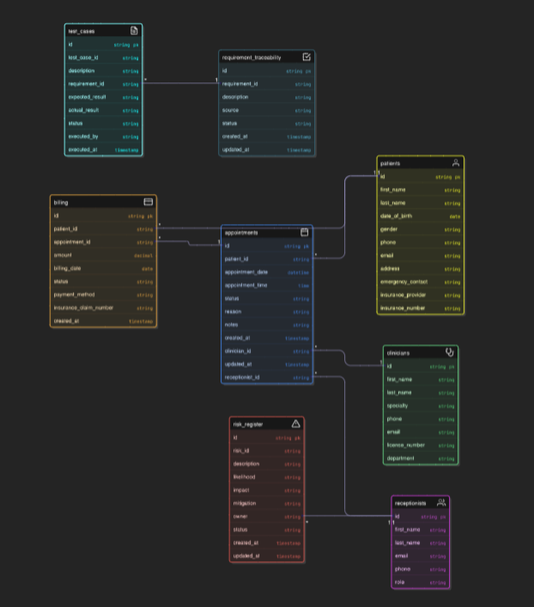
System Design
Entity-Relationship Diagram (ERD)
[Add the ERD showing entities, attributes, and relationships.]

