Slide 1
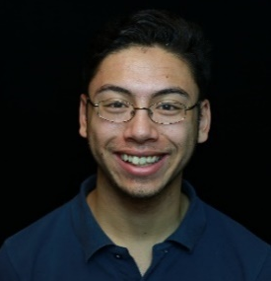
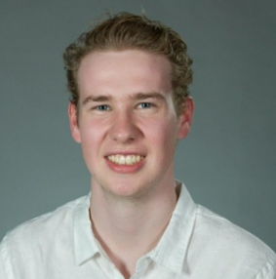
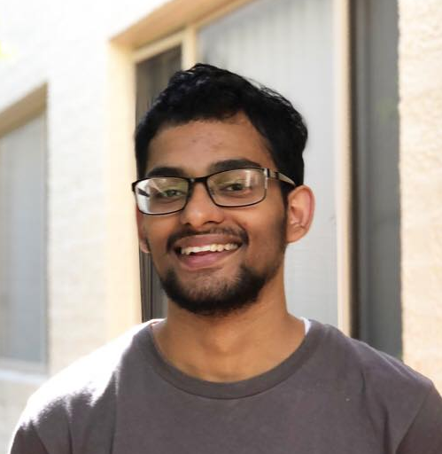
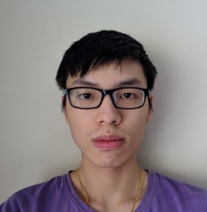

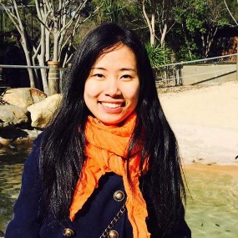
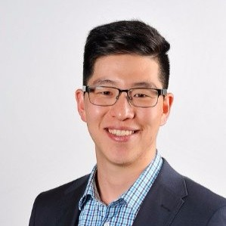
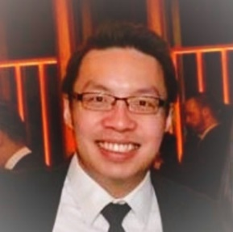
Joseph Meltzer
Thomas Hamer
Manal Mohania
Yong Wei Lim
Team Lead
Principal Software Developer
AI Developer
Statistical Modelling
Deployment Specialist
Front-end Developer
AI Developer
Software Engineer at Amazon Web Services
Quantitative Trader at
Tibra Capital
Research Developer at IBM
Human Centric Computing and HCI expert
Joseph.Meltzer@anu.edu.au
u6081614@anu.edu.au
Manal.Mohania@anu.edu.au
u6019071@anu.edu.au
New Group Members
Thien Bui-Nguyen
Sijia Qin (Scarlett)
Bradley Kim
Derrick Leong
Front-end Developer
Full Stack Developer
Client Representative
Client Representative
Front-end Specialist
Tutor of COMP1730 at ANU and JavaScript at Code Camp
u6050672@anu.edu.au
Sijia.Qin@anu.edu.au
bradley.kim@accenture.com
derrick.leong@accenture.com

