Slide 1
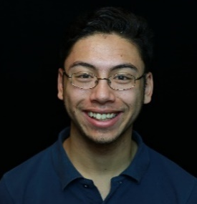
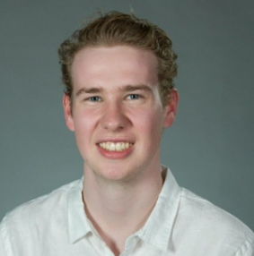
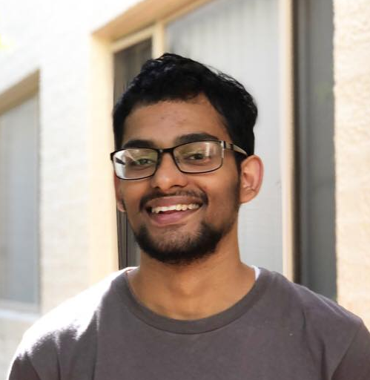
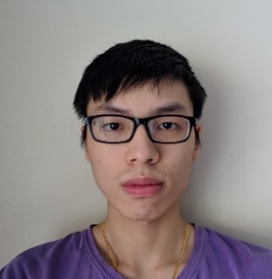

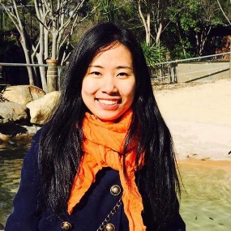
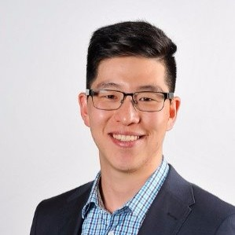
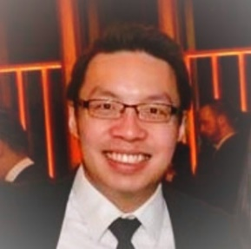
Joseph Meltzer
Thomas Hamer
Manal Mohania
Yong Wei Lim
Team Lead
Frontend Developer
AI Developer
Statistical Modelling
AI Developer
Deployment Specialist
Frontend Developer
Software Engineer at Amazon Web Services
Quantitative Trader at
Tibra Capital
Research Developer at IBM
Human Centric Computing and HCI expert
Joseph.Meltzer@anu.edu.au
u6081614@anu.edu.au
Manal.Mohania@anu.edu.au
u6019071@anu.edu.au
New Group Members
Thien Bui-Nguyen
Sijia Qin (Scarlett)
Bradley Kim
Derrick Leong
Frontend Developer
Backend Developer
Client Representative
Client Representative
Front-end Specialist
Tutor of COMP1730 at ANU and JavaScript at Code Camp
u6050672@anu.edu.au
Sijia.Qin@anu.edu.au
bradley.kim@accenture.com
derrick.leong@accenture.com

Slide 2
Joseph Meltzer
Thomas Hamer
Manal Mohania
Yong Wei Lim
Thien Bui-Nguyen
Sijia Qin (Scarlett)
Team Lead
Frontend Developer
AI Developer
Statistical Modelling
AI Developer
Deployment Specialist
Frontend Developer
Frontend Developer
Backend Developer
Software Engineer at Amazon Web Services
Quantitative Trader at
Tibra Capital
Research Developer at IBM
Human Centric Computing and HCI expert
Front-end Specialist
Tutor of COMP1730 at ANU and JavaScript at Code Camp
Joseph.Meltzer@anu.edu.au
u6081614@anu.edu.au
Manal.Mohania@anu.edu.au
u6019071@anu.edu.au
u6050672@anu.edu.au
Sijia.Qin@anu.edu.au

