Slide 1
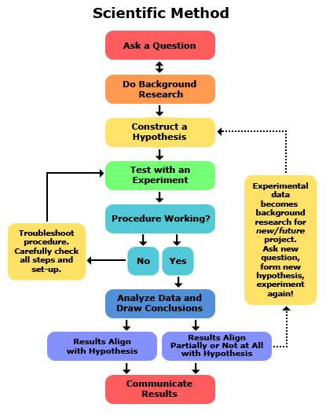
What is research?
Research is a process to discover new knowledge.
National Academy of Sciences: the objective of research is to “extend human knowledge of the physical, biological, or social world beyond what is already known.”

Slide 2
Social science v. “Bench science”
“Bench science”: physics, biology, chemistry
Lab-based
Social science: economics
Surveys
Experiments
Quantitative and qualitative data
soft science v. hard science

Slide 3
Ethics is often not discussed in agricultural & resource economics.
But, it is essential to:
…train new researchers in ethics
…discuss the details and subtleties of misconduct
…address how economists make day-to-day ethical decisions
…ensure that our work is replicable and reproduceable

Slide 4
Replication Crisis
A 2016 Nature poll of 1,500 scientists reported that 70% of respondents had failed to reproduce at least one other scientist's experiment.
That included: 87% of chemists, 77% of biologists, 69% of physicists and engineers, 67% of medical researchers, 64% of earth and environmental scientists, and 62% of all others.
50% had failed to reproduce one of their own experiments.
Less than 20% had ever been contacted by another researcher unable to reproduce their work.
A minority had ever attempted to publish a replication, and of those 24% had been able to publish a successful replication, while 13% had published a failed replication.
In 2009, 2% of scientists admitted to falsifying studies at least once and 14% admitted to personally knowing someone who did.
.

Slide 5
Replication Crisis in Economics
A 2016 study in the journal Science found that one-third of 18 experimental studies from two top-tier economics journals (American Economic Review and the Quarterly Journal of Economics) failed to successfully replicate.
With the original researchers’ assistance, that percentage increased to about half, suggesting reporting practices and requirements are seriously deficient.
A 2017 study in the Economic Journal suggested that "the majority of the average effects in the empirical economics literature are exaggerated by a factor of at least 2 and at least one-third are exaggerated by a factor of 4 or more".

Slide 6
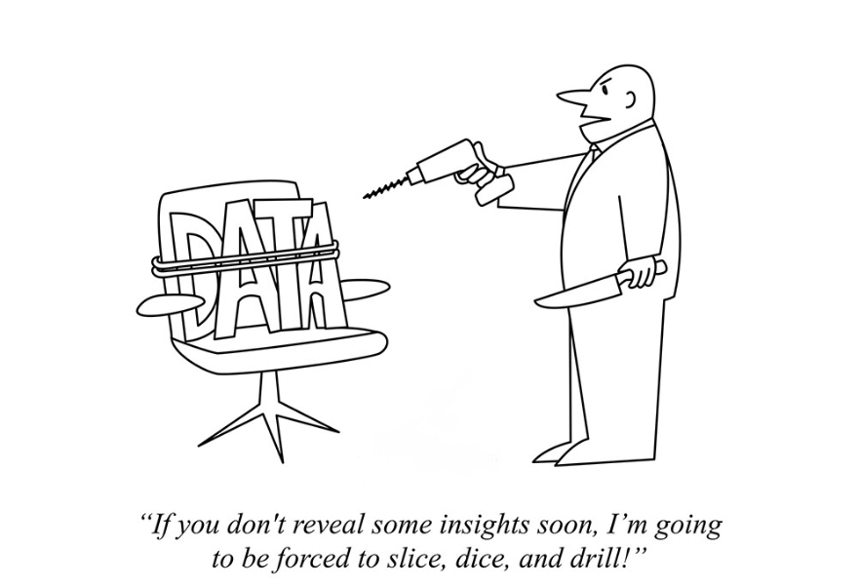
Unethical Data Management and Analysis
Michael Lacour
Dan Ariely
Francesca Gino
Brian Wansink
And the “solution”:
…to come next week!

Slide 7

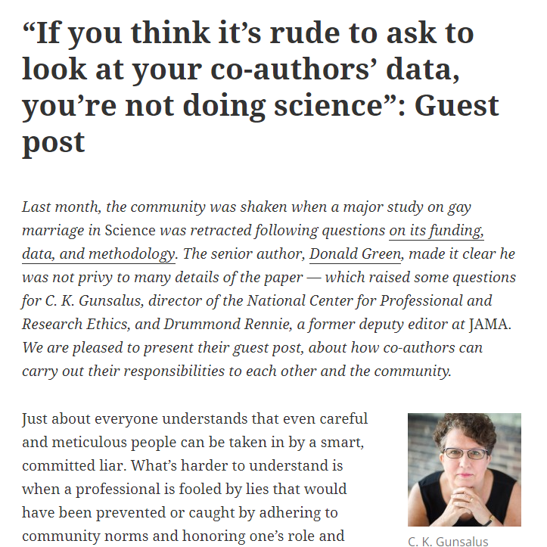
Michael LaCour
Falsified data: "When Contact Changes Minds: An Experiment on Transmission of Support for Gay Equality."
Science, Media: NPR, NYTimes…
Falsified grants: $793,000
Falsified analysis

Slide 8
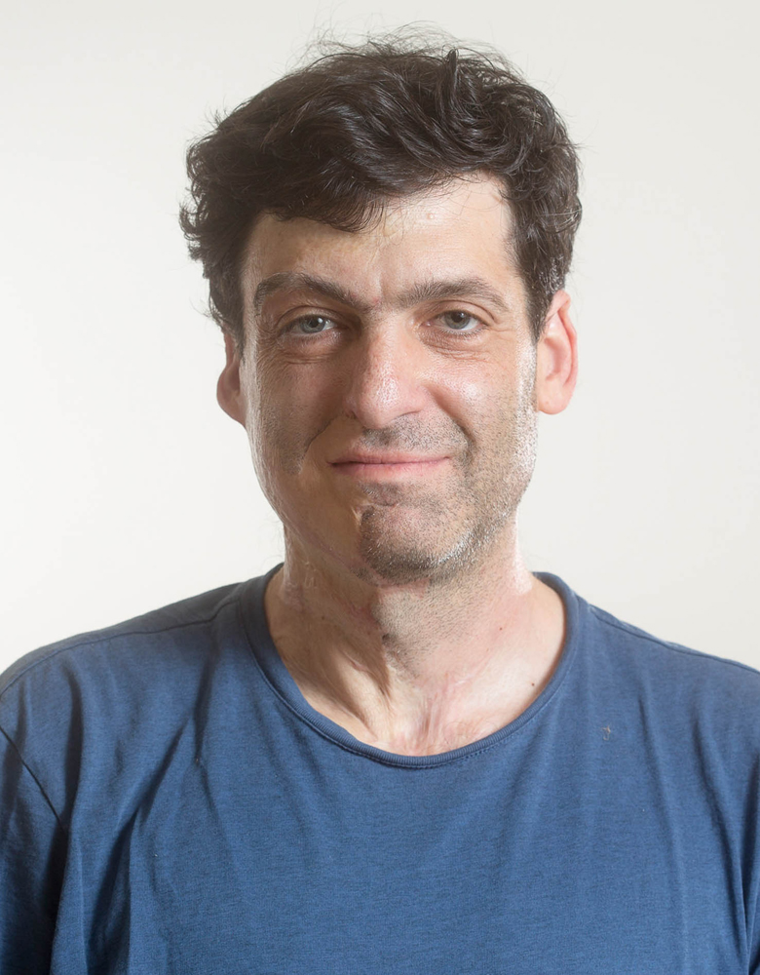
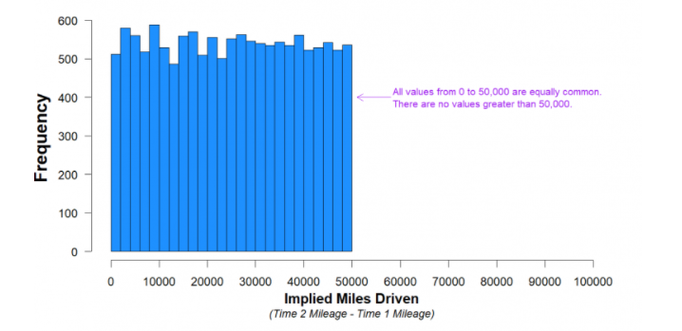
Dan Ariely (???)
August 2021 (and ongoing).
One publication: three studies. This is about Study 3.
13,500 drivers were randomly sent one of two policy review forms to sign:
“I promise that the information I am providing is true” appeared at the bottom of the document and the other where the statement appear at the top.
Falsified data.
Falsified analysis?
https://datacolada.org/98

Slide 9

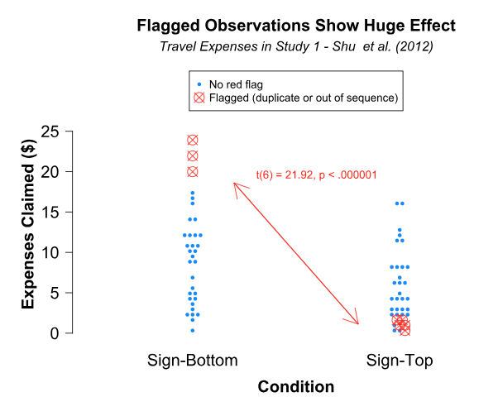
Francesca Gino (???)
Recent, recent: June 2023 (and ongoing).
Collaborator on Ariley paper, with Study 1 & 2.
TWO different people independently faked data for two different studies in a paper about dishonesty.
Falsified data.
Falsified analysis?
https://datacolada.org/109
(and 110, 111, 112)

Slide 10
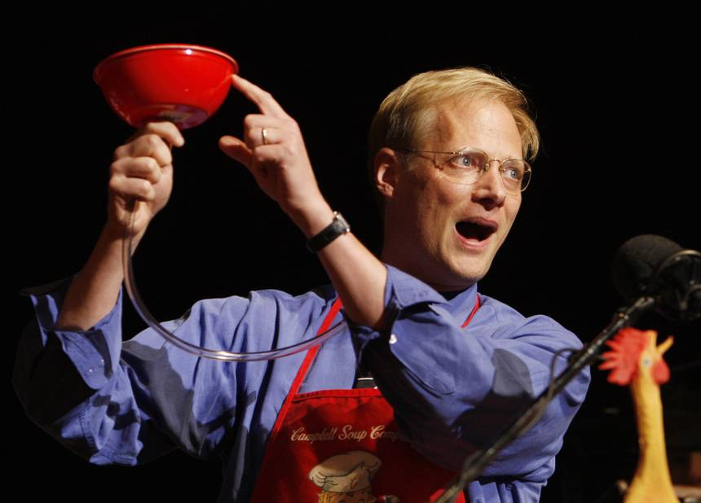
Brian Wansink
“The Grad Student Who Never Said ‘No’”
“I told her to work hard [and] squeeze some blood out of this rock.”
“She analyzed the data over and over until she began discovering solutions that held up.”

Slide 11

Wansink Unwittingly Triggers Mass Reexamination
Based on his Nov 2016 blog post, a few start stress testing the published articles
Discrepancies and suspicious patterns – like “blood in the water”
“Scrutiny of Wansink's work began after a 2016 blog post in which he recounted giving a data set to a graduate student and telling her there's "got to be something here we can salvage." That caught the attention of Dutch graduate student Tim van der Zee and others, who subsequently began reviewing Wansink's work and finding errors.”
-NY Times 9-20-2018
John S. Dyson Chair of Consumer Behavior
Director: Cornell Food and Brand Lab
Co-Director of:
Institute for Behavioral Economics and Consumer Choice
Cornell Center for Behavioral Economics in Child Nutrition Programs

Slide 12
Popularity and Publication ≠ Immunity
Now that the dust has (mostly) settled…
18 of his articles retracted with many more “corrected” (one more than once)
Co-author Collin Payne left New Mexico State University in Jan 2018 with email records showing “p-hacking on steroids” E.g., “Do not despair. It looks like stickers on fruit may work (with a bit more wizardry).”
Cornell issues findings in Sep 2018: “Professor Wansink committed academic misconduct in his research and scholarship, including misreporting of research data, problematic statistical techniques, failure to properly document and preserve research results, and inappropriate authorship.”→ Wansink resigns
The Great Recession was a watershed moment of reflection in macro and finance
Wansink’s actions and the wider ‘replication crisis’ offers a similar opportunity for professional reflection and introspection in applied microeconomics

Slide 13
Data Manipulation: p-Hacking or HARKing
Manipulate the data or specification so that the result you want becomes significant.
p-Hacking / fishing / data dredging / data mining / researcher degrees of freedom – variable or sub-sample construction, specifications.
e.g. “Do not despair. It looks like stickers on fruit may work (with a bit more wizardry).”
Hypothesizing After Results are Known (HARKing) – running results to see what is significant, without a hypothesis as your guide.
Not guided by theory or conceptual model.

Slide 14
Defining and Describing Data Manipulation
Leamer: “Let’s take the ‘con’ out of econometrics” (1983).
Kennedy: “Sinning in the basement” (2002).
Gelman and Loken: “Garden of forking paths” (2013):
“…dataset can be analyzed in so many different ways (with the choices being not just what statistical test to perform but also decisions on what data to [include] or exclude, what measures to study, what interactions to consider, etc.), that very little information is provided by the statement that a study came up with a p < .05 result.”

Slide 15
Falsification and Fabrication
Falsification is manipulating research data with the intention of giving a false impression.
This includes manipulating images, removing outliers or “inconvenient” results, changing, adding or omitting data points, etc.
Similar to fabrication, which includes the wholesale making up of data.
There is a general perception that falsification and fabrication are “worse”.
But falsification, p-Hacking, HARKing, and other methods of data manipulation all serve to undermine the scientific record.

Slide 16
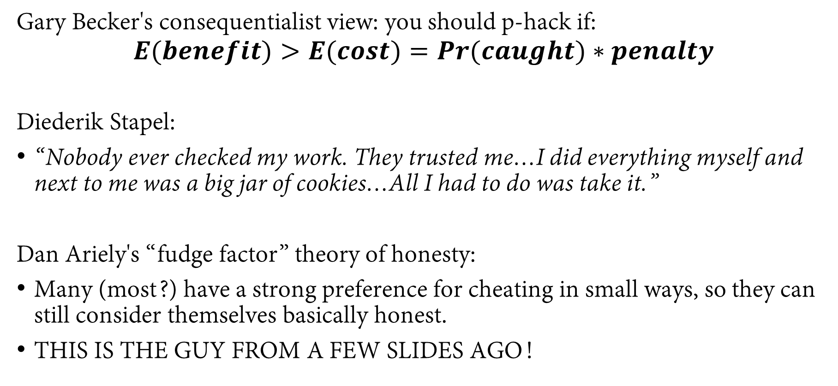
Perspectives on Research Misconduct Motives
Gary Becker's consequentialist view: you should p-hack if:
$$E(benefit)>E(cost)=Pr(caught)∗penalty$$
Diederik Stapel:
“Nobody ever checked my work. They trusted me…I did everything myself and next to me was a big jar of cookies…All I had to do was take it.”
Dan Ariely's “fudge factor” theory of honesty:
Many (most?) have a strong preference for cheating in small ways, so they can still consider themselves basically honest.
THIS IS THE GUY FROM A FEW SLIDES AGO!

Slide 17
Perspectives on Research Misconduct Motives
Andrew Gelman – a moralistic framing of these issues is unhelpful and misses the fact that most researchers live in a “statistical fantasy world” in which $p<0.05$ is the norm:
“It’s fine to encourage good behavior and slam bad behavior—but let’s remember that lots of bad work is being done by good people.”
“The problem is a fundamental lack of understanding. Yes, cheating occurs, but the cheating arises out of statistical confusion... The big problem is not overt ‘manipulation’ but researchers fooling themselves.”

