Slide 1
AIDI 2005-02 Capstone Term II
Project MMP
Next Word Predictor
Team Members
Manoj Varma Alluri (100850681)
Navaneeth Jawahar (******214)
Sharath K Prabhu (100819265)
Jeel Jani (******261)

Slide 2
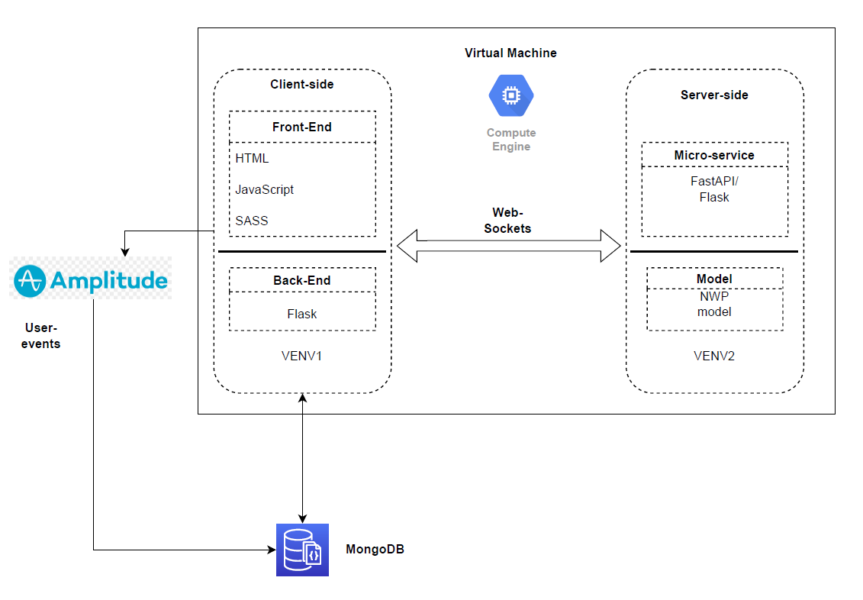
Project Architecture

Slide 3
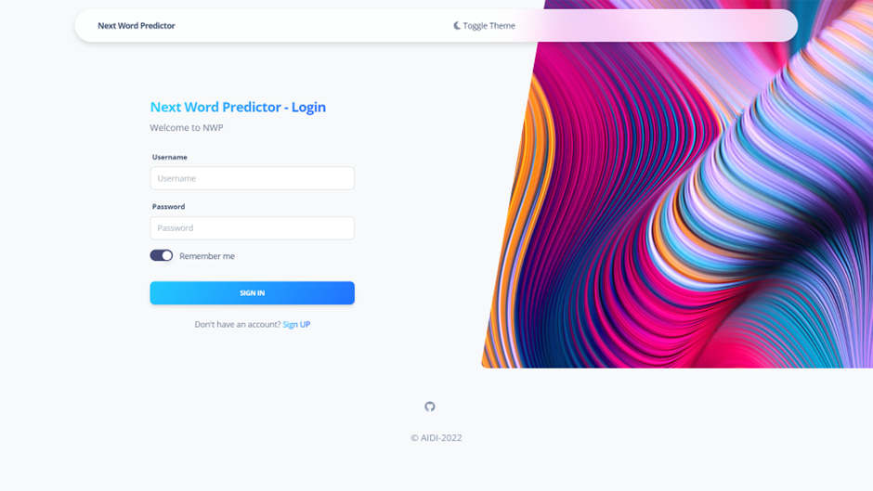
Log In Page

Slide 4
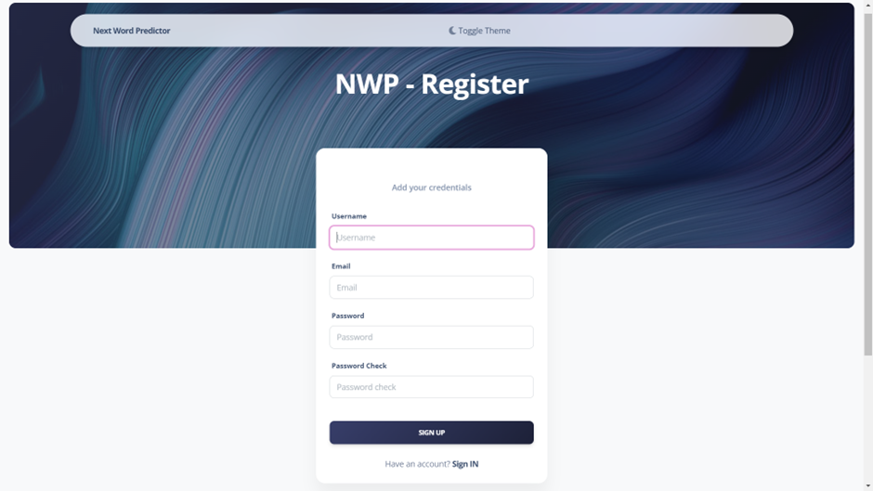
Sign Up Page

Slide 5
Application performance

Slide 6
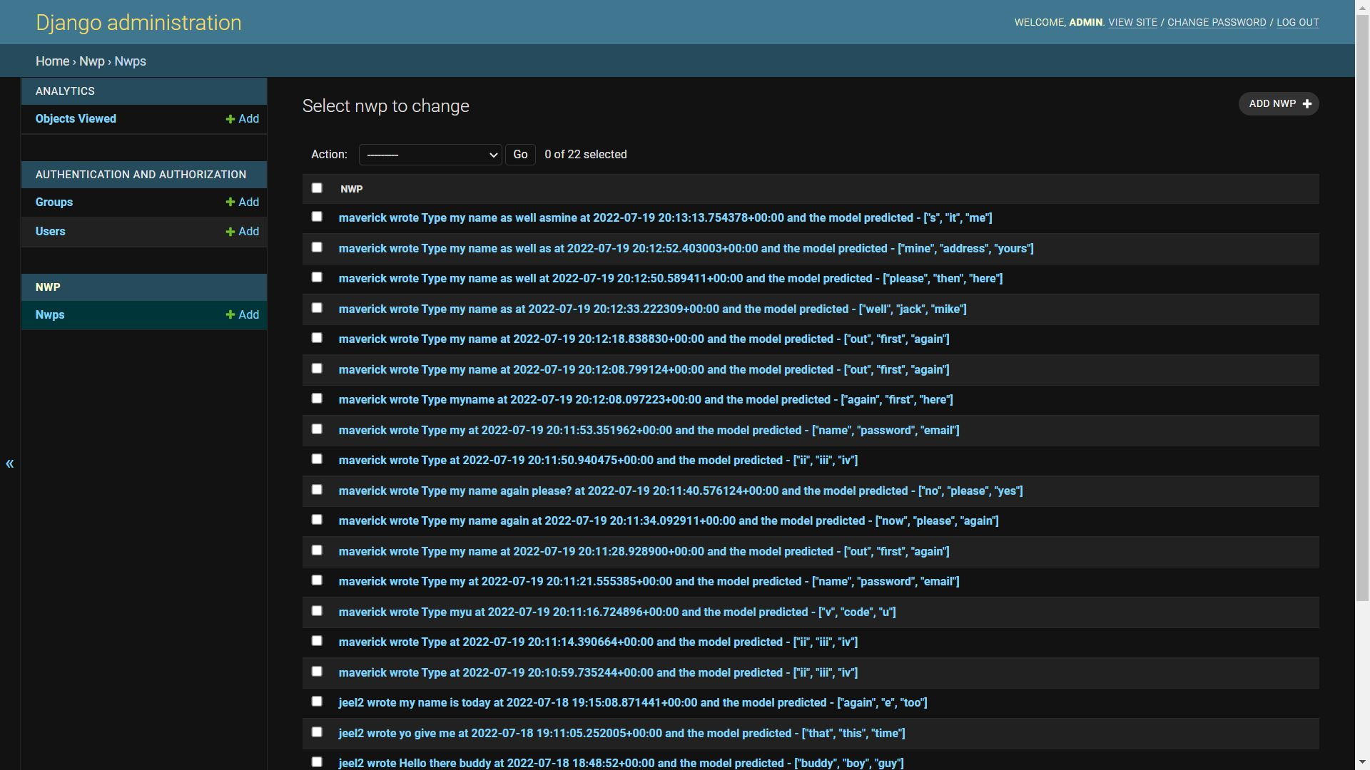
Database

Slide 7
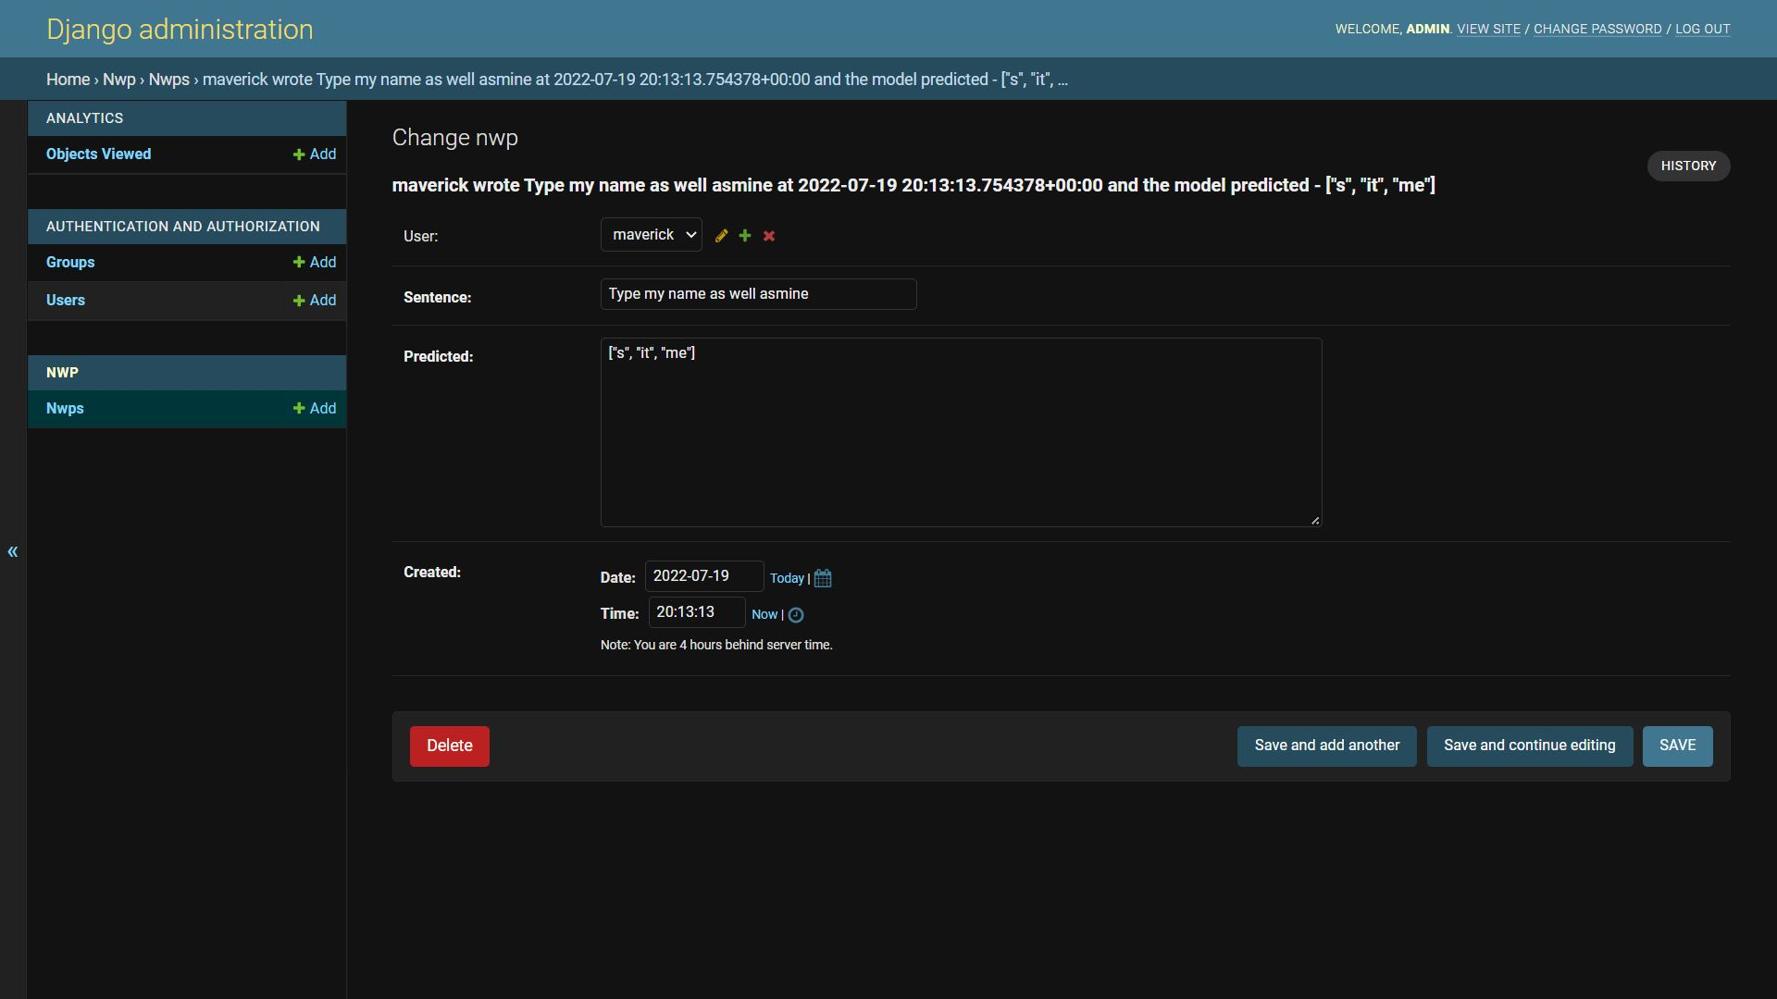
User details stored

Slide 8
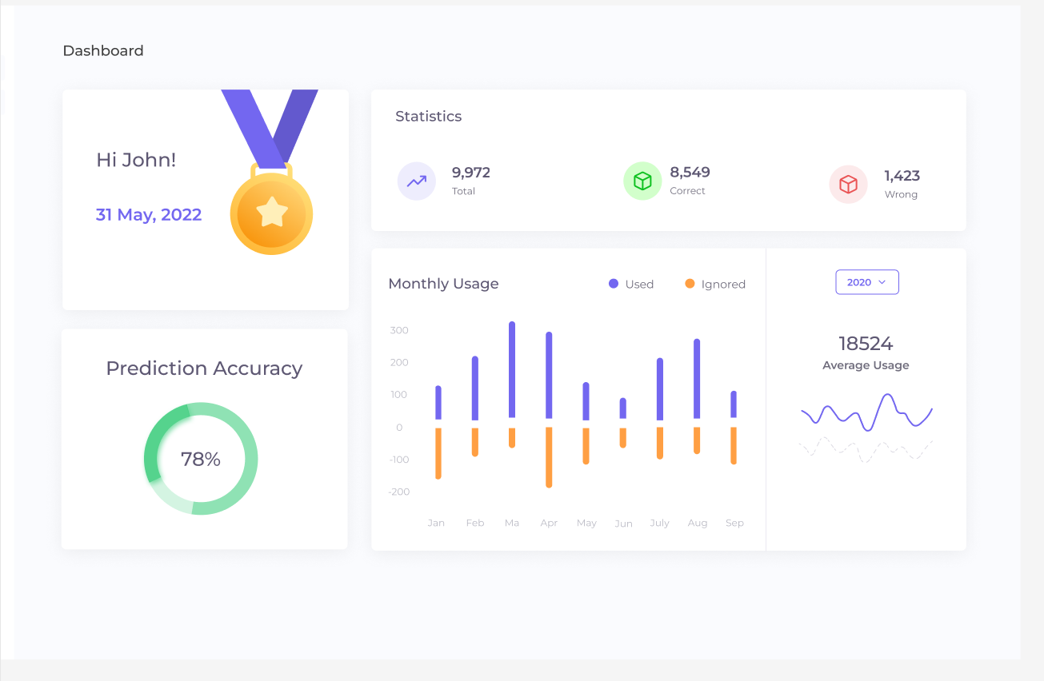
Future development - Application Analytics Paradigm

Slide 9
GitHub Link
https://github.com/AIDI-2022/next-word-predictor

