Slide 1
AIDI 2005-02 Capstone Term II
Project Kick-Off
Team Members
Manoj Varma Alluri (100850681)
Navaneeth Jawahar (******214)
Sharath K Prabhu (100819265)
Jeel Jani (******261)

Slide 2

Next Word Predictor
Aim:
To ease writer’s life by providing suggestions
Deliverable:
A website with next-word prediction feature.
Who are we helping:
Students and Content Writers

Slide 3
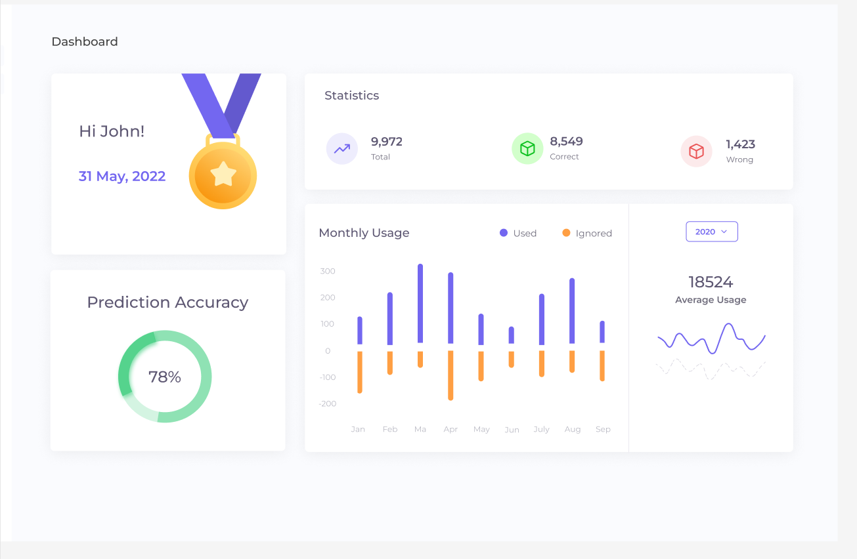
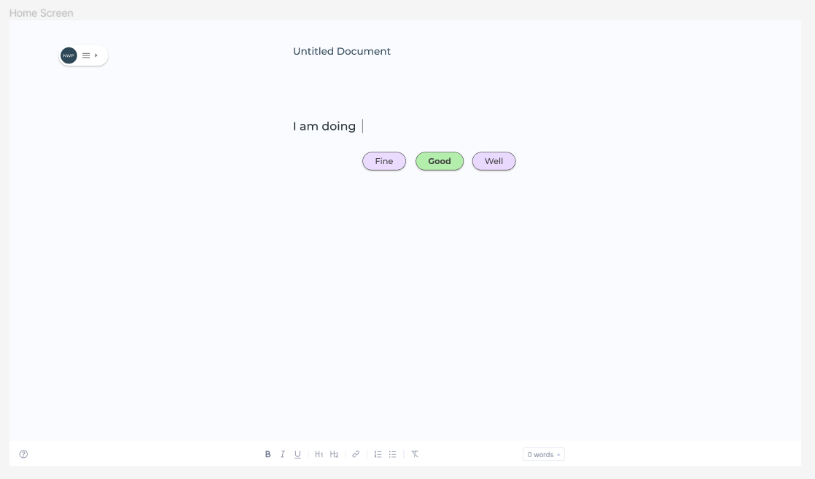
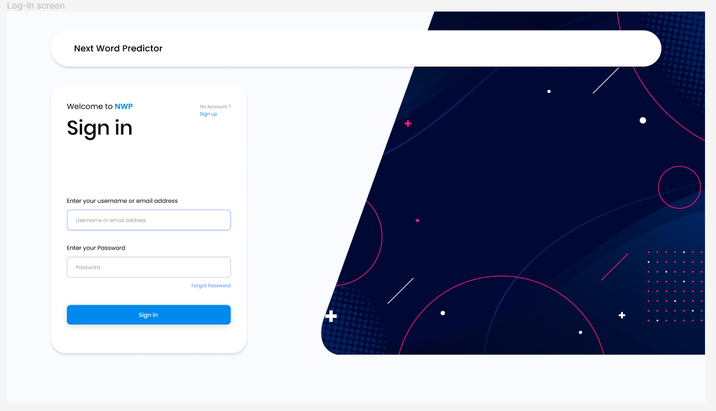
Features and Functions

Slide 4
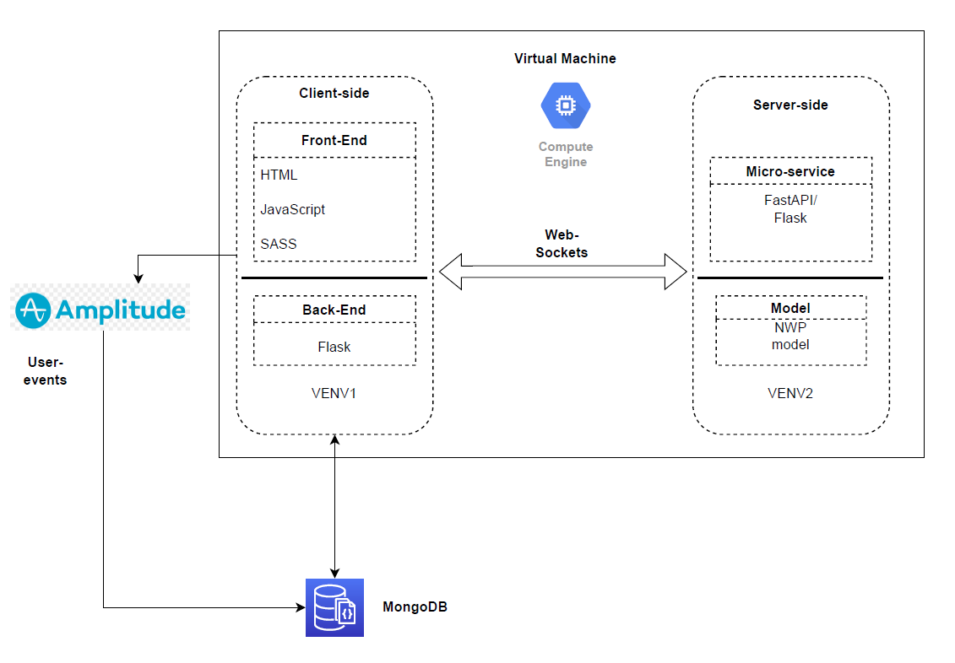
High level architecture

