Slide 1

Brain Tumor Detection Capstone Project - AIDI 2005
Submitted by:
Jaivardhan Singh - 100849063
Usman Qureshi - 100847689
Hamad Aslam - 100851221
Khaleel Khan Patel - 100851770
Moaz - 100849590
Irfan Shaik - 100855785
Under the guidance of:
Marcos Bittencourt

Slide 2
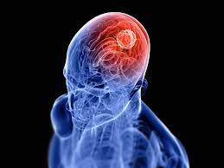
What is brain tumor
A brain tumor is an abnormal cell growth or mass in the brain.
The early discovery of brain tumors can save millions of lives.
In the United States, the 5-year survival rate for persons with a malignant brain tumor is around 36%.
Source: https://www.matherhospital.org/wp-content/uploads/2017/09/brain-tumor-blog-photo.jpg

Slide 3
Why Deep Learning
It's Effective With Unstructured Data
Self-Learning Capabilities
Efficiency in terms of cost
Scalability

Slide 4
Technology stack
For Deep Learning Model
Python
PyTorch
Transfer Learning (ResNet)
For Application
Python
HTML
MyBinder

Slide 5
Working of Model
Image
Deep learning Model
Result
Data Augmentation
Pre-Trained Network
Classification and segmentation

Slide 6
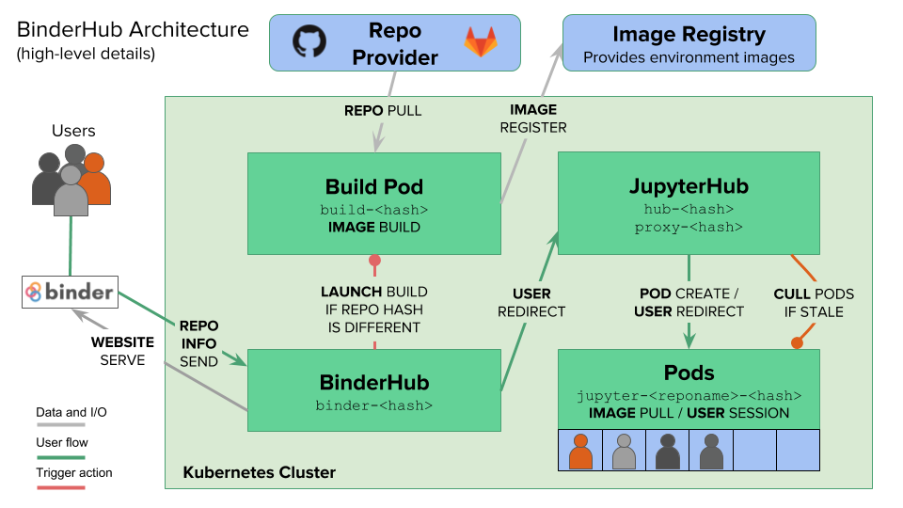
Project Application
Source: The BinderHub Architecture — BinderHub 0.1.0 documentation

Slide 7
Thank you!

