Slide 1
Poker King
A Multiplayer Poker Experience

Slide 2





Our Mission Statement
We strive to create a fun online poker experience so that users can play and talk with their friends in their own personal computers / Macbook.

Slide 3
Scrum Experience
Key User Stories:
As a GUI designer, I want to design an interface that looks nice and ordered and easy to interact with.
As a programmer, I want to make an efficient model design that works fast and is easy to add additional functionalities to.
As a player, I want to have a fun and smooth poker experience with my friends from my personal computer.

Slide 4
Strengths/Weaknesses
Strengths:
Comradery: Team members work well together
Communication: Daily team meetings to ensure progress
Environment: Diversity brings good conversation and a relaxing environment to work.
Weaknesses:
Scheduling: We had a hard time scheduling daily meeting at beginning of the projects
Meetings had to start very late at night, for all to be there.

Slide 5

Design and Implementation

Slide 6
Challenges
Hand implementation:
Implement Comparable<Hand> so that sorting works properly and best hands can easily be determined.
Problem:
Each type of hand has different level and also different ways to compare
What we do differently:
The general compareTo in the Hand object will compare the hands’ level, and if they have the same level, they will call compareTo method of each type to compare the same type.

Slide 7

Hand implementation

Slide 8
Challenges
Setting up network:
Implement a network so that each player can connect to the game via the server.
Problem:
No members with prior experience, issues with with multi-threaded server
What we do differently:
We utilize multiple socket connections, each connected with an individual client. The server then iterates through the connections based off of the current player.

Slide 9
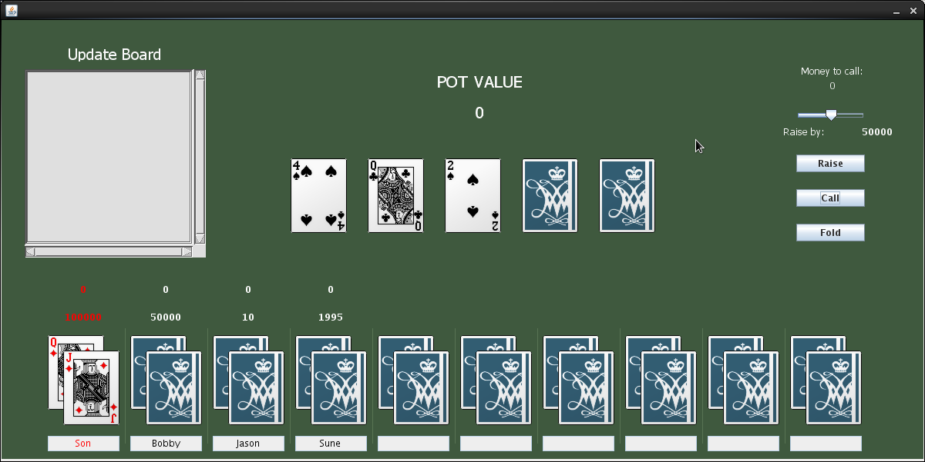
User Interface

Slide 10
Future enhancements
Version 2.0:
Logic for splitting pot
User accounts database
Integrate the game with Bucknell ID system and possibly Campus Dollar
Version 3.0+:
Real-time voice synchronization
GUI animation

