Slide 1
Production Planning
Assessment
Chase Scully
Wayward Warlock
DUE DATE:

Slide 2
Introduction
Introduction:
This assessment will cover the process of developing pitches and concepts, establishing an art style for a multi discipline creative project and presenting concepts to stakeholders for approval. Your task is to generate a creative project idea and create comprehensive planning and pitching documentation, refining it with feedback before delivering it to the client. This documentation will cover all aspects of your project and provide a clear and detailed roadmap for its successful execution.
The provided brief is designed to collect all the evidence of competency required for this subject. Following an alternative brief and/or presenting additional evidence of competency needs to be negotiated with your trainer. Further information on the assessment process and requirements can be found in the unit’s subject and assessment guide. The assessment will include:
Analysing a brief.
Developing a pitch.
Creating storyboards.
Developing and refining concepts.
Conducting a risk assessment.
Planning and conducting presentations.
Gathering and addressing feedback and conducting a post mortem review.
Observing and maintaining healthy work practices.
The assessment instructions:
All sections marked in green must be edited/filled out by each student. Be sure to replace “Student Name” on the first slide and include your name in the document filename.

Slide 3
Brief|Overview/Requirements
Overview:
Develop a game pitch/proposal to meet the requirements of the major project, create a storyboard demonstrating the key mechanics and pitch the concept to your team for consideration. As a team develop and refine a concept to meet the project requirements, establish the visual style of the concept and present the concept to stakeholders for approval.
Project Requirements:
Must be achievable in the specified project timeline.
Must be appropriate for the allocated team size and resources.
Cannot be network multiplayer.
Must be modelled after existing Arcade-style game.
Cannot contain explicit/inappropriate themes or content.
Storyboard Requirements:
The storyboard must use the provided template.
The storyboard must be from the players perspective.
The storyboard must have at least 6 panels and must include relevant UI and descriptions.
Appropriate back-ups must be made during production.
Art Bible/Style Guide Requirements:
The art bible/style guide must clearly outline the visual style of the chosen concept.
Each artist in the team must make meaningful contributions to the art bible/style guide.
Presentation Requirements:
Each team member must actively participate in two presentations with stakeholders.

Slide 4
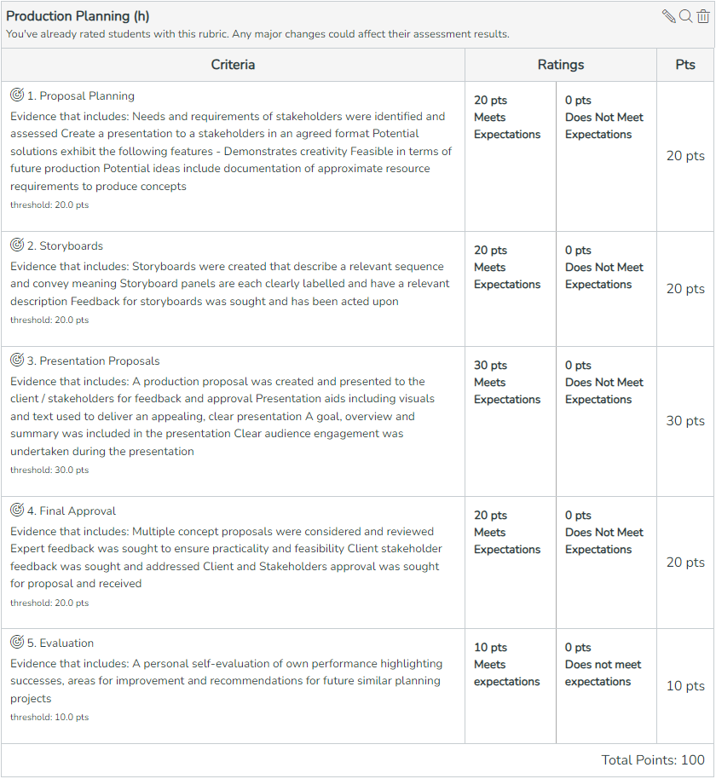
Brief|Rubric

Slide 5
Proposal Planning

Slide 6
Production|Art Bible
An art bible/style guide is a document designed to communicate the visual style of the game and is used to ensure that the art team has a unified vision moving into production. In conjunction with the other artists in your team create an art bible/style guide for the chosen concept, ensuring that it is in-line with the requirements of the project.
The contents of the art bible are dependent on the concept and may include:
An overview of the visual style
The Moodboard
The Style Guide
A section covering characters.
A section covering environments.
A section covering lighting/atmosphere/mood.
A section covering workflow and technical details.
A section covering UI
A section covering VFX
Original concept art
Storyboards or gameplay diagrams
Gameplay mockup artwork/key visual art
Upload the Art Bible Document as a separate .PDF to Canvas.

Slide 7
Production|Technical Design Document
A technical design document is a document that contains general programming guidelines and descriptions/diagrams of complex systems. Its purpose is to serve as reference for programmers expanding existing systems or creating new systems.
The contents of a technical design document may include:
Descriptions of the technique and algorithms that will be used for implementing artificial intelligence behavior(s) and the decision-making process.
The names of the software that's being used as well as their version number.
Diagrams/flow charts describing complex systems. This may include enemy spawning, power-up usage, ability creation, enemy creation, etc.
Naming conventions for files, variable names, function names, or class names.
Upload the Technical Design Document as a separate .PDF to Canvas.

Slide 8
Project Proposals | Idea
Independently generate a project idea that could be completed in a short amount of time with a small team. The idea will be shared with your team.
Project Title
Wayward Warlock
Platform
Mobile/PC
Genre
Twin Stick Shooter
Target Audience
Teens And Young Adults
Theme
Medieval fantasy shooter based on a wizard trying to survive.
Elevator Pitch
You play as the final wizard of a guild, and must fight the endless onslaught of elemental golems while using their own power against them at any cost to survive.

Slide 9
Project Proposals | Idea
Independently generate a project idea that could be completed in a short amount of time with a small team. The idea will be shared with your team.
Visual Style and Art Direction
Cartoon realistic.
Gameplay Mechanics
Defeat elemental golems using a basic magic bullet to gain elemental charges, that will defend the user as well as build a special attack that defeats all golems on screen. Defeating golems replenishes user’s mana bar which when depleted, the user will die.
Unique Selling Points
Elemental power ups with varying powers and boost towards player, as well as a satisfying special attack.

Slide 10
Project Proposals | Idea
Independently generate a project idea that could be completed in a short amount of time with a small team. The idea will be shared with your team.
Story
The wizard was a part of a high esteem guild of wizards, teaching them ways to become a powerful one as well as fighting through dungeons for money and resources. Wey once taught a high esteem prodigy, Astroth. Astroth was power hungry, going beyond the teachings of Wey, and even able to clear a dangerous dungeons by himself and finding golems in the dungeon that he was inspired to have as his army. So Astroth stole the elemental catalyst, able to create any elemental being or weapon, only limited by imagination. So Astroth attacked all guild members, to seek more power from them, leaving Wey by themself. Astroth seeks to defeat Wey so no one can defeat him. So Wey must hold their own against the endless hoard of Astroth creatures created from the catalyst, until the catalyst breaks from the overuse of mana.
Character
Wey, the final wizard of their guild, finds themself in the ruins of their own guild hall, now with nothing else left to lose. They ready themself for their last fight against the horde of elemental golems until they hold out long enough to defeat Astroth..
Environment
A ruined wizard guild hall border off by a small stone wall, within a dense forest

Slide 11

Project Proposals | Reference Sheet
Research and gather reference images and create a reference sheet for your proposed project idea, insert the reference sheet below.

Slide 12
Storyboards

Slide 13
Storyboards | Storyboards, Game Diagrams, and Previsualization Gameplay
Insert the storyboards and Previsualization Gameplay mockups here

Slide 14
Presentation Proposals

Slide 15
Production|Presentation
In conjunction with the rest of your team and utilising the created presentation aids present the concept to a teacher/industry panel at the scheduled time for approval. Each member of the team must actively participate in at least one presentation.
You will be assessed on your ability to:
Convey the key concepts and central ideas in the presentation.
Utilize presentation aids to support the audiences understanding of key concepts.
Use appropriate language and communication techniques to secure audience interest to achieve the presentation outcomes.
Summarize key points and ideas where required to facilitate understanding.
Provide opportunities for stakeholders to ask questions and clarify concepts where necessary.

Slide 16
Production|First Pitch - Presentation
Utilizing the completed storyboard, mood board and any other visual aids present the concept to the rest of your team for consideration.
When pitching the concept ensure that the presentation covers:
The player/camera perspective.
The objective of the game.
The win/lose states of the game.
The core mechanics.
The art/visual style of the game.

Slide 17
Production|First Pitch - Presentation Feedback
Present the concept to relevant stakeholders, record the feedback given during the presentation and answer the questions below.
List the feedback you received on the game concept and include any issues/concerns. Answer here.
List the feedback you received on the presentation and presentation aids.
Answer here.
Describe how the game concept is going to be modified based upon the provided feedback. Answer here.
Describe how the presentation could be improved based upon the provided feedback.
Answer here.
Upload the First Pitch Presentation as a separate .PDF to Canvas.

Slide 18
Final Approval

Slide 19
Production|Second Pitch - Presentation Feedback
Present the concept to relevant stakeholders, record the feedback given during the presentation and answer the questions below.
List the feedback you received on the game concept and include any issues/concerns. Answer here.
List the feedback you received on the presentation and presentation aids.
Answer here.
Describe how the game concept is going to be modified based upon the provided feedback. Answer here.
Describe how the presentation could be improved based upon the provided feedback.
Answer here.
Upload the Second Pitch Presentation as a separate .PDF to Canvas.

Slide 20
Documentation & Feedback | Roles
List your team members and the responsibilities of each team member
Team Member's Name | Team Member's Responsibilities
Answer here. | Answer here.
Answer here. | Answer here.
Answer here. | Answer here.
Answer here. | Answer here.
Answer here. | Answer here.
Answer here. | Answer here.
Answer here. | Answer here.
Answer here. | Answer here.

Slide 21
Production|Tasks – Individual Evidence
Present multiple screen captures to clearly demonstrate your tasks completed in the pre-production phase. Evidence can include: concept artwork, 3d modelling, prototyping screenshots and video, etc..

Slide 22
Evaluation

Slide 23
Evaluation | Post-Mortem
Conduct a self-evaluation your own performance highlighting successes, areas for improvement and recommendations for future projects below.
What specific contributions did I make that positively impacted the project idea and pitch?
Answer here (~50 words)
If you were to plan another project again or had more time, what would you change or do differently to improve the success of the project?
Answer here (~50 words)
What specific skills or knowledge do I need to improve on for future team-based projects?
Answer here (~50 words)

Slide 24
Production Planning|Submission
The following files must be uploaded to Canvas for assessment. All submitted files must adhere to the provided naming conventions.
Storyboards and Previsualization Gameplay:
The storyboards and Previsualization Gameplay mockups exported in .png format.
GameName_ProductionPlanning _Storyboards.png
GameName_ProductionPlanning _PrevisGameplay.png
Art Bible:
The completed art bible in .pdf format. The art bible/style guide must be approved by all team members.
GameName_ArtBible.pdf
Technical Design Document:
The completed technical design document in .pdf format. The technical design document must be approved by all team members.
GameName_TechnicalDesignDocument.pdf
Presentations:
The presentation slides, project roadmap/milestone document and any other presentation aids used during the team pitch presentation. Convert to a .pdf.
GameName_PresentationSlides_01.pdf
GameName_PresentationSlides_02.pdf
Workbook:
The assessment workbook. Convert to a .pdf.
2024-2025_ProductionPlanning_Game_YourName.pdf

