Slide 1
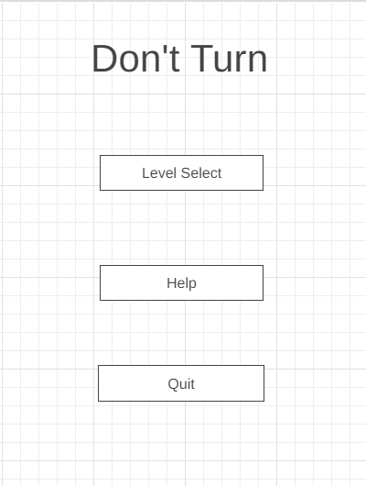
Name of game
Level button
Takes the player to the level screen
Help button
Takes the player to the help screen
Quit button
Will only appear on the pc build

Slide 2
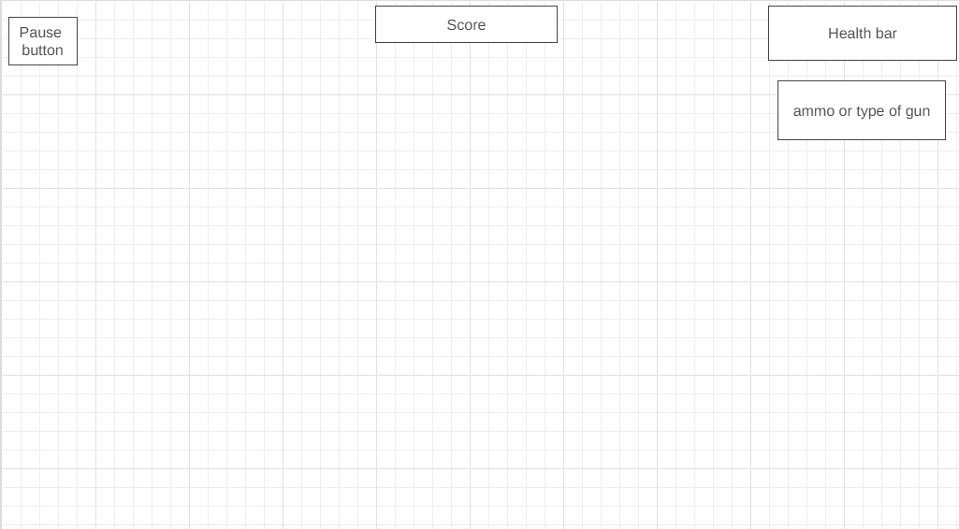
Pause button
Only appears on android
Pauses the game
Score text
Displays the players score
Saves it to file
Health bar
When the player gets hurt the bar will go down
When its empty the win/lose screen will appear and the game is paused
Ammo box (stretch)
Displays ammo
Displays current weapon

Slide 3
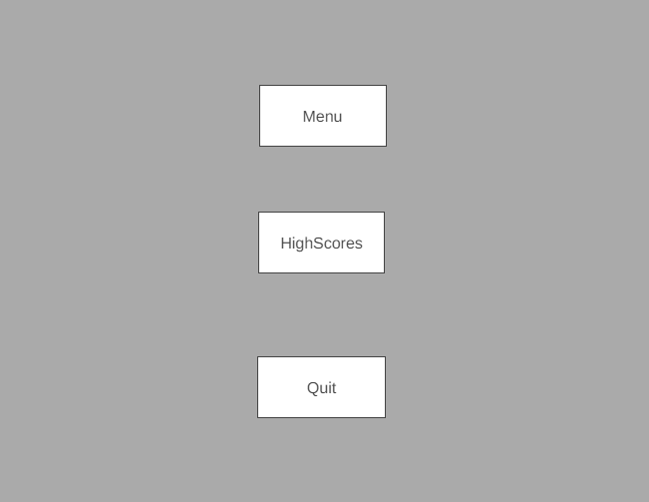
Menu button
Takes the player back to the menu scene
High Score button
Takes the player to see his score on the high score scene
Quit button
Only appears on pc build
Quits application

Slide 4
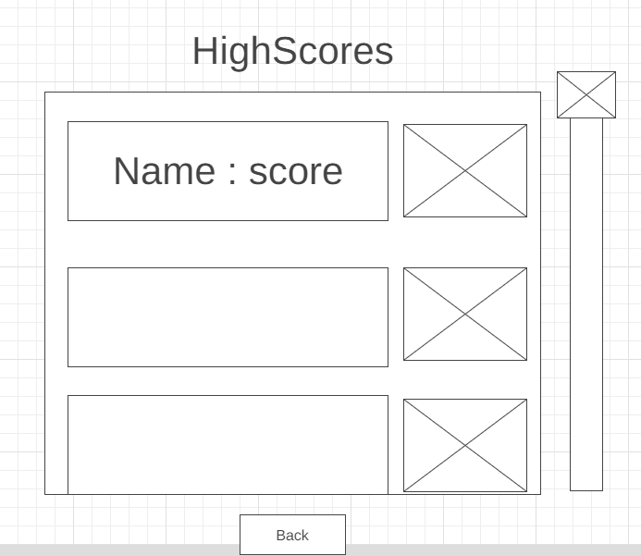
Scores
Displays the name of the player and the high score they got
Reads from file
Sliding Bar
Slides down when dragged to show more scores when filled.
Map
Displays the map the player got the score on
Back Button
Takes the player back to the menu scene

