Slide 1
Lost in the Haunted Woods
Craig Lovell
AIE Programming Year 1
Cross platform

Slide 2
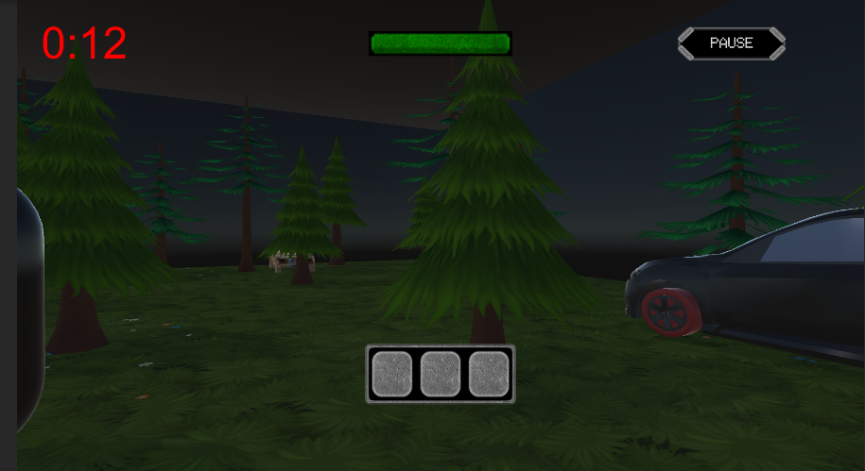
Idea / Pitch
In the haunted woods, you find yourself stuck when your car breaks down. Making you leave your vehicle and look for lost parts to fix the car. While all this is happening, a silent, evil, mysterious being is trying to kill you. The items you need to find quickly are a Battery, Wheel, and a Gas Can.

Slide 3
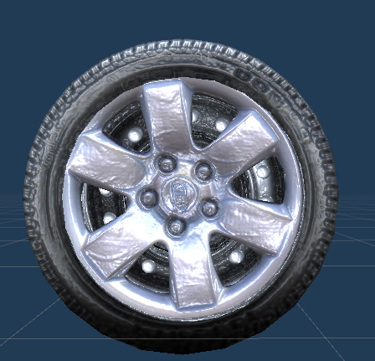
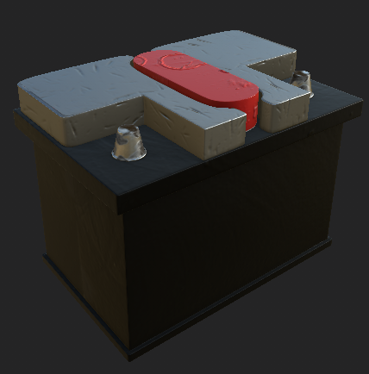
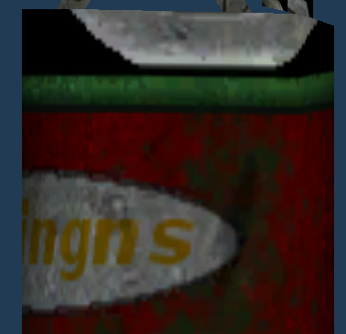
Items
Wheel
Battery
Gas Can
These are the items you need to find these items are collectables which are the means to escape without these you are stuck

Slide 4
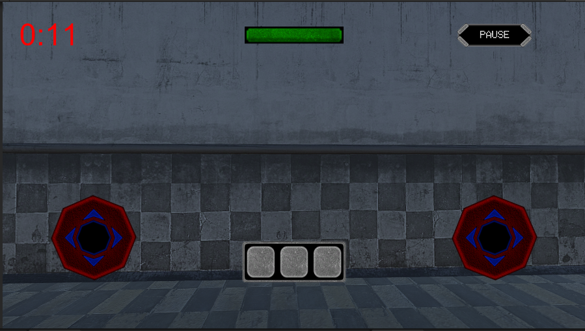
Player Movement / Phone Controls
Phone – uses 2 virtual joysticks - The left joystick controls the moving around forwards ,back ,left ,right. - The Right one controls where you look by rotating the player around a 360* Axis

Slide 5
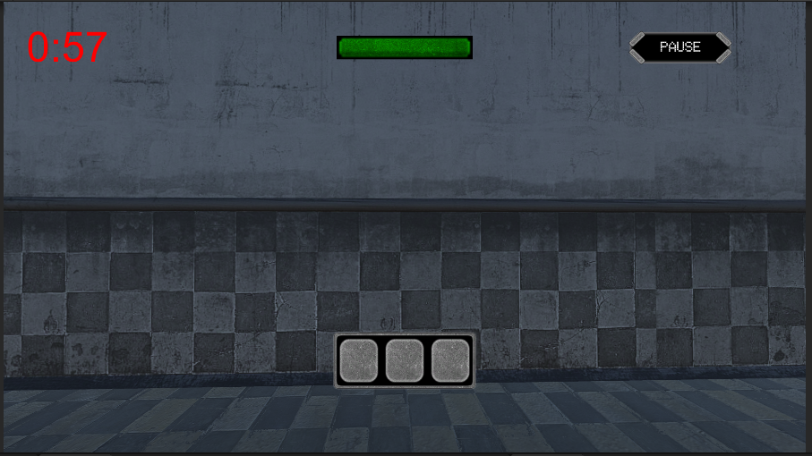
Player Movement / Keyboard Controls
Computer – Uses Keyboard and mouse - Using W, A, S, D the player and move around the game area - Using the mouse or I, J, K, L the player can rotate around and look behind left or right

Slide 6
Game System Player & Enemy
The enemy is set to case the player this is done by giving the enemy a constantly updating player location so it can always chase / follow
Enemy can also kill / damage the player this is set if the enemy is in a specific radius to the player and is set to trigger on a cooldown.

Slide 7
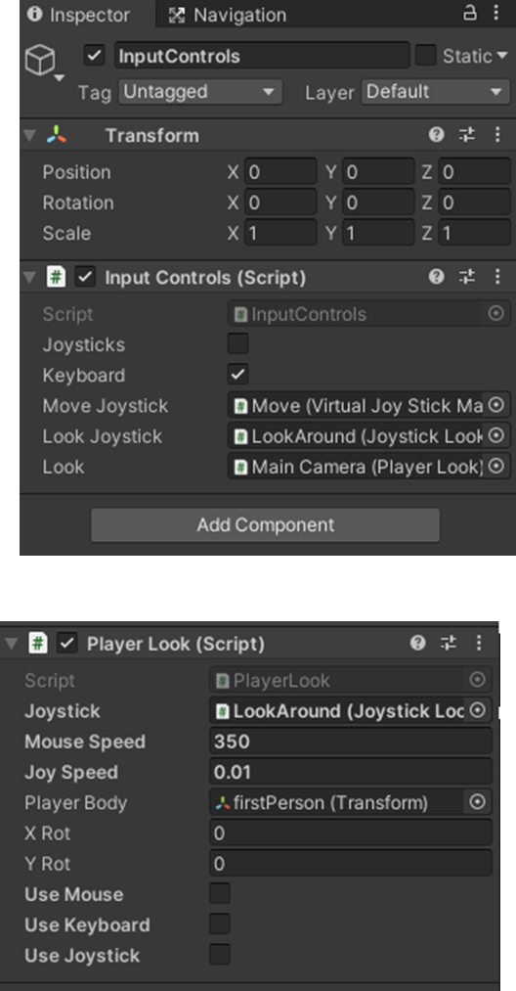
Game System Virtual Controls
Virtual Controllers which can be toggled depending on what you are testing for phone seeing joysticks and on the web and PC version no sticks are on screen.
For phone there are 2 virtual joysticks which can be toggled on and off using an input script to control switching from joysticks to keyboard depending on what is being built for.

Slide 8
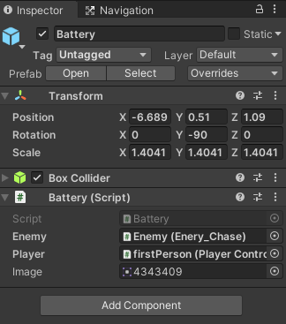
Game System Collectable Items
Each collectable has its own script which controls when it's picked up and what to-do once the item is picked up its then added to the inventory at the bottom of the screen
If you add a 4th item, you will need to change a few things and creating a script for the item like the others and changing a few variables so it will fit 4 and update correctly.
Items are set up to be a collectable which is triggered on a collision with the player and then are stored in a list.

Slide 9


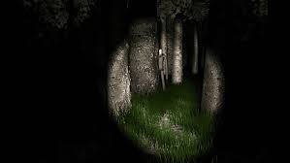
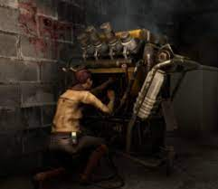
Reference from other games
Slenderman - Lost In The Haunted Woods has a similar concept with escaping after you find all hidden items, in this case, car parts.
In Silence - Lost In The Haunted Woods relates by taking place being in the woods and having to escape the woods alive.
Lunch Lady - Collecting pages hidden around the map to escape the killer lunch lady.
Dead By Daylight - The idea of completing a task to escape

Slide 10
Player experience and game POV
- The player will be looking for the 3 hidden items placed around the map, in the means to escape while looking for these items an evil being is hunting the player down in the woods the more items, they collect, the faster the evil one gets.
Game Genre & Rating
Horror, Escape, Survival, Mysterious, Thriller.
PG13

Slide 11
Visual And Audio Styles Used
To create the creepy atmosphere, the game uses an ambient sound which covers the whole map this should helps to create the feel that you are being watch and that there's something bad out in the woods.
When the enemy is chasing the player, when it gets close, a breathing sound can be heard in a specific radius around the enemy.

Slide 12
Unity Assets
https://assetstore.unity.com/packages/2d/gui/basic-ui-elements-concrete-48833
https://assetstore.unity.com/packages/3d/vehicles/rusty-cars-3437
https://assetstore.unity.com/packages/3d/environments/landscapes/handpainted-forest-pack-v1-0-144637
https://assetstore.unity.com/packages/3d/props/oil-cans-841
https://assetstore.unity.com/packages/tools/gui/graphy-ultimate-fps-counter-stats-monitor-debugger-105778
https://assetstore.unity.com/packages/3d/vehicles/low-poly-car-149312
https://assetstore.unity.com/packages/2d/textures-materials/sky/10-skyboxes-pack-day-night-32236

Slide 13
Software & Library's
Targeting Audience
- Unity - Visual Studio - Input controls - Vector - TextMeshPro, Buttons
- 13+ - This being as it is a simple game concept and easy if you know what you're doing but can also be fun at an older age too.
Targeting Platforms
Aiming for the game to be used on - Phones - Pc - Websites

Slide 14
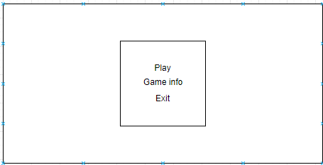
Wireframe Main Starting Screen

Slide 15
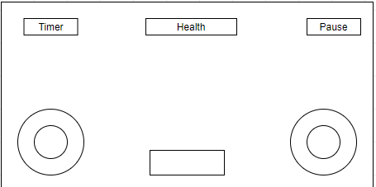
Wireframe Phone Game Screen

Slide 16
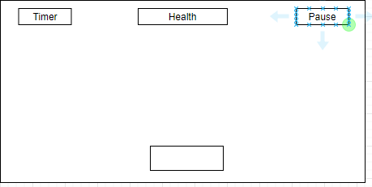
Wireframe Pc Game Screen

Slide 17
Milestones
Week1
Week3
Basic controls and map were built and tested.
All Game screens where made. Menu, Pause, Game Over
Sound and inventory System were made to show you what items you have picked up so far
Week2
Week4
Storyline and gameplay features where added like the collectables .
Bug fixing and documentation are being finalized and fixed

