Slide 1
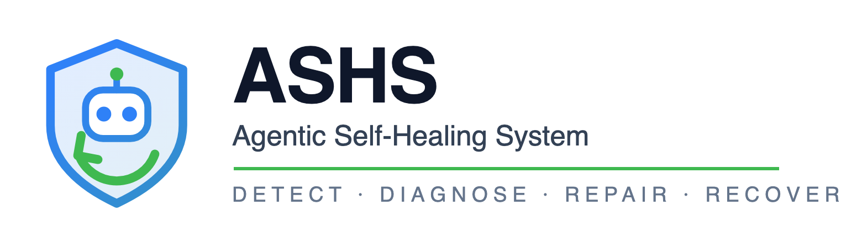
It finds the failure, works out whose bug it is, fixes it in the right repository, and proves the fix held.
Ten minutes · one live demo
Pushkar Mishra
Notes:
Hold while people settle.

Slide 2
THE PROBLEM
A 500 in production names nobody
One request fails across three teams' services. The error surfaced in the product — but the cause could be any of them.
Step
Who does it
Typical cost
Notice it
On-call, or a customer
Minutes to hours
Work out whose bug it is
Three teams on a call
Hours to days
Write the fix
One engineer
Minutes
Prove it worked
Often skipped
—
The fix is the cheapest step. Everything around it is the cost.
ASHS · Agentic Self-Healing System
1
Notes:
Ask the room how long it takes to get the ticket to the right team. Nobody says under an hour.

Slide 3
THE APPROACH
Attribution is deterministic
Only the narrative and the patch come from a model. Nothing else does.
Decided in code
Decided by the model
Who owns the bug
Why it happened, in prose
Which agent may repair it
What the fix should be
Whether it may run at all
Nothing else
The decisive check is objective: we validate the payload a service returned against the schema that same service publishes. Anyone can re-run it and get the same answer.
ASHS · Agentic Self-Healing System
2
Notes:
A demo where you ask an LLM 'who broke this?' proves nothing — you cannot audit it, and it will be confidently wrong at the worst moment.

Slide 4
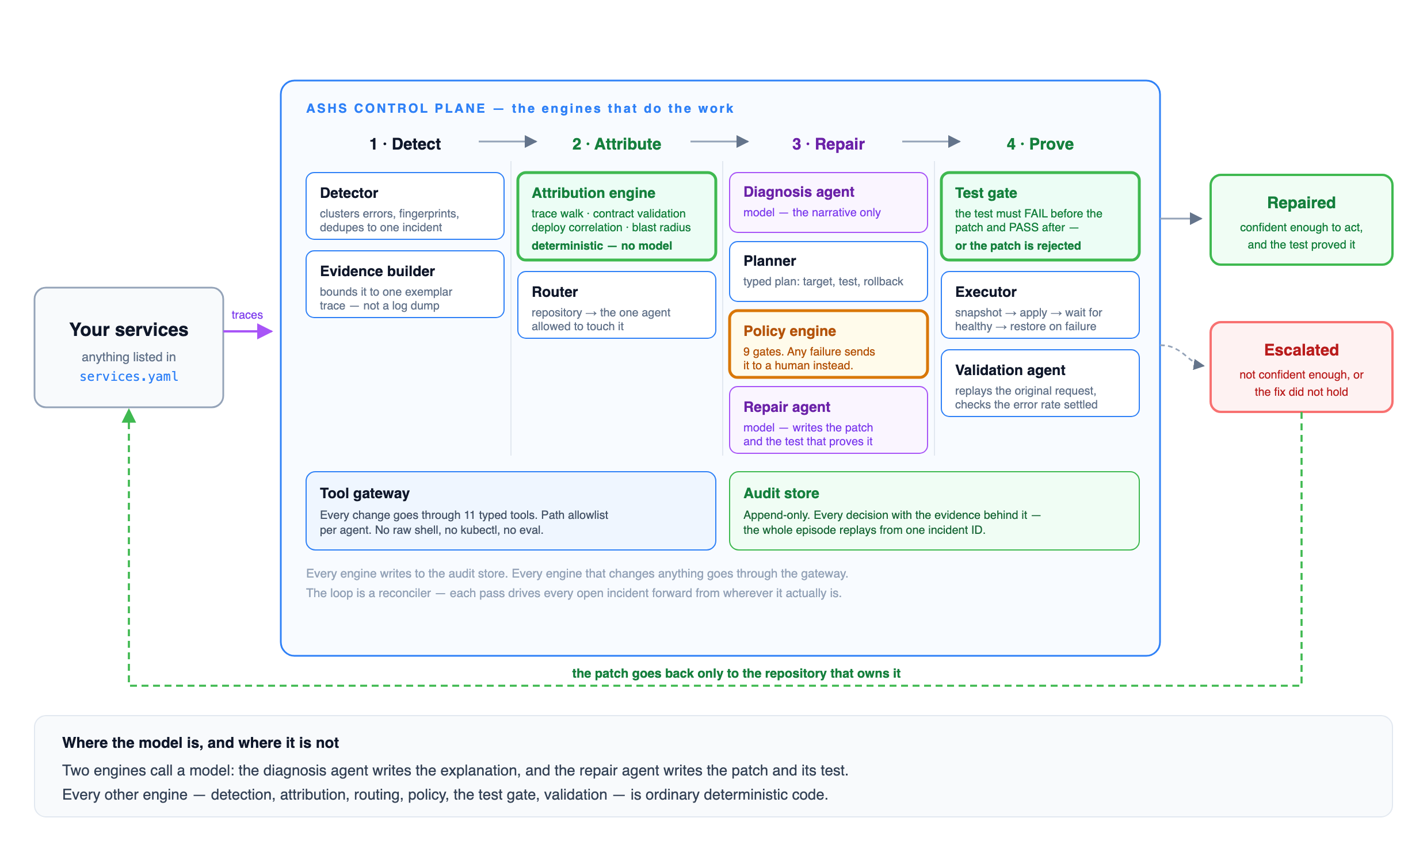
HOW IT WORKS
The engines that do the work
ASHS · Agentic Self-Healing System
3
Notes:
Left: your services, unchanged, not in the request path. Middle: the loop. Right: it either repairs or it stops and tells a human.

Slide 5
LIVE DEMO
Two faults, two different answers
ACT 1 — the product owns it
ACT 2 — a capability owns it
Both capabilities are cleared against their own published schemas.
Scores 0.92 — high enough to act.
Test fails before the patch, passes after.
Surfaced in the product. Fault domain two repositories away.
It returns HTTP 200 that breaks its own schema — it never errors at all.
A different team's agent patched a different repo.
Repaired itself in ~80 seconds
Repaired in ~85 seconds
Act 1 shows the repair is real. Act 2 shows the attribution is real — it routed past the service where the error appeared.
ASHS · Agentic Self-Healing System
4
Notes:
Run `make demo`. 1m47s for both acts. If short on time, ACT=2 is the one to keep — it carries the harder claim in 40 seconds.

Slide 6
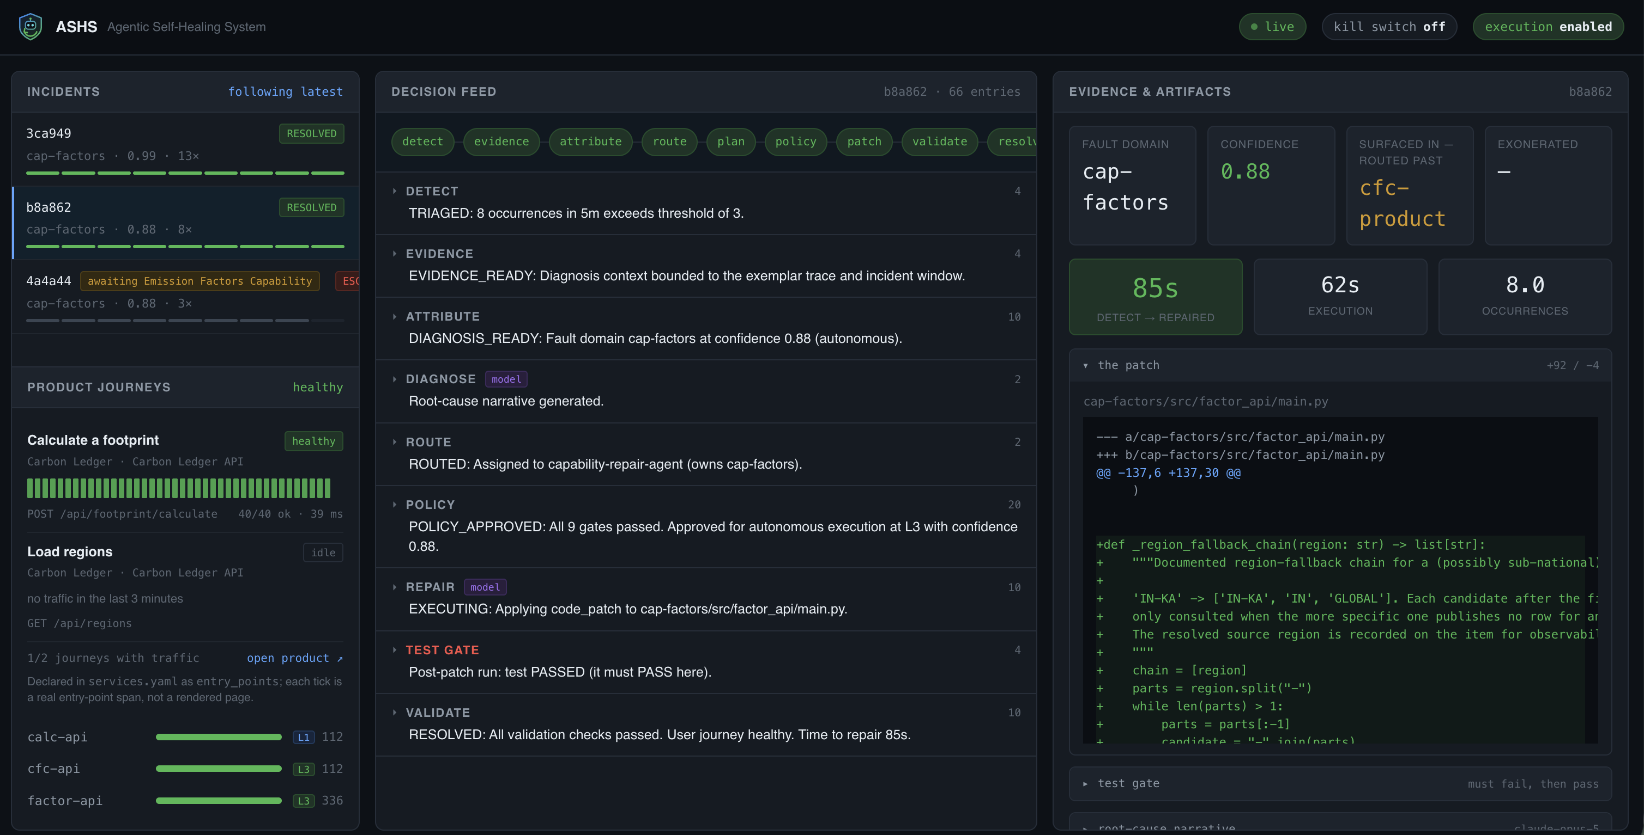
THE EVIDENCE
Nothing on screen that isn't in the audit trail
Every decision, with the evidence behind it · the actual diff · both test-gate runs · who was cleared and why · replayable from one incident ID
ASHS · Agentic Self-Healing System
5
Notes:
Click into the Act 2 incident live if there is time.

Slide 7
BE CLEAR ABOUT THIS
A working prototype, not a product
What is real
What is not
The attribution engine
Runs on Compose, one machine — no HA, no auth
The policy gates and the test gate
Patches are snapshot/restore, not git or a PR
The audit trail
"Deploy" is a hot reload, not a real rollout
Byte-for-byte rollback
Real telemetry is far noisier than this
The open gap worth naming first: we only see failures that throw. Flip an emission factor from 0.71 to 0.95 and every request still returns 200 — nothing detects it.
ASHS · Agentic Self-Healing System
6
Notes:
Volunteering this is what makes the rest credible. A good engineer in the room will find this gap — get there first.

Slide 8
WHERE IT GOES
What we would build next
Next
Why
Git-backed pull requests
Repairs land in the review workflow teams already trust
Approval UI
It already drafts a patch when unsure — let a human approve it in one click
Detection beyond errors
SLO burn, latency, silent corruption — none of which throw
Calibrated confidence
Measure whether repairs held, and fit the weights to that
Kubernetes execution
Canary and progressive rollout instead of a hot reload
"The fix was never the hard part. Knowing whose it was, being allowed to make it, and proving it worked — that is the product."
ASHS · Agentic Self-Healing System
7
Notes:
Close here, then questions. 45/45 exit checks pass today; three clean runs from a full reset, ~90s per repair loop.

