Slide 1
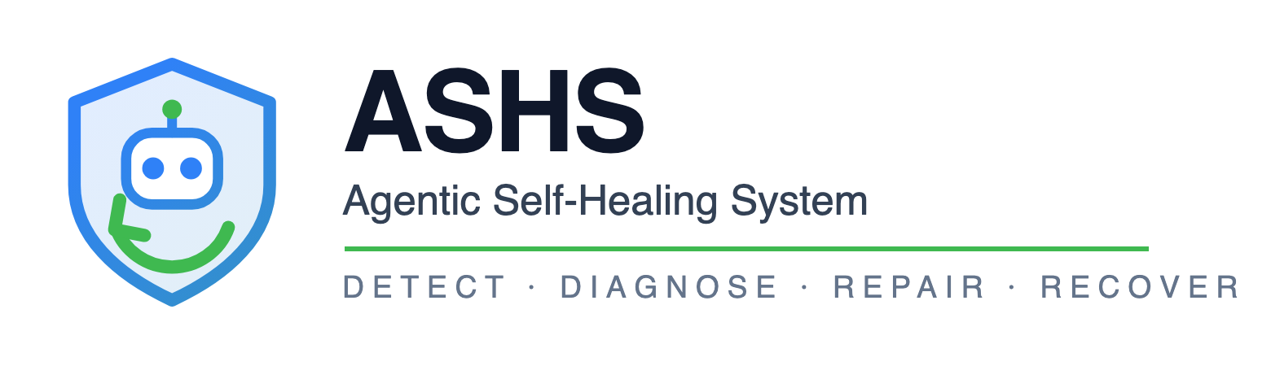
An autonomous repair control plane for multi-team service estates
It finds the failure, works out whose bug it is, fixes it in the right repository, and proves the fix held.
Pushkar Mishra
Notes:
Hold this while people settle. Do not open with architecture.

Slide 2
THE PROBLEM
A 500 in production names nobody
When a user-facing request fails across a service boundary, here is where the time actually goes:
Step
Who does it
Typical cost
Notice it
On-call — or a customer
Minutes to hours
Work out whose bug it is
Three teams on a call
Hours to days
Convince the owning team
Politics
Hours to days
Write the fix
One engineer
Minutes
Prove it worked
Often skipped
—
The fix is the cheapest step. Everything around it is the cost.
ASHS · Agentic Self-Healing System
1
Notes:
Ask the room: how long from page to the right team having the ticket? Nobody answers 'under an hour'. That gap is what this attacks — not typing speed.

Slide 3
THE PROBLEM
Why attribution is the hard part
A user hits POST /api/footprint/calculate. It returns 500. The error surfaced in the product. The cause could be:
Candidate
Distance from the symptom
The product itself
0 hops — mishandling a perfectly valid response
The calculation capability
1 hop down
The emission-factors capability
2 hops down
None of them
A bad deploy, or a schema that drifted
Three teams. Three repositories. One error message that names none of them.
The naive move — blame whatever you called — is wrong about as often as it is right.
ASHS · Agentic Self-Healing System
2
Notes:
This is the slide that makes the rest matter. In most orgs this is a 40-minute conference call before anyone writes a line of code.

Slide 4
THE APPROACH
Attribution is deterministic
Only the narrative and the patch come from a model. Nothing else does.
Decided in code
Decided by the model
Who owns the bug
Why it happened, in prose
Which agent may repair it
What the fix should be
Whether it may run at all
Nothing else
The exit tests assert that no model call appears at or before the attribution decision. If one did, the build fails.
ASHS · Agentic Self-Healing System
3
Notes:
If you take one thing away, take this. A demo where you ask an LLM 'who broke this?' proves nothing — you cannot audit it, and it will be confidently wrong at the worst possible moment.

Slide 5
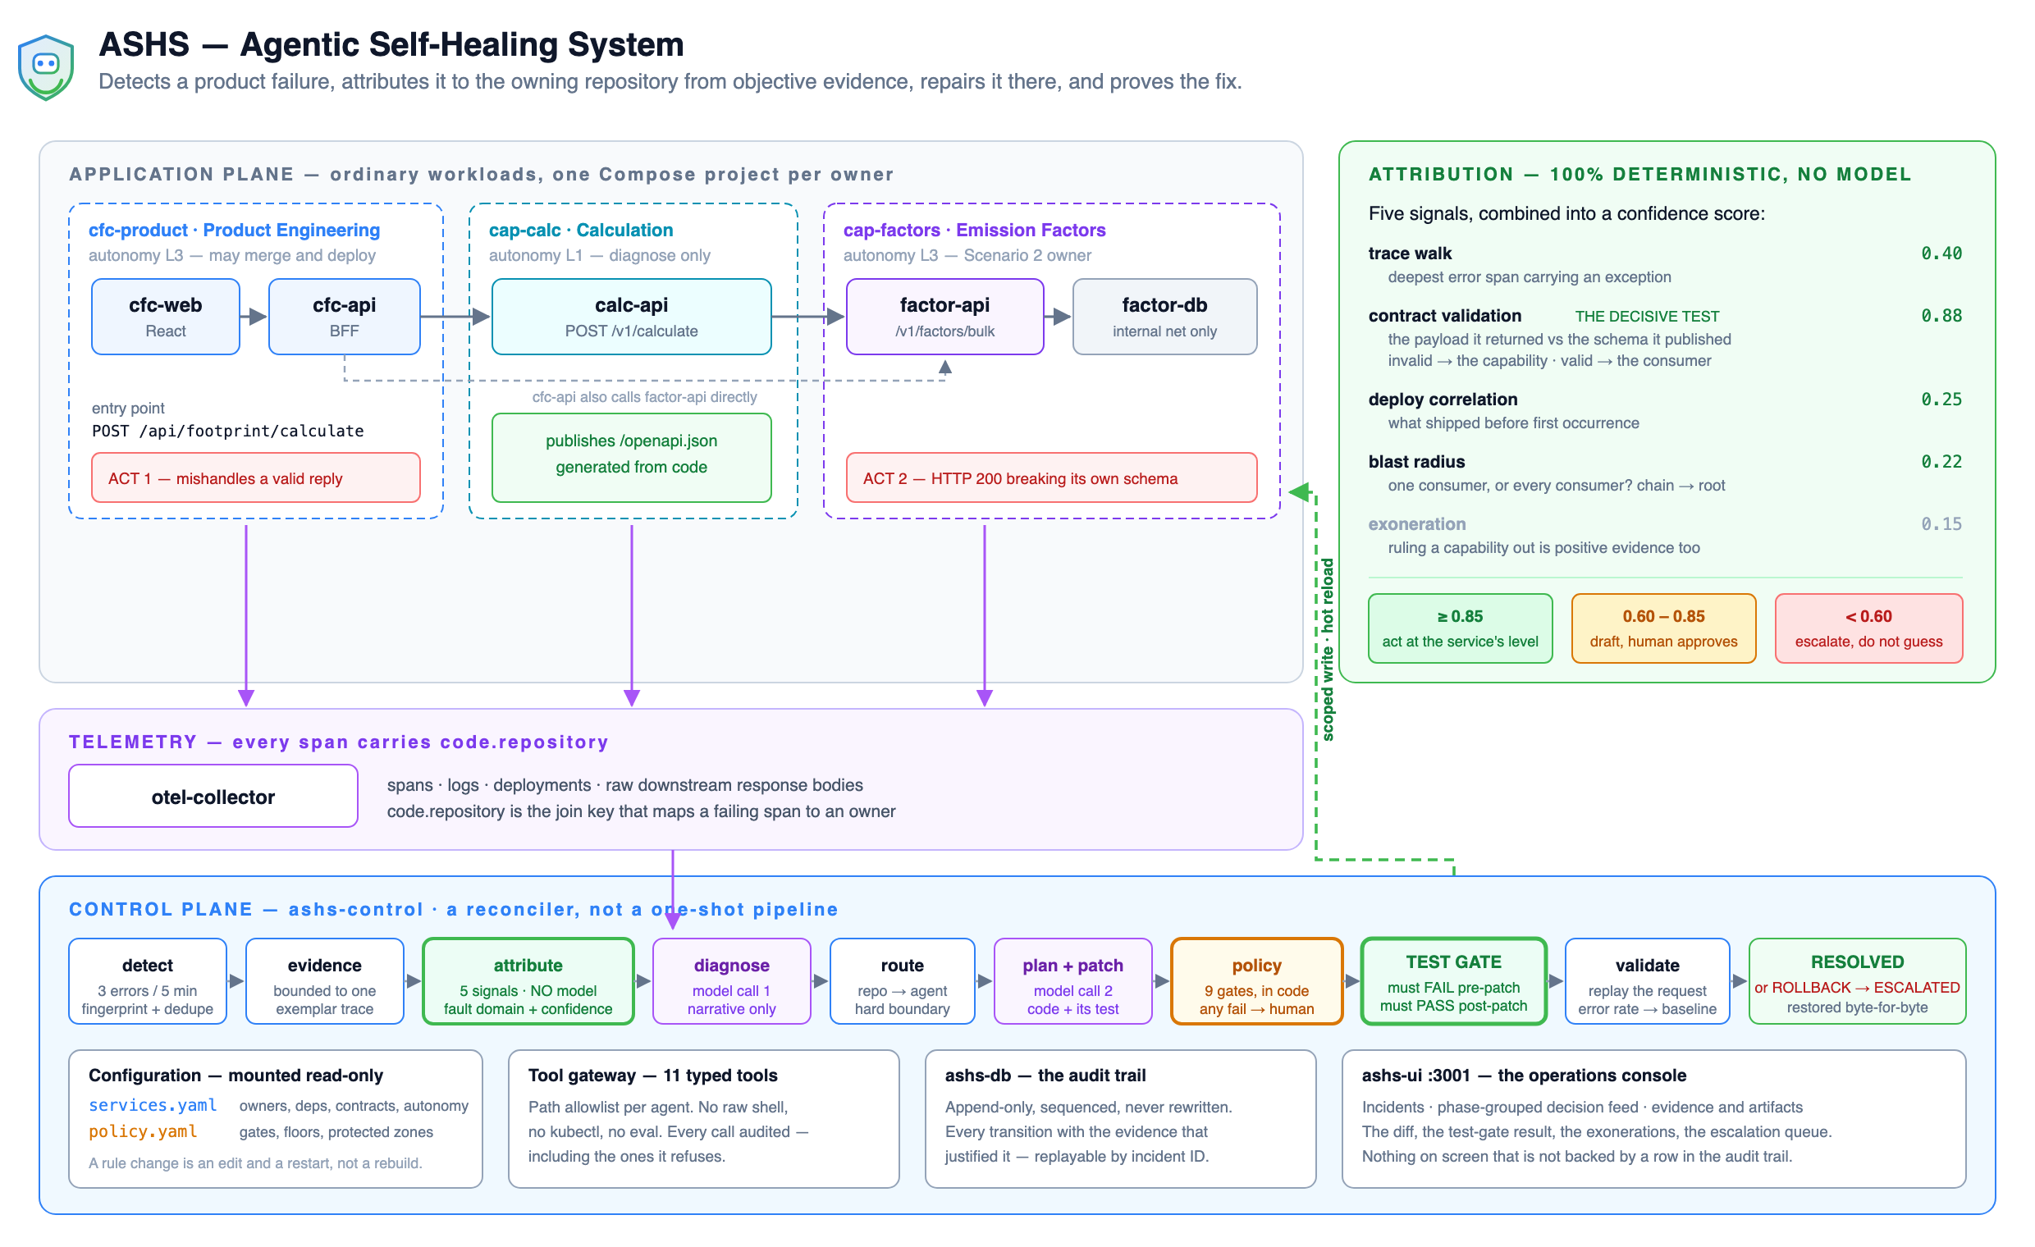
HOW IT FITS TOGETHER
Architecture
ASHS · Agentic Self-Healing System
4
Notes:
60 seconds. Trace one request left to right, then point at the purple arrows: every span carries code.repository, the join key that turns a failing span into an owner with no lookup table and no guessing.

Slide 6
HOW IT DECIDES
Five signals, combined
Signal
Weight
What it actually does
Contract validation
0.88
The payload a capability returned, against the schema it published
Trace walk
0.40
Deepest error span that carries an exception
Deploy correlation
0.25
What shipped just before the first occurrence
Blast radius
0.22
One consumer failing, or all of them? Follows the chain to its root
Exoneration
0.15
Ruling a capability out is positive evidence too
Contract validation is the only signal that can clear the bar alone — because it is the only one that is objective. Their schema, their payload, no inference in between.
ASHS · Agentic Self-Healing System
5
Notes:
If asked 'why 0.88?' — a conclusive schema violation is proof, not inference. Anyone in the room can re-run that check and get the same answer.

Slide 7
HOW IT DECIDES
Confidence, never certainty
0.85 and above
0.60 to 0.85
Below 0.60
Act — at that service's own autonomy level
Draft the patch. A human approves it.
Escalate with the evidence. Do not guess.
Set the floors in three places. The most specific one wins.
services.yaml confidence_floors: # per service — most specific
.env ASHS_AUTONOMOUS_FLOOR # per environment
policy.yaml confidence: # global default
"Act at 0.85 on the product, but demand 0.95 before anything touches emission factors" is one line of YAML. That is an ownership decision, not a code change.
ASHS · Agentic Self-Healing System
6
Notes:
Different teams will want different answers, and they should be able to set them without touching code.

Slide 8
WHAT STOPS IT
Guardrails, written in code
Guardrail
How it is enforced
Test gate
Patch rejected unless its test fails before the patch and passes after
Path allowlist
Tool gateway, per agent, from services.yaml
Protected zone
Emission factors, formulas, migrations, platform/**
Change budget
A cap on autonomous merges per service per day
Loop breaker
Two failed attempts on one fingerprint, then a human
No self-modification
Agents cannot touch ASHS's own policy
Kill switch
Halts the reconciler — checked on every pass
Eleven typed tools. No raw shell, no kubectl, no eval. The exit tests assert those do not exist.
ASHS · Agentic Self-Healing System
7
Notes:
Five of these are proven to refuse in the phase-2 suite. Not 'configured to' — proven, with the refusal written to the audit trail.

Slide 9
WHAT STOPS IT
The test gate is the centrepiece
TEST GATE pre_patch: FAILED (it must fail here)
TEST GATE post_patch: passed (it must pass here)
A test that passes before the fix proves nothing.
So the patch is rejected on the spot — whatever the model claimed about it, and however good the diff looks. The model writes the patch and the test. It does not get to decide whether either one is acceptable.
If the defect stopped reproducing on its own, the incident closes as stale. No patch, and nobody gets paged.
ASHS · Agentic Self-Healing System
8
Notes:
The most important slide for a skeptical engineer.

Slide 10
WHY TRUST IT
Trust the envelope, not the model
Property
Because
Auditable
Every decision is an append-only row with the evidence behind it. Replayable from an incident ID.
Deterministic
Ownership, routing and policy never call a model. Same evidence, same verdict, every time.
Checkable by hand
The decisive signal is a public schema against an observed payload. Re-run it yourself.
Reversible
Snapshot before any change. A failed check restores the source byte for byte.
Bounded
Typed tools, path allowlist, protected zones, change budget, loop breaker, kill switch.
And it stops. Below 0.85 it drafts and asks. Below 0.60 it refuses outright.
ASHS · Agentic Self-Healing System
9
Notes:
The honest framing: you should not trust the model. You should trust the envelope around it — and that envelope is code you can read.

Slide 11
LIVE DEMO · ACT 1
The product owns it
calc-api HTTP 200 total=0 <- still contract-compliant
product HTTP 500 x 8 <- same request, through the product
Both capabilities are exonerated against their own published schemas.
cfc-product scores 0.92 — clears the floor, so it repairs itself.
Test gate: fails before the patch, passes after.
RESOLVED in about 80 seconds
ASHS · Agentic Self-Healing System
10
Notes:
Say: the capability is behaving perfectly — that response validates against its own schema. Every naive system starts by blaming what it called.

Slide 12
LIVE DEMO · ACT 2
The capability owns it — two hops down
surfaced in cfc-product where it broke
fault domain cap-factors ROUTED PAST the service that failed
confidence 0.88
factor-api returns HTTP 200 that violates its own published schema.
It never errors. Only contract validation can see this at all.
The capability's own agent patched a different repo, owned by a different team — through the same test gate.
RESOLVED in about 85 seconds
ASHS · Agentic Self-Healing System
11
Notes:
The money beat. Mention the second incident opened for cap-calc — the middle capability failed too, and was attributed to the same owner. That is blast radius doing real work.

Slide 13
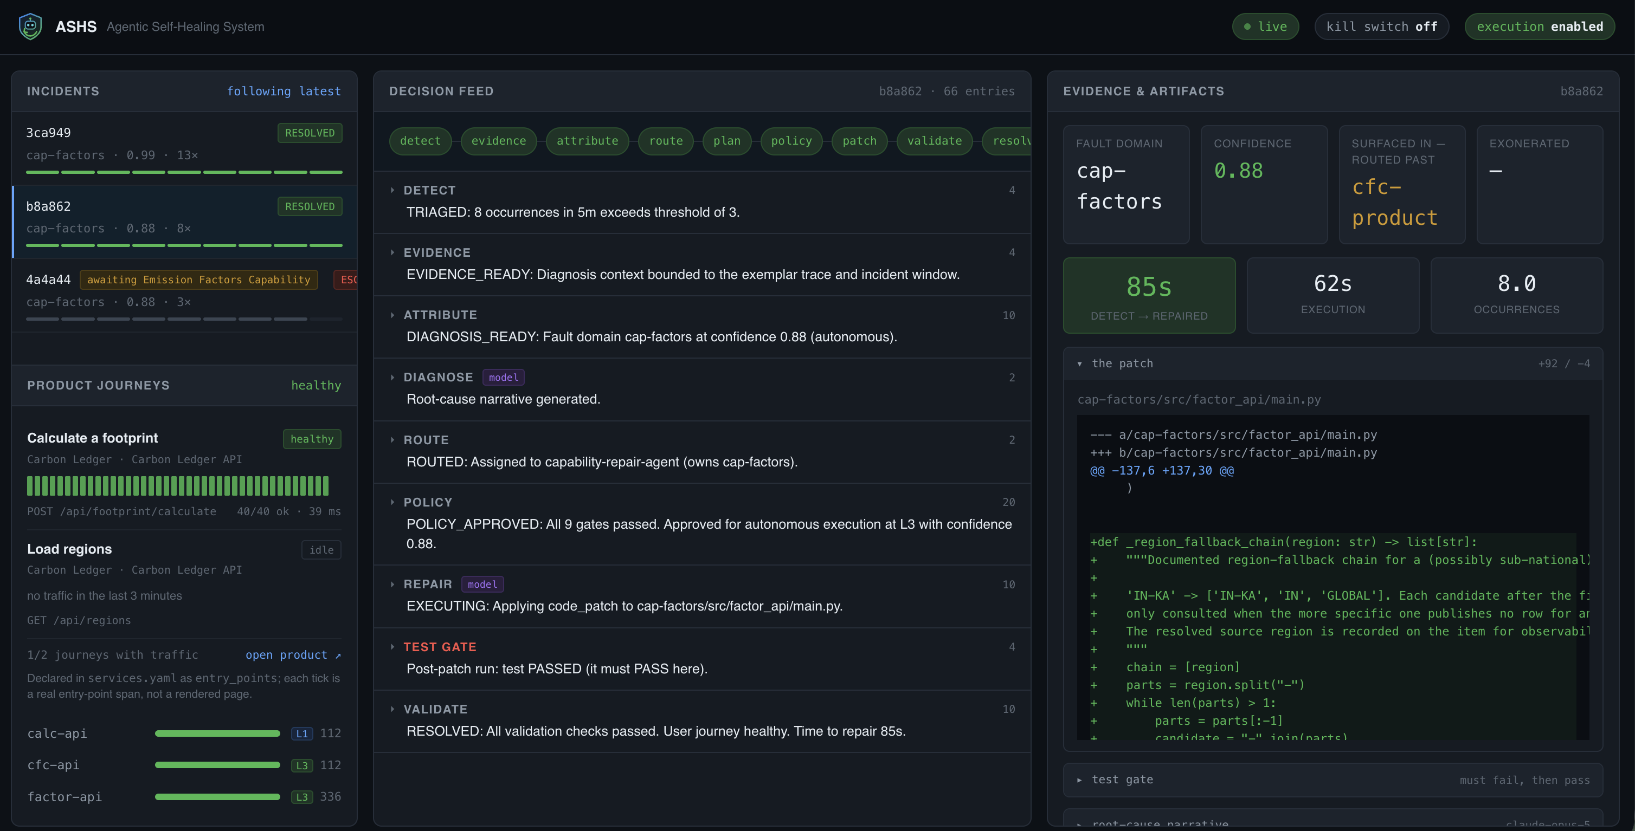
THE EVIDENCE
Nothing on screen that isn't in the audit trail
Incidents and their state · the decision feed grouped by phase · the actual diff · both test-gate runs · who was exonerated and why · the escalation queue
ASHS · Agentic Self-Healing System
12
Notes:
Click into the Act 2 incident live. Collapse the decision feed and say: thirty-three decisions, every one with the evidence that justified it.

Slide 14
THE VALUE
Where the time goes
Today
With ASHS
Detect
Minutes to hours
A sweep every 10 seconds
Attribute
Hours to days, three teams
Seconds, deterministic, with evidence
Route to the owner
Manual, and political
Automatic, from the catalog
Fix
Minutes
~80s, or a draft awaiting approval
Prove it worked
Often skipped
Mandatory, or it does not merge
The second-order value matters more
The argument moves from opinion to evidence. "Your service returned this payload; here is your published schema." That ends the call.
Exoneration is worth as much as blame — two teams get their morning back.
Every incident leaves a reviewable artifact, whether it repaired or refused.
ASHS · Agentic Self-Healing System
13
Notes:
Do not lead with 'saves engineer hours'. Lead with 'ends the ownership argument'. Engineering leaders feel that pain far more sharply.

Slide 15
THE RISKS
What can go wrong, and what catches it
Risk
What catches it today
Residual
Wrong attribution
Deterministic signals; escalates below 0.60
Real if telemetry is poor
A bad patch merged
Test gate must fail then pass; replay
A test can be shallow
Runaway repair loop
Loop breaker, change budget, kill switch
—
Touches something it shouldn't
Path allowlist, protected zones, typed tools
Depends on the catalog
Silent corruption, no errors
Nothing. Not detected today.
Open gap
Model unavailable mid-incident
Falls back to deterministic diagnosis
Loses the patch, not the owner
The honest one: this is only as good as code.repository on your spans and an OpenAPI generated from your code. Without both, attribution degrades to guesswork.
ASHS · Agentic Self-Healing System
14
Notes:
Volunteering this is what makes the earlier slides credible. Do not skip it.

Slide 16
BE CLEAR ABOUT THIS
It is not production grade
A working prototype, not a product. Say so before anyone asks.
Runs on Docker Compose, on one machine. No HA, no multi-tenancy, no RBAC, no auth.
Patches are snapshot-and-restore on a mounted volume — not git, and not a pull request.
"Deploy" means a hot reload. No build, no canary, no progressive rollout.
Real telemetry is noisier than this estate by orders of magnitude.
The demo fault-injection endpoints are compiled into the services.
Emission factors are indicative only — not for reporting or disclosure.
What is real: the attribution engine, the policy gates, the test gate, the audit trail and the rollback. Those are the parts worth arguing about.
ASHS · Agentic Self-Healing System
15
Notes:
If someone asks 'can we run this next quarter?' the answer is no — and the next five slides are why that is fine.

Slide 17
WHAT COMES NEXT · 1 OF 5
Close the honesty gaps first
Weeks, not quarters. None of this needs new intelligence — only plumbing.
Feature
Why it matters
Git-backed patches
Swap snapshot/restore for a branch, a diff and a review. Repairs land in the workflow teams already trust.
Approval UI
The 0.60–0.85 band already drafts a patch. Give a human Approve / Reject / Amend in the dashboard — and record which they chose.
Slack and PagerDuty
The escalation already carries owner and contact. Wiring it up is one handler, not a redesign.
Time-to-diagnosis metric
We record time-to-repair but not how fast it noticed. That is the number that shows the loop is alive.
Rename POLICY_APPROVED
It reads as though a human approved. Nine deterministic gates did. Words matter in an audit trail.
ASHS · Agentic Self-Healing System
16
Notes:
The first two are what turn this from a demo into something a team could actually adopt.

Slide 18
WHAT COMES NEXT · 2 OF 5
We only see failures that throw
This is the biggest functional gap, and the one a good engineer will find. Get there first.
Feature
What it unlocks
SLO and anomaly detection
Latency regressions, error-budget burn, throughput cliffs — none of which raise an exception
Semantic corruption checks
A capability returning a plausible but wrong number. Contract validation catches shape, not meaning.
Continuous contract diffing
Catch a schema change at deploy time, before a consumer breaks on it
Golden-output regression
Pin known-correct answers; alert when the same input produces a different one
Today: flip an emission factor from 0.71 to 0.95. Every request still returns 200. Totals shift by 40%. Error rate never moves — and nothing detects it. Customers report carbon numbers that are wrong.
ASHS · Agentic Self-Healing System
17
Notes:
This is the most intellectually interesting gap in the system.

Slide 19
WHAT COMES NEXT · 3 OF 5
Make it prove its own accuracy
Right now the weights are hand-set and defended by argument. They should be measured.
Feature
Why
Outcome feedback
Did the repair hold for seven days, or did the incident come back? Feed that back per signal.
Calibrated confidence
Fit the weights to observed correctness, then publish them — so the floors mean something empirical.
Disagreement log
When a human overrides the fault domain, record it. That set is the training data for all of this.
Per-signal precision
"Contract validation has been right 47 times out of 47" beats "we weight it 0.88".
Cost per incident
Model spend, compute, and engineer-minutes saved — per repair.
ASHS · Agentic Self-Healing System
18
Notes:
This turns 'trust the envelope' into 'here is the measured track record'. A year of episodes makes this a completely different pitch.

Slide 20
WHAT COMES NEXT · 4 OF 5
From three services to a real estate
Quarters. The catalog already drives everything — the hard part is onboarding and trust, not code.
Feature
Why
Self-service onboarding
A guided path and a linter for services.yaml, so a team can add itself
Kubernetes execution
Replace hot reload with a real deploy: canary, progressive rollout, automatic revert on SLO breach
RBAC and authentication
Who may move a floor, engage the kill switch, or approve a drafted patch
Dependency discovery
Derive depends_on from observed traces instead of maintaining it by hand
Maintenance windows
Stop opening incidents during a planned migration
HA control plane
Today it is a single point of failure
ASHS · Agentic Self-Healing System
19
Notes:
Adding a service is already a YAML edit — that groundwork is done.

Slide 21
WHAT COMES NEXT · 5 OF 5
The ambitious end
Only worth attempting once everything before this is solid. Direction, not commitment.
Cross-incident learning — "this fingerprint class is always a missing null-guard in a BFF." Pattern libraries per fault family.
Preventive repair — run the same contract validation against a pre-merge build, and the violation never reaches production.
Coordinated multi-service repair — some fixes need a change on both sides of a boundary, with two owners approving.
Explain it to the owner — generate the pull request description for the team that owns the code, in their vocabulary, evidence attached.
Chaos-driven validation — continuously inject known faults in staging and assert the system still attributes them correctly. Regression testing for the attribution engine itself.
ASHS · Agentic Self-Healing System
20
Notes:
Do not let these overshadow the near-term slides, which are the ones that actually get funded.

Slide 22
WHERE IT STANDS
What is proven today
Phase
Checks
What it proves
0 — harness
13
One calculation produces one trace across three services
1 — detect and attribute
9
cfc-product at 0.92, both capabilities exonerated, no model involved
2 — plan and gate
13
Plan reaches approval; five guardrails proven to refuse
3 — repair and revert
10
Repair lands; a forced failure reverts byte for byte
45 of 45 passing. Three consecutive clean runs from a full reset — 20 to 23 seconds to boot, 85 to 90 seconds for the repair loop.
"The fix was never the hard part. Knowing whose it was, being allowed to make it, and proving it worked — that is the product."
ASHS · Agentic Self-Healing System
21
Notes:
Close here. Then take questions.

Slide 23
APPENDIX
Commands, and the questions you will get
Question
Answer
make demo-prep # restores source, keeps history
make demo # both acts, 1m47s
ACT=1 make demo # the repair only
ACT=2 make demo # the attribution only
make verify # 45 checks
make demo-rollback # forced failure -> revert
Did the model pick the owner?
No. The tests assert zero model calls through attribution.
What if it's wrong?
Below 0.85 it asks. Below 0.60 it refuses. Bad patch reverts byte for byte.
Can I tune the thresholds?
Floors yes, in three places. Signal weights are code, deliberately.
Never run make reset, clear-incidents or three-runs with an audience watching — each one blanks the dashboard.
Will it work on my services?
If they emit OTel with code.repository and publish an OpenAPI from code, yes.
Can we run it in production?
No. See the prototype slide.
ASHS · Agentic Self-Healing System
22
Notes:
Leave this up during Q&A.

