Slide 1

Responder:
A Familiar HTTP Service Framework
Kenneth Reitz

Slide 2
Hi.

Slide 3

@kennethreitz

Slide 4


Slide 5


Slide 6

github.com/kennethreitz
Requests
Responder
Maya
Records
Tablib
httpbin.org
Python-Guide.org
SayThanks.io
'Import This' Podcast
Em Keyboard
Certifi
Autoenv

Slide 8
Pipenv is the porcelain I always wanted to build for pip. It fits my brain and mostly replaces virtualenvwrapper and manual pip calls for me. Use it.
— Jannis Leidel (former pip maintainer)

Slide 9
Pipenv is finally an abstraction meant to engage the mind instead of merely the filesystem.
— Justin Myles Holmes

Slide 10


Slide 11
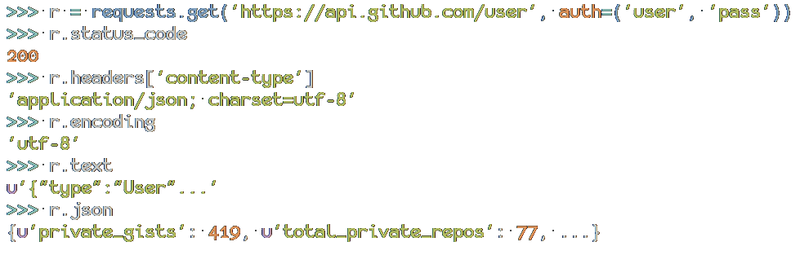

Requests:
HTTP for Humans

Slide 12
Requests is the perfect example how beautiful an API can be with the right level of abstraction.
— Armin Roncher (Flask, etc)

Slide 13
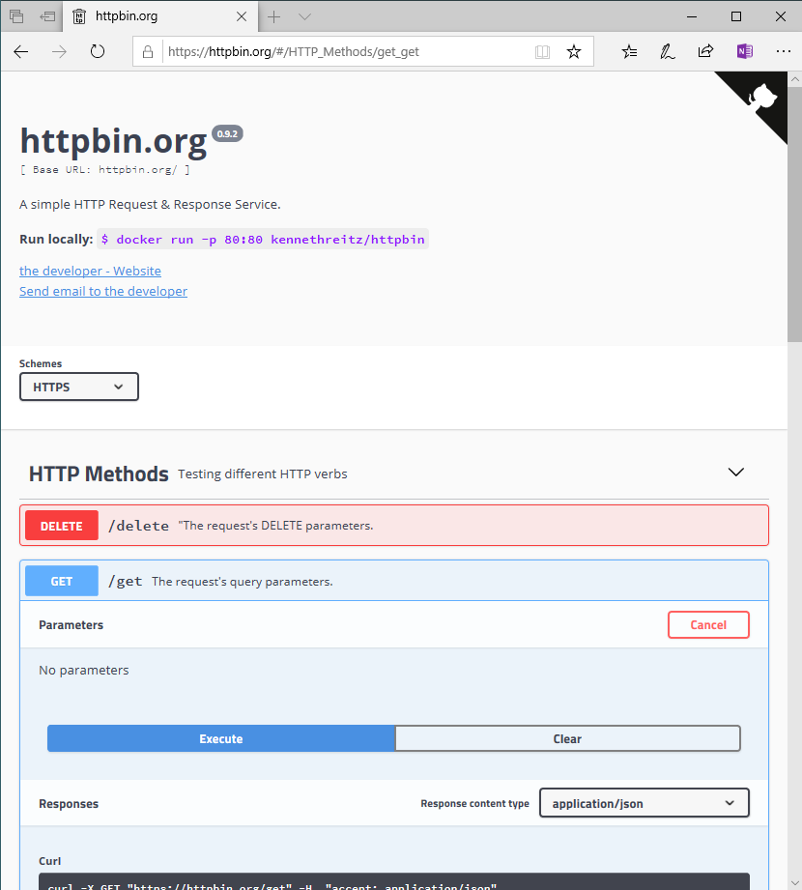

Slide 14
1999: Zope + Plone
Established Python early-on as a serious contender for web development, used heavily in government.
Python 1.5.2 was released in 1999.
Other community tools, like buildout.

Slide 15
The Rest of the World:
Classic ASP, PHP, Perl, and CGI Scripts.

Slide 16
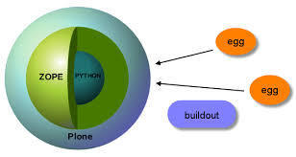
1999: Zope + Plone

Slide 17
2006: Pylons
A serious contender to Django.
Other community tools, like buildout.

Slide 18

The Rest of the World:
The Classics + Ruby on Rails.

Slide 19
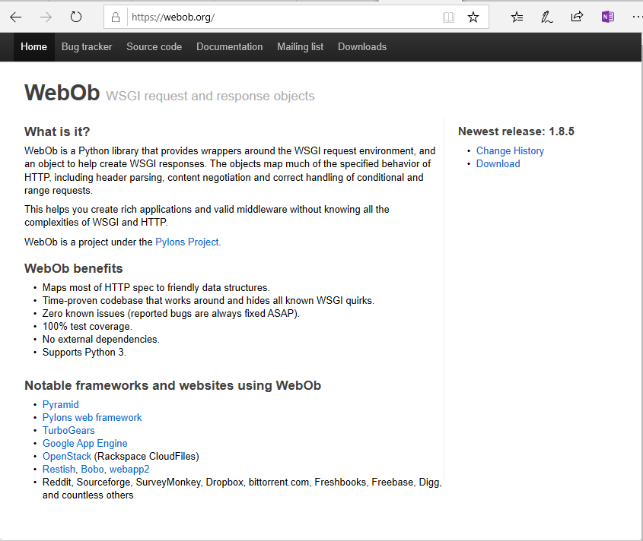
2007: Webob

Slide 20
Django
A serious web development framework.
Originally built for a small newspaper in Kansas, it excels greatly at content-driven applications.
Makes a lot of decisions for you (architecture, etc).
Was the de-facto web framework for Python for a long time.

Slide 21

Honorable Mention: Pyramid.
The reasonable alternative to Django.

Slide 22
Flask
Everyone’s favorite framework.
Started out as an April Fool’s joke (denied).
Grew on popularity due to user-friendliness.
Simple API presented; rarely need to reference the documentation when using it.

Slide 23
Django Channels
Plone vs. Zope
Django vs. Pyramid
Django vs. Flask
????

Slide 24
Falcon
Plone vs. Zope
Django vs. Pyramid
Django vs. Flask
????

Slide 25
Responder
Plone vs. Zope
Django vs. Pyramid
Django vs. Flask
????

Slide 26

The Future

Slide 27
Responder

Slide 28
What Responder is…
Plone vs. Zope
Django vs. Pyramid
Django vs. Flask
????

Slide 29
What Responder isn’t…
Plone vs. Zope
Django vs. Pyramid
Django vs. Flask
????

Slide 30
Pipenv Sales Pitch
Officially recommended tool from python.org.
Lets you use Pipfile/Pipfile.lock today.
Automates away virtualenv entirely.
Ensures deterministic builds, including hash check verification upon installation.
Other tools: e.g. $ pipenv graph

Slide 31
DEMO (Q&A)

Slide 32
Thank you!
kennethreitz.org/values

Slide 34


