Slide 1
THE GLOBAL BUSINESS & WEALTH ECOSYSTEM
AIG
Earn. Multiply. Dominate.
Earn when you invest. Earn when others invest.
Earn as your business grows. All fees back to the network.
aigplatform.com · Global · 2025
Confidential

Slide 2



THE CORE PRINCIPLE
Three ways to earn. One ecosystem.
01
02
03
You invest, you earn
Others invest, you earn
Business grows, you earn more
Your money works 24/7 through AIG-curated investment opportunities and the GDM marketplace. AI guides every decision.
When people you bring into the network invest, trade tokens or transact, commissions flow back to you automatically. 100% of fees returned.
As your business scales using AIG tools and training your earning multiplies. Help others do the same — and earn again on their success.

Slide 3

Curated deal flow
Hand-picked investment opportunities — not random, not generic. Vetted through AIG's AI engine before they reach you.
AI
Investment
AI-guided decisions
Scenario modeling, risk analysis and pattern recognition across market history — before you commit a single dollar.
The guiding light
of the AIG ecosystem.
Token-based investment models
Use AIG tokens to participate in structured investment opportunities. Your tokens are your stake in the ecosystem.
Your capital. Curated deals.
AI intelligence. Real returns.
Network multiplier
Investment is #1
When others in your network invest, commissions return to you automatically. The network earns together — every time.
Investment is the guiding light — everything else in AIG is built to grow your wealth.

Slide 4



THE AIG ECOSYSTEM
Six pillars. One network.
AI Investment
Money Transfers
Token & Crypto
Curated deals, token models, AI-guided
Global transfers & payments
Marketplace, tokens, crypto services
Learn →
Learn →
Learn →
WDM Services
GDM Marketplace
The Network
Business tools built for scale
Real estate, cars, offshoring & more
Affiliate earning, shared fee flow
Learn →
Learn →
Learn →

Slide 5




AI INVESTMENT ADVANTAGE
Six ways AI makes you a smarter investor.
Information at scale
Emotion-free analysis
Scenario simulation
Scans thousands of sources in seconds. Earnings reports, market data, news — surfaces only what matters to your portfolio.
No panic selling, no greed at the top. AIG's AI analyzes without reacting — pure clarity every time.
Test 'what if' situations instantly. What happens if rates rise 2% or a sector drops 30%? Run the numbers fast.
Diversification gaps
Learning on your terms
Pattern recognition
Detects hidden correlations between holdings before they cost you — two 'different' assets moving together in a crisis.
Ask anything — P/E ratios, bond duration, options Greeks — at your own pace, at exactly your level.
Identifies historical patterns across market cycles and sectors that would take a human analyst weeks to compile.

Slide 6

TOKEN & CRYPTO SERVICES
Your tokens work.
So does your money.
Token marketplace
Token investment models
Buy, sell and exchange AIG tokens and partner crypto assets in a curated, network-native marketplace.
Use tokens to participate in structured investment opportunities. Your tokens are your stake in the ecosystem.
Token-powered purchases
Global money transfers
Use AIG tokens in the GDM marketplace — condos, cars, boats, bank accounts. No internet searching required.
Move money anywhere in the world. Fast, low-cost, network-powered. All transfer fees return to the network.

Slide 7
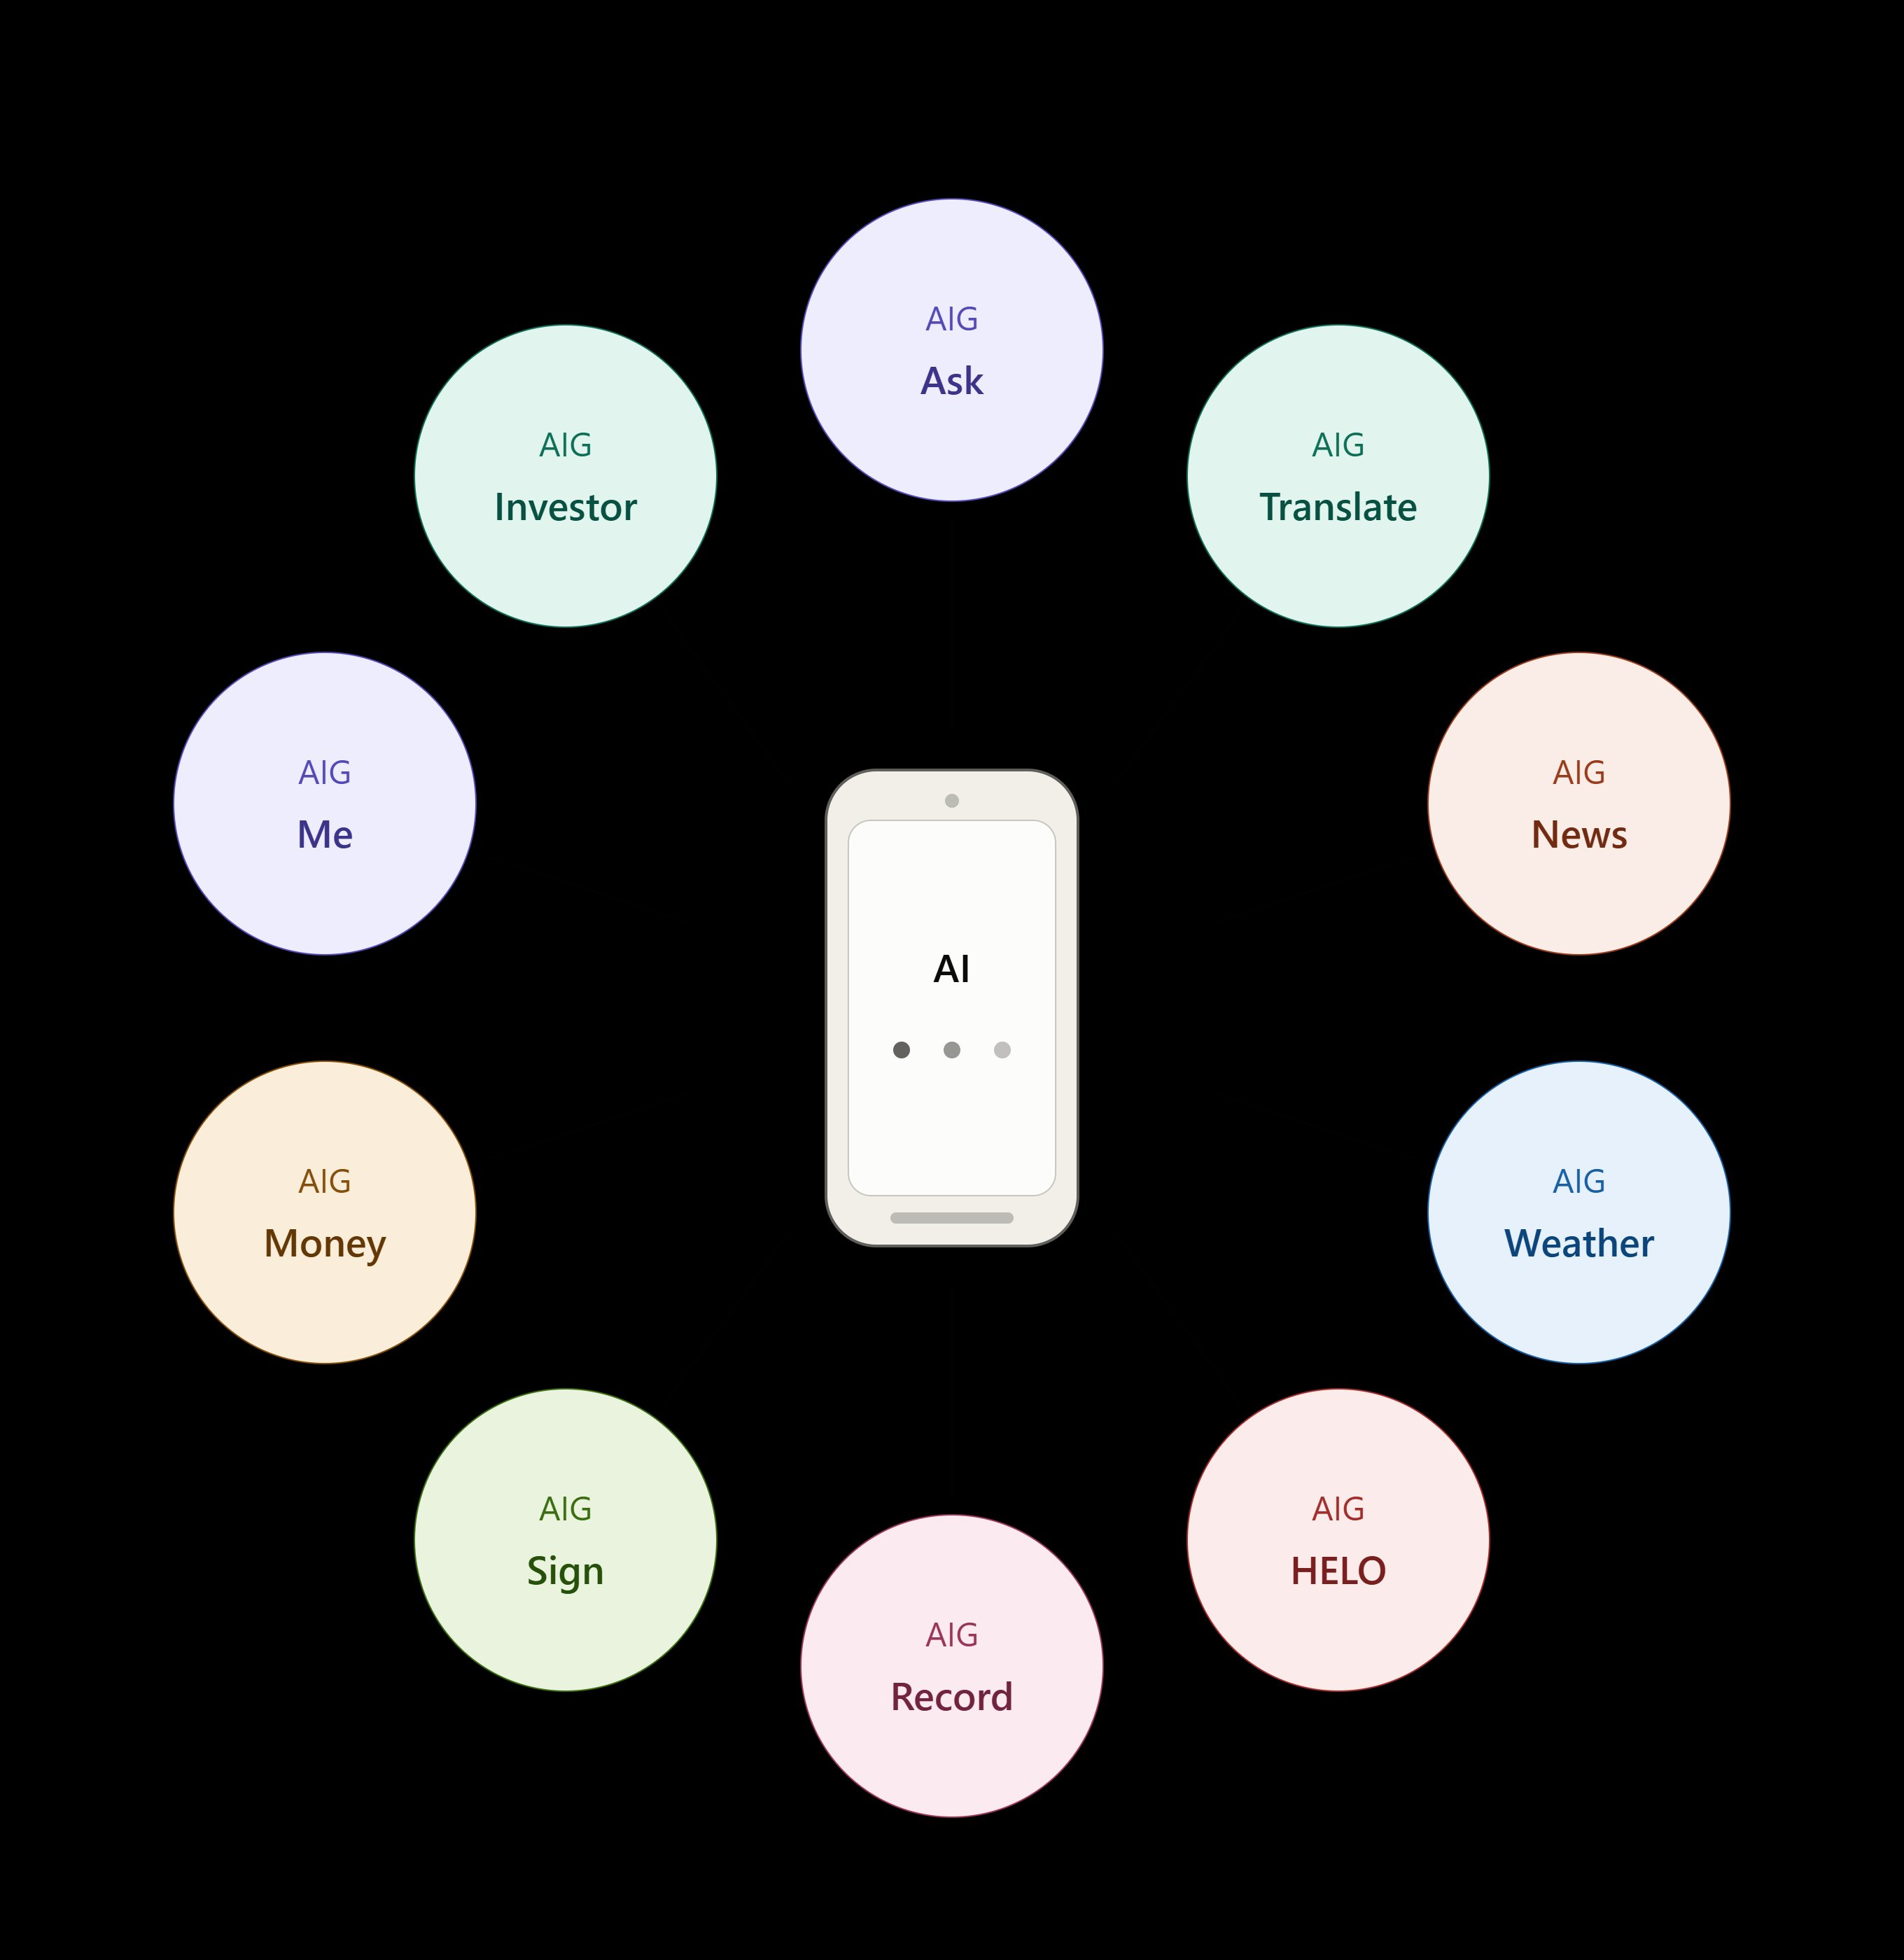
AIG Phone
Built-in apps
10 AI apps.
One device.
· AIG Ask
· AIG Translate
· AIG News
· AIG Weather
· AIG HELO
· AIG Record
· AIG Sign
· AIG Money
· AIG Me
· AIG Investor

Slide 8
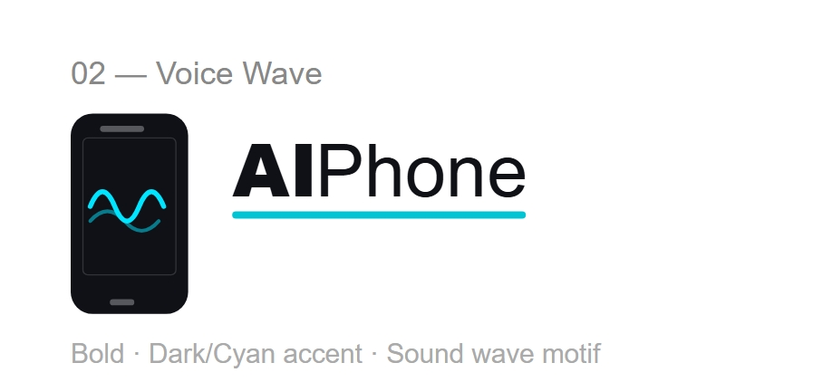
AIG Ask
AIG Investor
Your personal AI assistant — answer questions, research, decide faster.
Real-time investment guidance, portfolio tracking and network earnings.
AIG Money
AIG Translate
Fully AI-managed
assistant phone
Global money transfers, token management and payments on one screen.
Break language barriers instantly. Communicate globally, close deals locally.
Every moving part of your day,
handled automatically.
AIG HELO
AIG Sign & Record
aigphone.com
Emergency and safety AI. Always connected, always watching out for you.
Sign documents and record meetings with AI summaries — no paper, no delay.

Slide 9

WDM
Use AIG tokens. Skip the searching. Everything is turnkey, vetted, and ready to change your life.
100% of all brokerage fees returned to the AIG network.
Real Estate
Luxury Cars
Condos, houses, commercial
Premium vehicles, turnkey
Luxury Boats
Business Offshoring
Yachts & leisure vessels
Company setup & relocation
World Domination Market
Not a store.
A life-changing marketplace.
Bank Accounts
Nationalities & Residency
Multi-jurisdiction banking
Citizenship programs
100% of all WDM service & brokerage fees returned to the AIG network

Slide 10


AIG MONEYGAMES
Win real money.
Risk zero of your own.
How it works
Monthly prize
€1,000
→ Free to enter — no deposit needed
→ Every player starts with 10,000 coins
Highest profit from 10,000 coins wins
→ Trade & invest with virtual coins
Yearly jackpot
→ Highest monthly profit wins €1,000
Best annual performer claims the jackpot — no own money ever required.
→ Yearly champion wins the jackpot
→ We make money work for you
We make your luck change for the better.

Slide 11



SHARED INCOME FLOW
Every service. Every fee. Back to the network.
AIG does not keep service fees. 100% of all fees from every platform service flow directly to network members.
Money Transfer Fees
Token Transaction Fees
Network
Pool
100% of all service fees
Investment Service Fees
Real Estate Brokerage
flow directly to
AIG network members
Luxury Car & Boat Sales
Business Offshoring Fees
Your earnings
Based on package level
& network activity
WDM Service Fees
Training & Retreat Fees
Fees are separate from product prices — you pay fair market value, the entire service layer works for you.

Slide 12
MEMBERSHIP PACKAGES
Choose your starting point.
Join free and explore — or invest in a package to unlock earning potential, tools, and withdrawal rights.
Free
Starter
Growth
Elite
Start here
Most popular
Scale faster
Full power
✓ Network access
✓ All Free benefits
✓ All Starter benefits
✓ All Growth benefits
✓ Earn from all network activity
✓ Min. account top-up required
✓ Higher earning limits
✓ Maximum earning potential
✓ Cannot withdraw until top-up met
✓ Specific earning limit unlocked
✓ Priority investment access
✓ Full WDM marketplace access
✓ Network earnings can fund top-up
✓ Investment activates withdrawal
✓ Enhanced network multipliers
✓ Global retreats included
Investing with your package is not mandatory — but earnings cannot be withdrawn until your top-up minimum is met. Network earnings can fill your top-up.

Slide 13




HOW EARNINGS WORK
Simple rules. Powerful results.
01
Join the network
Start free or choose a package. Begin earning from network activity and platform service fees from day one.
02
Earn from the network
Every investment, token trade, money transfer, GDM and WDM transaction generates fees — 100% flow back to you.
03
Earnings accumulate
On the free plan, earnings build but cannot be withdrawn. They can be used to fill your package top-up requirement.
04
Invest to unlock
Meet your minimum top-up via investment or accumulated earnings to unlock full withdrawal rights.
05
No ceiling
Once active, grow your network, upgrade your package, and earn from every corner of the AIG ecosystem — without limit.
The hunger to grow is the only entry requirement.

Slide 14
THE NETWORK MODEL
You grow. They grow. Everyone earns.
You
Network rules
Start. Earn. Invest.
→ Earn on every investment
Your network
→ Earn on every token trade
They earn. You earn.
Their network
→ Earn on every GDM purchase
Multiplies again.
→ 100% of all service fees back
Global reach
→ No ceiling on network size or earnings
Unstoppable momentum.

Slide 15
WHY AIG
Anyone can offer tools.
Only AIG gives you the whole world.
Others
AIG
✓ Investment tools only
✓ Investment + business + lifestyle
✓ Keep all service fees
✓ 100% fees back to network
✓ No network income
✓ Earn on entire network activity
✓ No token ecosystem
✓ Full token & crypto marketplace
✓ No lifestyle market
✓ WDM: real estate to nationalities
✓ Generic support only
✓ AI Phone, training & MoneyGames

Slide 16
YOUR NEXT MOVE
The network is growing.
Are you in?
Invest. Earn. Multiply. Repeat.
All you need is the hunger.
Join free — earn from the network from day one.
Upgrade when ready to unlock full investment and withdrawal power.
Play MoneyGames. Win real money. Risk nothing.
Join Free →
Play MoneyGames
aigplatform.com · info@aig.com · +1 800 AIG-HELP

