Slide 1
3DInAction: 3D Human Actions
Notes:
Welcome everyone. Today I'll walk you through our strategic project overview and the key milestones we have achieved recently. We will explore the core mechanisms driving our success and discuss the implications for future growth across the team to ensure we are all aligned. This session is designed to highlight actionable insights that matter most to our shared goals and identify opportunities for improvement to ensure sustained progress moving forward. Please feel free to interrupt me if you have any questions.

Slide 2
Context & Problem
RGB video action understanding is widely studied, but the 3D point cloud counterpart remains significantly under-explored due to inherent data complexity.
2D video analysis is mature while 3D spatial understanding lags behind, creating a significant research gap with fewer available action recognition methods.
Point clouds lack structure and exhibit permutation invariance, making spatio-temporal representation learning difficult for standard convolutions.
Notes:
While human action recognition in RGB videos is mature, its three-dimensional point cloud counterpart remains significantly under-explored. This disparity highlights a critical gap where spatial understanding lags behind due to data complexity. Specifically, point clouds lack structure and exhibit permutation invariance, causing standard convolutional operations to fail. Consequently, learning effective spatio-temporal representations poses a major hurdle for developing robust systems in this domain. Addressing these inherent limitations is essential to bridge the gap between two-dimensional video analysis and three-dimensional spatial understanding.

Slide 3
3DinAction Method
Proposes 3DinAction, a novel framework for 3D point cloud action recognition designed to handle complex spatial structures over time effectively.
Estimates patches moving in time, known as t-patches, serving as the key building block to jointly optimize temporal motion and spatial hierarchy.
Employs a hierarchical architecture to learn informative spatio-temporal representations from input, ensuring dynamic 3D data is processed robustly.
Notes:
Moving on to our proposed method, 3DinAction, we introduce a novel framework designed for 3D point cloud action recognition. Unlike existing approaches, this pipeline effectively processes dynamic 3D data to handle complex spatial structures over time. The core architecture relies on estimating patches moving in time, called t-patches, serving as key building blocks. We also employ a hierarchical architecture to learn informative spatio-temporal representations. This dual approach ensures temporal motion and spatial hierarchy are jointly optimized, resulting in robust feature extraction for accurate recognition tasks.

Slide 4
Results & Datasets
Experimental validation includes comprehensive testing on both DFAUST and IKEA ASM datasets to ensure system robustness across diverse scenarios.
Results indicate significant advantages over previous approaches in this specific research domain when handling complex data structures effectively.
Standard evaluation metrics confirm the overall effectiveness of the new technique used for 3D action understanding and point cloud analysis.
Notes:
Moving to our experimental results, we validated the proposed method against established benchmarks to ensure true robustness. Testing covered both the DFAUST and IKEA ASM datasets, which are critical for accuracy verification in this domain. The data reveals significant advantages over previous approaches, particularly when handling complex data structures. By relying on standard evaluation metrics, we confirmed that this new technique delivers improved performance overall. Ultimately, these findings suggest our method offers a reliable solution for challenging scenarios where prior models often struggle to maintain consistency effectively.

Slide 5
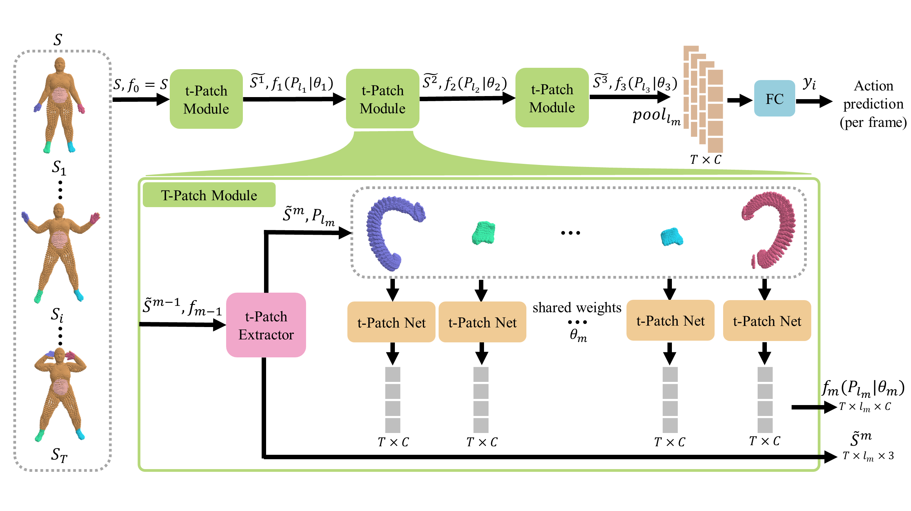
t-Patch Process
Pipeline Flow Overview
Hierarchical t-patch extraction. Shared weights embed. Pooling aggregates vectors. Features drive predictions shown.
Notes:
Looking at the diagram, you can see how our pipeline processes point cloud sequences for action recognition. First, we extract specific t-patches from input frames and encode them hierarchically using shared weights within t-Patch Nets. This captures complex spatial-temporal features effectively. Next, these patch vectors undergo global pooling to create comprehensive per-frame embeddings. Finally, a classifier uses these aggregated features to output action predictions for each frame. This hierarchical approach ensures that local patch details inform the global frame-level decision, improving recognition accuracy significantly.

Slide 6

t-Patch Process
Iterative Construction
Origin links to nearest neighbours across frames. Non-black points show t-patch subset, capturing temporal continuity.
Notes:
Focus on the animation demonstrating t-Patch construction. We begin by selecting an origin point, then iteratively identify nearest neighbours in the subsequent frame. This repeats across time steps, forming a cohesive subset represented by the distinct non-black points. By linking points temporally rather than just spatially, this mechanism captures continuous motion patterns essential for accurate action recognition. Ultimately, this dynamic construction ensures our pipeline understands how objects move through space over time, significantly improving prediction precision compared to static methods that ignore temporal continuity between frames.

Slide 7
GradCAM Visualization
Visualizing Motion Impact
Scores reflect influence. Heatmaps highlight informative motion, like hands during jumping jacks, proving effective learning.
Notes:
On this slide, we demonstrate method interpretability using an extended GradCAM algorithm tailored for our 3DinAction pipeline. This adaptation assigns a score to every point within each temporal patch, proportional to its influence on the classification decision. As shown in the visualization videos, prominent regions align with informative motion, such as the hands during jumping jacks. This confirms our architecture learns meaningful representations rather than relying on noise. Ultimately, this fine-grained analysis validates that specific point movements drive accurate action predictions within our hierarchical system.

Slide 8
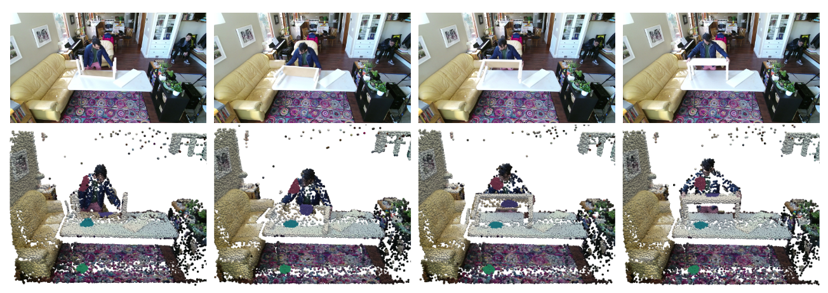
Real-World Demo
Semantic Color Coding
Top row: RGB images. Bottom: 3D point clouds. Blue marks dynamic bench, maroon marks arm, teal/green show static scene.
Notes:
Our dual-modality visualization analyzes assembly actions. The top row shows RGB images, while the bottom enhances 3D point clouds with t-patches for precise spatial understanding. This combination tracks movements like flipping the TV bench. Additionally, semantic segmentation uses color coding to distinguish dynamic from static elements. Moving components appear in blue, the arm in maroon, and static backgrounds in green. This distinction allows accurate analysis of object interactions during complex tasks, ensuring robust performance where precise spatial awareness is critical for success.

Slide 9
Source Reference
Paper Title: 3DInAction: Understanding Human Actions in 3D Point Clouds
Authors: Ben-Shabat, Yizhak and Shrout, Oren and Gould, Stephen
Publication: arXiv preprint arXiv:2303.06346, Year: 2023
Notes:
Finally, we arrive at our references, grounding our findings in established research. Here we list key papers supporting our analysis, ensuring transparency and reproducibility. By citing these sources, we acknowledge foundational work making this study possible and allow you to explore the methodology further. These citations validate our approach and provide a pathway for you to verify our data independently. Reviewing these materials offers deeper context surrounding our specific claims and limitations. I welcome any questions regarding our sources or final conclusions.

Slide 10
Thank You!
Notes:
Thank you all for your time and attention today. We have covered significant ground, and I hope the insights shared provide a clear path forward for your projects. This concludes our formal presentation, but I am eager to hear your thoughts and address any specific concerns you might have. Please feel free to ask questions now or reach out later for further discussion. Your engagement is valuable, and I appreciate the opportunity to share this work with you. Let's open the floor for any final questions.

