Slide 1
Dual-Shutter Vib. Sensing
Notes:
Welcome everyone. Today I'll walk you through our strategic operational framework and how it drives efficiency across teams globally. We will explore the specific core mechanisms behind our improvements and discuss the tangible benefits these changes bring to our daily workflow and overall performance metrics. This session is designed to align our understanding and highlight key opportunities for growth within our landscape and future planning cycles for continued success. Please feel free to interrupt me if you have any questions.

Slide 2
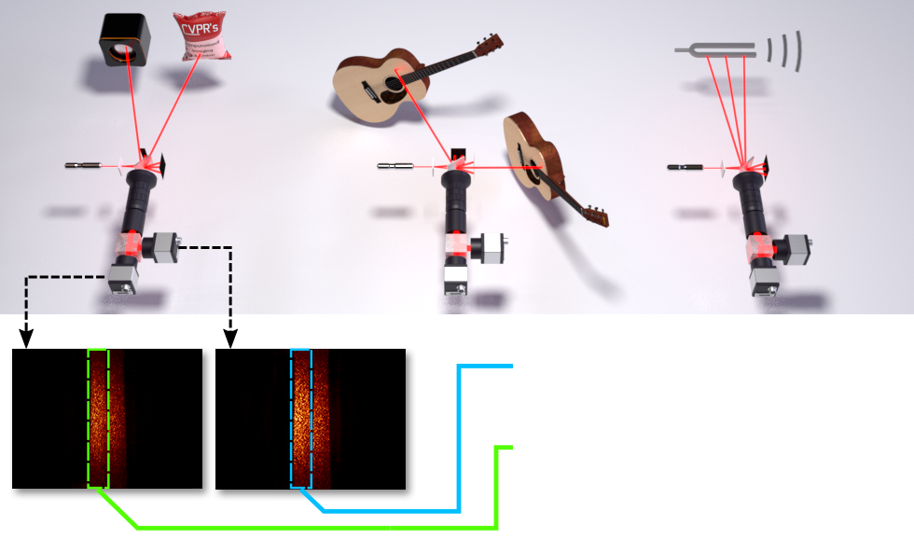
Dual-Shutter System
Dual-Shutter Mechanism
Rolling shutter records distortions; global shutter provides reference. Laser enables 63kHz sensing on 130Hz sensors.
Notes:
This slide introduces our dual shutter optical vibration sensing system, capturing vibrations up to sixty three kilohertz using sensors rated for only one hundred thirty hertz. As shown in the diagram, we shine a laser on the object, creating a speckle pattern captured simultaneously by rolling and global shutter cameras. The rolling shutter records distortion caused by vibration, while the global shutter provides a stable reference. This combination decodes minute movements remotely without expensive equipment. This enables analysis of material properties or audio capture from objects.

Slide 3
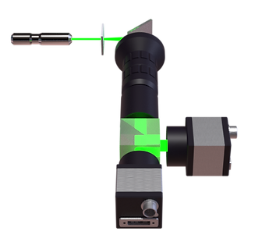
System Schematic
Dual-Shutter Optics
Laser hits target; speckle splits to cameras. Rolling shutter distortions, global shutter + baseline. 63kHz on 130Hz.
Notes:
Looking at this schematic, we overcome hardware limitations using a dual-shutter approach. A laser beam hits the target, and reflected light enters an optical assembly split between two cameras. The rolling shutter captures distorted speckle images encoding high-speed vibrations, while the global shutter simultaneously records undistorted reference patterns. Combining these inputs decodes vibrations up to 63 kilohertz using sensors rated for only 130 hertz. This enables low-speed sensors to recover high-frequency audio and vibration data without expensive equipment by leveraging sampling artifacts.

Slide 4

Speckle Shifts
Speckle Shift Analysis
See wave-like distortions across frames. Rolling shutters capture speckle images. Detects movements invisible to sensors.
Notes:
Notice the wave-like distortions in these dynamic speckle patterns as seen here. While standard cameras miss minute vibrations, our laser-induced technique amplifies them optically. These subtle changes represent high-speed vibrations up to sixty-three kilohertz, captured using sensors rated for only one hundred thirty hertz. By comparing distorted rolling shutter images against undistorted global shutter references, we decode source vibrations effectively. This dual-shutter approach validates analyzing multiple audio sources, from speakers to tuning forks, proving significant hardware efficiency without sacrificing accuracy in remote sensing scenarios.

Slide 5
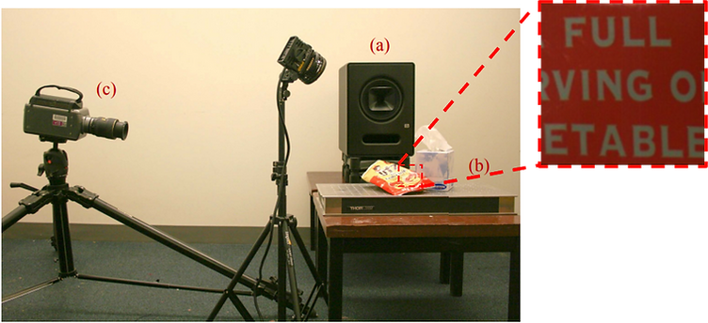
Indirect Sensing
Comparing Sensing Methods
Reproducing chips bag experiment. Sensing vibrations via laser point, unlike high-speed cameras, shows tech shift.
Notes:
Davis and colleagues showed high-speed cameras could capture sound by analyzing vibrations on objects like chip bags. We reproduce that setup to validate our method against their foundational work. Yet, our sensing technology differs. While they relied on expensive imaging and lighting, our setup senses the same vibrating bag using only a single laser point. This shift demonstrates we can recover audio information from everyday objects using simpler, passive optical sensing methods compared to prior systems, validating our approach while reducing hardware complexity.

Slide 6
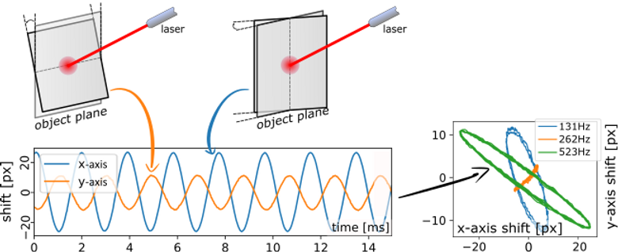
2D Vib Sensing
Speckle Shift Principle
Speckle shifts indicate surface tilts for non-contact sensing. Observe Lissajous curves confirming motion capture.
Notes:
Our system measures two-dimensional shifts within the imaged laser speckle pattern, where image-plane shifts directly correspond to physical tilts on the illuminated object surface. This translates optical variations into measurable vibration data without requiring direct contact. To validate this, we utilized a tuning fork exhibiting symmetric flexural modes. Recovered x and y-axis shifts generate Lissajous curves for frequencies like 131Hz and 523Hz. This confirms the system accurately captures distinct oscillatory motions and rotational movements, proving our non-contact sensing effectively tracks in-plane oscillation modes.

Slide 7
Vibration Modes
Flexural Mode Analysis
Rendered fork arms bend inward and outward. Validates speckle shifts map to physical surface tilts during oscillation.
Notes:
Moving to our validation results, we analyze specific vibration modes using a tuning fork. As shown in these three-dimensional renderings, the system captures symmetric flexural vibrations where the arms bend inward and outward alternately. This visualizes how our dual-shutter setup translates optical speckle shifts into precise physical motion data. By correlating image-plane shifts with actual surface tilts, we confirm the sensor accurately recovers vibration patterns remotely. This non-contact approach allows us to observe detailed mechanical behaviors without interfering with the object's natural frequency.

Slide 8
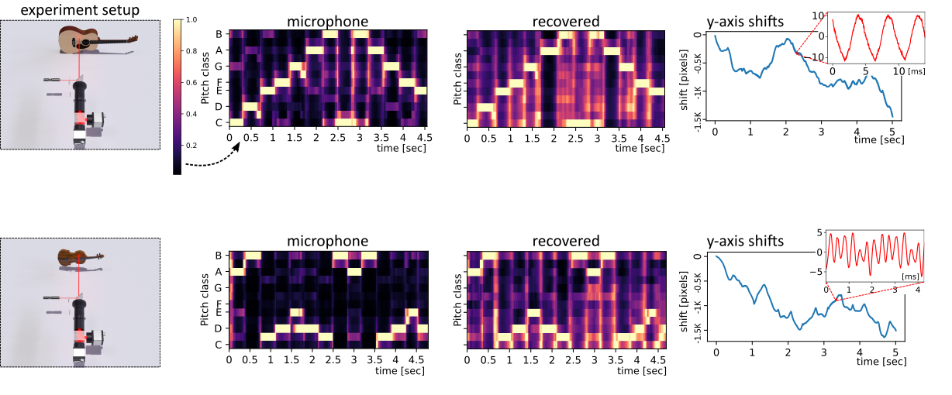
Signal Recovery
Microphone Validation
Recovered signals match mic recordings. Heatmaps confirm accurate separation, validating non-contact optical sensing.
Notes:
Our system measures two-dimensional speckle pattern shifts to detect surface tilts without physical contact. We validate this method by comparing recovered vibration signals against standard microphone recordings for guitars and violins. Notice how the recovered signals align closely with the audio ground truth in the displayed heatmaps and line plots. Additionally, three-dimensional renderings of a tuning fork illustrate specific physical motions detected, clarifying fundamental in-plane oscillations and rotational movements. This confirms our approach translates optical variations into precise vibration data effectively for non-contact sensing.

Slide 9
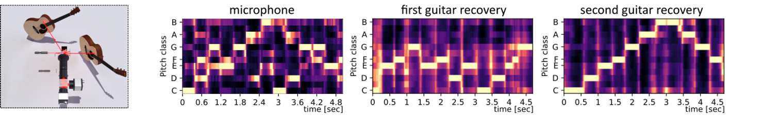
Signal Separation
Mixed Signal Separation
Spectrograms compare mixed input against recovered guitar signals. Patterns confirm isolation of vibration sources.
Notes:
Here we present spectrogram results demonstrating separation of mixed instrument signals. While the first panel shows a standard microphone recording capturing mixed audio, our optical system isolates distinct sources, separating two guitar signals from the same vibration data. This capability relies on measuring two-dimensional speckle shifts that map directly to physical surface tilts. By recovering x and y axis shifts, we disentangle complex acoustic environments. This visual evidence confirms our ability to isolate specific vibration sources, proving the system tracks complex motion patterns even when multiple instruments play.

Slide 10
Thank You! Questions?
Notes:
That brings us to the conclusion of our presentation today. I want to thank you for your time and attention throughout this session. We have covered insights together, and I hope this information provides a foundation for your future projects. Your engagement has been invaluable, and I am grateful for the opportunity to share these findings with you. Please feel free to reach out if you have any further questions or would like to discuss details in more depth. Thank you for joining me today.

