Slide 1
Virtual Sketch Framework
Notes:
Welcome everyone. Today I'll walk you through the core objectives of this project. We will explore foundational strategies designed to enhance operational efficiency and drive meaningful results across the team. This session aims to align our clear understanding of upcoming changes and ensure everyone is fully equipped for success while reviewing key project milestones and addressing potential challenges early on to mitigate risks effectively. Please feel free to interrupt me if you have any questions.

Slide 2
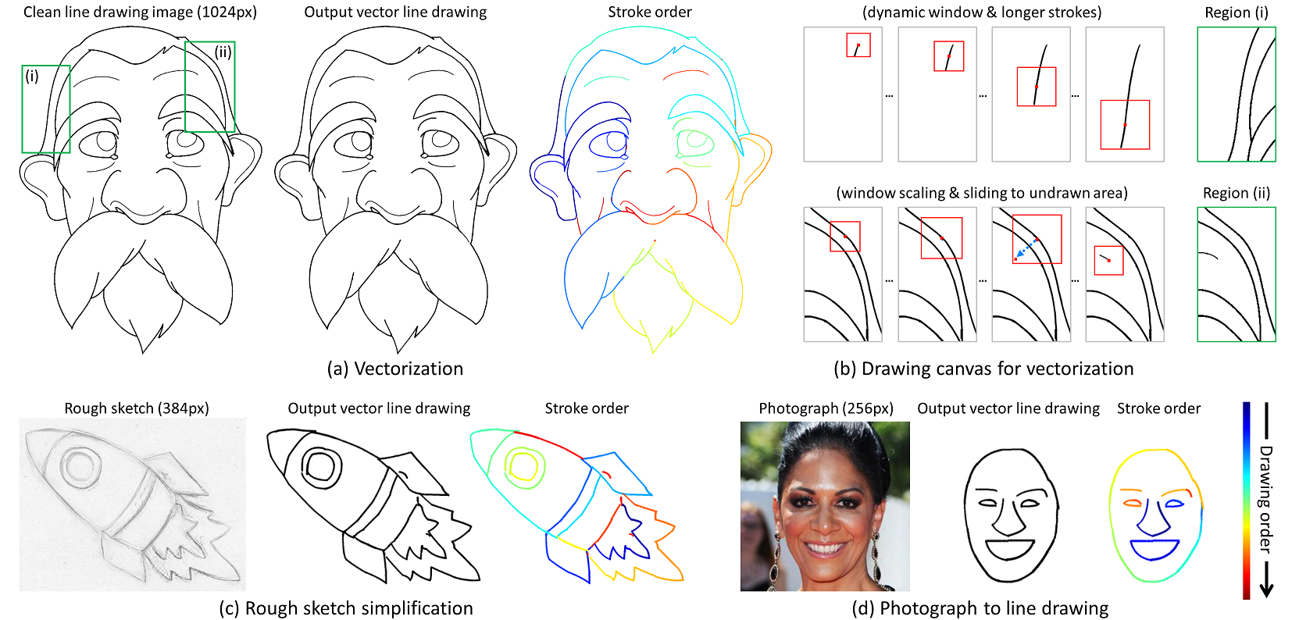
Virtual Sketch
Vectorization Process
Processes sketches and photos into vectors with stroke ordering. Bridges raster to vector via analysis for efficiency.
Notes:
This slide introduces our virtual sketching framework, bridging the gap between raster images and editable vector formats. As shown in the diagram, the system processes diverse inputs like rough sketches or photographs to generate structured stroke ordering and refined vector paths. The core mechanism is iterative refinement, evolving initial points into detailed features while correcting strokes over time. This ensures smooth line art generation across various subjects, from human faces to rockets, proving the framework's versatility in handling complex outlines efficiently.

Slide 3
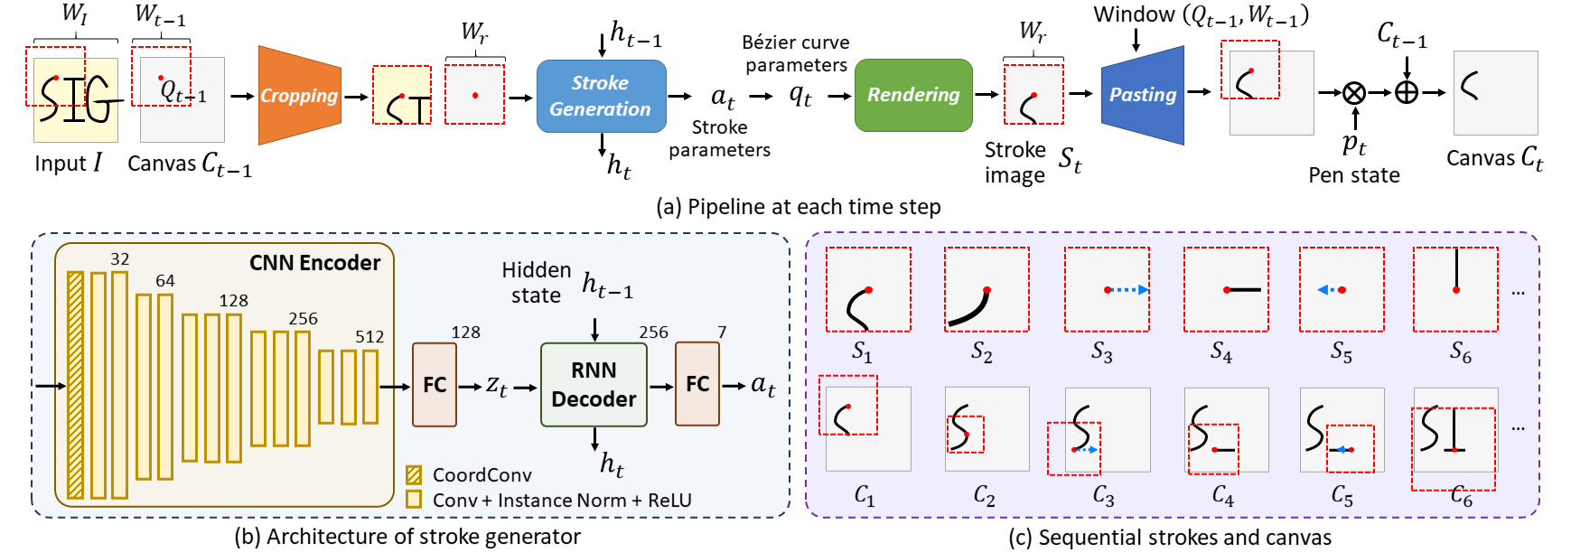
Generator Model
Model Architecture
CNN encoder extracts features; RNN decoder outputs strokes. Maintains temporal consistency while updating canvas.
Notes:
This framework employs a Convolutional Neural Network encoder to process visual features, paired with a Recurrent Neural Network decoder for sequential stroke generation. Unlike single-pass methods, the system progressively refines the canvas over time, as seen in the animations. Starting from rough points, it iteratively adds detail while maintaining temporal consistency. This ensures complex features like facial contours are accurately traced, enabling high-quality vector line art. Combining spatial interpretation with sequential output, it produces smooth sketches that evolve naturally rather than appearing instantly, handling diverse inputs.

Slide 4

Face Refinement
Progressive Refinement
Red point expands to eyes and beard. Strokes evolve iteratively. Ensures structural integrity and stroke ordering.
Notes:
Let's examine this animated sequence demonstrating our progressive refinement mechanism. Instead of generating final line art immediately, the system starts with a single point that iteratively evolves into detailed facial features. You can see how rough outlines transform into smooth vector lines through iterative stroke correction. This approach ensures geometric accuracy by focusing on key feature extraction. By tracing specific points over time, we maintain structural integrity across different source materials. This gradual construction allows for precise detail enhancement where it matters most.

Slide 5
Rocket Line Art
Progressive Refinement
Rough sketches refine to line art. Red boxes highlight detail on nose cone, ensuring consistency via stroke correction.
Notes:
Observe this rocket sketch transforming from a rough outline into clean vector line art. Red boxes highlight areas like the nose cone undergoing iterative detail enhancement. This approach builds complex structures gradually, ensuring precise stroke ordering. By managing feature extraction this way, the system maintains structural consistency even when starting from varying levels of initial detail. This demonstrates the model's ability to handle diverse inputs while producing accurate, simplified drawings. Progressive refinement ensures corrective adjustments remain possible throughout the stroke generation phase.

Slide 6
Penguin Refinement
Iterative Correction
Rough dots become clean line art. Markers highlight iterative corrections for smooth outlines and feature extraction.
Notes:
Focus on the penguin animation demonstrating our progressive refinement mechanism. The process begins with coarse markers, specifically a rough dot-based outline, before evolving into clean, smooth line art. Notice how the system iteratively corrects strokes to manage complex structures effectively. This ensures accurate feature extraction while maintaining artistic intent throughout the transformation. By bridging the gap between rough inputs and simplified drawings, the framework guarantees consistent outline refinement. Ultimately, this iterative tracing allows coherent reconstruction from initial sketches to polished vector outputs seamlessly.

Slide 7
Feature Tracing
Photo-to-Line Sequence
Portrait vectorizes from photo. Red markers trace features sequentially. Ensures structural integrity during refinement.
Notes:
Here we observe the vectorization sequence of a woman's portrait transforming from a pixelated photo into a simplified line drawing. Notice the red bounding boxes highlighting key feature points like the eyes and nose as they are traced. This demonstrates our framework's ability to extract specific structural elements accurately rather than simply filtering pixels. Unlike instant conversion, the system uses iterative refinement to mimic natural human drawing sequences. This ensures the final vector art maintains logical construction while preserving critical details throughout the entire processing timeline.

Slide 8
Portrait Vectorization
Facial Feature Tracing
Watch the photo transform into line art. System extracts facial features and refines outlines to maintain structure.
Notes:
Here we see the vectorization sequence of a man's portrait, transforming from a pixelated photo into a simplified line drawing. Notice the red markers indicating key feature points being traced and refined over time. This demonstrates our progressive refinement process, where structural analysis ensures facial feature extraction occurs logically rather than instantly. By managing stroke ordering, the system preserves semantic structure even with complex subjects. This approach guarantees high accuracy in outline refinement, turning rough inputs into clean vector art while maintaining structural integrity throughout the conversion.

Slide 9
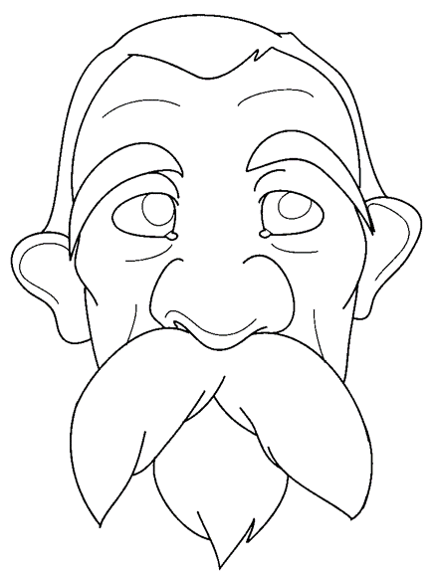
Static Face Art
Stylized Line Quality
Displays stylized line art. Detailed eyes and mustache demonstrate precise feature extraction from rough inputs.
Notes:
Here you see the final output of our framework, a stylized black-and-white line drawing of a male face. This demonstrates our progressive vectorization process, transforming rough inputs into clean art through iterative refinement. Notice how the system moves from initial points to full facial features, ensuring smooth transitions from abstract sketches to precise vectors. By using visual markers and stroke correction, we maintain structural integrity while converting pixelated photos into professional-grade vector art. This capability ensures consistent quality across diverse subjects like faces and objects.

Slide 10
Thank You!
Notes:
Thank you very much for your time and attention today. We have covered significant ground, exploring core functionalities and layout structures that drive effective presentation design. I hope this overview provided actionable insights into optimizing your own slides for clarity and impact. Remember that the best designs always serve the audience's understanding first. I am now happy to open the floor for any questions you might have regarding the material we discussed or how to apply these principles in your future work.

