Slide 1
LightIt: Lighting Control
Notes:
Welcome everyone. Today I'll walk you through the core objectives and strategic updates defining our current project phase. We will examine the critical business drivers behind our recent performance and briefly outline the clear actionable steps required to achieve our upcoming milestones effectively. This session aims to provide clarity on our direction and ensure we are all fully aligned on the very important prioritized tasks for the next quarter. Please feel free to interrupt me if you have any questions.

Slide 2
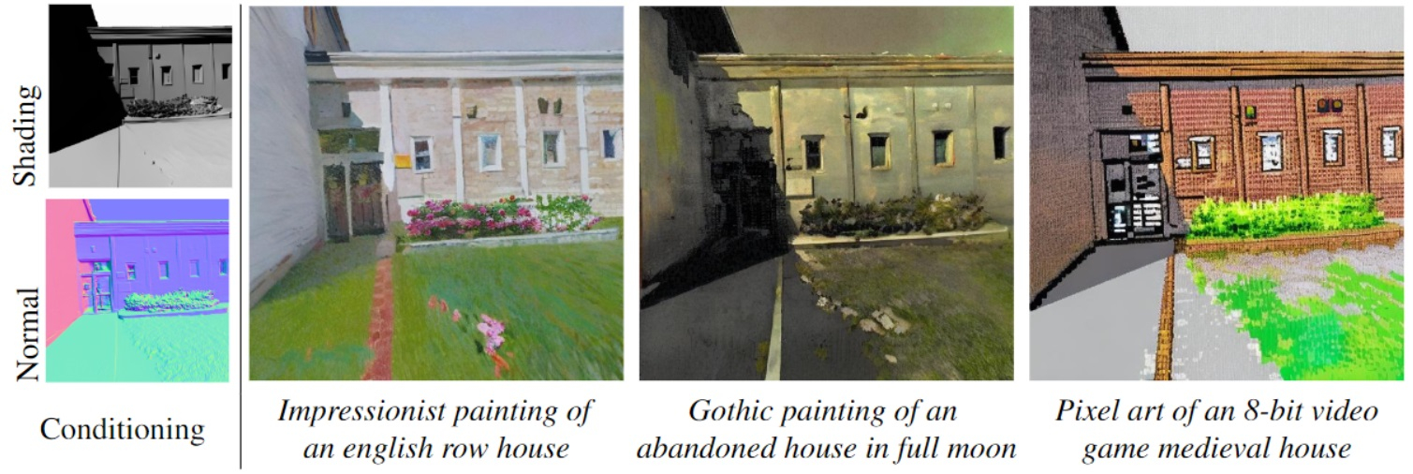
Style Control
Artistic Style Control
Shading maps guide impressionist and pixel-art styles. Separation ensures consistent geometry across transformations.
Notes:
This four-panel visual comparison illustrates how our model separates content structure from stylistic rendering. Structural inputs like shading and normal maps guide distinct artistic styles, ranging from impressionist to pixel-art, ensuring consistent geometry across aesthetic transformations. By preserving underlying spatial details, the system maintains coherence even when switching between complex structures and organic textures. Ultimately, this demonstrates robust generative capabilities that handle diverse subjects effectively, from iconic landmarks to natural landscapes, without sacrificing clear structural integrity during style transfer operations as seen here.

Slide 3
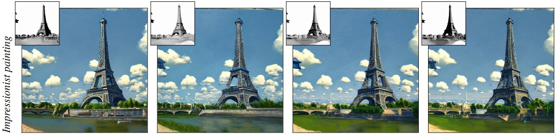
Style & Lighting
Conditional Rendering
Grayscale refs guide geometry; lighting varies. Views show consistent structure under varying cloud and lighting.
Notes:
These three impressionist-style renderings of the Eiffel Tower are paired with small grayscale reference images to demonstrate our conditional generation mechanism. Structural guidance maintains geometric consistency while applying new artistic styles independently. Notice how lighting and cloud conditions vary, yet the tower's underlying shape remains preserved. This proves the system generalizes effectively beyond specific domains to handle complex textural requirements. Such flexibility allows multiple distinct valid interpretations from a single structural input, showcasing robust control over aesthetic properties without compromising shape.

Slide 4
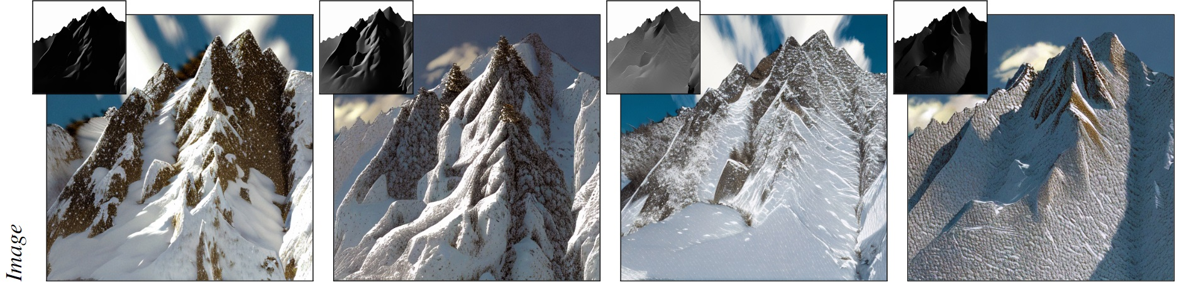
Scene Geometry
Normal Map Integration
Geometry inputs guide creation. Insets show maps ensuring realistic texture mapping and varying lighting in mountain scenes.
Notes:
Our system demonstrates versatile synthesis across diverse subjects, from landmarks to organic environments like these snow-covered mountains. Notice the insets beside each scene displaying corresponding height or normal maps. These geometric inputs explicitly guide the synthesis process, controlling surface geometry and lighting to ensure realistic texture mapping. This mechanism confirms our model effectively handles both structured architectural elements and natural textures within a single framework. By linking structural maps directly to visual output, we achieve high-quality generation across varying lighting conditions.

Slide 5

Synthesis Steps
Depth-Guided Synthesis
Four panels show stages guided by grayscale depth insets. This ensures coherence between layout and final visual output.
Notes:
Here we observe the model's progressive generation process through four panels depicting the Taj Mahal. Notice how each stage includes grayscale depth insets that guide the structural composition before details are added. This mechanism ensures coherence between the initial silhouette and the final rendered output, allowing the model to refine image quality over time. Ultimately, this demonstrates it handles complex architectural details effectively without domain restrictions, proving its versatility across diverse subjects while maintaining structural integrity throughout the synthesis process.

Slide 6
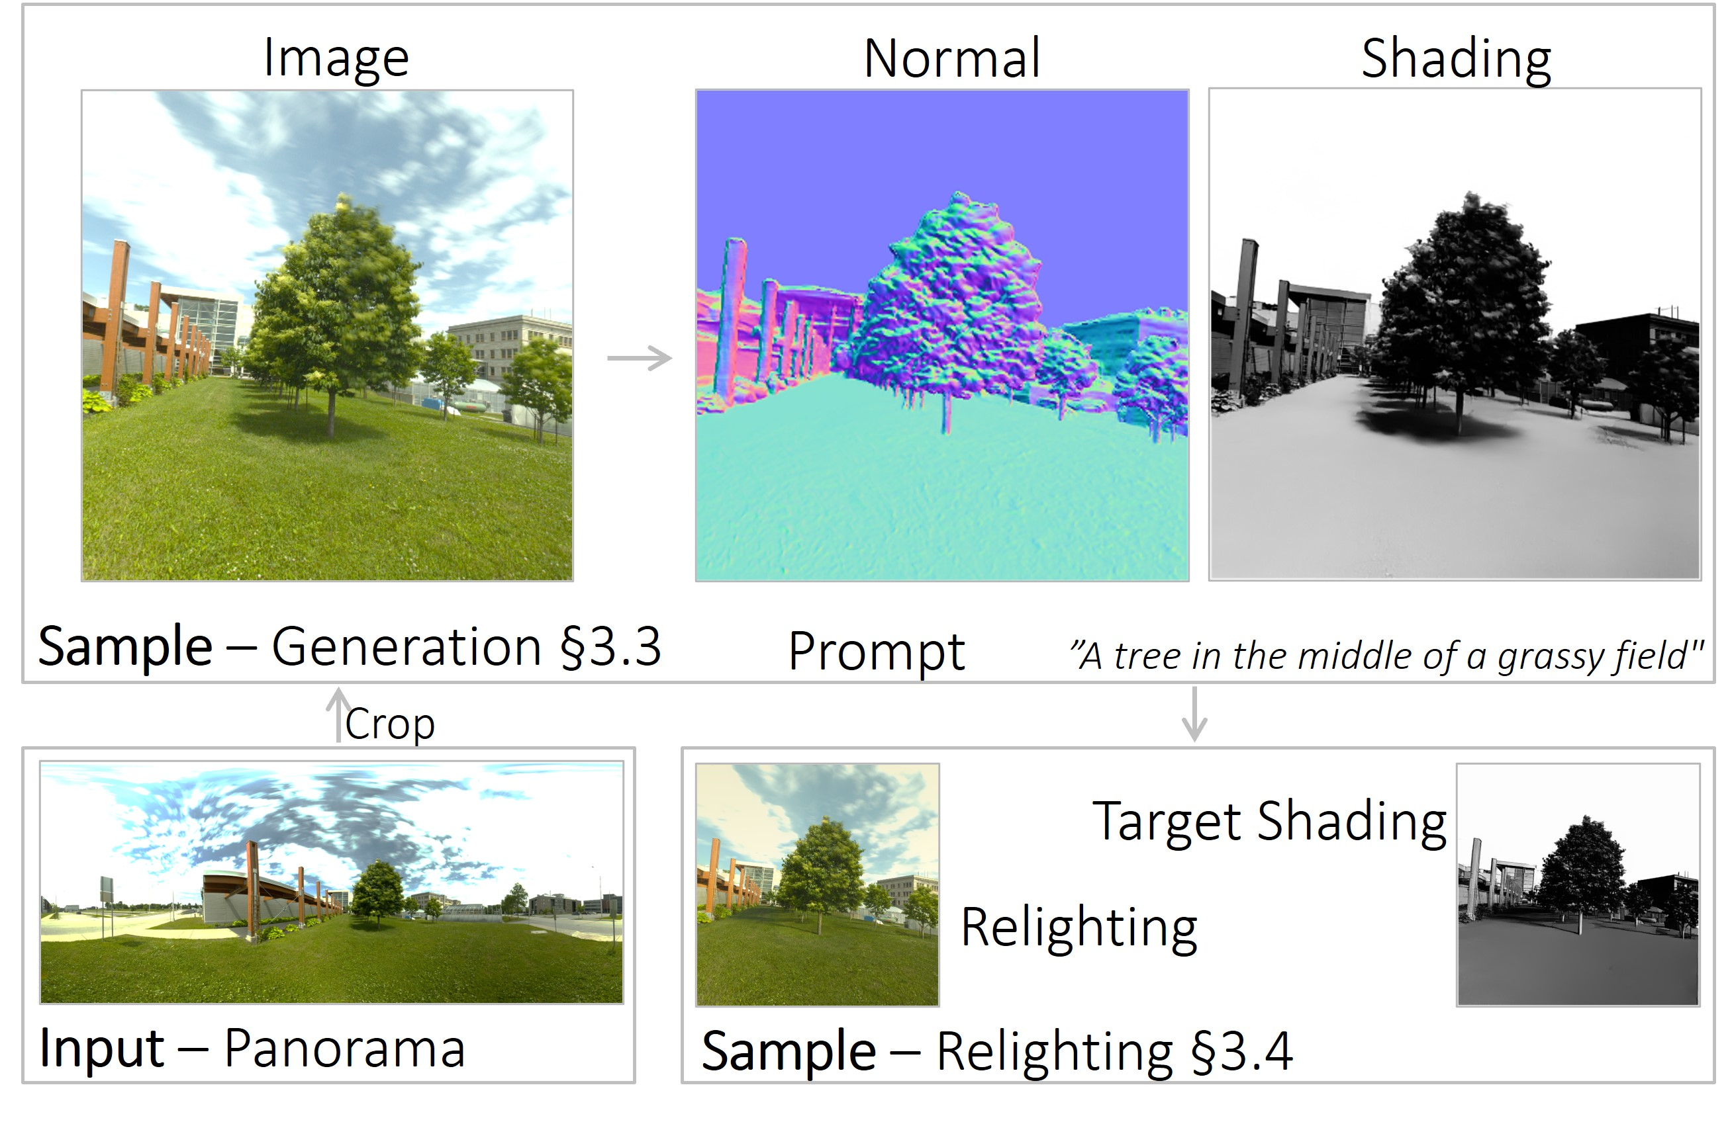
Data Workflow
Training Data Flow
Arrows trace data from panoramas to samples, normal maps, and prompts. Target shading outputs enable training.
Notes:
This diagram illustrates our data creation workflow for generating training pairs. The pipeline begins with an input panorama yielding cropped samples, which generate normal and shading maps to inform prompt creation. This process concludes with target shading and relighting outputs, transforming raw visual input into structured training data. Notice how the arrows indicate the direction of data flow, clarifying how information moves through each stage. Understanding this flow is critical for interpreting how the pipeline manages data dependencies and ensures consistent processing order for effective model training.

Slide 7
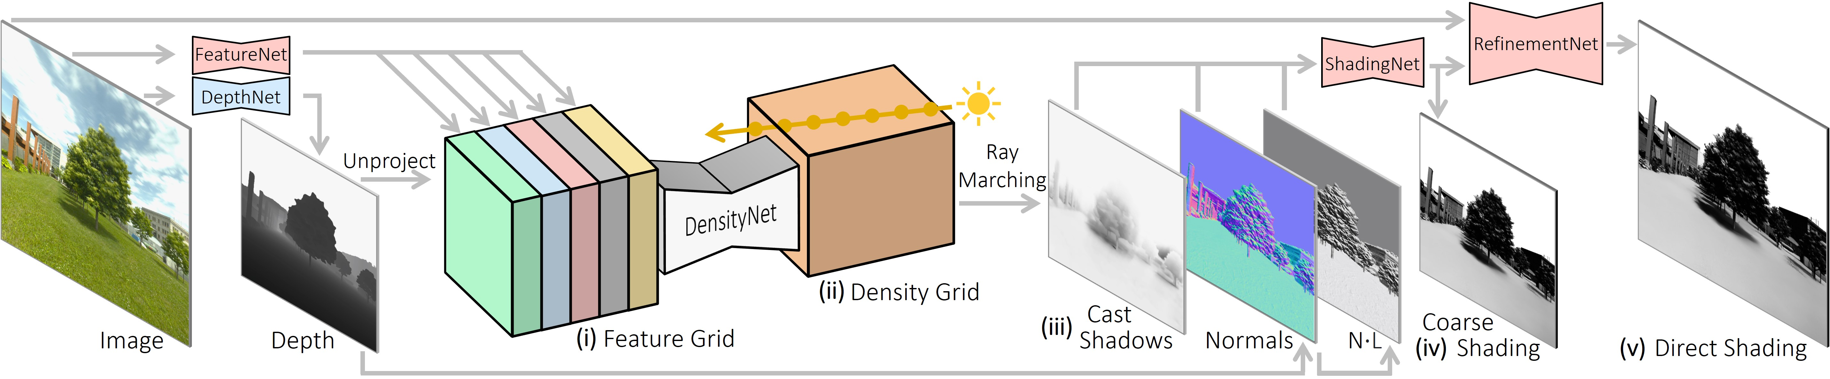
Shading Pipeline
Volumetric Shading Flow
See flow from input encoding to volumetric grids. Ray marching traces shading within volume, refined to direct shading.
Notes:
Looking at this pipeline diagram, you can see our shading estimation mechanism in action. The process begins by encoding input images and depth data through dedicated networks to extract essential spatial features. This foundational step prepares the data for volumetric processing, where unprojection and density grids organize information in three-dimensional space. Subsequently, ray marching techniques traverse this volume to accumulate shading values before refinement stages polish the results. This structured flow transforms raw inputs into accurate direct shading output, ensuring efficient and coherent lighting estimation throughout the entire rendering pipeline.

Slide 8
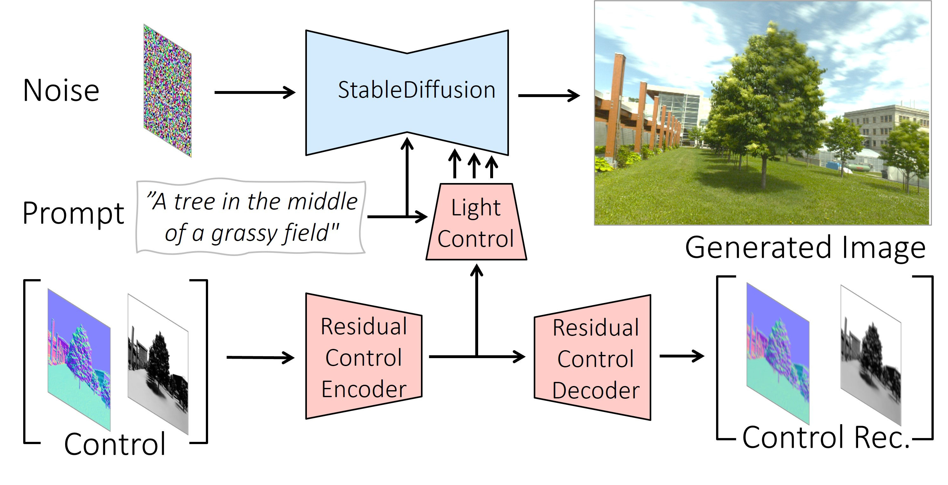
Model Pipeline
SD Backbone + Controls
Diagram: SD backbone uses noise/prompts. Control modules extract features. Dual outputs guarantee integrity.
Notes:
As illustrated here, our architecture leverages a StableDiffusion backbone to transform noise vectors and textual prompts into coherent images. We integrate specialized Light and Residual Control modules to manage feature extraction and reconstruction simultaneously within the system. This dual-output design produces both the final image and control reconstructions for validation, ensuring structural integrity throughout the pipeline. Ultimately, this approach allows precise manipulation of the synthesis workflow while maintaining compatibility with existing diffusion models, delivering robust performance without compromising quality.

Slide 9
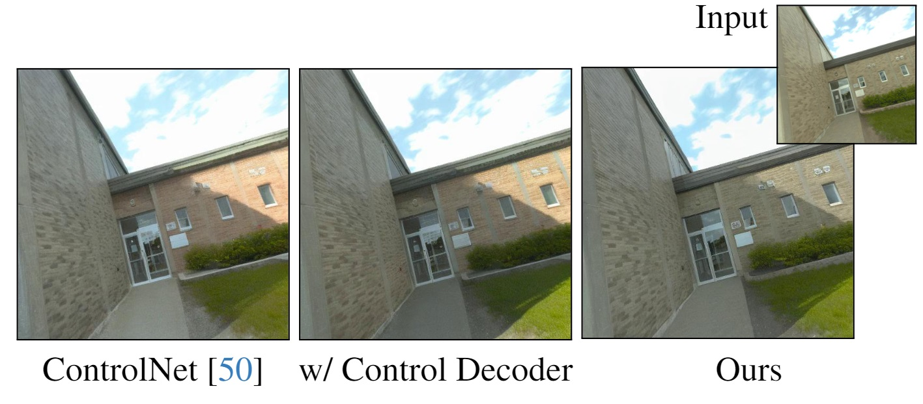
Performance
Identity Preservation
Proposed method preserves building details better than ControlNet baseline. Control decoder enhances structural fidelity.
Notes:
This visual comparison evaluates three outputs generated from the same brick building input. The left uses the standard ControlNet baseline, while the middle tests an intermediate variant with a control decoder. Our proposed method on the right demonstrates superior structural fidelity, preserving sharper building details and sky texture. This confirms that integrating the control decoder enhances conditioning capabilities. Ultimately, these results validate that our new training pipeline effectively maintains input details better than existing approaches, proving the value of our architectural modifications for real world scene generation.

Slide 10
Thank You!
Notes:
Thank you all for your time and attention today. We have covered significant ground, and I hope these insights provide a clear path forward for your projects. This concludes our presentation, but I am eager to hear your thoughts and address any specific challenges you might be facing. Please feel free to ask questions now or reach out later for further discussion. Your engagement turns these ideas into reality, and I appreciate the opportunity to share this knowledge. I would be happy to take any final questions now.

