Slide 1
MobileNeRF: Real-Time 3D
Notes:
Welcome everyone. Today I'll walk you through our latest strategic initiatives and how they impact future growth. We will explore the core mechanisms driving these changes and discuss the tangible benefits they bring to our daily operations while highlighting key performance indicators. Understanding these updates is crucial for maintaining efficiency and fostering innovation across all departments during this transition period to ensure sustained success. Please feel free to interrupt me if you have any questions.

Slide 2
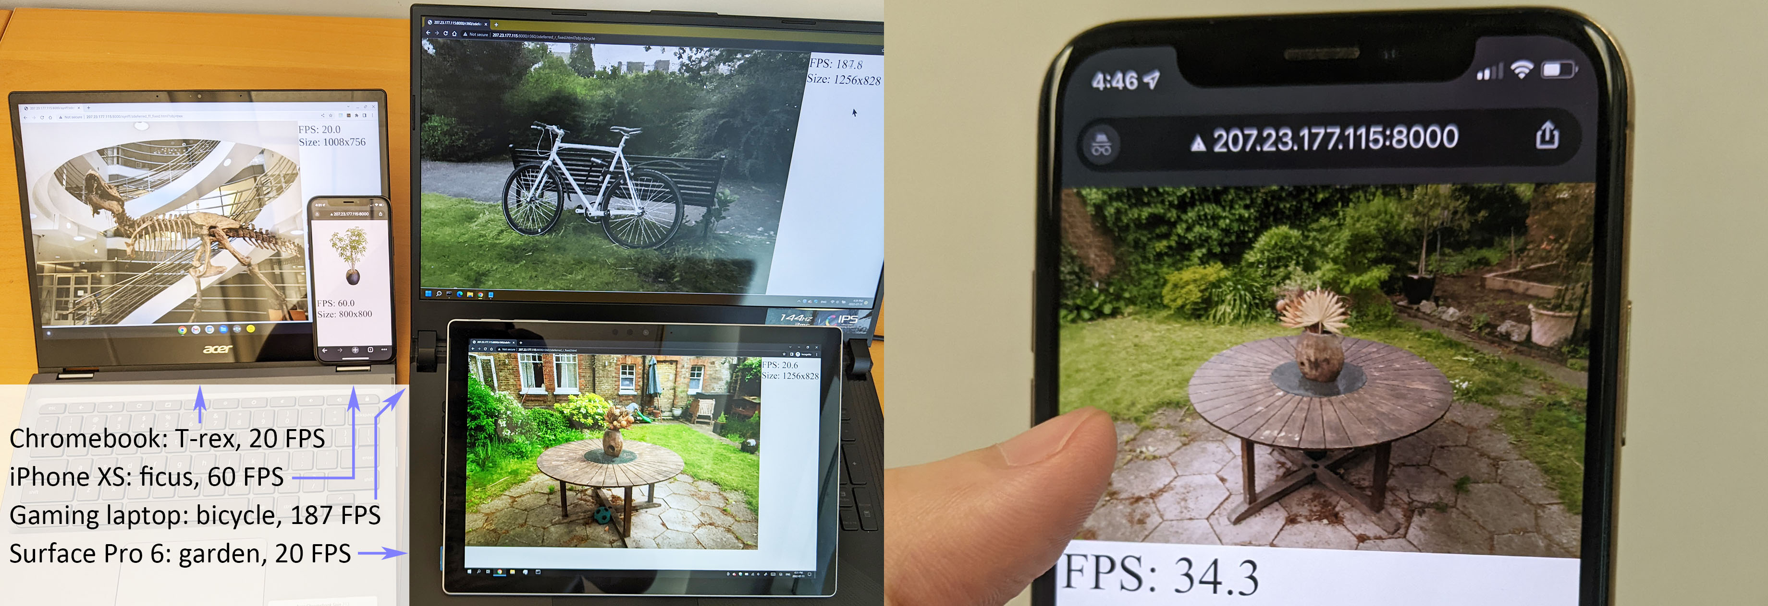
Real-Time FPS
Cross-Platform Testing
Chromebook, iPhone XS, gaming laptop, Surface Pro 6. FPS counters confirm interactive rates across all hardware.
Notes:
Looking at this collage, you can see our method running simultaneously across four devices, ranging from a mobile iPhone XS to a powerful gaming laptop. Each screen displays complex scenes like a skeleton exhibit or a garden, accompanied by a frame rate counter. This setup proves our rendering pipeline maintains interactive speeds regardless of underlying hardware constraints. By validating performance across diverse form factors, we ensure robust optimization for varying computational resources. This confirms the system delivers consistent experiences whether on desktop or mobile environments.

Slide 3
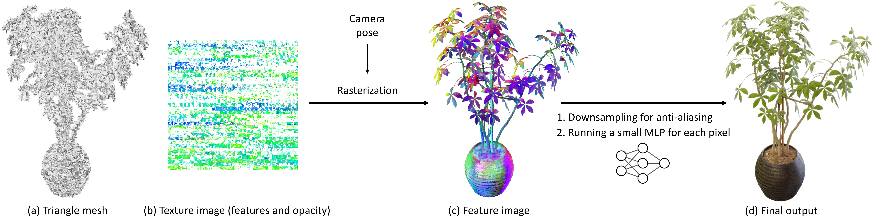
Neural Pipeline
Mesh to Image Workflow
Mesh (a) maps texture (b). Raster yields features (c) via pose. MLP refines to image (d). Ensures integrity,realistic result.
Notes:
Examine the diagram illustrating our neural rendering pipeline. The workflow begins with a triangle mesh establishing the plant's structural foundation, mapped to a texture image to ensure geometric integrity. Next, camera pose data drives rasterization to convert geometry into a feature image, which is downsampled and fed into a Multi-Layer Perceptron. This neural refinement synthesizes high-quality details, transforming basic geometry into a photorealistic plant image. Combining rasterization with neural networks allows for realistic synthesis from simple geometry data, bridging the gap between structural models and fidelity.

Slide 4
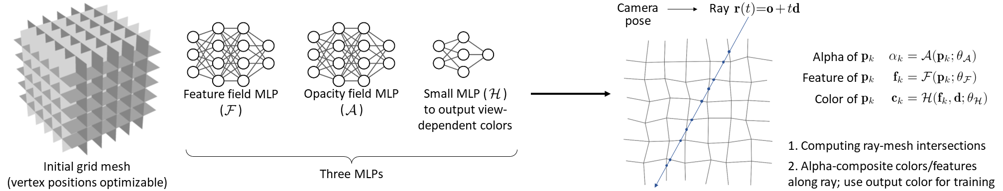
MobileNeRF Pipeline
Architecture & Formula
Mesh feeds 3 MLPs: feature, opacity, color. Ray-mesh intersections sample points. Yield alpha, color. Arrows show flow.
Notes:
MobileNeRF utilizes a hybrid architecture combining an initial grid mesh with three distinct Multi-Layer Perceptrons for feature, opacity, and color. By separating geometric and appearance properties into dedicated neural components, the system efficiently processes data. Rendering computes ray-mesh intersections to determine sampling points, applying specific formulas to calculate alpha values and color outputs. This mechanism ensures accurate volume rendering by translating geometric intersections directly into visible pixels. Ultimately, this structured data flow enables high-quality rendering suitable for mobile constraints without sacrificing visual fidelity or speed on edge devices.

Slide 5
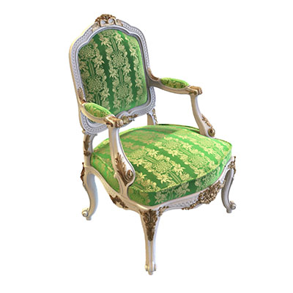
Furniture Recon
Capturing Fine Details
Captures rococo flourishes and curved legs accurately. Upholstery and carved frames validate high-frequency texture handling.
Notes:
This ornate armchair demonstrates our method's ability to handle complex geometry and textures simultaneously. Notice the intricate rococo-style flourishes and green patterned upholstery, which typically challenge standard rendering pipelines. By optimizing visual output through iterative learning throughout the training phases, we capture high-frequency details like the carved wooden frame and curved legs accurately. This validates our system's capability beyond simple synthetic items, proving it effectively handles real-world scenes with diverse materials while maintaining sharp fidelity across complex shapes and surfaces.

Slide 6
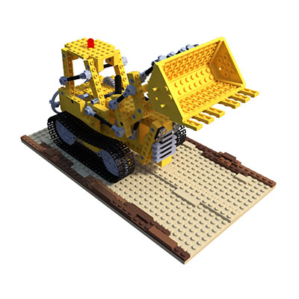
LEGO Geometry
Sharp Edge Fidelity
LEGO vehicle validates synthetic handling. Crisp edges confirm high-frequency geometry recovery without blurring.
Notes:
Here we examine reconstruction capabilities using synthetic LEGO structures with sharp edges. This yellow construction vehicle demonstrates our model's ability to capture complex geometries and distinct materials accurately. Unlike smooth organic shapes, LEGO bricks challenge the system with hard boundaries and uniform textures. Validating performance on such rigid objects ensures robustness across varying structural complexities. This visual fidelity confirms that our rendering pipeline successfully optimizes image synthesis even in scenes with high-frequency details, proving generalization beyond simple shapes to diverse applications.

Slide 7
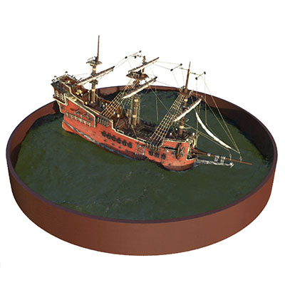
Miniature Views
Detailed Model Output
Intricate masts and sails show sharp recovery. Confirms system renders complex geometry with high texture fidelity.
Notes:
We specifically evaluate rendering quality using detailed miniature models featuring complex components. Our architecture generates views and optimizes parameters to achieve high-fidelity reconstruction. Please focus on the red pirate ship shown here, highlighting our ability to capture intricate details like masts and sails. By optimizing through this multi-step pipeline, we ensure accurate geometry and texture even in challenging environments like this miniature basin. This proves the robustness of our approach for varied objects, ensuring consistent output quality across diverse scenes and complex reconstructions.

Slide 8
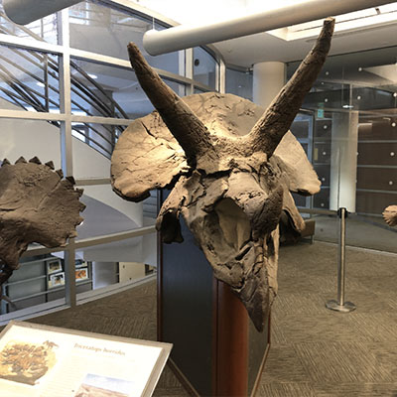
Surface Details
Reconstruction Quality
Triceratops shows sharp brow horns and frill details preserved. Validates complex geometry and fine surface variations.
Notes:
Looking at our reconstruction results, note this detailed rendering of a fossilized Triceratops skull. This image exemplifies our method's capability to capture fine surface details across diverse geometries and textures. We tested natural elements and complex fossils to validate robustness beyond household items. Our pipeline progresses from training phases to high-quality output. Notice the sharpness of the brow horns, demonstrating successful optimization steps. This validation confirms our approach handles distinct object types effectively, ensuring reliable reconstruction quality for complex artifacts.

Slide 9
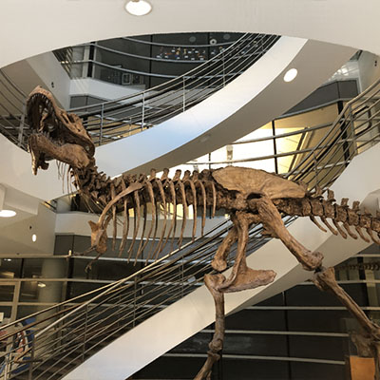
Large-Scale Scene
Complex Indoor Spaces
Reconstructs large museum atriums. Dinosaur skeleton, stairs, railings shown. Handles infrastructure beyond small scale.
Notes:
Moving beyond small isolated objects, our method demonstrates robust performance on large-scale environments as seen in this museum atrium reconstruction. Here, observe a detailed dinosaur skeleton surrounded by complex infrastructure like curved staircases and glass railings. This visual confirms the model's ability to handle diverse geometry and extensive spatial coverage without losing fidelity. By testing across everyday objects, natural elements, and massive indoor spaces, we ensure the system generalizes well across domains. This capability is crucial for real-world applications where scenes are rarely simple.

Slide 10
Thank You!
Notes:
Thank you for your time and attention throughout this presentation. We have explored critical insights together, and I hope these findings offer a clear path forward for your upcoming initiatives. This moment marks the beginning of implementing these strategies effectively within your teams. Please feel free to ask if you need further clarification on any specific points we covered. I am now happy to open the floor for any questions you might have, and I look forward to our continued collaboration.

