Slide 1
3D Human Pose Forecasting
Notes:
Welcome everyone. Today I'll walk you through our strategic roadmap and key operational updates for the upcoming quarter. We will examine the core metrics driving our performance and explore the new initiatives designed to enhance efficiency across all teams. This session aims to align our goals and clarify the path forward for every department involved while ensuring we address concerns immediately so we move forward with a shared understanding of our priorities. Please feel free to interrupt me if you have any questions.

Slide 2
Trajectory2Pose Goal
Forecast pose in complex scenes where variability arises from environmental interactions. Handles dynamics while maintaining skeletal predictions.
Employs a hierarchical coarse-to-fine strategy for prediction. Global trajectories are forecasted first to establish coarse movement patterns.
Local poses are conditionally predicted based on the established global trajectories foundation. This ensures global consistency before refining specific local details.
Notes:
Our primary objective is forecasting human pose within complex scenes where interactions create variability. To address this, we propose Trajectory2Pose, employing a hierarchical coarse-to-fine strategy. We first forecast global trajectories to establish coarse movement patterns across the scene. Upon this foundation, local poses are conditionally predicted to ensure fine-grained accuracy. This dependency ensures global consistency before refining local details, preventing drift while maintaining precise skeletal predictions over future time steps. By separating trajectory and pose, we handle intricate background dynamics that confuse joint-based forecasting models.

Slide 3
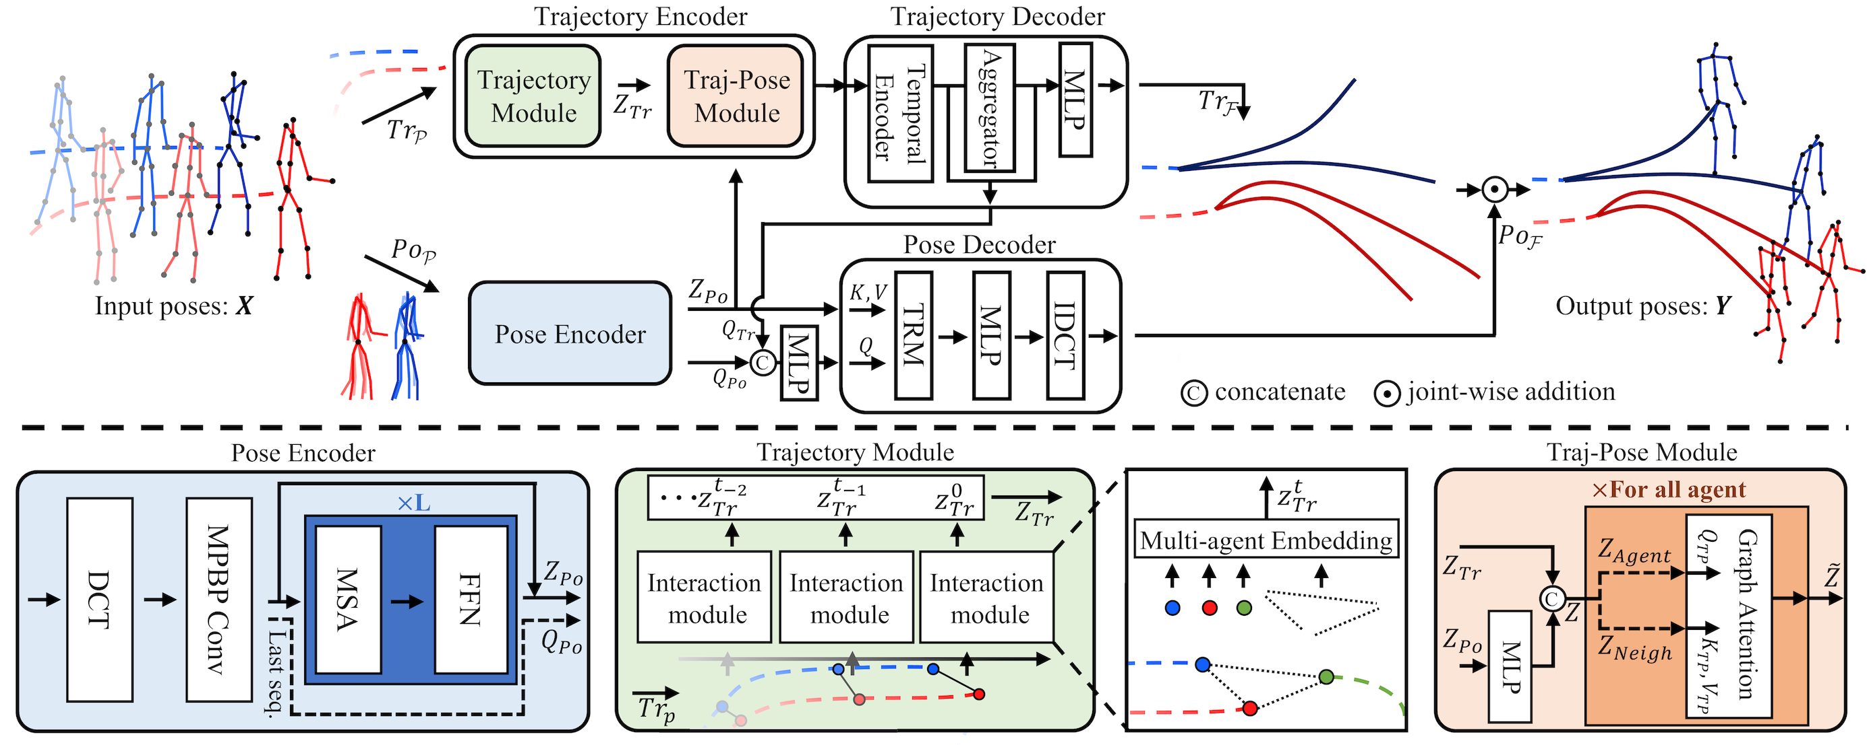
T2P Architecture
Coarse-to-Fine Design
Follow data flow. Global trajectories condition local motion, aligning goals with actions via interaction modules.
Notes:
Observe this diagram showing how we separate motion prediction into coarse global trajectories and fine local motions. Encoders forecast global paths using historical data, while modules condition local pose generation on those trajectories to align long-term goals with short-term actions. Notice the graph attention mechanisms weighing interactions between agents to capture social dynamics. By combining these scales, we avoid errors common in single-scale models, ensuring robust forecasting. This dual approach models both path intent and detailed execution accurately for comprehensive proficiency.

Slide 4

CMU-Mocap Eval
Visualization Protocol
Black: GT trajectory (1s obs + 2s future). Color: 2s prediction. Compared vs MRT, JRT, TBIFormer on CMU-Mocap.
Notes:
To validate our T2P model, we benchmarked against leading methods like MRT and JRT using the CMU-Mocap dataset. Please observe the comparison videos where black lines indicate ground truth trajectories spanning observed and future periods, while colored lines represent our two-second predictions. This visual protocol highlights how our approach maintains better alignment with actual motion data compared to baselines from top venues like NeurIPS and ICCV. Our architecture leverages graph attention to manage social dynamics, demonstrating superior forecasting capability in multi-agent scenarios.

Slide 5
T2P vs Baseline
CMU-Mocap Performance
Ground truth in black; 2s predictions in color. T2P tracks closer to truth than MRT, JRT, TBIFormer. Superior accuracy Mocap
Notes:
We evaluate T2P against strong baselines like MRT and JRT using the CMU-Mocap dataset, where black lines indicate ground truth and colored lines show our two-second predictions. As seen in these comparisons, our architecture leverages graph attention and interaction modules to better capture social dynamics, resulting in forecasts that align much closer to reality than prior works. The diagram illustrates how trajectory and pose encoders collaborate to refine feature aggregation. Ultimately, T2P demonstrates superior accuracy in motion forecasting, validating our approach against leading techniques.

Slide 6
MRT Baseline Analysis
MRT Prediction Quality
MRT predictions (color) drift from GT (black). Observe trajectory errors T2P corrects via interaction-aware modeling.
Notes:
We evaluate T2P against established baselines like MRT using the CMU-Mocap dataset. Here, black lines indicate ground truth trajectories while colored lines show predictions. Notice how T2P maintains closer alignment with the ground truth over the two-second future horizon compared to MRT. This clear visual evidence highlights our architecture's superior ability to capture complex motion dynamics using graph attention mechanisms. Ultimately, this demonstrates significant advancements in forecasting accuracy relative to prior state-of-the-art works.

Slide 7
Sample Results
Qualitative Analysis
Black lines indicate ground truth; colored lines show predictions. Demonstrates motion alignment in CMU-Mocap scenarios.
Notes:
These videos demonstrate the T2P model's performance on CMU-Mocap samples. Notice the black lines representing one second of history and two seconds of future ground truth, contrasted against our colored predictions for the forecast period. This visualization highlights how our architecture captures complex motion dynamics. The smooth alignment between trajectories confirms the model's ability to generate accurate, physically plausible poses. Our interaction modules handle multi-agent relationships without sacrificing motion fluidity, proving robust forecasting capabilities across diverse scenarios and validating the design choices.

Slide 8
JRDB-GMP Dataset
JRDB-GMP Dataset Specs
Mobile robot captures RGB+LiDAR. Supports >2s, 3+ agents. Video: Jordan Hall pose tracking proves accuracy in crowds.
Notes:
We parsed a new dataset from the JRDB collection to train forecasting models on complex scenarios involving long-term predictions and multiple agents. Acquired via a mobile robot, this data integrates RGB and LiDAR modalities for perception. Our architecture utilizes trajectory encoders paired with graph attention mechanisms to weigh agent interactions effectively. Visual samples from Jordan Hall validate tracking accuracy by comparing raw footage against processed pose data. This confirms the system handles dynamic crowds and structural complexities across campus environments.

Slide 9
Publication Reference Details
Title: Multi-agent Long-term 3D Human Pose Forecasting via Interaction-aware Conditioning
Authors: Jeong, Jaewoo, Park, Daehee, and Yoon, Kuk-Jin
Conference: IEEE/CVF Conference on Computer Vision and Pattern Recognition (CVPR)
Year: 2024 | Pages: 1617--1628 | Presentation Date: May 2026
Notes:
As detailed in our publication, this work tackles the complex challenge of forecasting three-dimensional human poses for multiple agents over extended time horizons. Our solution employs interaction-aware trajectory conditioning to effectively model social dependencies, ensuring predicted movements accurately reflect interactions between individuals in the scene. By focusing on these multi-agent dynamics, we significantly improve long-term prediction accuracy in social scenarios. This mechanism allows us to capture nuanced behavioral patterns that traditional methods often overlook, providing a robust framework for understanding collective human motion in crowded environments.

Slide 10
Thank You!
Notes:
That brings us to the conclusion of our session today. I want to express my gratitude for your time and attention throughout this discussion. We have covered significant ground, and I hope these insights provide a solid foundation for your future endeavors. The key takeaway is to apply these concepts practically to drive meaningful results within your own teams. I am now happy to open the floor for any questions you might have regarding the material we discussed. Thank you once again for joining me on this journey.

