Slide 1
Scientific Taste in AI
Notes:
Speaker A: Welcome everyone. This opening slide presents the essential meta information, including the title and authorship for our functional layout proposal.
Speaker B: Exactly. Establishing this context upfront ensures we all share the same reference point before examining the technical specifications.
Speaker A: With that foundation set, we will now proceed directly to the core content schema.

Slide 2
Sci Taste & RLCF
Judging high-impact research ideas.
Gap: Execution focused, not idea generation.
RLCF aligns models via community feedback.
Notes:
Speaker A: We define scientific taste as the capacity to judge and propose research ideas with high potential impact. This capability relies heavily on the judgement and foresight found in great scientists.
Speaker B: This distinction matters because most AI scientist research currently focuses on executive capability rather than idea generation.
Speaker A: To close this gap, our RLCF framework uses large-scale community signals like citations as supervision for reinforcement learning. This frames scientific taste learning as a preference modeling and alignment problem.
Speaker B: By framing taste as a preference modeling problem, we shift the focus from pure execution to aligning with community values.
Speaker A: This establishes a pathway to cultivate idea generation capabilities that are currently underexplored in the field.

Slide 3
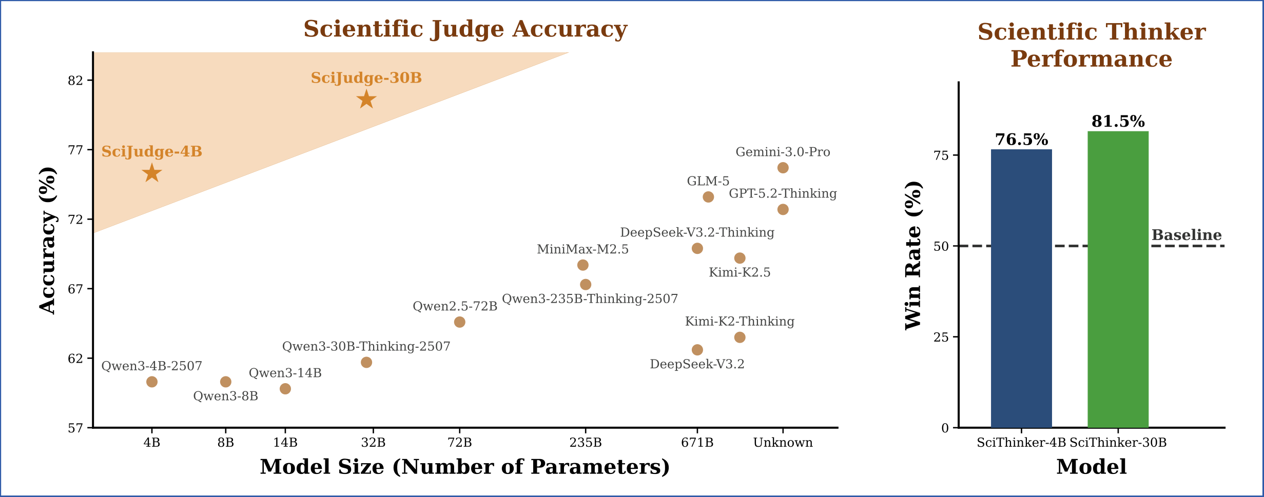
Accuracy Gains
Scaling Boosts Taste
• SciJudge-30B hits 82% accuracy • SciThinker-30B wins 81.5% • Size scales scientific taste
Notes:
Speaker A: We need to distinguish between AI assisting with execution tasks and the deeper capability of scientific taste. While tools help with literature search, selecting valuable ideas remains a separate challenge.
Speaker B: That distinction is critical because execution is about doing the work, but taste is about knowing which work is worth doing. This defines the real bottleneck in automated discovery.
Speaker A: The data on the right supports this, showing that scientific judgment scales with model size. SciJudge-30B reaches 82% accuracy, and SciThinker-30B achieves an 81.5% win rate against the baseline.
Speaker B: Notice how the 30B variants significantly outperform the 4B models in both charts. This confirms that larger capacity directly translates to better scientific intuition, not just faster processing.
Speaker A: So as we scale these models, we are genuinely enhancing the ability to identify high-value scientific directions rather than just automating routine tasks.

Slide 4
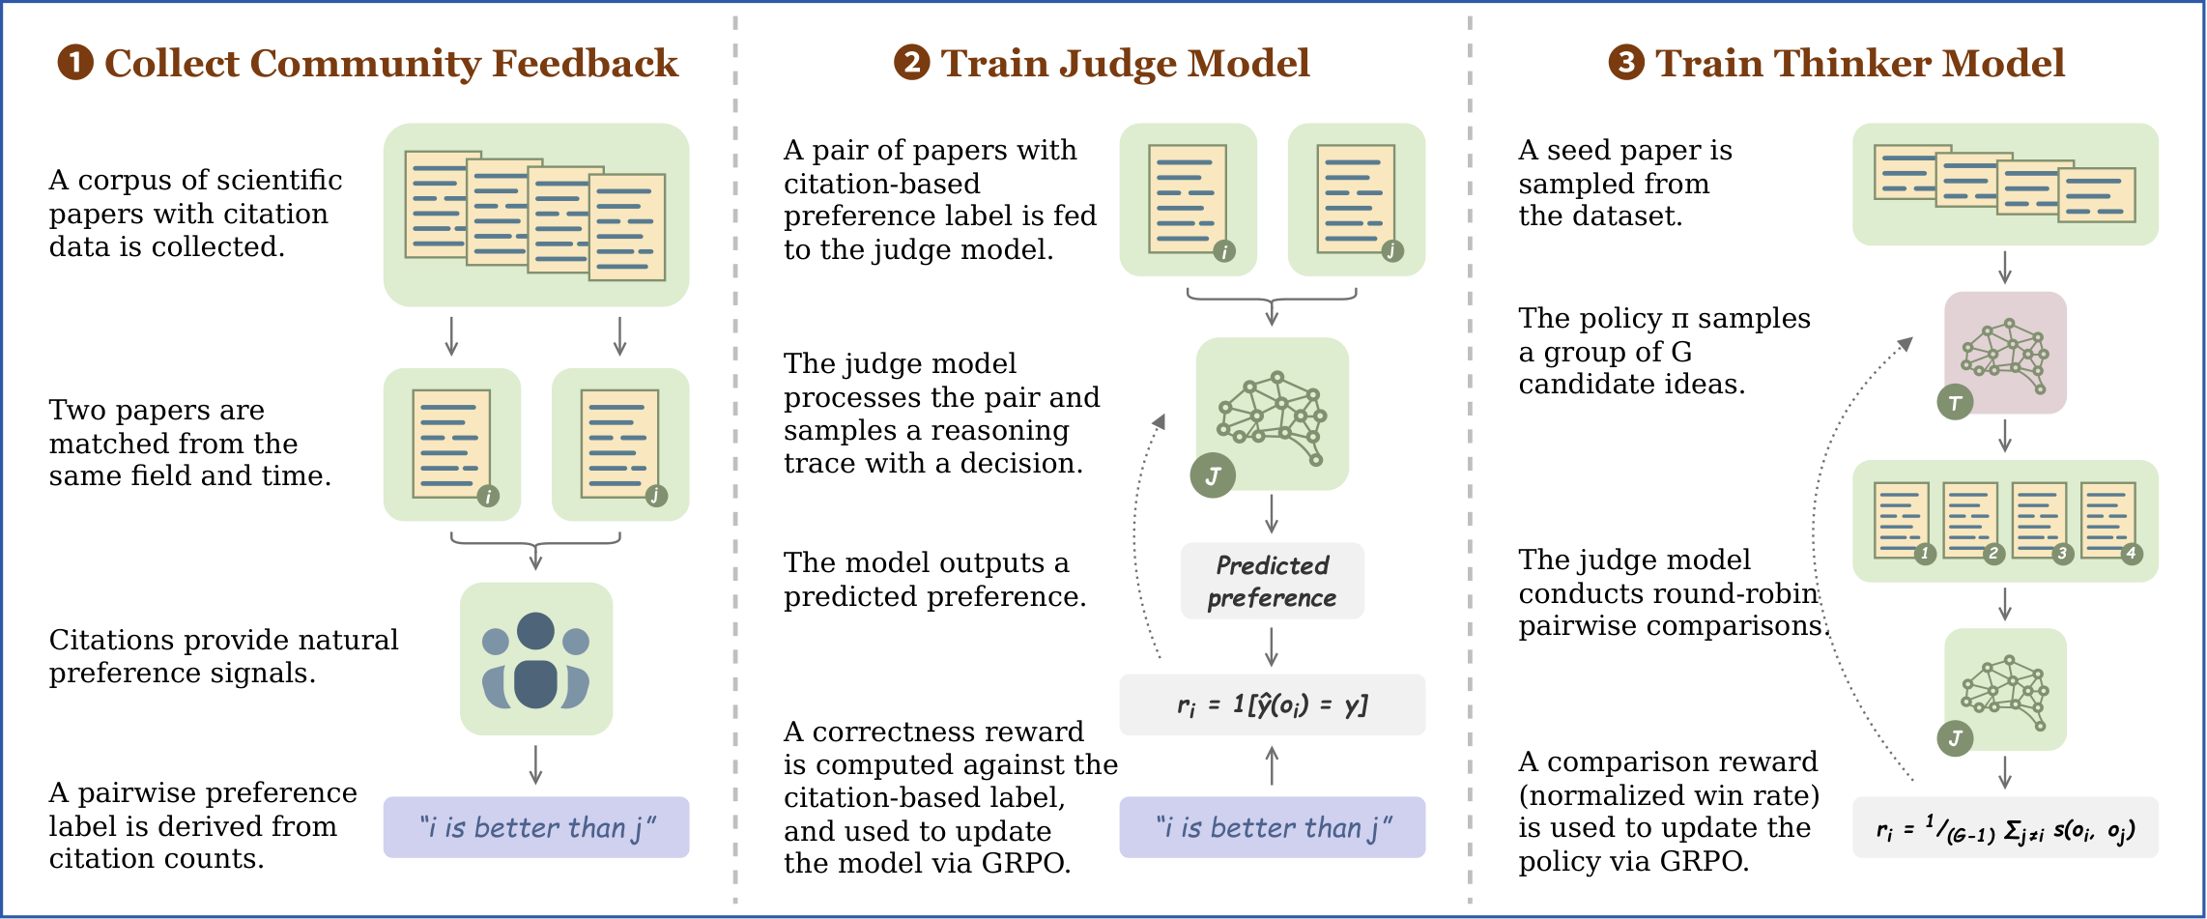
RLCF Pipeline
Three-Step Training
Build preference data from citations. 2. Train Judge to evaluate impact. 3. Align Thinker via Judge rewards.
Notes:
Speaker A: This slide outlines the three-step RLCF pipeline we use to encode scientific taste into the model.
Speaker B: Essentially, we are translating historical citation impact into a trainable reward signal instead of relying on human annotations.
Speaker A: As the diagram shows, we construct preferences from citation data to train a Scientific Judge, which then serves as the reward model for the Scientific Thinker.
Speaker B: That distinction is crucial because the Thinker learns to maximize predicted impact rather than simply mimicking existing text patterns.
Speaker A: Ultimately, this allows the system to propose follow-up research ideas that are aligned with community-validated success.

Slide 5
SciJudgeBench Eval
Built from 2.1 million arXiv papers published through 2024.
Creates 696,758 field- and time-matched citation-based preference pairs.
Tests in-domain judgement, generalization, and ideation vs proprietary models.
Notes:
Speaker A: We begin with the benchmark construction, relying on a corpus of 2.1 million arXiv papers published through 2024. This massive scale allows us to generate high-quality evaluation data without temporal bias.
Speaker B: We derive 696,758 field- and time-matched citation-based preference pairs from this corpus to ensure robust evaluation. This matching strategy prevents the model from succeeding simply due to temporal artifacts in the data.
Speaker A: For the evaluation settings, we cover in-domain judgement across core fields including Computer Science, Mathematics, and Physics while testing generalization on future papers and biology transfer. Additionally, the ideation evaluation compares Scientific Thinker against base policies and strong proprietary models.
Speaker B: By testing on future-year papers and bioRxiv transfer, we verify true reasoning capability beyond memorization. It validates performance against proprietary models in a way that static datasets cannot.
Speaker A: Ultimately, this combination of large-scale data and rigorous testing defines our leaderboard metrics.

Slide 6
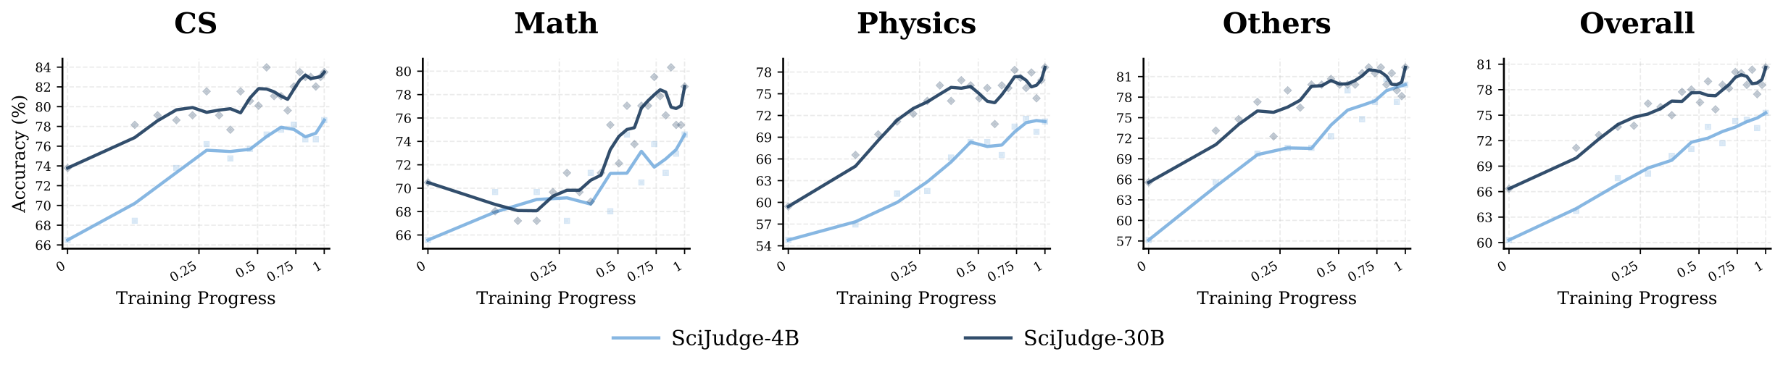
SciJudge Trends
30B Surpasses 4B Model
Accuracy rises in CS, Math, Physics. 30B outperforms 4B. Scaling benefits visible across all categories.
Notes:
Speaker A: We trained the Scientific Judge using GRPO with citation-based pairwise supervision and position-swap consistency.
Speaker B: That foundation allows the Scientific Thinker to use the Judge as a reward model for preference alignment.
Speaker A: Looking at the scaling curves, you can see accuracy tracked across CS, Math, and Physics as training progresses.
Speaker B: Crucially, the SciJudge-30B line stays above the 4B model, demonstrating that performance scales reliably with model size.
Speaker A: Ultimately, the overall categories confirm clear scaling benefits across all domains.

Slide 7
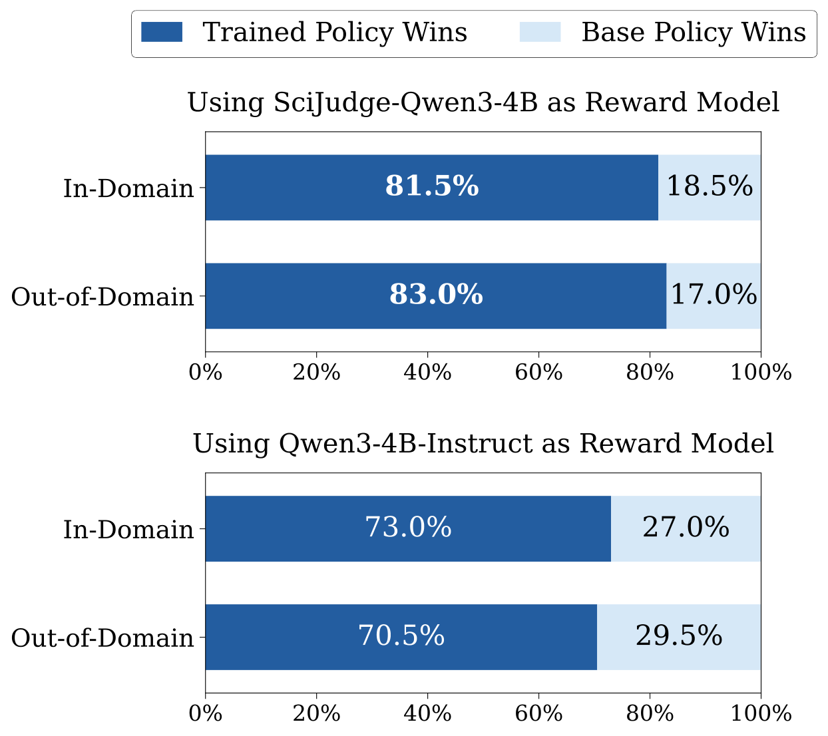
Policy Win Rate
Trained vs Base Policy
Bars show trained policy wins in-domain, out-of-domain. Consistent across SciJudge, Instruct. Robust generalization.
Notes:
Speaker A: We now examine how our training methodology translates into measurable performance gains for the policy.
Speaker B: Here the Scientific Thinker undergoes preference alignment using the Scientific Judge as its reward model.
Speaker A: The visual evidence shows the trained policy exceeds base policy win rates across both in-domain and out-of-domain settings.
Speaker B: This consistency across different reward models suggests the improvements are robust rather than overfitted.
Speaker A: Ultimately, this confirms the approach delivers reliable generalization across varied evaluation contexts.

Slide 8
Thank You!
Notes:
Speaker A: This brings us to the conclusion of our presentation today.
Speaker B: Exactly - we hope these insights provide a clear path forward for everyone.
Speaker A: On behalf of our team, we want to express our sincere gratitude.
Speaker B: We appreciate your partnership and look forward to next steps.

