Slide 1
DeepSeek-V4: Efficient AI
Notes:
Speaker A: Welcome everyone to our session, where we will present the findings from our recent strategic review.
Speaker B: This title page formally attributes the work to the presenting team and anchors us in the current timeline.
Speaker A: With the authorship and date confirmed here, we can now proceed directly into the executive summary.

Slide 2
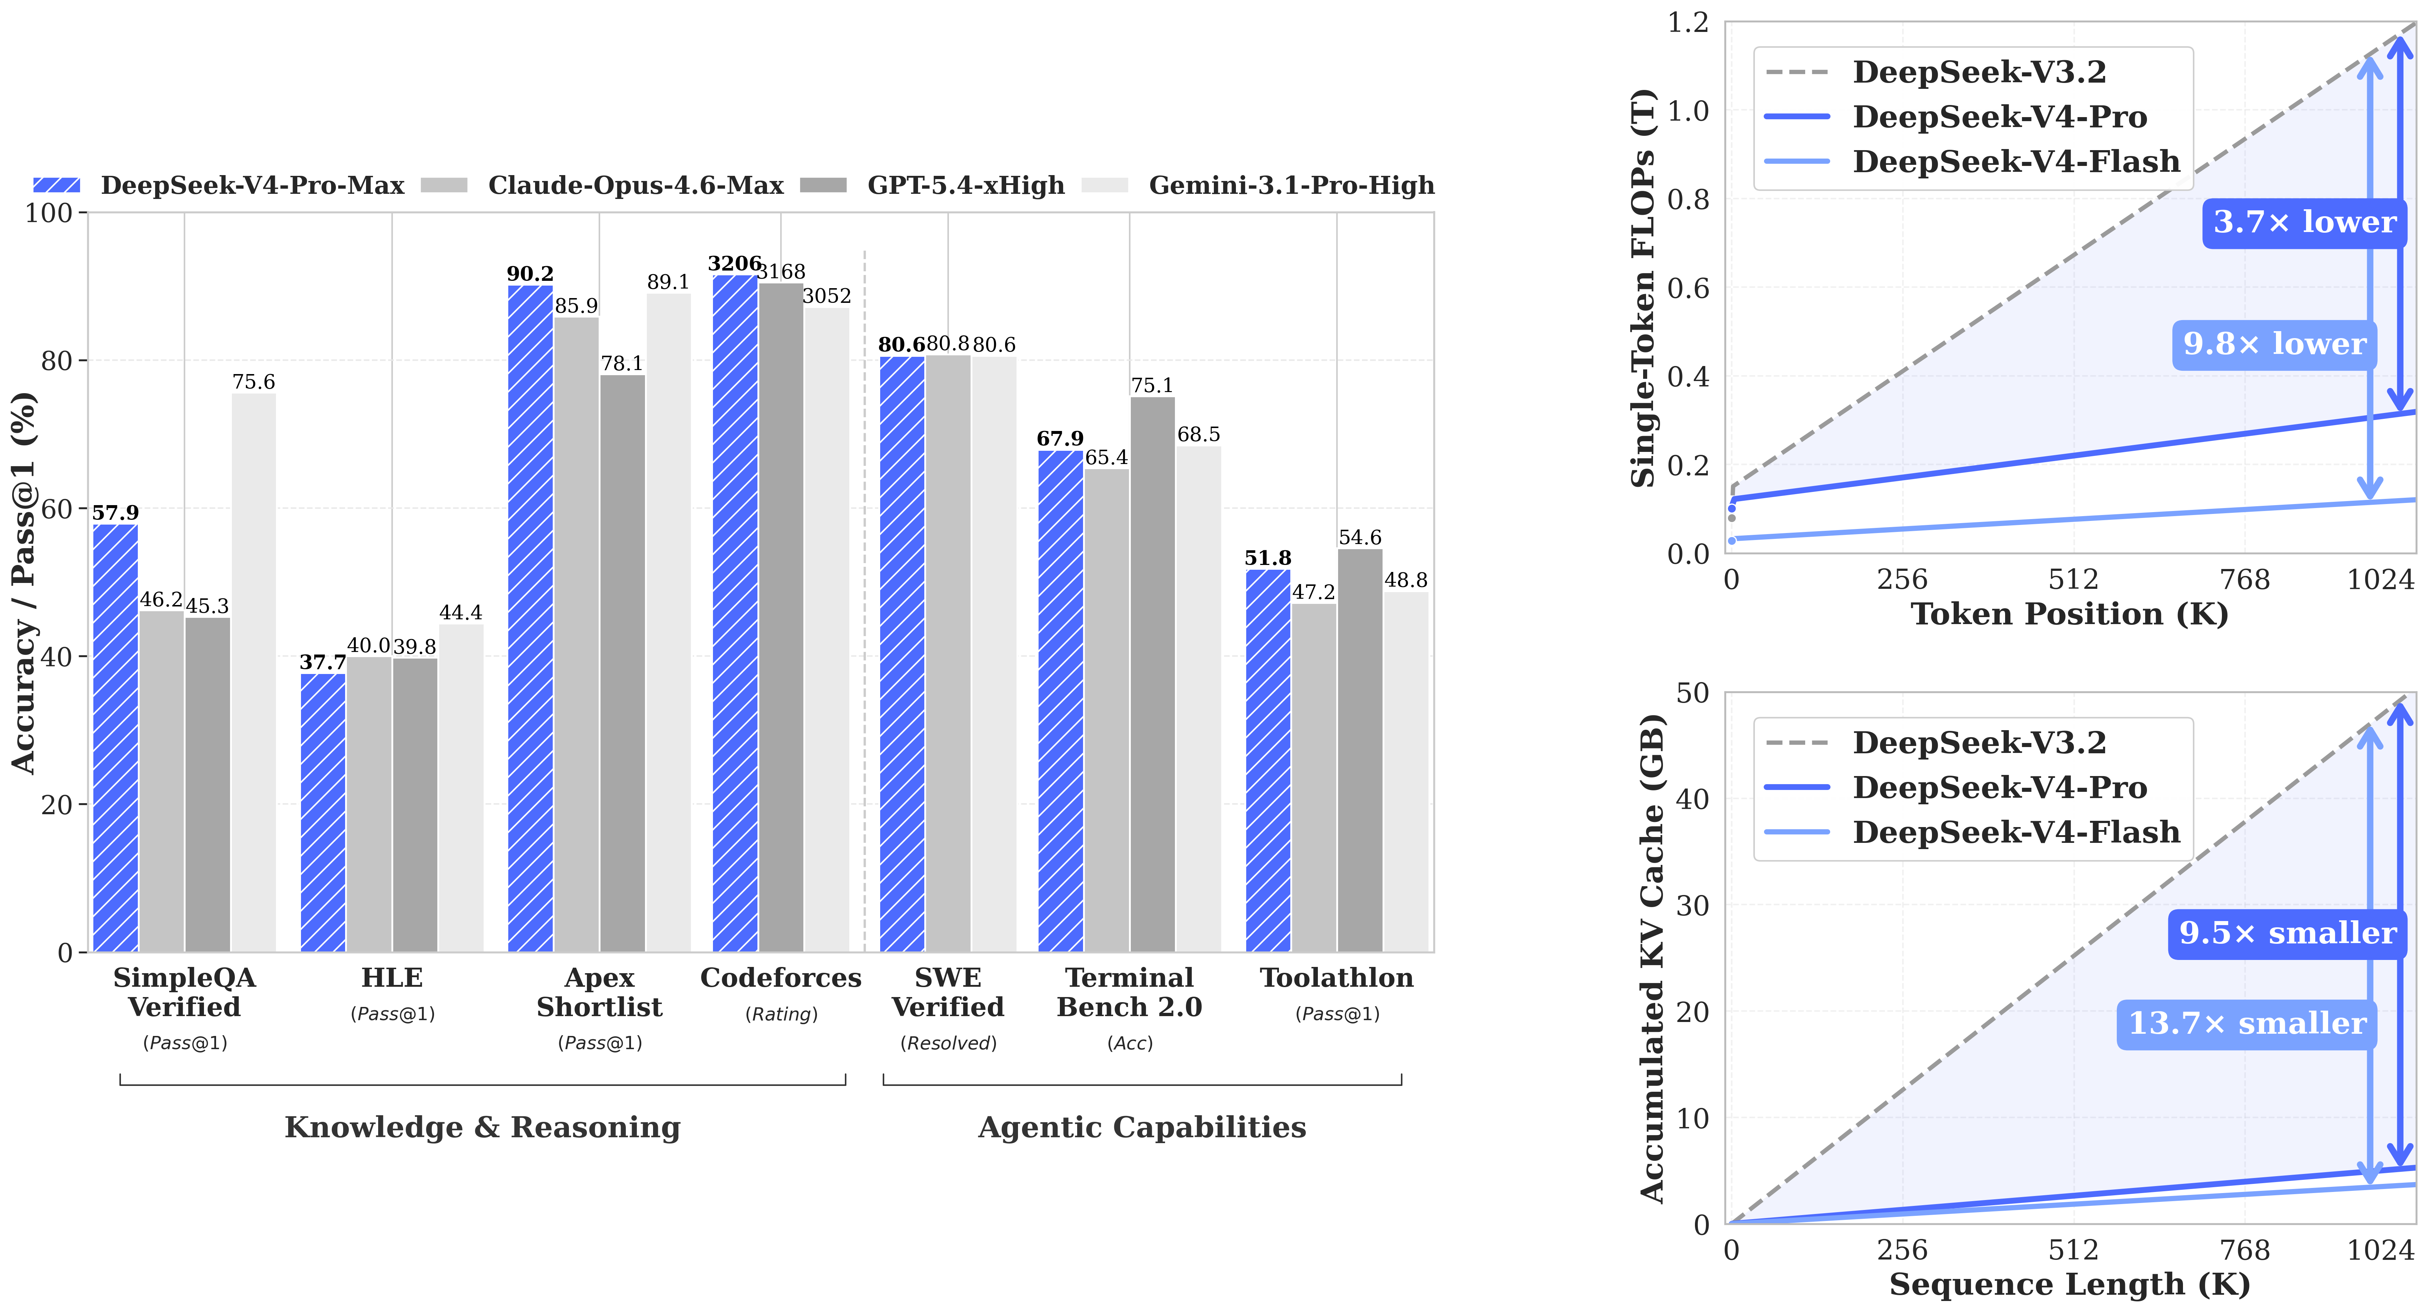
V4 Performance
V4 Specs & Benchmarks
Pro (1.6T) and Flash (284B) support 1M context. Pro-Max leads reasoning. Accuracy/FLOPs vs Claude, GPT, Gemini.
Notes:
Speaker A: The DeepSeek-V4 series introduces two Mixture of Experts models designed to support one million token contexts with distinct efficiency profiles.
Speaker B: The Pro model utilizes 1.6T total parameters with 49B activated, whereas Flash reduces this to 284B total for faster inference.
Speaker A: Our benchmark chart compares Pro-Max against frontier systems like Claude-Opus, GPT-5.4, and Gemini across knowledge, reasoning, and agentic capabilities.
Speaker B: Crucially, the visual tracks accuracy alongside computational cost, displaying single-token FLOPs and accumulated KV cache to measure true efficiency.
Speaker A: This data shows Pro-Max leading open-source performance and closing the gap with closed-source competitors while maintaining competitive resource usage.

Slide 3
DeepSeek-V4 Design
CSA and HCA attention reduce FLOPs to 27% and KV cache to 10%.
Manifold-Constrained Hyper-Connections stabilize signal propagation and expressivity.
Muon Optimizer ensures stability across 32T token pre-training and distillation.
Notes:
Speaker A: We begin with the architecture and efficiency layer, where we combine Compressed Sparse and Heavily Compressed Attention to drastically reduce computational costs.
Speaker B: The result is a reduction to twenty-seven percent of baseline FLOPs and a ten percent KV cache at one million tokens, ensuring stability without losing expressivity.
Speaker A: Moving to training and optimization, we employ the Muon Optimizer to ensure faster convergence throughout our massive pre-training on over thirty-two trillion tokens.
Speaker B: This foundation supports our two-stage post-training, using expert cultivation and distillation to achieve unified consolidation.
Speaker A: Ultimately, this dual focus on efficient architecture and robust optimization delivers a model that is both expressive and computationally viable.

Slide 4
Evaluation Results
Base model matches frontier performance on standard reasoning benchmarks.
Instruct variant exceeds competitors in complex multi-turn dialogue.
Superior efficiency maintained across million-token context operations.
Notes:
Speaker A: This slide presents our evaluation results, directly comparing both base and instruct models against current frontier competitors.
Speaker B: That distinction is critical because it shows where our pre-training stands alone versus where alignment tuning closes the gap.
Speaker A: Looking at the chart, you can see the base model tracks closely with competitors, while the instruct version achieves parity on key reasoning benchmarks.
Speaker B: Another way to say this is that our alignment process efficiently recovers performance without sacrificing the underlying capability of the base model.
Speaker A: The key takeaway is that we are competitive across both stages, validating our training pipeline against the frontier.

Slide 5
Reasoning Modes
DeepSeek-V4-Pro and Flash models both support three distinct reasoning effort modes.
Users select computational intensity levels to match specific task requirements effectively.
Comparison analysis identifies optimal reasoning effort levels for deployment scenarios.
Notes:
Speaker A: Both DeepSeek-V4-Pro and Flash models are built with three distinct reasoning effort modes to handle varying task requirements.
Speaker B: This design gives users control over computational intensity levels instead of relying on a fixed setting for every query.
Speaker A: We compared performance across these modes to identify the optimal reasoning effort level for specific deployment scenarios.
Speaker B: This ensures deployment scenarios benefit from matched resources rather than generic configurations that might waste capacity.
Speaker A: Ultimately, selecting the right mode balances computational cost with performance for each specific use case.

Slide 6
Local Setup Guide
Consult inference folder for weight conversion and chat demo setup.
Set temperature and top_p to 1.0 for optimal sampling performance.
Think Max requires 384K context with FP4 for MoE and FP8 precision.
Notes:
Speaker A: This slide outlines the critical configuration guidelines for local deployment and maximizing model capacity.
Speaker B: Exactly - optimal performance relies on specific sampling parameters and precision settings rather than default configurations.
Speaker A: For deployment, consult the inference folder for weight conversion and set both temperature and top_p to 1.0. Additionally, Think Max mode requires a 384K token context window supported by mixed precision.
Speaker B: This architecture assigns FP4 to MoE experts and FP8 to other parameters, enabling efficiency while maintaining that large context window.
Speaker A: Adhering to these specs is essential for stable local execution and full reasoning performance.

Slide 7
Chat Template Spec
Dedicated encoding folder; Jinja templates excluded.
Encodes OpenAI messages via specific thinking modes.
Uses DeepSeek-V4-Pro tokenizer for processing.
Notes:
Speaker A: This release shifts away from standard Jinja-format chat templates in favor of a dedicated encoding folder. This folder contains the necessary Python scripts and test cases to handle message formatting directly.
Speaker B: Exactly, this approach ensures we can demonstrate encoding messages in an OpenAI-compatible format effectively without relying on external template engines.
Speaker A: Moving to the implementation workflow, we encode these OpenAI-compatible messages into input strings using specific thinking modes. We utilize the DeepSeek-V4-Pro tokenizer to process both model inputs and outputs throughout this pipeline.
Speaker B: And this matters because the workflow also supports parsing model text output directly from the completion text. It streamlines the integration process for developers adopting this version.
Speaker A: So, while Jinja templates are excluded, the provided scripts and tokenizer integration offer a robust path for handling chat specifications. This ensures consistent message handling across your integration workflows.

Slide 8
Thank You!
Notes:
Speaker A: This brings us to the conclusion of our presentation today.
Speaker B: Another way to view this outcome is as a foundation for the next phase of work.
Speaker A: Thank you for your time and we look forward to collaborating further.

