Slide 1
Dexterous Hand-Object WM
Notes:
Speaker A: Welcome everyone, this presentation outlines the key findings from our recent project.
Speaker B: And this opening slide serves to anchor our discussion by presenting the essential meta information for the session.
Speaker A: You will see the title and author details here, which establish the scope and ownership of the data we are about to review.
Speaker B: That's the key point, as knowing the source and date helps ground the subsequent analysis in the correct operational period.
Speaker A: With that context established, let's move directly into the first section of our analysis.

Slide 2

DexWM Overview
Core Challenges & Wins
Observe: Action space & loss. Subtle motions challenge. DexWM predicts keypoints. 900h data. Beats Diffusion Policy 50%.
Notes:
Speaker A: Modeling dexterous interactions is challenging because existing models rely on coarse actions that miss subtle finger motions. DexWM addresses this by predicting future latent states conditioned on past states and dexterous actions.
Speaker B: That shift to fine-grained action spaces is crucial, especially since we represent actions using finger keypoints extracted from egocentric videos. This strategy enables training on over 900 hours of data instead of being limited by scarce robotic demonstrations.
Speaker A: As the keypoints visualization shows, visual features alone are insufficient for modeling this level of detail. We employ an auxiliary hand consistency loss to ensure accurate hand configurations beyond what visual input provides.
Speaker B: The result is a model that outperforms prior world models in future-state prediction tasks. It surpasses Diffusion Policy by over 50 percent on average across grasping, placing, and reaching.
Speaker A: Ultimately, this demonstrates strong zero-shot transfer to unseen skills on robotic hardware. Modeling fine-grained dynamics from human video enables robust dexterous manipulation.

Slide 3
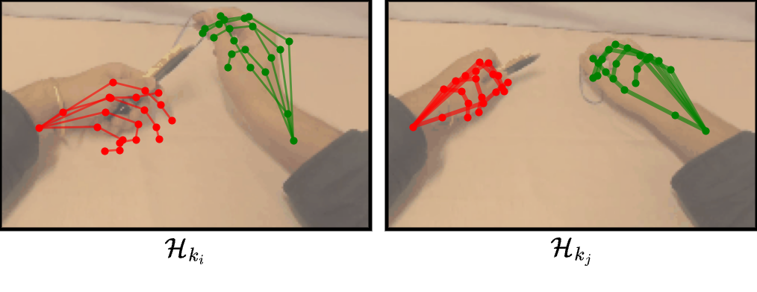
3D Keypoint Rep
Keypoint Action Method
• Visual: Pose change Hₖᵢ to Hₖⱼ.
• Unified rep uses 3D keypoint diffs.
• Camera motion preserves global context.
Notes:
Speaker A: In DexWM, we represent hand actions as differences in 3D keypoints between frames. This provides a unified way to capture dexterous movements mathematically.
Speaker B: Exactly, and looking at the visual, you can see how the keypoints track pose changes over time. This difference calculation effectively isolates the motion itself.
Speaker A: We calculate this using the H kj minus H ki formula to measure pose changes. We also supplement this with camera motion data to capture the agent's overall movement during the sequence.
Speaker B: That addition ensures global context is preserved within the model, rather than just focusing on local hand gestures. It ties the dexterous action to the broader environment movement.
Speaker A: So together, these elements create a robust representation that handles both fine-grained manipulation and overall agent motion. This sets the foundation for how DexWM predicts future states.

Slide 4
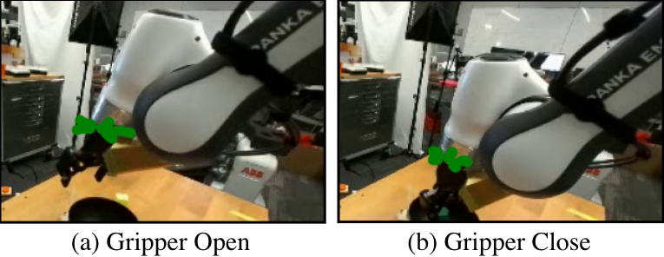
DROID Keypoints
Dummy Keypoint Strategy
• Concentric circles at end-effector • Radii vary with gripper open/close • Mimics finger spread dynamics
Notes:
Speaker A: We establish a unified representation for dexterous actions by modeling hand movements as differences in 3D keypoints between frames.
Speaker B: Right - incorporating camera motion ensures we capture the agent's overall movement effectively as well.
Speaker A: For parallel-jaw grippers, we approximate dexterous hands using dummy keypoints placed on concentric circles centered at the end-effector.
Speaker B: As shown here, the radii vary with the gripper state to mimic finger spread dynamics for compatibility.
Speaker A: This ensures we capture frame-to-frame spatial changes effectively regardless of the hardware.

Slide 5
Task Prediction
Visualizing Prediction
Observe smooth manipulation in rollout. Generates states autoregressively. Validates fidelity across diverse tasks.
Notes:
Speaker A: DexWM predicts future latent states autoregressively using initial states and dexterous action sequences. These latent states are then decoded into images for direct visual visualization.
Speaker B: Exactly, and these side-by-side comparisons validate visual fidelity across multiple test examples. You can see the model accurately replicates complex manipulation dynamics in real-time.
Speaker A: Looking at the videos, we see diverse dexterous tasks like cloth folding, object manipulation, and liquid pouring. These scenarios effectively validate applicability across varied physical interaction contexts.
Speaker B: These examples cover complex physical interaction scenarios that often challenge standard models. The visual alignment shows the system handles non-rigid objects and fluids effectively.
Speaker A: Ultimately, these open-loop rollouts demonstrate that the model maintains accuracy over sequential hand manipulation tasks. This confirms DexWM's capability to handle varied physical complexities reliably.

Slide 6
Counterfactuals
Physical Dynamics
Predicts states from input.
Processes atomic actions.
Visualizes pushing and toppling.
Enables counterfactual planning.
Notes:
Speaker A: DexWM predicts future states from a consistent initial state by processing atomic actions intended for controlling the right hand. This facilitates planning through counterfactual state estimation.
Speaker B: Another way to say this is that the system evaluates potential outcomes before committing to a physical move.
Speaker A: The visual references depict diverse physical interactions including pushing, lifting, and rotating various objects across sequential frames. You can see specific directional movements like moving right, up, or forward in these examples.
Speaker B: Notice how the model predicts physical dynamics like toppling when the hand pushes an object forward.
Speaker A: This confirms the model's ability to simulate counterfactual actions for effective manipulation planning.

Slide 7
Action Transfer
MPC Planning & Transfer
Transfers actions from reference sequences via DexWM. Plans trajectories using MPC. Shows folding on unseen data.
Notes:
Speaker A: This slide demonstrates our Action Transfer Framework, which moves actions from reference sequences into new environments using DexWM and PEVA models.
Speaker B: The DexWM planning method enables this by finding optimal trajectories between start and goal images using an MPC framework with the Cross-Entropy Method.
Speaker A: Looking at the video examples, you can see this process guide diverse manipulation tasks like assembling puzzles or removing cup lids across different surfaces.
Speaker B: Importantly, these test tasks were unseen during training, which validates the model's ability to generalize across various object interactions and constraints.
Speaker A: This confirms that reference trajectory inputs allow us to adapt manipulation tasks effectively across different settings without task-specific retraining.

Slide 8
Thank You!
Notes:
Speaker A: That brings us to the conclusion of our presentation today.
Speaker B: We want to express our sincere gratitude for your time and attention throughout this session.
Speaker A: We hope the insights shared here provide a solid foundation for your next steps.
Speaker B: Thank you for joining us, and we are available for any further discussion you might need.

