Slide 1
Exclusive Self-Attention
Notes:
Speaker A: Welcome to this session where we will walk through the functional layout schema for systematic slide generation.
Speaker B: This title reflects our focus on standardizing how we present complex technical information across teams.
Speaker A: You will notice the author names and date listed here to establish ownership and the current version of this framework.
Speaker B: Exactly - that metadata is crucial for tracking iterations and ensuring everyone is aligned on the latest specifications.
Speaker A: With those details confirmed, we can now proceed to the core content of our analysis.

Slide 2
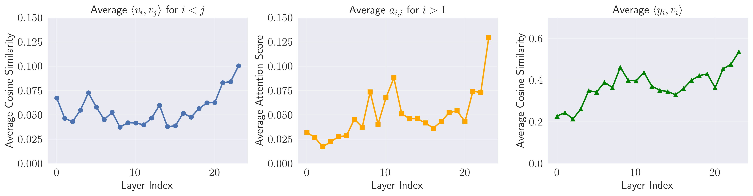
Layer Analysis
Architecture Trends
Interleaved self-attention and feed-forward layers. Graphs track cosine similarity and attention scores across layers.
Notes:
Speaker A: We start with the core architecture, where transformers rely on interleaved self-attention and feed-forward layers as a foundational design.
Speaker B: This setup ensures self-attention aggregates contextual information while feed-forward networks perform position-wise feature updates.
Speaker A: To understand how this functions in practice, we track cosine similarity and attention scores across the layer indices shown in this chart.
Speaker B: You can see these metrics vary significantly across layer indices, which indicates distinct behavioral patterns throughout the model depth.
Speaker A: This layer-wise analysis demonstrates that internal dynamics shift significantly even while the foundational design remains constant.

Slide 3
XSA Motivation
Standard attention redundantly reinforces self-values instead of modeling context.
XSA removes output projection onto self-value vectors to eliminate similarity bias.
Maintains expressiveness with only two lines of code change on standard mechanisms.
Notes:
Speaker A: Our analysis reveals that standard self-attention exhibits a similarity bias where outputs redundantly reinforce self-values rather than modeling context. This means diagonal attention scores remain consistently high across layers, undermining the attention layer's core purpose.
Speaker B: That overlap essentially duplicates FFN functionality across increasing layers instead of capturing unique contextual information. It limits the model's ability to distinguish between self-reference and actual context.
Speaker A: To address this, Exclusive Self-Attention removes the projection of the output onto the self-value vector to eliminate similarity bias completely. This ensures outputs contain neither self-values nor components correlated with them, focusing purely on context.
Speaker B: Another way to say this is that we improve modeling efficiency by focusing strictly on context without losing expressiveness. Crucially, the implementation requires only two lines of code change on top of existing mechanisms.
Speaker A: So the core hypothesis states XSA leverages residual connections and FFN blocks effectively without sacrificing performance. This allows us to fix the bias while keeping the architecture intact.

Slide 4
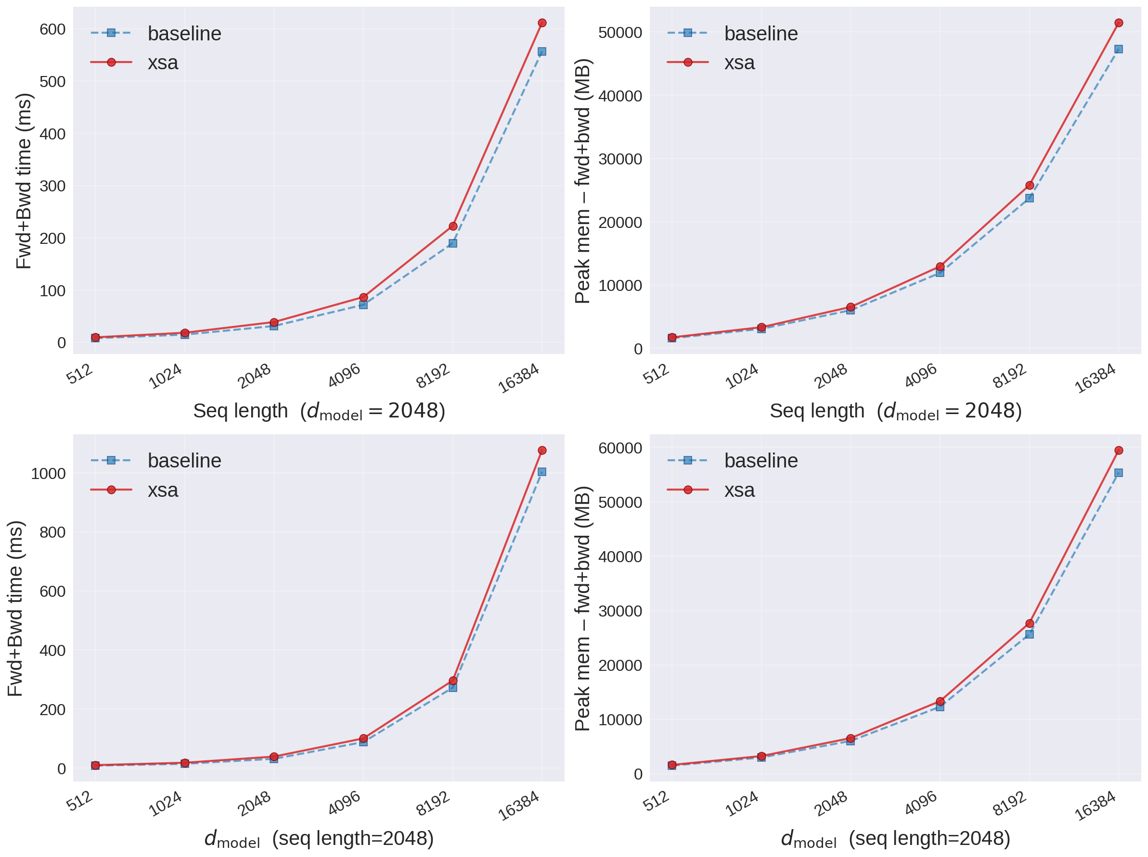
XSA Efficiency
Speed & Memory Metrics
XSA shows minimal overhead vs baseline on B200 GPUs. Lines track time and memory growth across sequence lengths to 16k.
Notes:
Speaker A: To validate XSA, we trained modified NanoGPT models on FineWeb-100BT across three parameter scales. Our primary goal here is to confirm that these architectural changes do not come with a prohibitive computational cost.
Speaker B: Exactly, because even a powerful mechanism fails if it slows down training too much. We measured forward and backward pass times alongside peak memory on B200 GPUs to quantify that overhead.
Speaker A: Looking at the benchmark results, the XSA lines sit slightly above the baseline for both time and memory across sequence lengths. However, the gap remains narrow even as we scale up to sixteen thousand tokens.
Speaker B: That stability is crucial since it means the overhead is consistent and manageable regardless of model dimension. We effectively gain the architectural benefits without sacrificing practical training efficiency.
Speaker A: So while there is a marginal cost, it is negligible compared to the performance gains we will see next. This confirms XSA is viable for large-scale deployment.

Slide 5
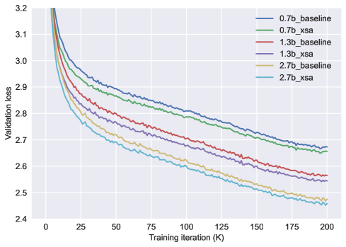
Validation Loss
XSA Scaling Advantages
Validation loss drops across 0.7B to 2.7B models. XSA outperforms baselines, confirming scalability benefits.
Notes:
Speaker A: To validate our approach, we trained modified NanoGPT models using RoPE and extra LayerNorm on the FineWeb-100BT dataset. We tested three scales ranging from 0.7 to 2.7 billion parameters over 200K iterations.
Speaker B: Exactly, and the chart shows validation loss decreasing steadily across all sizes. This confirms that the architecture remains stable as we scale up parameters.
Speaker A: Beyond convergence, XSA consistently outperforms the baselines in both validation loss and downstream accuracy. We verified this across eight tasks using the LM Harness evaluation suite.
Speaker B: Another way to say this is that accuracy improves consistently with larger model sizes. These results demonstrate clear scalability benefits rather than just isolated gains.
Speaker A: So, the method not only converges reliably but also leverages increased capacity effectively. This sets the stage for our broader performance analysis.

Slide 6
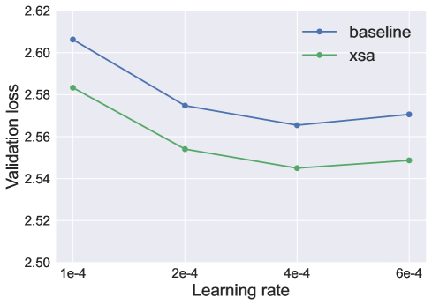
XSA Robustness
Validation Loss Trends
Notice consistent gap between XSA and baseline lines. Performance margin holds across all tested learning rates.
Notes:
Speaker A: To evaluate robustness, we utilized a modified NanoGPT implementation with RoPE and extra LayerNorm trained on the FineWeb-100BT dataset.
Speaker B: This setup covers three model scales up to 2.7 billion parameters using AdamW with a cosine decay schedule.
Speaker A: Looking at the validation loss, XSA maintains a near-constant performance margin over the baseline across four distinct learning rates.
Speaker B: That's the key point - the architectural benefits persist regardless of the specific optimization schedule used during training.
Speaker A: Ultimately, the consistent convergence trends confirm that XSA delivers stable improvements independent of learning rate sensitivity.

Slide 7
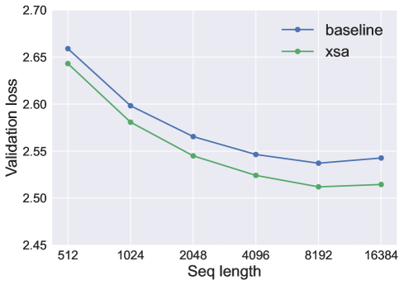
Context & Future
Findings & Future Work
Loss stays lower as length grows. Implicit sink via diagonal elements. Future: scales, optimizers, generalization.
Notes:
Speaker A: We validated XSA using NanoGPT with RoPE, training models from 0.7 to 2.7 billion parameters on FineWeb-100BT.
Speaker B: This scope lets us verify the mechanism's stability before committing to massive scale.
Speaker A: As the graph shows, XSA maintains lower validation loss than the baseline specifically as sequence length grows.
Speaker B: This happens because the diagonal elements act as an implicit attention sink, preserving loss margins against explicit sinks.
Speaker A: Next, we will investigate how these findings generalize to larger data volumes and optimizers like Muon.

Slide 8
Thank You!
Notes:
Speaker A: This brings us to the conclusion of our presentation today.
Speaker B: We want to express our sincere gratitude for your time and attention to this topic.
Speaker A: Thank you for joining us to explore these insights together.
Speaker B: It has been a privilege to share this work with such an engaged audience.

