Slide 1
Fast-ThinkAct: Latent VLA
Notes:
Speaker A: Good morning everyone, and welcome to our presentation on the current initiative.
Speaker B: We are sharing this work today to align on the latest findings and next steps for the team.
Speaker A: Over the next few minutes, we will walk through the methodology and the key results we have gathered so far.
Speaker B: That's the key point - focusing on these outcomes will help us decide on the final implementation strategy.
Speaker A: With that context established, let's move directly into the background overview.

Slide 2
Fast-ThinkAct Core
Explicit chain-of-thought traces cause high inference latency.
Fast-ThinkAct uses verbalizable latent reasoning for compact planning.
Achieves 89.3 percent latency reduction while maintaining performance.
Notes:
Speaker A: Existing reasoning VLAs struggle with high inference latency because they rely on lengthy explicit chain-of-thought traces. Our proposed framework, Fast-ThinkAct, addresses this by enabling compact planning through verbalizable latent reasoning.
Speaker B: That's the key distinction. Instead of generating verbose text steps, we compress the reasoning process while keeping it verbalizable for efficiency.
Speaker A: We distill these latent CoTs from a teacher model using a preference-guided objective to align manipulation trajectories. Experiments show this reduces inference latency by up to 89.3 percent.
Speaker B: Crucially, this speed gain does not come at the cost of capability. The model maintains long-horizon planning and failure recovery in dynamic environments.
Speaker A: So, Fast-ThinkAct delivers efficient embodied control without sacrificing the complex reasoning required for vision-language-action tasks.

Slide 3
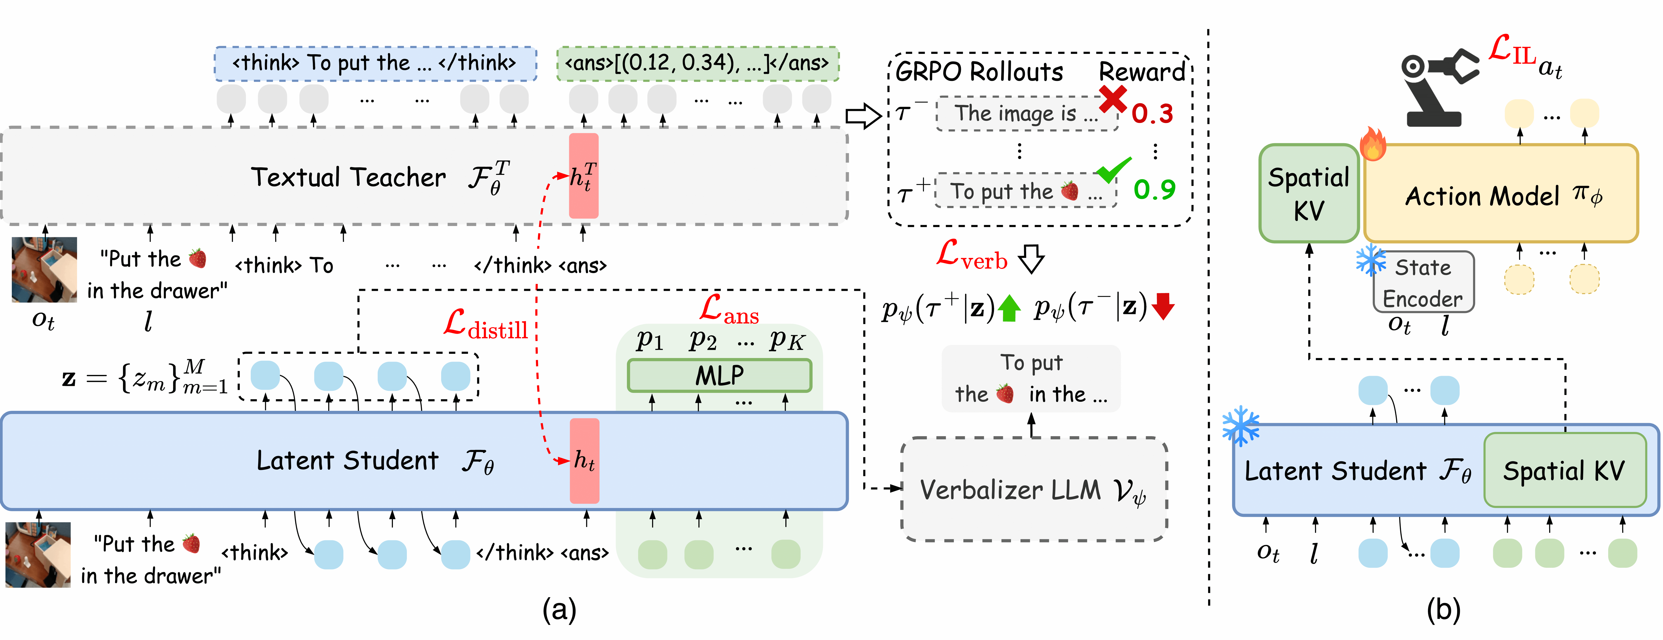
Core Architecture
Distillation Framework
Teacher trains with reasoning and rewards. Student distills latent reasoning. Action model executes from visual plans.
Notes:
Speaker A: Looking at the diagram, the Fast-ThinkAct method begins with a teacher model trained on textual reasoning and visual rewards.
Speaker B: This setup distills that heavy reasoning into a student model performing compact latent reasoning to reduce overhead.
Speaker A: A verbalizer then decodes these latents for supervision, allowing the action model to learn directly from the student's visual plan representations.
Speaker B: Crucially, this allows the system to achieve efficient reasoning-enhanced manipulation by streamlining the path from observation to action.
Speaker A: The result is a unified architecture that maintains high-level reasoning capabilities while ensuring fast execution.

Slide 4
Benchmark Data
Success & Efficiency
Leads LIBERO and SimplerEnv success rates. Latency confirms efficient inference speeds for real-time control.
Notes:
Speaker A: Here we present our quantitative evaluation across standard robot manipulation benchmarks. We focus on both success rates and the inference latency required for real-time control.
Speaker B: The bar charts show we outperform existing models like OpenVLA and ThinkAct across every category. This consistency proves robustness in spatial and long-horizon tasks.
Speaker A: Moving to the right, we also compare inference times for three and seven billion parameter models. Our method maintains competitive latency while delivering higher success rates on LIBERO and SimplerEnv.
Speaker B: That balance is critical for deployment, as lower milliseconds directly enable smoother robot manipulation. We achieve superior accuracy without sacrificing the speed needed for real-time applications.
Speaker A: Overall, these results confirm our approach offers both state-of-the-art performance and computational efficiency. This validates the scalability of our method for practical robotic systems.

Slide 5
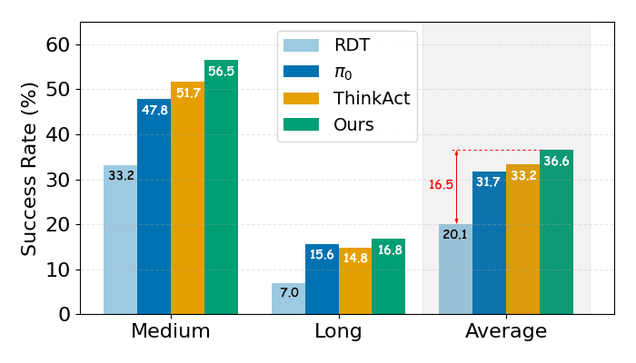
Success Rates
Superior Success Rates
Highest success in Medium and Average tasks. Beats RDT, π₀, ThinkAct. 16.5-point gap shows superior recovery.
Notes:
Speaker A: To validate failure recovery, we combined qualitative corrective guidance in simulation and real robots with quantitative benchmarks on RoboFAC.
Speaker B: This ensures we assess manipulation error recovery capabilities comprehensively across both environments.
Speaker A: The bar chart shows our method achieves the highest success rates in Medium and Average tasks compared to RDT, π₀, and ThinkAct baselines.
Speaker B: And this matters because the 16.5-point gap in the Average category signals a significant performance advantage in recovery effectiveness.
Speaker A: Consequently, we demonstrate clear success rate improvements and robust failure recovery over baseline methods.

Slide 6
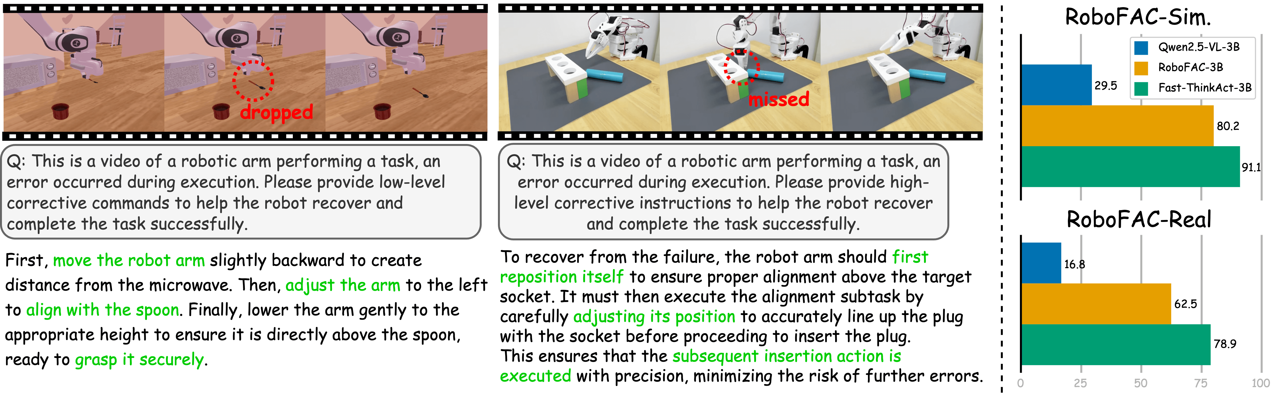
RoboFAC Results
Benchmark & Reasoning
Fast-ThinkAct leads on Sim and Real.
Reasoning is compact and accurate.
Visuals confirm effective error recovery.
Notes:
Speaker A: We begin by comparing reasoning quality, where our verbalized process provides a more compact and accurate alternative to standard teacher models.
Speaker B: That distinction is critical because teacher models often produce redundant sentences or incorrect content during task execution analysis.
Speaker A: Moving to the benchmarks, the bar chart shows Fast-ThinkAct-3B achieving higher scores than Qwen2.5-VL and RoboFAC across both Sim and Real datasets.
Speaker B: Exactly, and the accompanying visual sequences demonstrate how corrective instructions successfully guide the system to resolve physical manipulation failures.
Speaker A: This combination of efficient reasoning and strong benchmark performance validates our approach for complex execution errors.

Slide 7
Task Comparison
Superior To Base RDT
Diagram shows latent planning enabling superior stacking and multi-object placement versus base RDT model.
Notes:
Speaker A: Moving to our results, Fast-ThinkAct consistently outperforms the base RDT model across diverse manipulation tasks. You can see this in the qualitative comparisons where we handle complex stacking and multi-object placement.
Speaker B: This architecture diagram clarifies why that improvement happens regarding system design. The teacher-student distillation allows the model to leverage textual reasoning for significantly better decision making.
Speaker A: Specifically, we utilize latent representation to refine those decisions before execution begins. Then, spatial key-value integration ensures the action model maintains precise manipulation control during the task.
Speaker B: That integration is crucial for executing the complex semantic instructions visible in the video comparisons. It effectively bridges the gap between high-level reasoning and low-level control.
Speaker A: Ultimately, the architecture validates successful execution where the base model often struggles. This confirms our approach delivers robust performance in real-world scenarios.

Slide 8
Thank You!
Notes:
Speaker A: That brings us to the conclusion of our presentation today. We sincerely appreciate your time and attention throughout this session.
Speaker B: We hope the insights shared here provide a strong foundation for your immediate next steps. Thank you for engaging with these ideas so thoroughly.
Speaker A: We are now happy to address any final questions you might have. Thank you very much.

