Slide 1
Human Video to Robot Traj
Notes:
Speaker A: Welcome everyone to today's session where we will outline the core structure and objectives of this project.
Speaker B: Exactly - this opening slide establishes the foundational context for our discussion, including the project timeline and ownership details you see listed here.
Speaker A: We designed this layout to ensure transparency from the start, so you clearly see the authorship and date associated with each phase of the analysis.
Speaker B: And this matters because it aligns our team's accountability before we dive into the specific functional requirements.
Speaker A: With that context set, let's transition now to the agenda.

Slide 2
GenMimic Overview
Generated video noise hinders zero-shot execution.
Two-stage pipeline lifts pixels to 4D for retargeting.
Physics-aware RL policy uses 3D keypoints.
Notes:
Speaker A: While video generation models offer potential for robot control, zero-shot humanoid execution remains difficult because generated videos often contain noise and morphological distortions.
Speaker B: That distinction matters because these artifacts hinder direct imitation, making standard pipelines designed for real footage ineffective for synthetic data.
Speaker A: Our GenMimic pipeline solves this by lifting pixels to a 4D representation before retargeting to humanoid morphology using a two-stage process.
Speaker B: Specifically, we employ a physics-aware RL policy conditioned on 3D keypoints, trained with symmetry regularization and tracking rewards for stability.
Speaker A: This structure allows us to achieve robust zero-shot execution where direct video imitation previously failed.

Slide 3
Benchmarking Results
GenMimicBench utilizes synthetic human-motion data from two video models.
Assesses zero-shot generalization and policy robustness for robotic systems.
Outperforms baselines in simulation; stable tracking on Unitree G1 without fine-tuning.
Notes:
Speaker A: On this slide, we present GenMimicBench, a synthetic human-motion dataset generated using two video models. This establishes a benchmark for assessing zero-shot generalization and policy robustness in robotic systems.
Speaker B: This synthetic curation enables us to assess zero-shot generalization and policy robustness across diverse actions effectively.
Speaker A: In terms of validation, we see improvements over strong baselines in simulation and stable motion tracking on a Unitree G1 robot. Crucially, we achieve these results without any fine-tuning or adjustments.
Speaker B: And this matters because it confirms video generation models can function directly as high-level policies.
Speaker A: Ultimately, this demonstrates a robust, zero-shot solution for robotic motion tracking across diverse actions.

Slide 4
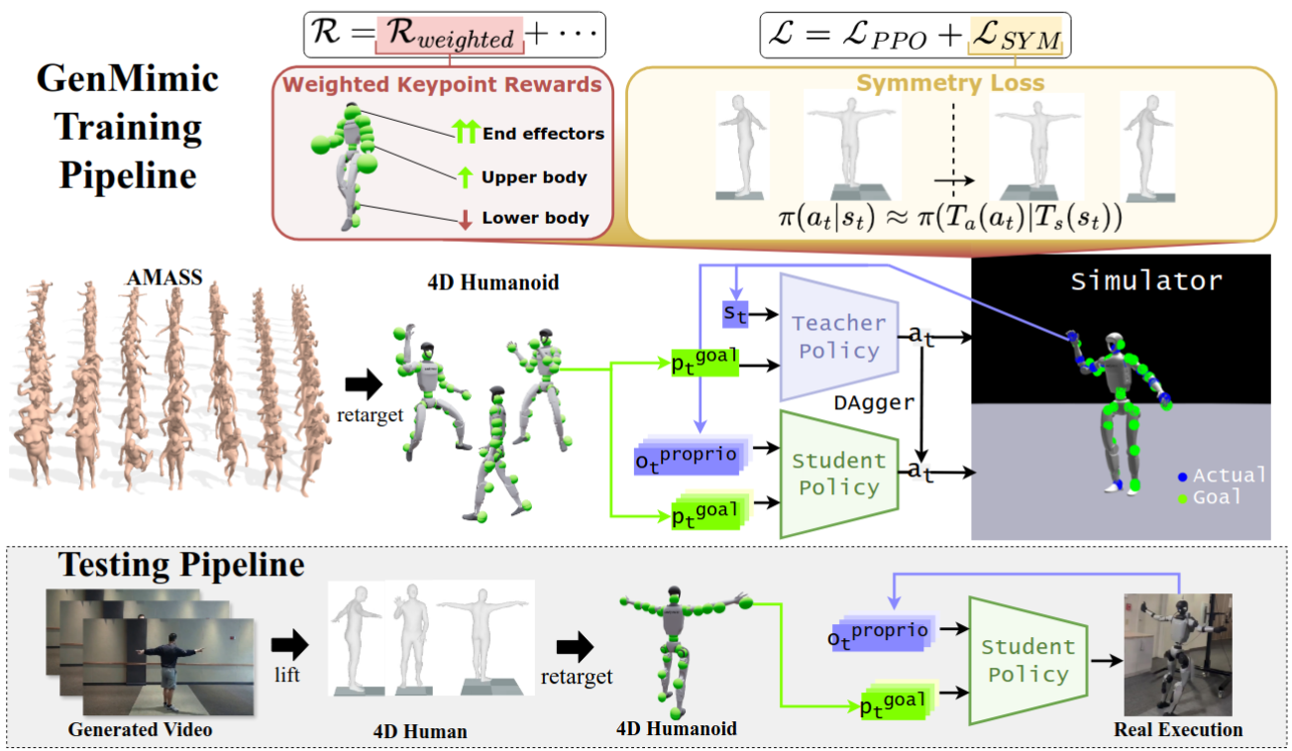
Pipeline Design
Teacher-Student Policy
• Teacher-student on 4D Model • AMASS training in simulator • Keypoint rewards & symmetry loss • Ensures accurate motion
Notes:
Speaker A: As you can see in the pipeline diagram, GenMimic relies on a teacher-student policy architecture built upon a 4D Humanoid model.
Speaker B: This structure is crucial because it facilitates robust control during motion imitation by separating high-level planning from low-level execution within the simulator.
Speaker A: Training flows from the AMASS dataset into the simulator, where we optimize performance using keypoint rewards combined with symmetry loss.
Speaker B: Specifically, the symmetry loss ensures accurate humanoid motion by preventing the model from learning unnatural or imbalanced poses.
Speaker A: Ultimately, this approach enables efficient learning in simulation before successful real-world execution occurs.

Slide 5

Human Video Demo
Input: Frame and Text
Observe motion matching the text prompt. Synthesizes diverse human actions from a single frame and instruction.
Notes:
Speaker A: This slide demonstrates our core capability to generate human action videos using just an initial frame and a text prompt.
Speaker B: This enables conditional video synthesis across a wide range of movements without requiring new motion capture for every action.
Speaker A: To achieve this, the GenMimic pipeline utilizes AMASS data and a 4D Humanoid model within a teacher-student architecture trained in simulation.
Speaker B: Crucially, the system optimizes keypoint rewards and symmetry loss during training to ensure stable real-world execution.
Speaker A: As shown in the sample videos, this approach allows the system to successfully imitate complex motions based on those textual conditions.

Slide 6
Robot Mimicry
Key Action Capabilities
Observe diverse actions like arm raising. Validates humanoid motion mimicry. Ensures physically plausible trajectories.
Notes:
Speaker A: Here we see the core result where generated human videos become physically plausible robot trajectories.
Speaker B: And this matters because the system moves beyond animation to validate complex humanoid motions in actual execution scenarios.
Speaker A: The underlying GenMimic pipeline drives this with a teacher-student policy trained on AMASS using keypoint rewards and symmetry loss.
Speaker B: You can see that stability in the examples, where the robot handles turning and object interaction without losing balance or form.
Speaker A: So across all these demonstrations, we confirm the model mimics diverse physical actions effectively from simulation to reality.

Slide 7
Planning Impact
Physical Actions
Observe complex multi-limb coordination. Enables robust motion analysis. Vital for real-world planning.
Notes:
Speaker A: This slide highlights the diversity of physical actions within our dataset, ranging from simple arm raises to complex stepping motions. These varied demonstrations cover the multi-limb coordination required for robust motion analysis.
Speaker B: Classifying these as humanoid mimic examples signals their direct use in robot imitation learning systems. It indicates we are moving beyond static poses into dynamic sequence reproduction.
Speaker A: Notice in the video clips how actions like turning while grabbing or waving while stepping demand synchronized limb movement. This complexity ensures the data supports rigorous testing of motion replication tasks.
Speaker B: That variety is critical because it allows us to evaluate how well systems reproduce specific human gestures and sequences in real-world scenarios. This ensures the imitation learning framework can handle complex physical interactions.
Speaker A: Ultimately, this robust motion analysis provides the necessary foundation for generating physically plausible robot trajectories.

Slide 8
Thank You!
Notes:
Speaker A: This concludes our review of the functional layout and brings us to the end of the presentation.
Speaker B: Exactly - we want to express our sincere gratitude for your attention and engagement throughout this session.
Speaker A: Thank you very much for your time, and we are now available for any questions you might have.

