Slide 1
Solving Model Forgetting
Notes:
Speaker A: Welcome to this overview of our functional layout schema.
Speaker B: Presenting this meta information upfront ensures alignment on the document version and ownership.
Speaker A: We will reference these details throughout to maintain clarity, so let's move directly into the core architecture.

Slide 2
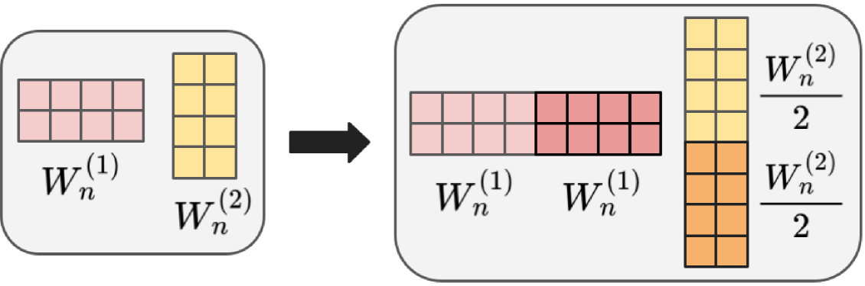
Model Forgetting
Matrix Update Mechanism
Fine-tuning erases knowledge. Visual shows matrices combining to modify components, preventing knowledge loss while adapting.
Notes:
Speaker A: When we fine-tune neural networks for specialized tasks, they often suffer from catastrophic forgetting, effectively erasing previously learned knowledge.
Speaker B: This forces a difficult trade-off where acquiring expert skills in fields like medical diagnosis risks compromising the model's general competence.
Speaker A: To solve this, the architecture utilizes a matrix transformation structure where specific weight matrices combine to form modified components.
Speaker B: Notice how the diagram depicts matrices W_n^{(1)} and W_n^{(2)} combining through color-coded blocks to adjust parameters without direct overwriting.
Speaker A: This approach allows us to maintain foundational knowledge while successfully adapting to new specialized domains.

Slide 3
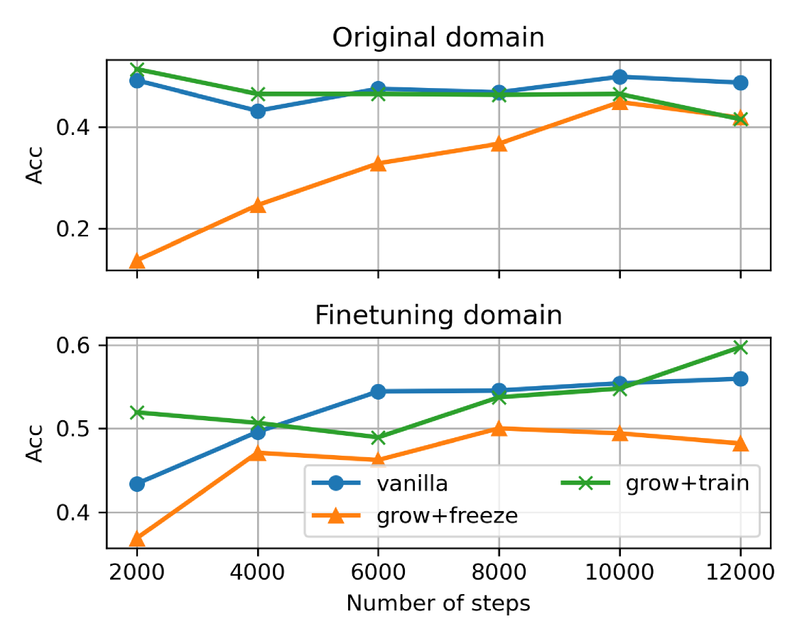
Accuracy Growth
Grow+Train vs Baseline
Grow+train leads finetuning accuracy gains. Original domain stays stable across strategies over 12k steps.
Notes:
Speaker A: Our approach introduces a function-preserving mechanism that grows MLP submodules within pre-trained Transformers.
Speaker B: Exactly, by duplicating the up-projection weights and compensating in the down-projection layer, we maintain the model's initial behavior while creating space for new skills.
Speaker A: Looking at the accuracy trends over twelve thousand steps, the grow and train method significantly outperforms both vanilla fine-tuning and the grow and freeze strategy in the finetuning domain.
Speaker B: Crucially, this improvement doesn't come at a cost, as original domain performance remains stable across all growth strategies compared to the baseline.
Speaker A: This confirms that expanding capacity through structured growth allows for superior adaptation without overwriting previously learned knowledge.

Slide 4
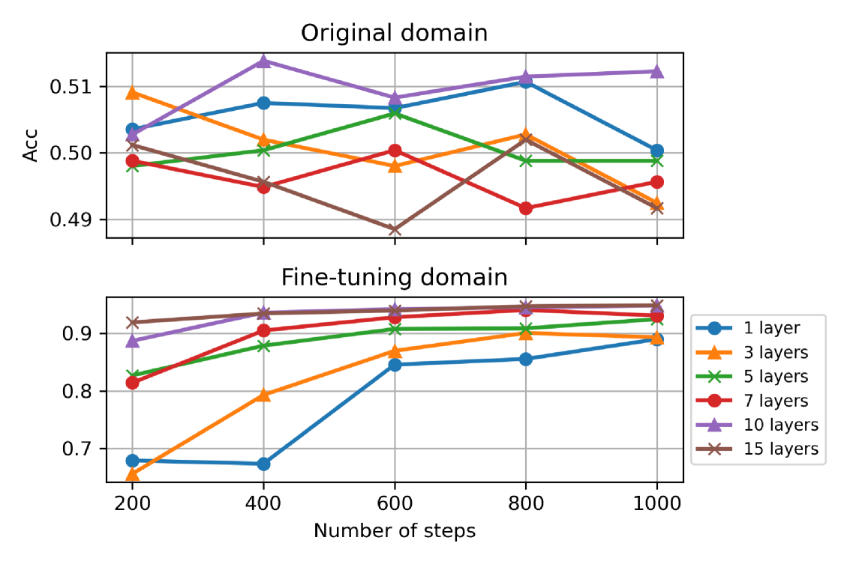
Layer Stability
Accuracy Across Layers
Accuracy stable across 1-15 layers. Original domain stays high. Fine-tuning improves. Prevents knowledge collapse.
Notes:
Speaker A: This slide validates our method's ability to eliminate forgetting across varying layer counts and domains. We see that G-Freeze matches standard fine-tuning on new tasks while nearly preserving original domain knowledge.
Speaker B: That stability is crucial because baseline fine-tuning collapses prior knowledge, causing accuracy to drop significantly on large domain shifts.
Speaker A: Looking at the accuracy chart, notice how G-Train further outperforms G-Freeze on complex tasks like MathQA by fine-tuning the up-projection. This shows targeted plasticity helps improve performance on these harder tasks.
Speaker B: Critically, this happens while foundational knowledge remains intact during training rather than being overwritten.
Speaker A: Ultimately, this confirms we can eliminate forgetting across varying layer counts without compromising on new task performance.

Slide 5
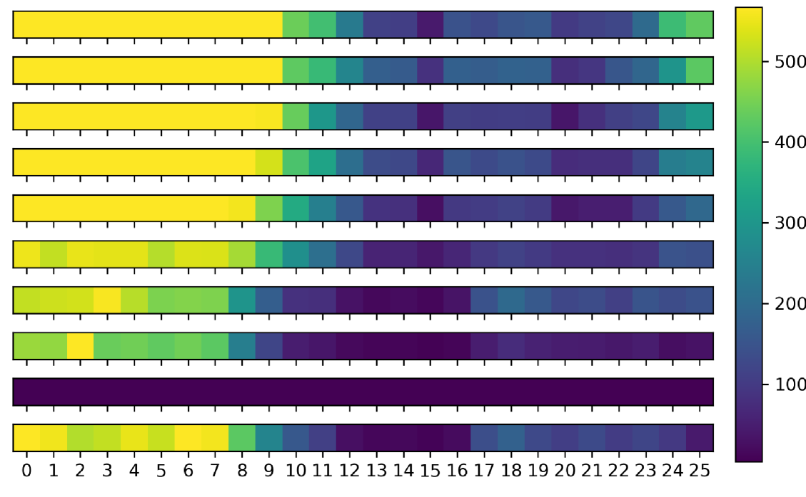
Segment View
Data Segment Analysis
Bars show 26 categories. G-Freeze retains knowledge. Baseline fails on shifts. Gradients indicate contribution density.
Notes:
Speaker A: As we analyze the data distribution across these twenty-six categories, G-Freeze matches standard fine-tuning on new tasks while preserving original domain knowledge.
Speaker B: In contrast, the baseline fine-tuning collapses prior knowledge completely, with accuracy dropping to near-zero on original tasks.
Speaker A: However, on complex tasks like MathQA, G-Train fine-tuning the up-projection outperforms G-Freeze.
Speaker B: Exactly, this indicates that targeted plasticity aids adaptation without sacrificing foundational knowledge entirely.
Speaker A: Ultimately, the goal is balancing stability across domain shifts with the flexibility needed for complex reasoning.

Slide 6
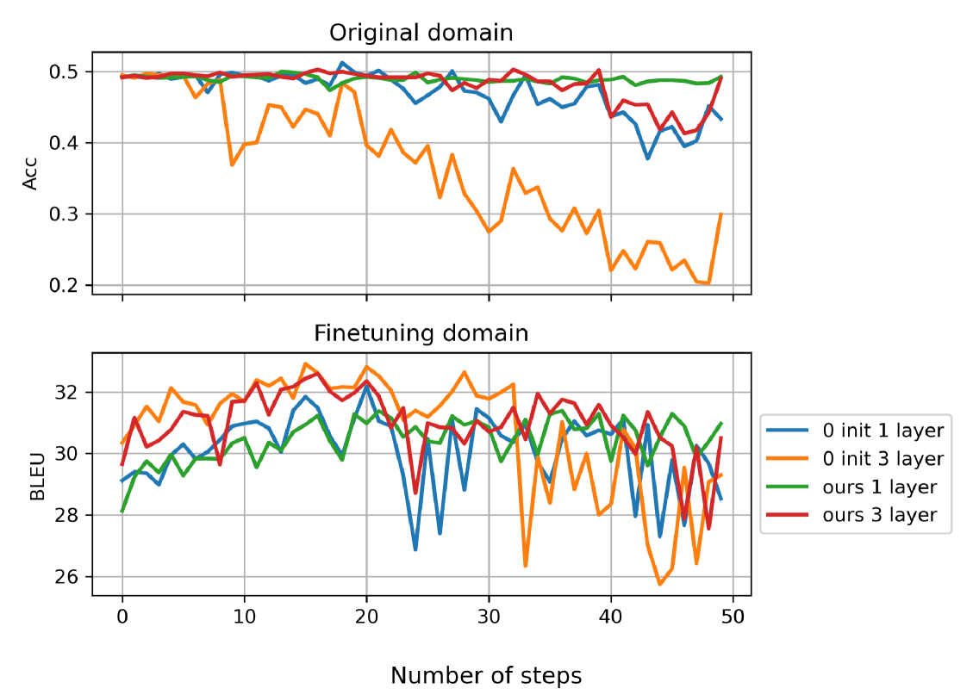
Init Ablation
Accuracy & BLEU Trends
Notice 'ours' lines stay high while zero init drops. Shows robustness across 50 steps for 1 and 3 layer configs.
Notes:
Speaker A: Let's examine the impact of different initialization strategies on accuracy and BLEU scores during our ablation studies. We evaluate performance continuously over fifty training steps to validate the core methodology.
Speaker B: The chart directly compares our function-preserving approach against standard zero initialization baselines. Distinct lines track both one and three layer configurations to isolate the effect of added capacity.
Speaker A: Looking at the trends, our method consistently maintains higher performance compared to the zero initialization variants throughout the training process. This confirms that adding capacity to MLP layers resolves the trade-off between learning new tasks and retaining old knowledge.
Speaker B: Exactly - that stability demonstrates the model isn't overwriting previous knowledge while adapting. Even with just one layer, our initialization outperforms the baseline across both metrics.
Speaker A: So the key takeaway is that our initialization strategy enables effective growth without sacrificing existing capabilities.

Slide 7
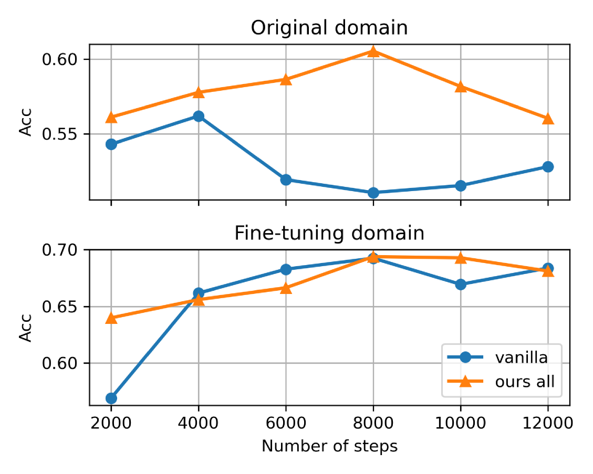
Final Results
Accuracy Trend Summary
"Ours all" exceeds vanilla in both domains. Graph confirms consistent accuracy growth without forgetting over steps.
Notes:
Speaker A: This slide summarizes our final performance comparison, showing how the proposed method outperforms vanilla baselines. We specifically resolve the trade-off between learning new tasks and retaining old knowledge.
Speaker B: This success comes from adding capacity to the MLP layers in a function-preserving manner. It ensures we expand capability without overwriting what the model already knows.
Speaker A: Looking at the chart, you can see accuracy trends over training steps for both the original and fine-tuning domains. Our method consistently tracks higher than the vanilla approach across both areas.
Speaker B: That consistent gap confirms we aren't sacrificing original domain performance to gain fine-tuning accuracy. It validates that the expansion strategy works simultaneously across domains.
Speaker A: So, the key takeaway is that we achieve superior results in both domains without the usual compromise. This demonstrates the effectiveness of our growth strategy over standard fine-tuning.

Slide 8
Thank You!
Notes:
Speaker A: This brings us to the end of our presentation today. We want to express our sincere gratitude for your time and attention.
Speaker B: We hope the insights shared here will support your future planning and decision-making processes. Thank you for engaging with us on this topic.
Speaker A: We are now available to address any final questions you might have. Thank you all for joining us.

