Slide 1
Long-Horizon Task Mastery
Notes:
Speaker A: Welcome everyone, today we are presenting our analysis on the Functional Layout schema.
Speaker B: That's right, and this title slide establishes the scope and authorship for the framework we are about to discuss together.
Speaker A: With those details established, we will move directly into the core requirements and implementation guidelines.

Slide 2
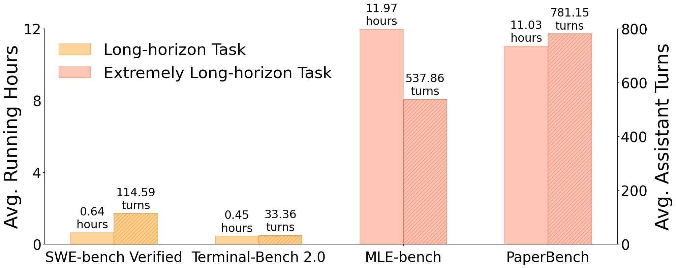
Horizon Demands
Benchmark Scale Metric
Higher running hours and assistant turns required for long-horizon tasks across benchmarks.
Notes:
Speaker A: Large language models now enable agents with memory and planning capabilities essential for real-world applications like vibe coding. However, moving from basic tasks to long-horizon challenges introduces significant complexity.
Speaker B: Exactly, and this chart highlights the scale of that complexity across standard benchmarks. You can see that extremely long-horizon tasks demand significantly higher running hours and assistant turns.
Speaker A: We observe this trend across SWE-bench, Terminal-Bench, and PaperBench, where interaction depth drives up the cost. The data shows that bug fixing and terminal coding require sustained engagement rather than single-shot responses.
Speaker B: That's the key point, because higher turn counts directly correlate with the computational cost shown in these benchmarks. It means solving these tasks requires maintaining agent stability over much longer execution windows.
Speaker A: So while the foundational capabilities exist, scaling them for these deep research tasks remains the primary hurdle we need to address.

Slide 3
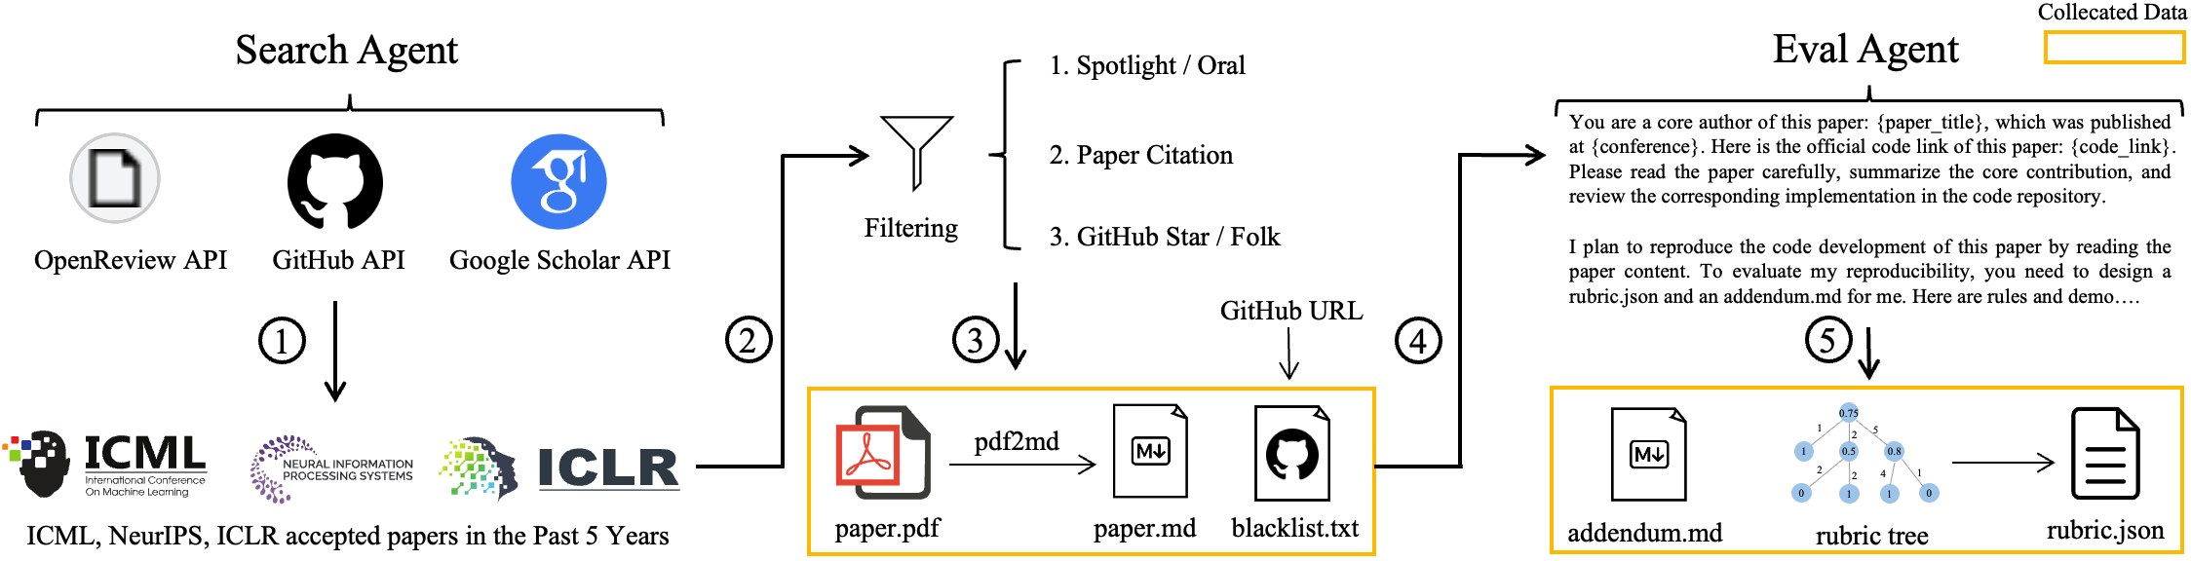
Research Pipeline
Pipeline Component Flow
Flow: Search Agent to Filtering to Eval Agent. Covers data collection, APIs, paper processing, and code implementation.
Notes:
Speaker A: This slide outlines how LLMs serve as the foundation for intelligent agents by enabling memory, tool use, and planning capabilities.
Speaker B: That foundation is critical because long-horizon tasks like bug fixing pose significant challenges due to their scale and interaction depth.
Speaker A: To address this, the diagram shows our research pipeline utilizing a Search Agent and filtering process that leads to an Eval Agent for assessment.
Speaker B: This workflow connects disparate steps like API usage and paper processing into a unified path for code implementation.
Speaker A: Right, and this structured approach enables the sustained interaction required for complex deep research applications.

Slide 4
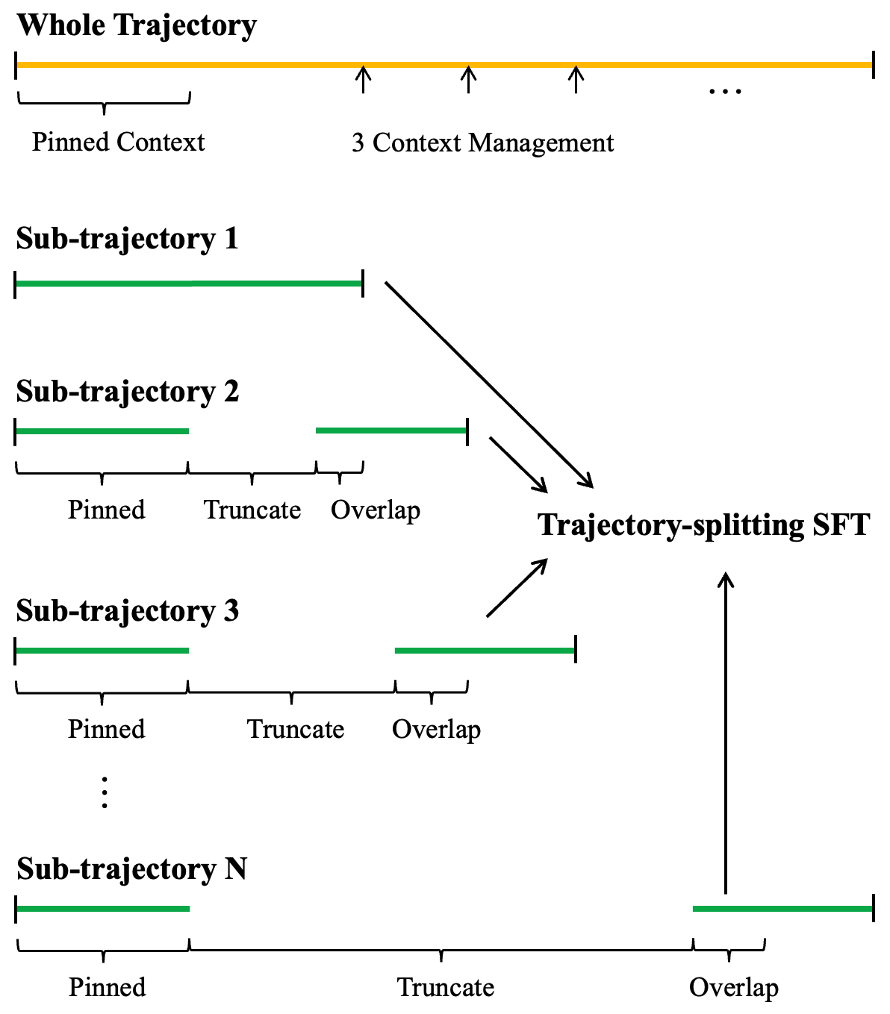
Trajectory Split
Splitting Segment Type
Divides trajectories into Pinned, Truncated, and Overlap parts. Enables fine-tuning on long contexts within limits.
Notes:
Speaker A: KLong addresses extremely long-horizon tasks like research paper replication, but standard models struggle with the context length required for full trajectories. To solve this, we employ a training methodology centered on trajectory splitting.
Speaker B: Crucially, this allows the agent to learn from extended sequences without exceeding token limits during supervised fine-tuning. It effectively breaks down complex workflows into manageable learning segments.
Speaker A: Looking at the diagram, you can see how a whole trajectory is divided into pinned, truncated, and overlapping segments before feeding into the SFT process. This structure ensures critical context is retained while maintaining training efficiency.
Speaker B: By overlapping these segments, the model maintains continuity across the split points, which is vital for tasks requiring iterative planning. Consequently, this generalizes well beyond replication to areas like code security and terminal coding.
Speaker A: Ultimately, this splitting strategy enables the model to handle the strict time limits and sandbox constraints inherent to these tasks. It is the foundational technique that allows KLong to replicate code successfully where standard contexts fail.

Slide 5
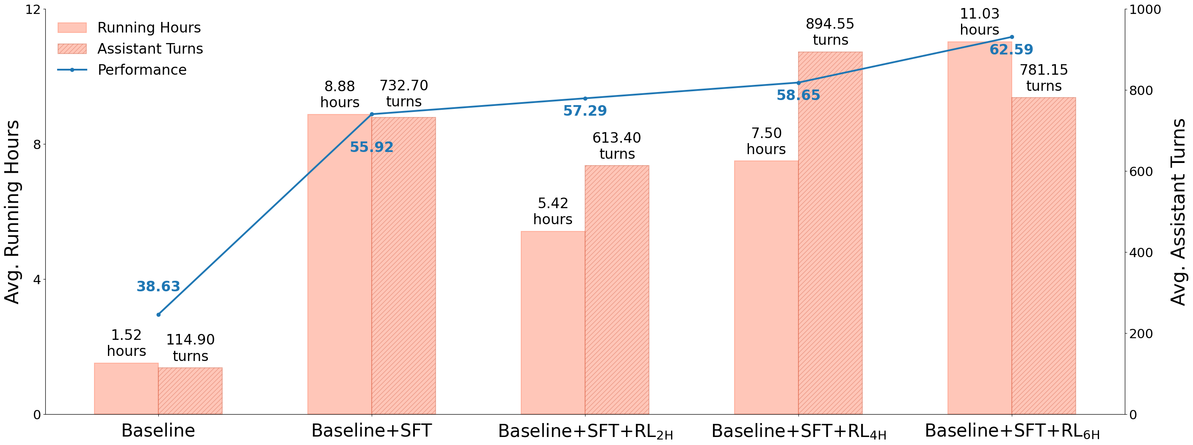
Scaling Results
Running Hours & Turns
Baseline: 1.52h, 115 turns. Advanced: 11.03h, 781 turns. Notice sharp rise in capacity and interaction depth.
Notes:
Speaker A: This slide demonstrates how our advanced configurations significantly extend the agent's operational capacity compared to the baseline. You can see the substantial increase in both running hours and assistant turns on the chart.
Speaker B: Exactly - this scaling is critical because replicating research papers requires sustained interaction over many hours, not just quick queries. The baseline simply cannot sustain the necessary context window or tool use duration.
Speaker A: Specifically, the Baseline plus SFT and RL6H configuration reaches over eleven hours and seven hundred eighty-one turns. This is a massive jump from the baseline's one and a half hours and one hundred fifteen turns.
Speaker B: That increase directly supports the evaluation strategy where a frontier judge model scores the replication quality using an author-written rubric. Without those extra turns, the agent couldn't complete the complex engineering tasks required for a high score.
Speaker A: So the key takeaway is that our method enables the long-horizon planning needed for independent code replication within sandbox constraints. This sets the stage for generalization into security and ML engineering domains.

Slide 6
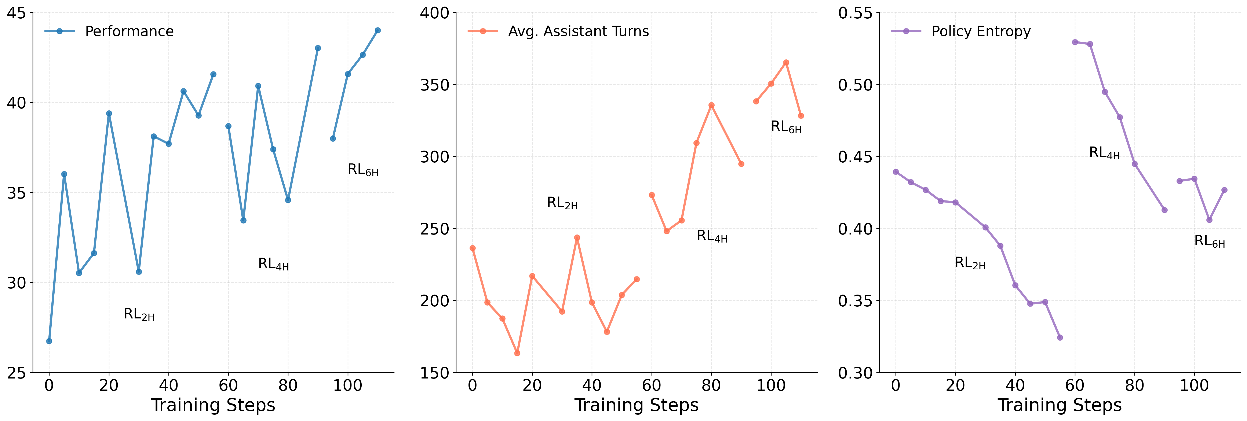
Training Trends
Key Training Metrics
Performance rises across RL configs. Turns and entropy drop. Shows improved efficiency and stability during training.
Notes:
Speaker A: KLong leads open-source models on PaperBench with an eleven percent improvement over Kimi K2 Thinking.
Speaker B: This performance gap narrows significantly with closed-source models due to the underlying training dynamics we see here.
Speaker A: The graphs show that across RL2H, RL4H, and RL6H, performance increases while assistant turns and policy entropy decrease over steps.
Speaker B: That reduction in turns and entropy signals the model is learning more efficient and confident reasoning paths during training.
Speaker A: Ultimately, these optimized dynamics drive the strong average performance we see on long-horizon tasks.

Slide 7
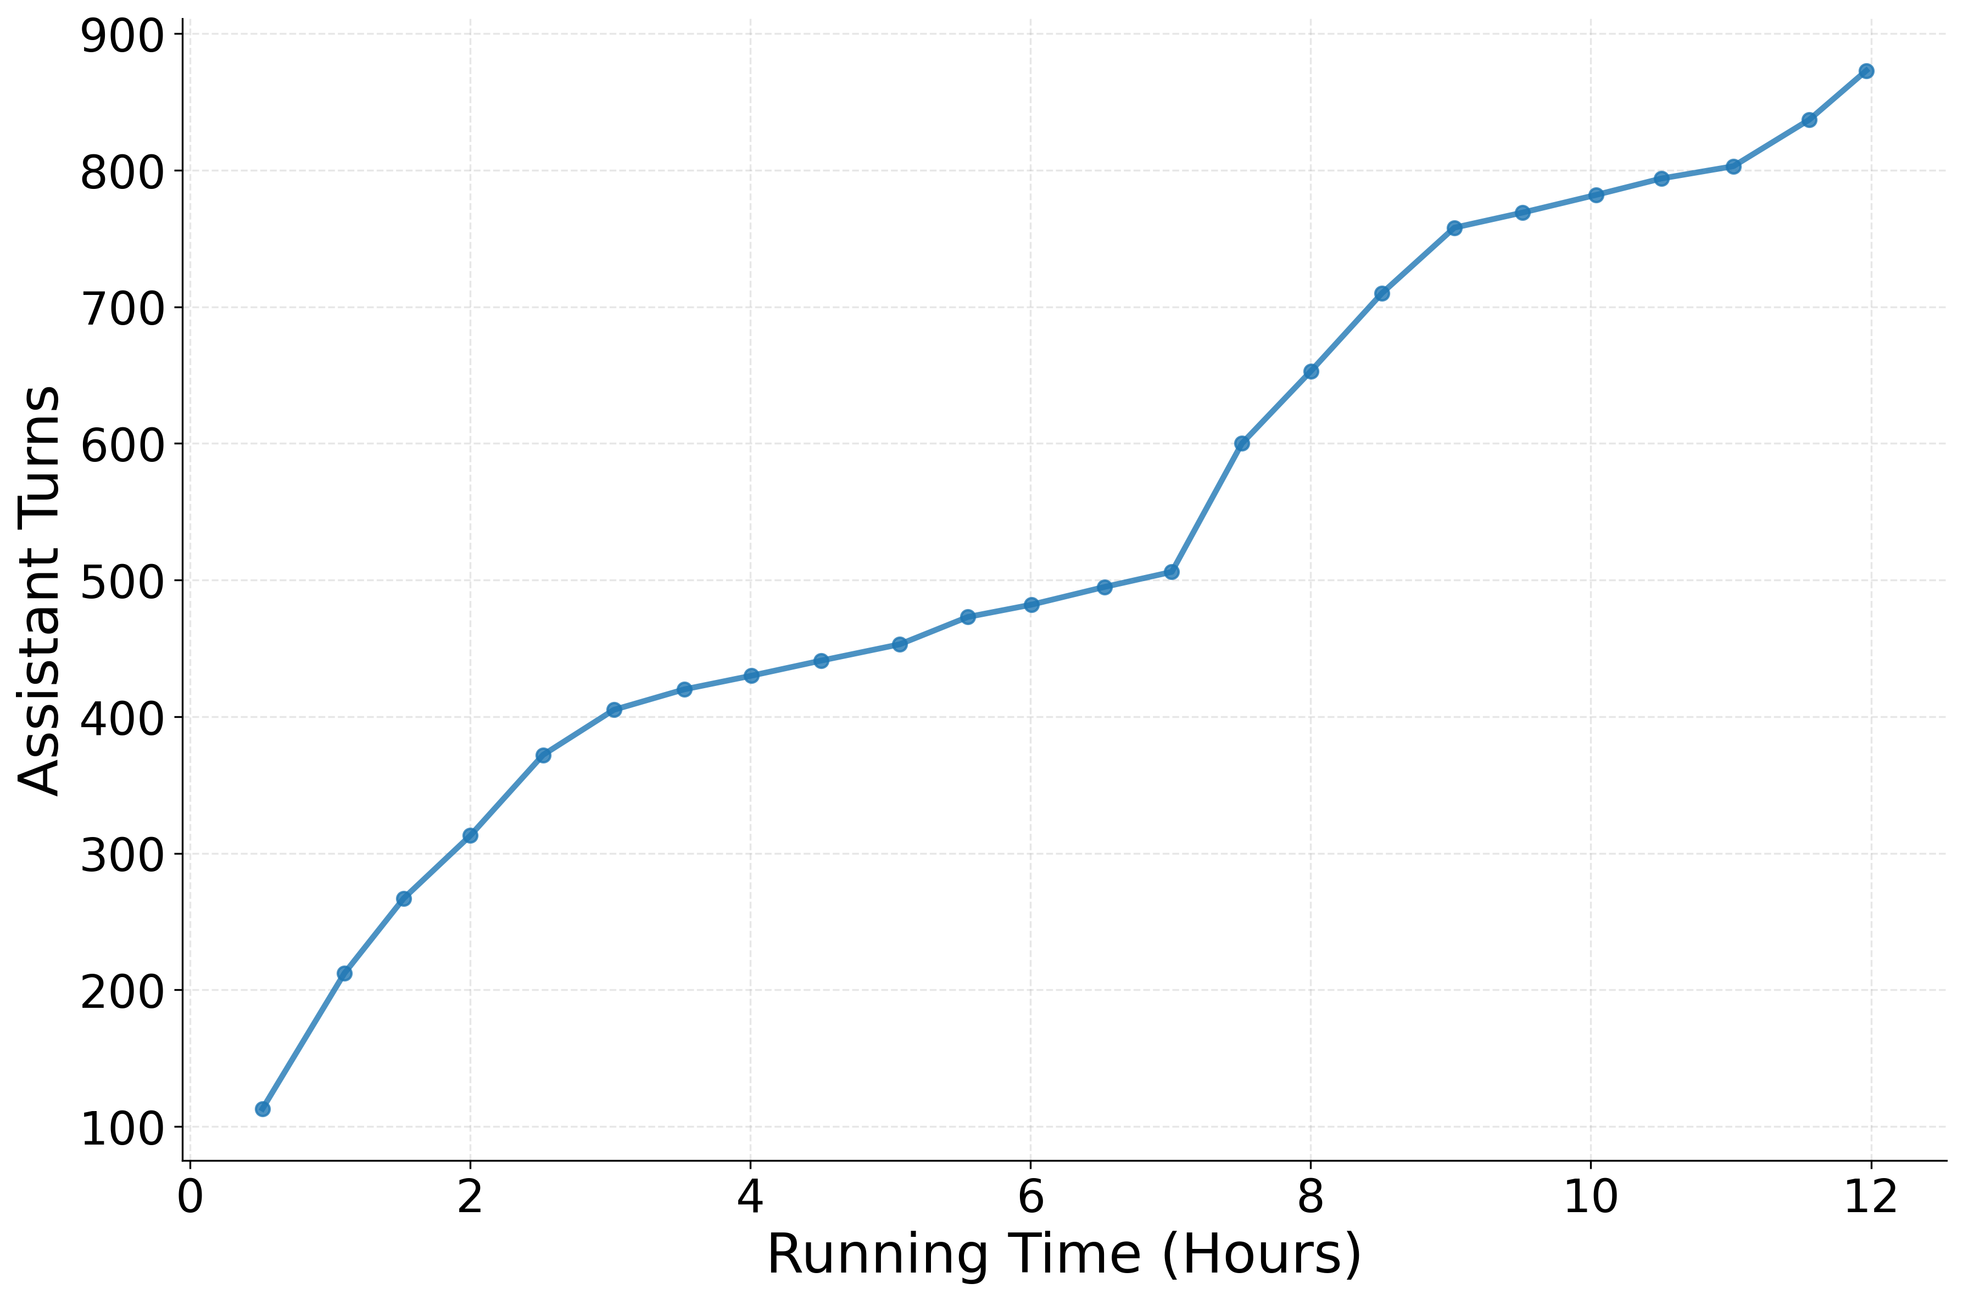
Turns Over Time
Sustained Turn Growth
• Turns rise steadily to 850 • Curve flattens slightly at end • Shows sustained engagement
Notes:
Speaker A: On PaperBench, KLong establishes a new standard for open-source models with an 11.28% improvement over Kimi K2 Thinking.
Speaker B: This performance is critical because it significantly narrows the gap between open and closed-source solutions.
Speaker A: Beyond benchmarks, the chart shows assistant turns steadily increasing from 100 to 850 over a 12-hour running period.
Speaker B: That sustained growth demonstrates the model's superiority for extremely long-horizon reasoning tasks like test-time adaptation.
Speaker A: Together, these results confirm KLong's unique capability to maintain engagement and performance over extended durations.

Slide 8
Thank You!
Notes:
Speaker A: This brings us to the conclusion of our presentation today.
Speaker B: We want to use this final moment to sincerely thank you for your time and attention.
Speaker A: Thank you for joining us, and we hope you found this session valuable.

