Slide 1
Scale Space Diffusion
Notes:
Speaker A: Welcome to our presentation on the functional layout system, where we will walk through the latest design specifications.
Speaker B: That's right, and as the date indicates, this reflects the most current standards effective this quarter.
Speaker A: You'll see our names listed here, representing the joint effort between the design and engineering teams.
Speaker B: Exactly, this shared ownership ensures the technical constraints align with the user experience goals from the start.
Speaker A: With that context established, let's move directly into the core architecture overview.

Slide 2

SSD vs. DDPM
Resolution Progression
SSD begins low-res, progressing upward. DDPM stays full-res. This yields a 1.58x inference speedup over DDPM.
Notes:
Speaker A: Our core insight connects diffusion noise to scale-space theory, revealing an information hierarchy across timesteps. This structure mirrors the low-pass filtering hierarchy found in traditional scale-space analysis.
Speaker B: Exactly - because highly noisy states contain no more information than downsampled images. Processing them at full resolution is therefore unnecessary computation.
Speaker A: SSD fuses these scale spaces by starting sampling at lower resolutions and progressively increasing as noise decreases. As the video comparison shows, we avoid the fixed high-resolution cost of standard DDPM.
Speaker B: This efficiency gain is substantial, achieving a 1.58x inference speedup for sixty-four by sixty-four generation. It proves we can reduce latency without altering the underlying diffusion objective.
Speaker A: Ultimately, we match computational cost to information content throughout the generation process. This eliminates wasted computation during the early noisy stages.

Slide 3
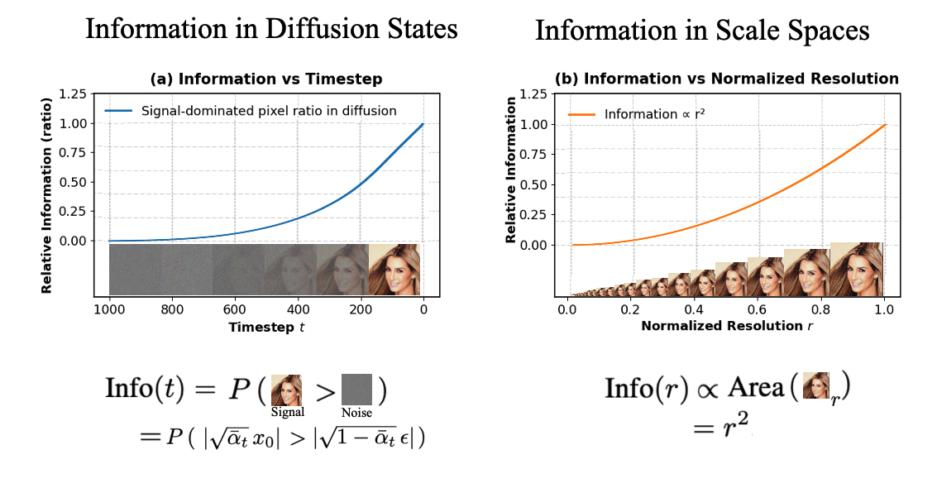
Diffusion Scale
Information Hierarchy
Signal ratio rises over timestep. Quadratic info vs resolution. Visuals show progression across scales.
Notes:
Speaker A: We begin by mapping the relationship between diffusion timesteps and scale-space theory through these information hierarchy graphs.
Speaker B: Another way to say this is that both systems track how meaningful signal emerges against a background of noise or lower resolution.
Speaker A: As you follow the curve in graph A, the signal-dominated pixel ratio rises steadily over time, contrasting with graph B which demonstrates a quadratic relationship between information and normalized resolution.
Speaker B: This parallel suggests that progressing through diffusion timesteps is mathematically similar to traversing scale spaces.
Speaker A: Consequently, we can leverage scale-space priors to optimize how information is recovered during the diffusion process.

Slide 4
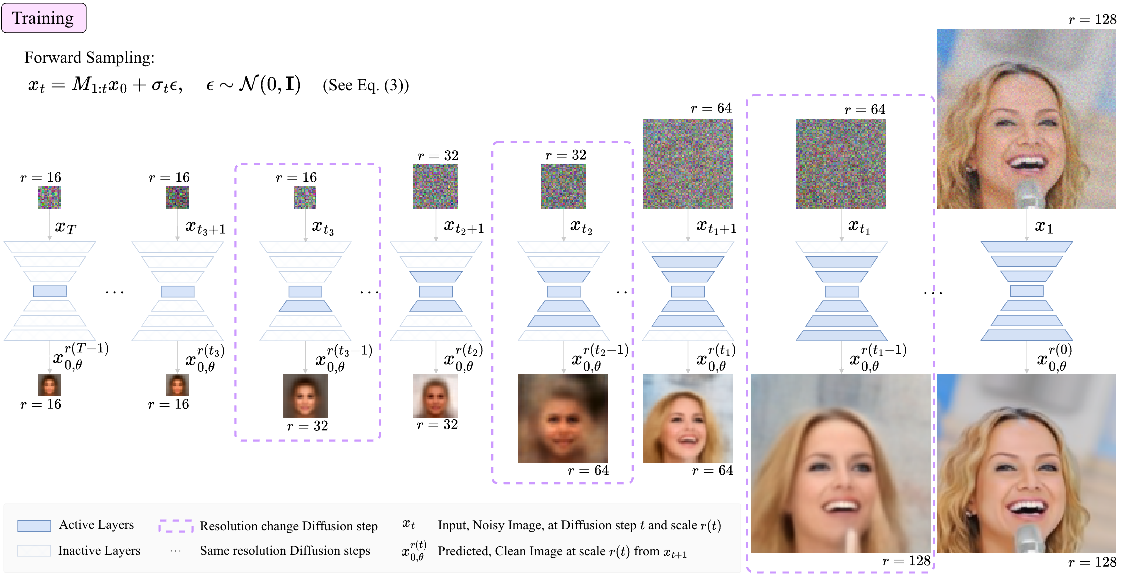
SSD Training
Resolution & Layers
Noisy inputs become clean across scales 16-128. Active and inactive layers manage resolution changes.
Notes:
Speaker A: This slide illustrates the training process of the Scale Space Diffusion model, demonstrating how noisy images at varying scales transition to clean images.
Speaker B: Exactly, the model operates across multiple scales with resolutions ranging from sixteen to one hundred twenty eight pixels.
Speaker A: During forward sampling, active and inactive layers are indicated to manage the resolution change diffusion steps shown in this sequence.
Speaker B: And this visual sequence demonstrates how resolution change diffusion steps occur across the training pipeline.
Speaker A: Ultimately, this varying resolution approach allows the network to handle image details at different structural levels within the network.

Slide 5
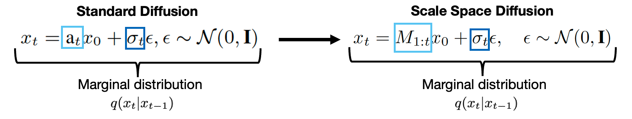
SSD Formulation
Operator Mapping Logic
Maps scalar $a_t$ to matrix operator $M_{1:t}$. Diagram shows shift via resize. Enables diverse marginal distributions.
Notes:
Speaker A: Here we define the core mechanism where Scale Space Diffusion maps a scalar value directly to a matrix-based linear operator.
Speaker B: That fundamental mapping is critical because it enables the transition from standard diffusion processes to our scale space formulations.
Speaker A: Looking at the diagram, the operator functions as any linear operator, though we specifically demonstrate it here as a resize operator to visualize the scale change.
Speaker B: Exactly, and this flexibility supports diverse mathematical formulations for the marginal distributions shown in the equation.
Speaker A: So ultimately, this operator definition allows us to generalize the diffusion process beyond standard constraints.

Slide 6
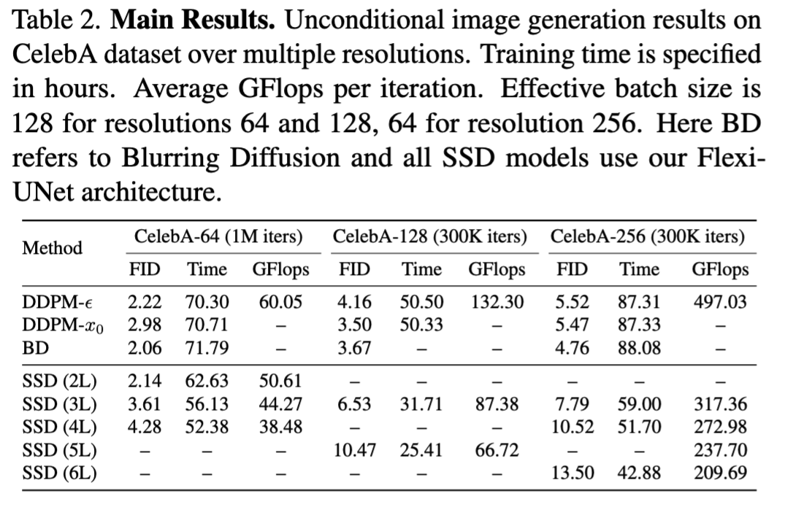
SSD Performance
Efficiency & FID Scores
Note lower training hours vs DDPM in table. FID scores stay comparable on CelebA. Gains grow with resolution levels.
Notes:
Speaker A: Turning to our quantitative evaluation, Table 2 shows that SSD achieves comparable FID scores to baselines like DDPM-ε while substantially lowering training time.
Speaker B: That efficiency stems from the model relationship, where DDPM-x₀ is effectively a special case of SSD known as SSD with one level.
Speaker A: Because of this, we save substantial training compute on the CelebA dataset without compromising the quality you see in the generation samples.
Speaker B: And this matters because the efficiency gains increase significantly at higher resolutions and when using more levels.
Speaker A: Ultimately, SSD delivers consistent performance with much lower computational cost across different scales.

Slide 7
Visual Results
Visual Progression
Shows transition from abstract patterns to portraits. Demonstrates progressive resolution enhancement in generation.
Notes:
Speaker A: We find that SSD generalizes DDPM-x0 as a special case, saving substantial training compute while maintaining comparable FID scores.
Speaker B: Right, and the animation reinforces this by showing progressive enhancement from abstract patterns to recognizable portraits without losing detail.
Speaker A: Beyond quality, the charts show information scales quadratically with resolution, resulting in substantially lower training time.
Speaker B: This means efficiency gains increase at higher resolutions, driven by the signal-dominated pixel ratio growing over timesteps.
Speaker A: Ultimately, this delivers baseline performance with a much more scalable and resource-efficient training process.

Slide 8
Thank You!
Notes:
Speaker A: This brings us to the conclusion of our presentation today.
Speaker B: Exactly - we want to express our sincere gratitude for your time and attention throughout this session.
Speaker A: Thank you for joining us, and we are happy to take any questions you might have.
Speaker B: Please feel free to reach out to us afterward if you need further clarification.

