Slide 1
SlopCodeBench: Code Decay
Notes:
Speaker A: Welcome everyone as we begin this session on the functional layout design proposed in this deck.
Speaker B: This opening slide serves to anchor us with the essential meta information before we proceed.
Speaker A: You will see the project title and authorship details here that define the scope of our work.
Speaker B: Another way to say this is that it ensures we are all aligned on the version and timeline of this analysis.
Speaker A: With that context established, let us move forward to examine the actual layout structure.

Slide 2
SlopCodeBench Core
Existing benchmarks measure correctness once, ignoring architectural deterioration during repeated editing.
SlopCodeBench uses 20 problems and 93 checkpoints to measure quality evolution without internal constraints.
Agents fail end-to-end, producing code 2.2 times more verbose and eroded than human repositories.
Notes:
Speaker A: Existing benchmarks evaluate models only once against complete specifications, measuring only correctness. This systematically undermeasures architectural deterioration during repeated editing.
Speaker B: Another way to say this is that they ignore extensibility and code quality under future change.
Speaker A: SlopCodeBench fixes this with 20 iterative problems and 93 checkpoints that specify external behavior while leaving internal structure unconstrained.
Speaker B: Empirical results show no agent solves problems end-to-end, with agent code being 2.2 times more verbose and eroded than maintained repositories.
Speaker A: Crucially, the maximum checkpoint solve rate is only 17.2 percent, and quality-aware prompts do not slow this deterioration.

Slide 3
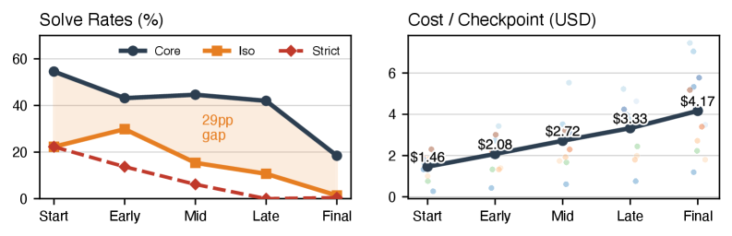
Solve Rate Drop
Performance vs Cost
• Costs rise 2.9x without correctness gain. • Solve rates drop steadily. • Core-isolated gap widens.
Notes:
Speaker A: This slide highlights a critical bottleneck where no agent fully solves any problem end-to-end, with Opus 4.6 leading at just a 17.2 percent strict solve rate.
Speaker B: That performance ceiling is paired with worsening efficiency, as costs grow 2.9 times across checkpoints without improving overall correctness.
Speaker A: Looking at the graph, you can see solve rates decrease over stages while the cost per checkpoint increases steadily from start to final.
Speaker B: And this matters because error-handling tests drive most declines, widening the gap between core and isolated rates up to 13.3 times.
Speaker A: Ultimately, this indicates substantial limitations in current agent capabilities, where scaling costs does not translate to scaling performance.

Slide 4
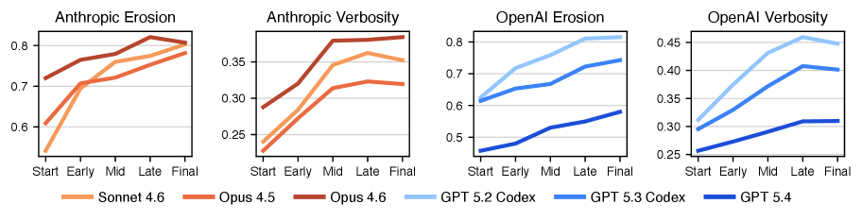
Erosion Metrics
Model-Specific Erosion
Notice diverging trajectories in Late stages. Sonnet 4.6 shows steeper decay. Verbosity varies by model architecture.
Notes:
Speaker A: Looking at the performance statistics, no agent currently solves all twenty problems end-to-end. Opus 4.6 leads the group, but even it achieves only a 17.2% strict solve rate.
Speaker B: That highlights a significant disparity between potential and execution. While core rates reach up to 53.8%, the isolated pass rates remain much lower, ranging from just 7.5 to 23.7%.
Speaker A: As checkpoints advance in the visual, the gap between those core and isolated pass rates widens significantly from 1.4 times to 13.3 times. Simultaneously, costs grow 2.9 times without corresponding improvements in correctness.
Speaker B: Exactly, and the line graphs show that error-handling tests drive most of this performance decline. We are essentially paying more for verbosity rather than structural reliability.
Speaker A: So the key takeaway is that model-specific degradation patterns are worsening despite higher costs. We need to address structural erosion rather than just scaling compute.

Slide 5
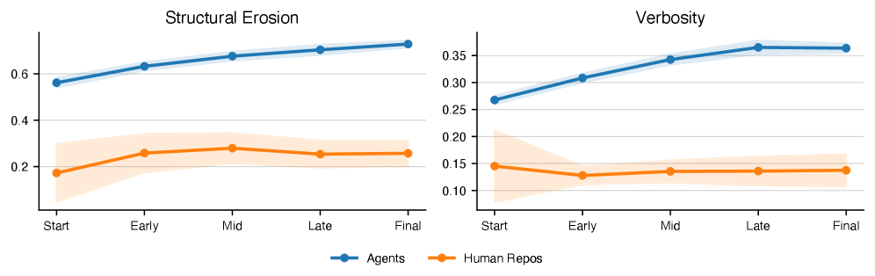
Drift Over Time
Structural Erosion Gap
Agents climb in erosion and verbosity. Human lines remain flat. 79% of agent paths worsen over time.
Notes:
Speaker A: Even the best agent reaches only a seventeen percent strict solve rate, with costs increasing nearly threefold without improving correctness.
Speaker B: Right, and that efficiency gap is compounded by code quality issues where agents concentrate complexity and drive up verbosity significantly.
Speaker A: As the chart shows, structural erosion and verbosity rise sharply for agents over time, whereas human repositories remain stable.
Speaker B: This indicates that seventy-nine percent of trajectories show rising erosion compared to no verbosity drift in human commits.
Speaker A: We need to prioritize structural stability alongside solve rates to prevent unsustainable technical debt accumulation.

Slide 6
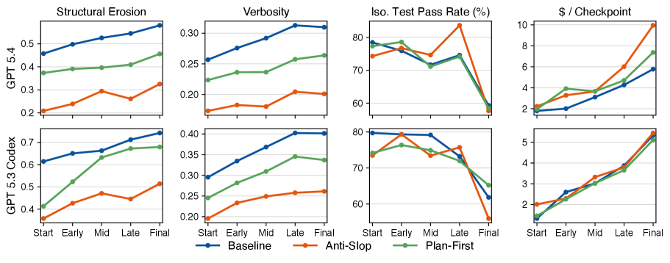
Strategy Impact
Clean Code, High Cost
Anti-slop cuts verbosity 34.5% but slopes persist. Costs rise 47.9% with no gain. Graph confirms unchanged decay trends.
Notes:
Speaker A: We need to assess whether prompt strategies like Plan First and Anti Slop effectively halt degradation across our benchmark metrics.
Speaker B: The critical finding is that while these strategies reduce initial verbosity, they fail to improve the core pass rates during iteration.
Speaker A: Looking at the line graph, verbosity drops by thirty-four point five percent, yet the degradation slopes for structural erosion and test pass rates remain unchanged.
Speaker B: This creates a negative trade-off where cleaner code raises costs by forty-seven point nine percent without actually fixing correctness.
Speaker A: Ultimately, no agent solves all problems end-to-end, with the highest strict solve rate capping at just seventeen point two percent.

Slide 7
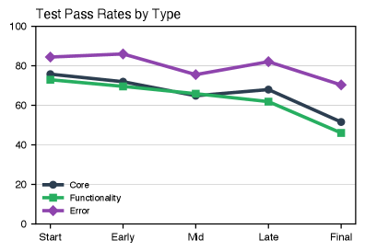
Test Pass Rates
Test Pass Rate Decline
• Error shows highest initial pass rate. • Core and Functionality decline over time. • Tracks Start to Final stages.
Notes:
Speaker A: We are analyzing test pass rates across five development stages to identify specific areas of code quality decline.
Speaker B: This breakdown is crucial because aggregating all test types would obscure the distinct behaviors we see between Core, Functionality, and Error categories.
Speaker A: As the chart shows, Error tests maintain the highest initial pass rate, whereas Core and Functionality rates demonstrate a clear decline from Start to Final.
Speaker B: Essentially, the system continues to catch basic errors, but the underlying functionality becomes less stable as development progresses.
Speaker A: This indicates we need to prioritize stabilizing Core and Functionality modules during later iterations to halt this downward trend.

Slide 8
Thank You!
Notes:
Speaker A: This brings us to the conclusion of our presentation today.
Speaker B: Exactly - we have established the foundation needed to move forward.
Speaker A: We sincerely appreciate your participation and thank you for joining us.

