Slide 1
Agentic Decomposition
Notes:
Speaker A: Welcome everyone, this opening slide displays the title of our presentation along with the author and date information.
Speaker B: That's right - establishing these details upfront ensures we all share the same context for the session.
Speaker A: We will use this information to frame our timeline and ownership before moving to the first content slide.

Slide 2
LLM Limits & MDAP
One percent per-step error makes million-step success impossible.
MDAP introduces minimal subtask decomposition for process management.
Subtask-level voting and red-flagging reduce correlated errors.
Notes:
Speaker A: We start by recognizing that LLMs face critical limits in extreme-precision, million-step tasks.
Speaker B: That compounding risk means even a one percent per-step error rate renders success impossible.
Speaker A: The MDAP Framework counters this with minimal subtask decomposition and subtask-level voting for error correction.
Speaker B: These red-flagging mechanisms are key since they reduce correlated errors effectively within complex systems.
Speaker A: Therefore, understanding these constraints is vital for large real-world process deployment.

Slide 3
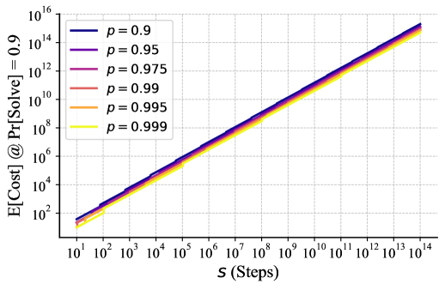
Scaling & Cost
Reliability Saves Cost
Plot: cost vs steps. Curves show probabilities (0.9-0.995). High reliability reduces cost. Accuracy gains save compute.
Notes:
Speaker A: We start with the MAD Architecture, which breaks long-horizon tasks into single-action subtasks handled by dedicated agents. This minimal context strategy avoids error accumulation and enables modular correction.
Speaker B: That structural choice is critical because it directly influences the cost scaling dynamics we see in the chart.
Speaker A: The log-log plot maps expected cost against step count, with curves representing success probabilities from 0.9 up to 0.995.
Speaker B: The key insight here is that higher success probability drastically reduces the cost scaling rate, visualizing the link between reliability and expense.
Speaker A: Ultimately, this demonstrates that improving agent reliability is the most effective way to control computational costs in complex workflows.

Slide 4
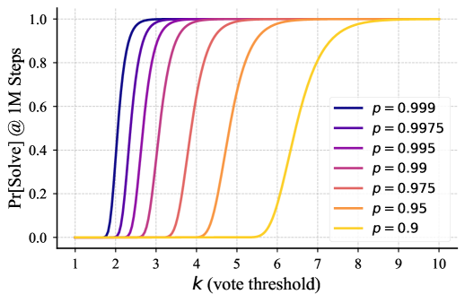
Task Solve Prob
Success vs. Threshold
Success rises with vote thresholds. Curves steepen as agent accuracy nears one. Shows reliability scaling.
Notes:
Speaker A: We employ Maximal Agentic Decomposition to split long-horizon tasks into minimal subtasks, where each agent handles a single action with minimal context.
Speaker B: This modularity avoids error accumulation from growing context and enables efficient error correction unavailable in monolithic systems.
Speaker A: The chart illustrates the performance dynamics, showing how the probability of solving tasks increases against vote thresholds across various agent success rates.
Speaker B: Exactly - notice the sigmoidal curves become significantly steeper as individual agent probability approaches one, visualizing how reliability scales with vote thresholds.
Speaker A: This confirms that managing these probabilities and thresholds allows us to achieve high reliability even across million-step tasks.

Slide 5
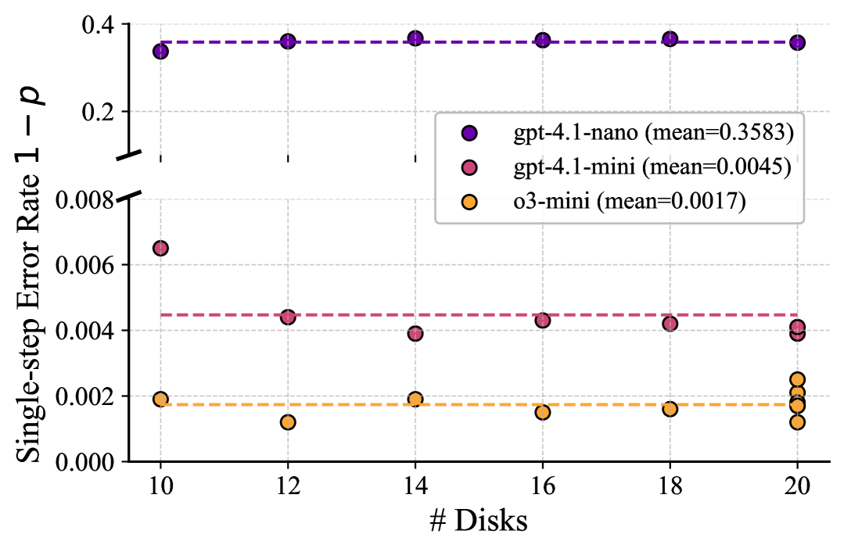
Step Error Rate
Model Error Comparison
Error rates (1 - p) for gpt-4.1-nano, mini, o3-mini across disk counts. Mean levels highlight reliability variance.
Notes:
Speaker A: We validated MAKER on the 20-disk Towers of Hanoi problem, executing over one million LLM steps with zero errors.
Speaker B: That scale is critical because it proves the system maintains reliability even as task complexity grows exponentially.
Speaker A: To establish the baseline, this chart displays single-step error rates for gpt-4.1-nano, mini, and o3-mini across varying disk numbers.
Speaker B: Exactly - this visualizes the inherent model variance, showing how error rates shift with disk count while maintaining distinct mean levels per model.
Speaker A: Combined with our red-flagging impact, this confirms zero errors across the full-scale execution despite these baseline model variances.

Slide 6
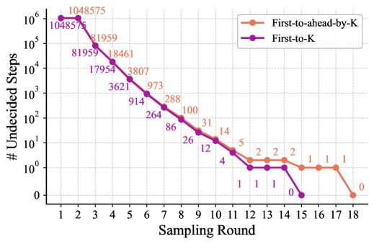
Undecided Steps
Undecided Steps Decay
Log graph shows exponential decay per round. Trends compare resolution strategies. Voting drives convergence rapidly.
Notes:
Speaker A: We validated MAKER on the 20-disk Towers of Hanoi problem, achieving over one million LLM steps with zero errors during full-scale execution.
Speaker B: This demonstrates robust performance at significant scale, visually confirmed by the logarithmic graph where undecided steps decrease exponentially with sampling rounds.
Speaker A: Our evaluation structure covers setup and single-step error-rate estimation to track exactly how these sampling rounds drive resolution.
Speaker B: Specifically, the comparison between First-ahead by K and First K strategies reveals how red-flagging impacts correlated errors across the system.
Speaker A: Ultimately, this comprehensive analysis confirms the convergence of undecided steps through our sampling rounds and voting mechanisms.

Slide 7
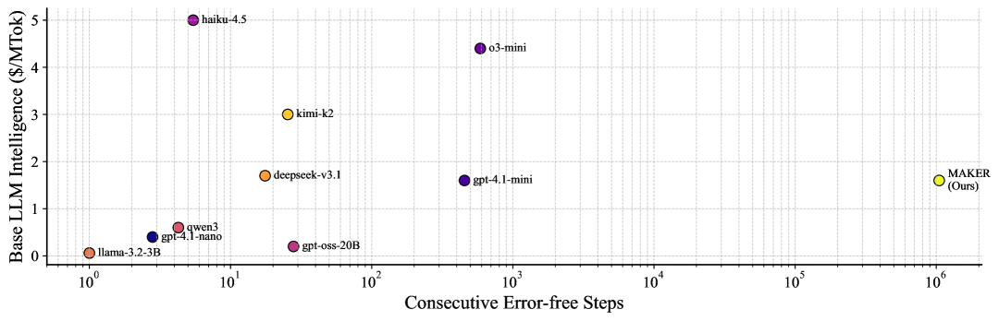
Scaling Results
Intelligence vs. Steps
Observe linear log-log trend: Intelligence predicts Error-free Steps. MAKER validates scaling trends across scales.
Notes:
Speaker A: We conclude by looking at how decomposing tasks into minimal subtasks enables effective error correction. This approach is what supports scaling processes to millions of steps without accumulating critical failures.
Speaker B: This stability matters because breaking down complexity prevents small errors from cascading into system-wide failures. It creates the foundation needed to reach this scale.
Speaker A: The log-log scatter plot here illustrates the direct relationship between Base LLM Intelligence and Consecutive Error-free Steps. You can see models like MAKER demonstrating performance trends across these different scales.
Speaker B: The data points validate scaling here rather than showing a hard ceiling. This confirms that higher base intelligence translates directly into longer error-free execution chains.
Speaker A: Ultimately, this evidence shows we can solve million-step tasks with zero errors by leveraging this scaling relationship.

Slide 8
Thank You!
Notes:
Speaker A: This brings us to the conclusion of our session today. We sincerely appreciate your attention and interest in this work.
Speaker B: Exactly - your engagement throughout this process has been invaluable to us. We are happy to address any questions you might have now.
Speaker A: Thank you again for joining us, and we look forward to continuing this conversation soon.

