Slide 1
Saguaro: Speculative SSD
Notes:
Speaker A: Welcome to our session where we will walk through the functional layout and key metrics of this project.
Speaker B: Right - this opening slide serves to formally introduce the presentation metadata and establish ownership of the work.
Speaker A: Here we list the title, authors, and date to ensure all stakeholders are aligned on the document version and timeline.
Speaker B: And this matters because it connects the upcoming analysis to the specific reporting period and team responsible for execution.
Speaker A: With those details confirmed, we can now proceed to the agenda and structural overview.

Slide 2
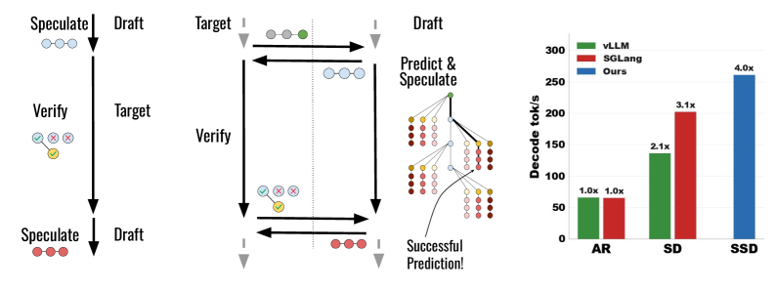
SSD Framework
Draft-Target Interaction
Draft predicts fast. Target verifies parallel. Ensures distribution. Yields bonus. Drafting waits. Stays sequential.
Notes:
Speaker A: This slide outlines the core Speculative Decoding framework, specifically how the fast draft model interacts with the target model. You can see in the diagram that the draft model predicts several tokens initially, which the target model then verifies in parallel.
Speaker B: That parallel verification is crucial because it guarantees the output tokens still match the target model's distribution exactly. Essentially, we gain speed without sacrificing the quality or probability profile of the final generation.
Speaker A: However, looking at the workflow, notice that drafting must wait for verification to complete before proceeding to the next step. Even though verification produces bonus tokens, the overall process remains fundamentally sequential.
Speaker B: Another way to say this is that while we reduce the number of forward passes, we cannot fully parallelize the drafting phase across time steps. This sequential dependency is the primary bottleneck we need to address in later optimizations.
Speaker A: Exactly, so while SSD improves efficiency, understanding this sequential limitation sets the stage for the batched improvements we will discuss next.

Slide 3
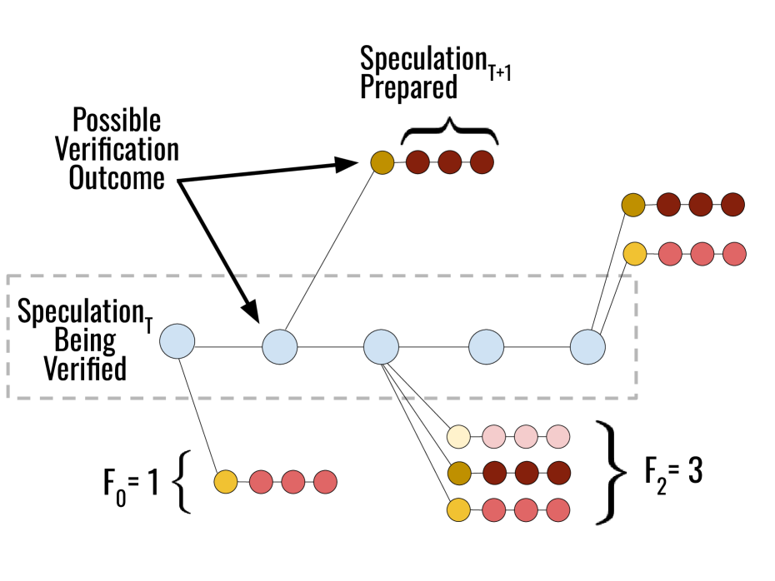
Saguaro Verify
Verification & Fan-Out
Visualizes state transitions. Fan-out values (F₀=1, F₂=3) control branching to optimize SSD framework cache and sampling.
Notes:
Speaker A: Saguaro optimizes the SSD framework through cache construction, sampling, and specific fallback handling mechanisms.
Speaker B: The diagram illustrates how these optimizations drive the speculative verification process via defined state transitions.
Speaker A: Notice the fan-out values assigned to each stage, such as F0 equals one and F2 equals three, which regulate speculation breadth.
Speaker B: Varying these values matters because it balances computational load against verification accuracy during greedy decoding.
Speaker A: We validated this setup on Llama-3 and Qwen-3 models using datasets like Alpaca and GSM8k.

Slide 4
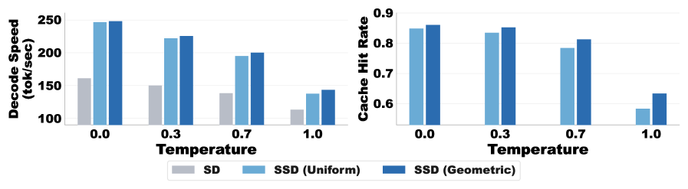
SSD Performance
Speed vs. Temperature
• Chart: Speed drops as temperature rises. • Cache hit rates remain stable. • SSD, Uniform, Geometric compared.
Notes:
Speaker A: This slide compares decode speed and cache hit rate performance across SSD, Uniform, and Geometric strategies under varying temperature conditions. Saguaro optimizes the SSD framework through three specific mechanisms including cache construction and sampling strategies.
Speaker B: Exactly, and we evaluated this using batch size one with greedy decoding across Llama-3 and Qwen-3 models. Datasets like Alpaca and GSM8k provide the comprehensive benchmarking needed to validate these results.
Speaker A: Looking at the chart, decode speed decreases as temperature increases, whereas cache hit rates remain relatively stable across variations. This trend holds true whether we apply SSD, Uniform, or Geometric sampling comparisons.
Speaker B: Another way to say this is that the caching mechanism is robust even when decoding becomes less deterministic at higher temperatures. The stable hit rate ensures that our fallback handling protocols do not introduce unnecessary overhead.
Speaker A: This confirms that the optimized instantiation enhances overall system efficiency without compromising performance stability. We will now move on to examine the specific latency benefits in greater detail.

Slide 5
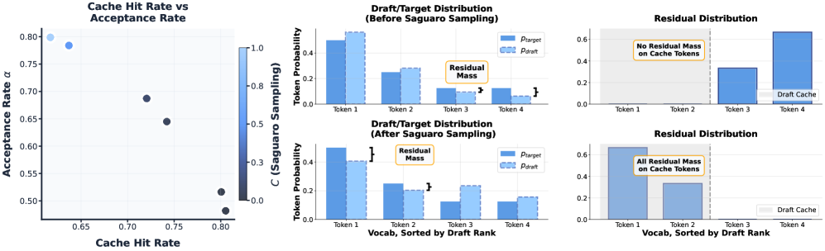
Saguaro Metrics
Cache Hit & Acceptance
Cache hits correlate with acceptance.
Shifts align draft-target distributions.
Residuals confirm optimization.
Notes:
Speaker A: We present Saguaro as an optimized instantiation of the SSD framework, integrating cache construction and dedicated fallback handling for improved performance.
Speaker B: Right - we validated this configuration using greedy decoding across Llama-3 and Qwen-3 on datasets like GSM8k and HumanEval.
Speaker A: The visual evidence here is critical, particularly the scatter plot showing the relationship between cache hit rate and acceptance rate.
Speaker B: This is significant because the adjacent bar graphs reveal how draft-target distributions shift favorably after sampling.
Speaker A: Ultimately, analyzing these residual distributions confirms that our optimizations directly improve performance without compromising stability.

Slide 6
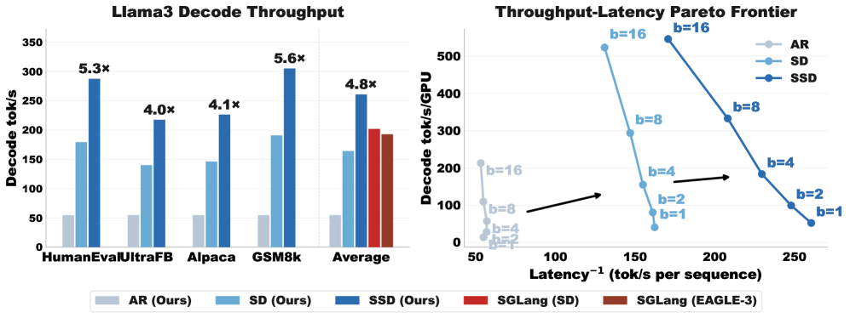
Llama3 Decode
Throughput & Latency
Bars indicate throughput. Line depicts latency. 5x speedup over baseline. 30% gain vs speculative. Batch sizes 1-8.
Notes:
Speaker A: Moving to our end-to-end evaluation, this chart shows the throughput-latency Pareto frontier for Llama3. Saguaro achieves a fivefold speedup over the autoregressive baseline across these tests.
Speaker B: Exactly, and this performance holds across varying batch sizes from one to eight, which is critical for real-world deployment.
Speaker A: When we compare against leading speculative decoding methods, the chart shows we are thirty percent faster than the strongest baselines.
Speaker B: This means we significantly outperform systems like SGLang and EAGLE-3 on both throughput and latency metrics simultaneously.
Speaker A: Ultimately, these results establish a new state of the art in decoding efficiency for large language models.

Slide 7
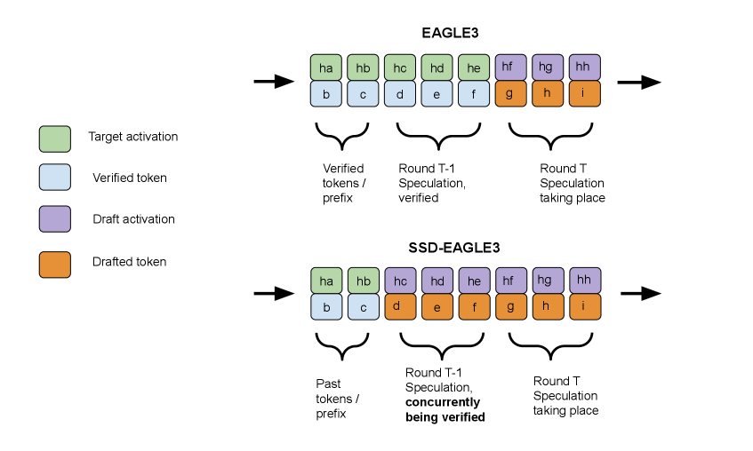
SSD + EAGLE-3
Conditioning Mechanism
Verification flow. Drafts condition on target activations. SSD forces self-conditioning on 2K tokens. Acceptance dips.
Notes:
Speaker A: This slide outlines the EAGLE-3 conditioning mechanism, where draft models typically improve acceptance by conditioning on target activations from previous verification rounds.
Speaker B: Exactly, and the visual distinguishes these stages by color-coding target activations against draft activations to show where self-activations must substitute as surrogates.
Speaker A: When we integrate SSD, drafts start preemptively without target activations from round T, which forces conditioning on up to 2K self-generated tokens. Consequently, this reduces acceptance on the latter portion of the generated sequence.
Speaker B: That's the key challenge, but our training ensures acceptance rates degrade slowly even under this longer self-conditioning burden. This stability is critical for maintaining overall decoding efficiency.
Speaker A: So the combined process remains viable because the model learns to maintain acceptance despite the lack of immediate target data during speculation.

Slide 8
Thank You!
Notes:
Speaker A: We have now reached the conclusion of our presentation and the end of today's session.
Speaker B: Another way to view this outcome is as a starting point for implementing the strategies we discussed.
Speaker A: Thank you for your time and attention, and we welcome any follow-up discussions offline.

