Slide 1
ThinkAct: Visual Planning
Huang et al. | 2025
Notes:
Speaker A: Welcome to our presentation on the new functional layout system.
Speaker B: This title slide captures our joint contributions and the project timeline to set the context.
Speaker A: We will use these foundational details to frame the technical methodology coming up next.

Slide 2
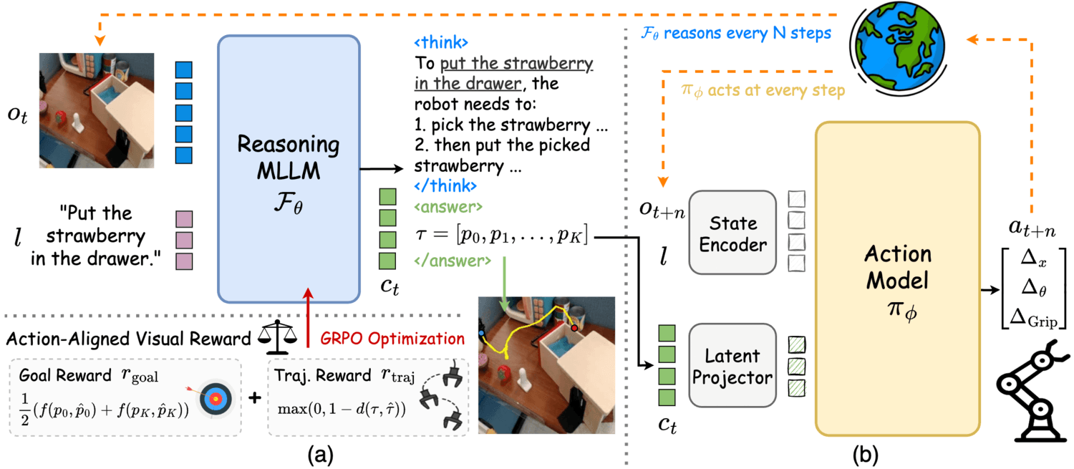
ThinkAct Method
Reasoning-Action Flow
Diagram: MLLM plans via visual rewards.
DiT Action Model executes plan latents.
Async flow: slow thinking, fast control.
Notes:
Speaker A: This diagram illustrates the core ThinkAct architecture, where a reasoning MLLM generates step-by-step plans that directly guide robot actions.
Speaker B: Right, and we use action-aligned rewards derived from visual trajectories to incentivize the embodied reasoning capability of that MLLM.
Speaker A: The optimization process leverages GRPO to align the model planning with specific executable outcomes.
Speaker B: These plan latents condition the DiT-based Action Model to predict executable actions while keeping the reasoning MLLM frozen.
Speaker A: Consequently, asynchronous operation during inference enables slow thinking paired with fast control for VLA tasks.

Slide 3
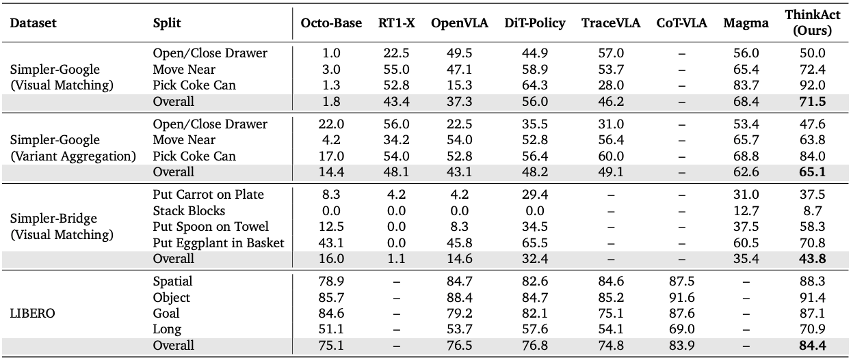
Benchmark Data
ThinkAct vs. Baselines
ThinkAct exceeds Octo-Base on Simpler-Google, Bridge, and LIBERO. Bold values denote best results across task splits.
Notes:
Speaker A: To validate our approach, we conducted quantitative comparisons across standard robot manipulation benchmarks. This table summarizes how ThinkAct performs against existing baseline models.
Speaker B: Using established datasets like SimplerEnv and LIBERO ensures our validation is robust and directly comparable to prior work.
Speaker A: Looking at the scores, ThinkAct achieves the best results across multiple task splits, indicated by the bold values in each row. We see consistent improvement over baselines ranging from Octo-Base.
Speaker B: This consistency across different environments confirms the model generalizes well rather than overfitting to a single task type.
Speaker A: Ultimately, these metrics demonstrate that ThinkAct delivers superior performance in complex manipulation scenarios.

Slide 4
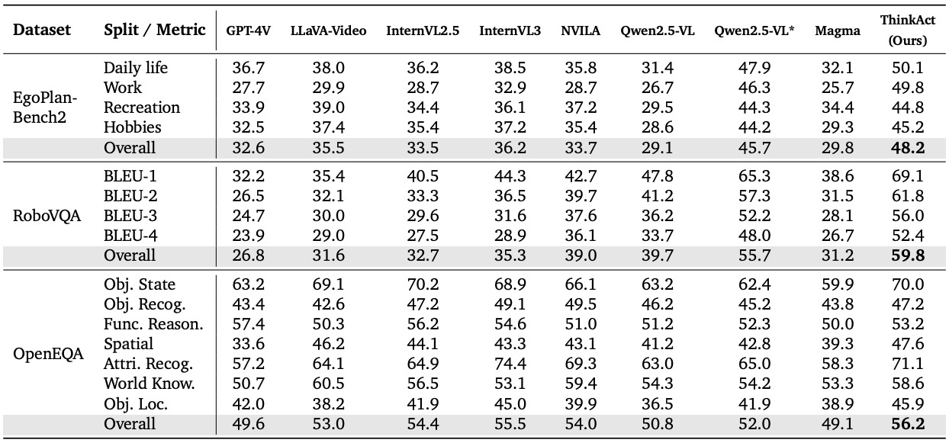
Benchmark Stats
Outperforming Baseline
Table shows ThinkAct leads GPT-4V and Qwen. Bold scores denote best results across EgoPlan, RoboVQA, OpenEQA.
Notes:
Speaker A: We evaluated ThinkAct across embodied reasoning benchmarks including EgoPlan-Bench2 and RoboVQA. This table summarizes the quantitative comparison against strong baselines like GPT-4V.
Speaker B: Exactly, and notice that we used multiple metrics and splits to ensure the assessment is robust across different vision and robotics tasks. The bolded scores highlight where our model achieves state-of-the-art performance.
Speaker A: As you can see in the rows, ThinkAct consistently outperforms the Qwen2.5-VL variants and GPT-4V. This is particularly evident in the manipulation and planning task columns where our scores are highest.
Speaker B: That consistency across diverse benchmarks confirms the model's generalization capability beyond just a single dataset. It demonstrates that the architecture handles complex embodied reasoning more effectively than existing vision-language models.
Speaker A: So, the key takeaway is that ThinkAct delivers superior performance in both perception and action planning. This validates our approach before we move on to the qualitative examples.

Slide 5
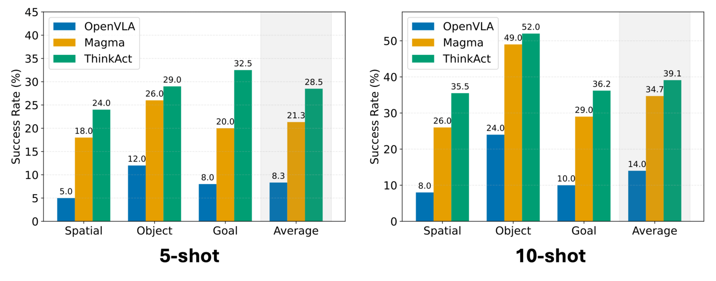
Success Rates
Highest Success Rates
ThinkAct leads Spatial, Object, Goal. Top scores show consistent outperformance of OpenVLA and Magma on benchmarks.
Notes:
Speaker A: To validate our approach, we conducted quantitative evaluations on the SimplerEnv and LIBERO benchmarks. We measured success rates across Spatial, Object, and Goal categories to ensure a comprehensive analysis.
Speaker B: Exactly, this breakdown matters because it shows generalization rather than success on a single task type. Looking at the charts, you can see ThinkAct maintains the lead across every category.
Speaker A: That's right. As the bolded values indicate, ThinkAct consistently outperforms both OpenVLA and Magma models in all tested categories. The gap is particularly visible in the Average success rate on both charts.
Speaker B: Another way to say this is that the performance isn't sporadic; it's robust across different manipulation challenges. This consistency is critical for deploying reliable robot agents.
Speaker A: So, the key takeaway is that ThinkAct delivers superior manipulation capabilities without sacrificing performance in specific sub-tasks. This establishes a new state-of-the-art on these benchmarks.

Slide 6

Reasoning Demo
Intermediate Reasoning
See MLLM generate plans guiding robot actions. Trajectories show task completion on SimplerEnv and LIBERO benchmarks.
Notes:
Speaker A: Here we demonstrate the qualitative results of intermediate reasoning steps and trajectories during robot manipulation tasks on SimplerEnv and LIBERO.
Speaker B: Notice how the system enables self-reflection, identifying failures in real-time to generate revised plans that guide the action model.
Speaker A: These capabilities allow ThinkAct to outperform DiT-Policy and OpenVLA baselines significantly across multiple benchmarks.
Speaker B: Exactly, and this matters because it effectively handles complex embodied reasoning tasks that typically break standard policies.
Speaker A: So, the combination of asynchronous reasoning and action-aligned visual rewards delivers robust execution in diverse scenes.

Slide 7
Self-Correction
Self-Reflection Cycle
MLLM spots failures in diagram. Plan latents revise action model. Loop ensures robust task completion.
Notes:
Speaker A: This slide highlights the self-correction capability where the reasoning MLLM identifies task failures and generates a revised plan.
Speaker B: That autonomy matters because it allows the system to recover and guide the action model to complete the intended task rather than stopping.
Speaker A: In the diagram, you can see how plan latents guide the action model asynchronously while we use action-aligned visual rewards for GRPO optimization.
Speaker B: Exactly - this alignment ensures the reasoning process directly supports precise robot actions through the optimization loop.
Speaker A: The result is a robust system that demonstrates self-reflection and successfully completes tasks after the correction process.

Slide 8
Thank You!
Notes:
Speaker A: This brings us to the conclusion of our presentation on the functional layout design.
Speaker B: Indeed - this completes our overview of how the schema supports the system architecture.
Speaker A: Thank you all for your time and attention today.
Speaker B: We appreciate the opportunity to share these findings with you.
Speaker A: Thank you.

