Slide 1
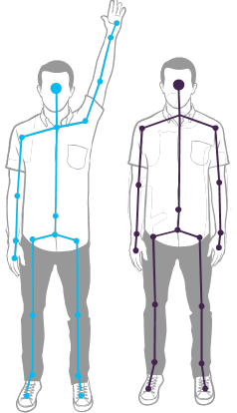
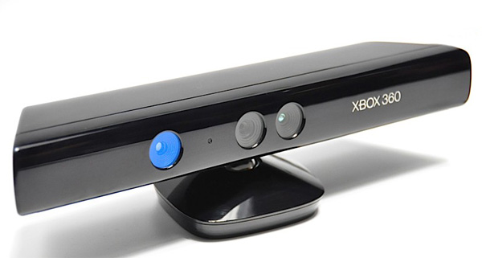
Gesture recognition using Kinect
By Sukrut Kelkar
ECE 578: Team 8

Slide 2
Project Task: Recognize human gestures using Kinect sensor and Open CV and control an Arduino with it
Steps involved:
1) Map the skeleton and the joint locations using the Kinect sensor and the Open CV library.
2) Using the specific join locations detect gestures.
3) Specific type of gestures create a control string/Character.
4) This string/Character is sent to the serial port of the Laptop.
5) Arduino continuously reads the serial port of the laptop and gets the control signal.
This control signal is used as a switch or a select line to select what kind of task should the Arduino perform.

Slide 3
How to use the Kinect with C++?
Kinect library has a wide range of functions which can be used directly in Visual Studios. For this header files like NuiApi.h camerasensor.h have to be imported before we can use these functions.
Components of the Kinect library used in this project are:
NuiInitialize : Initializes the Kinect
NUI_INITIALIZE_FLAG_USES_SKELETON: Initialize the sensor to provide skeleton data
NUI_SKELETON_FRAME: This Is a structure which has skeleton data as one of its members.
NuiSkeletonGetNextFrame: gets the next frame of data from the skeleton stream.
OpenCV library is used to map this data which is read on the laptop screen.

Slide 4
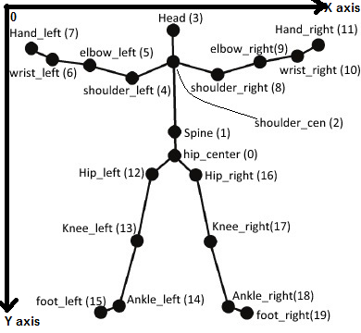
SkeletonData member has SkeletonPositions data in it.
When the eTrackingState is set to NUI_SKELETON_TRACKED the Kinect sends 20 joint locations from the skeleton in frame.
The joint locations are read and stored in two variable x[] and y[].
Each joint location will have x and y co-ordinates.
The diagram illustrates how the skeleton is detected and interpreted.
Eg: x[11],y[11] are co-od for right hand
Imp Note: Look at the axis carefully.
Note: This diagram is labelled according to how OpenCV maps it in our code.

Slide 5
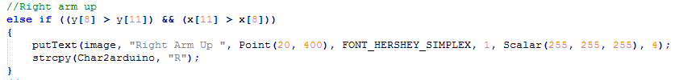
How does the gesture detection work?
Example snippet:
This if loop checks if shoulder_right joint is greater than right_hand. As the y-axis is upside down this gesture indicates that the hand is above the shoulder in the graph and it is also on the right hand side of the shoulder joint. If this is true then a character variable is updated with a value “R” which is then sent to the serial port and read by an Arduino. The Arduino has a code which will read the serial port and if it sees that the input is “R” it will glow a specific light.

Slide 6

Serial communication with Arduino
The visual studio code in C++ sends the string/character on a specific serial port. The Arduino code is such that it glows a specific light if it receives a specific character from the serial port.
The above snippet shows which character is designed for which gesture.

Slide 7

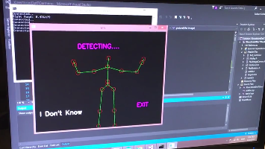
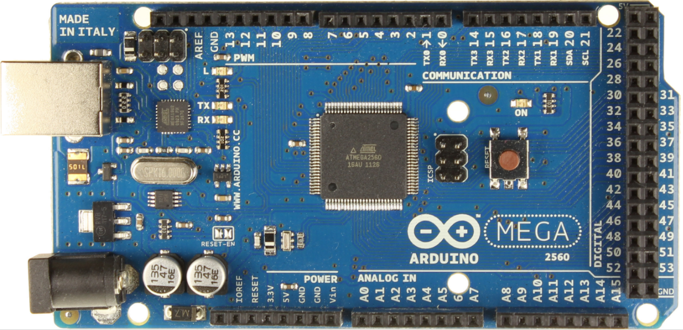
Block Diagram
Visual Studios
Header Files
Kinect Code
Open CV Code
Laptop
Arduino
Serial Comm code
Serial
Comm
Kinect
C++

Slide 8
The codes are pretty self explanatory. I have provided a file with this which will help you setup the Kinect and the open cv with visual studios. (Folder: Docs)
Steps:
Connect and test Kinect first with the developers kit
Connect and test the Arduino first with an example code
Attach all the necessary files provided and mentioned in the step 4
Follow the file “Steps for errorless header and library file inclusion (Kinect as well as open cv)”
Link to the video: https://www.youtube.com/watch?v=QMcdIPpK5pY

Slide 9
Thank you!!

