Slide 1
Chocolate Sales Analysis
Q1-Q4 Performance Review | Data-Driven Insights

Slide 2
Executive Summary
• Total Revenue: €6.18M across 1,094 transactions
• Product Portfolio: 22 unique products in 6 countries
• Average Deal Size: €5,652 per transaction
Key Insights:
• Australia leads with €2.24M (37.5% of total revenue)
• Smooth Silky Salty Bar is top product at €1.37M
• Peak sales in August (€1.06M); lowest in February (€85K)
• Ches Bonnell is top performer with €1.82M in sales

Slide 3
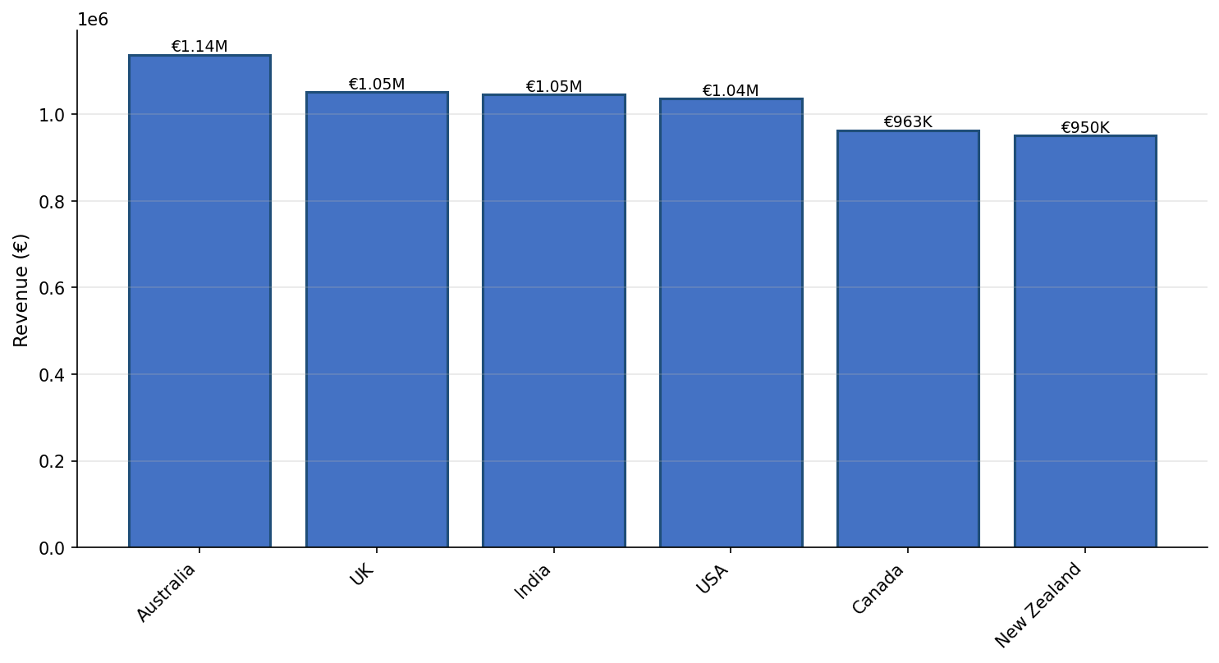
Revenue by Country

Slide 4
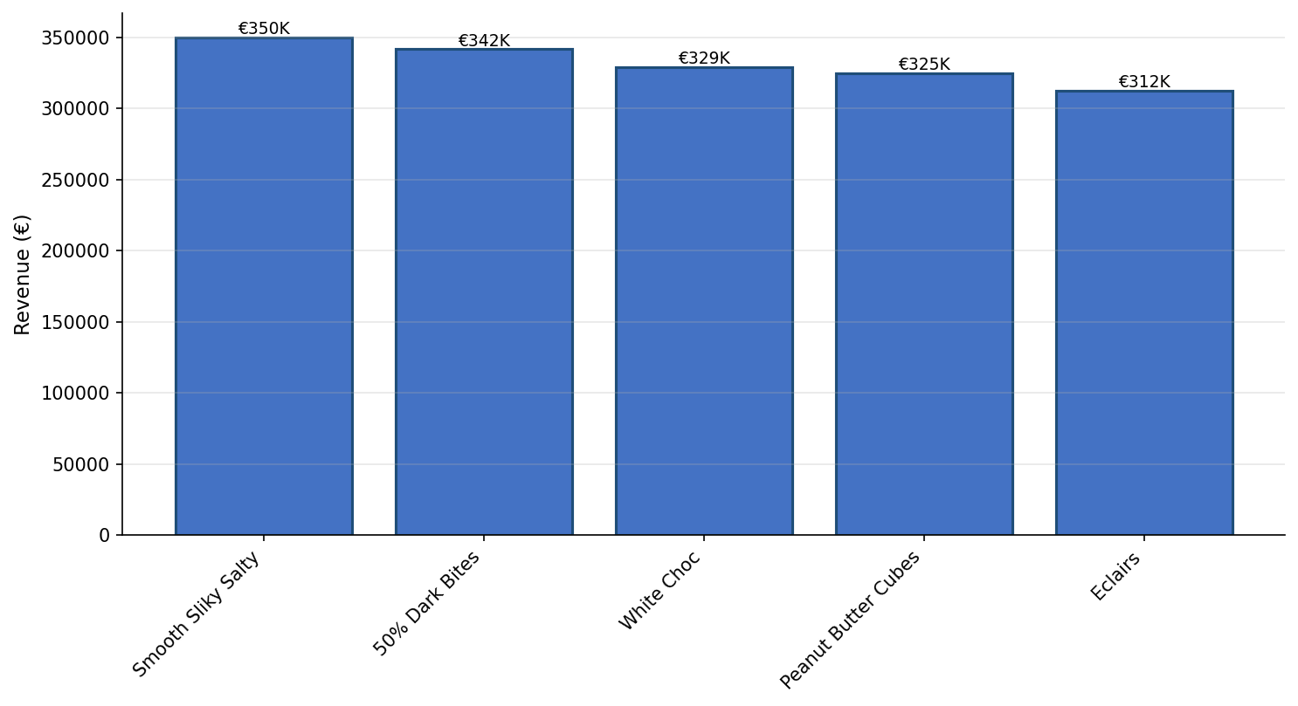
Top 5 Products by Revenue

Slide 5
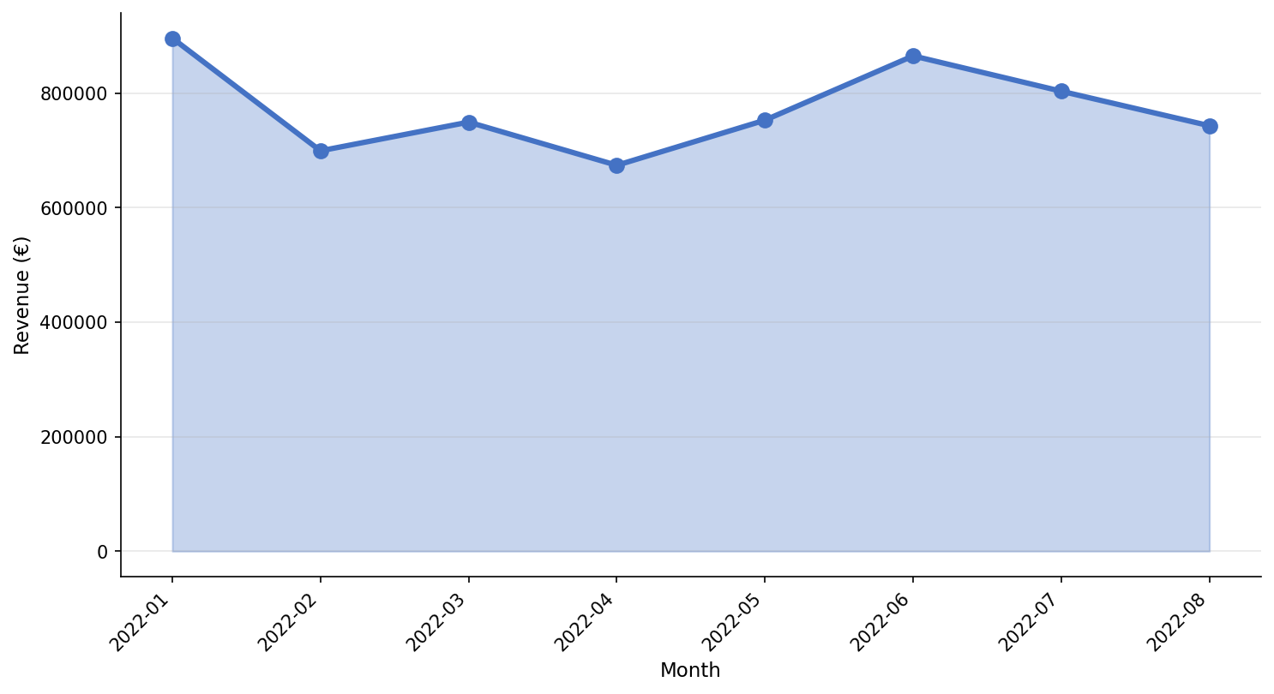
Monthly Revenue Trends

Slide 6
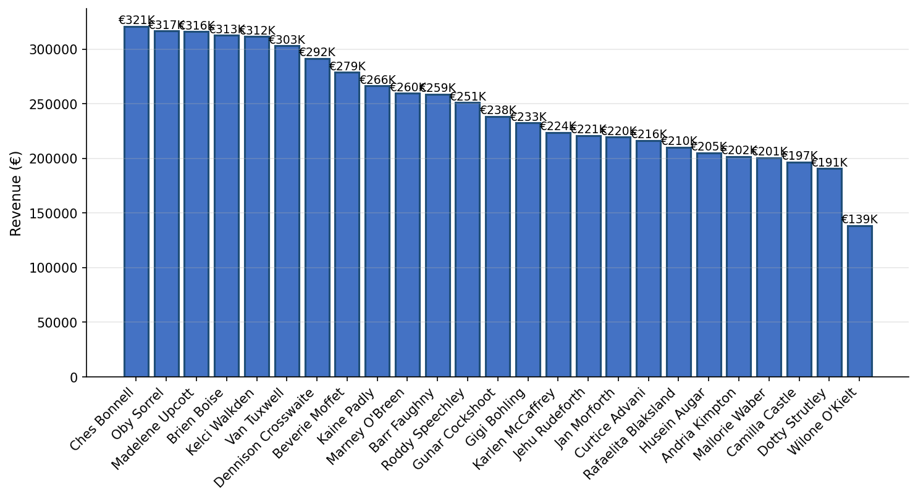
Sales Team Performance

Slide 7
Strategic Recommendations
1. Expand Australian Market Leadership
• Australia generates 37.5% of revenue—invest in market expansion
• Replicate successful strategies in other regions
2. Address Seasonal Volatility
• August peak (€1.06M) vs February low (€85K) shows 12x variation
• Develop off-season promotions to smooth revenue
3. Leverage Top Performers
• Ches Bonnell (€1.82M) and Gigi Bohling (€1.42M) lead the team
• Share best practices and consider mentorship programs
4. Product Portfolio Optimization
• Smooth Silky Salty Bar dominates—ensure supply chain resilience
• Consider expanding premium product lines

Slide 8
Thank You
Questions & Discussion

