Slide 1
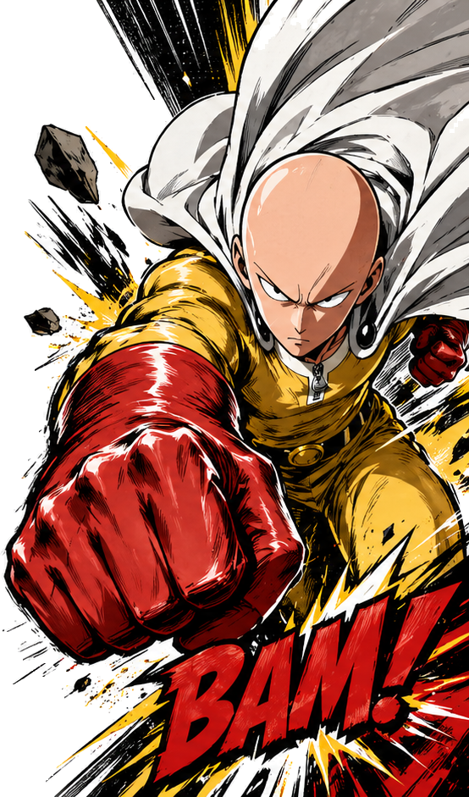



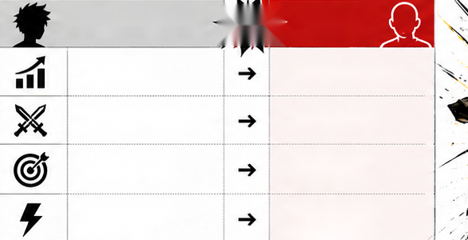






Why Is One Punch Man So Strong?
Narrative, psychological, and structural reasons behind Saitama's overwhelming power
A) CORE REASONS
B) HOW HE DIFFERS FROM TYPICAL SHONEN HEROES
1
BUILT AS A SATIRE
VS.
SAITAMA
Saitama was designed to parody power-scaling
TYPICAL SHONEN HERO
stories—his absurd strength is the premise
not the reward.
Growth arc
Already complete
2
ALREADY AT THE FINISH LINE
While others train and climb for years to reach
Wins through struggle
Wins instantly
the top, he begins where most protagonists
are supposed to end.
Power is a goal
Power is the
3
LIMIT-BREAKING SIMPLICITY
starting point
His routine is both disciplined and comically extreme:
Tension comes
Tension comes
100 push-ups, 100 sit-ups, 100 squats,
from battle
from meaning
and a 10 km run every day.
C) NARRATIVE IMPACT
4
EMOTIONALLY UNSHAKEN
He fights without fear, ego, or hesitation.
WHY IT WORKS
No need to prove himself—he's already
Saitama is not just strong in a physical sense.
beyond the need for validation.
He works because his power flips the usual
5
THE STORY NEEDS AN UNBEATABLE HERO
battle-anime formula and turns the real
His power lets the series go beyond battles
conflict inward:: purpose, boredom,
to explore boredom, meaning, and identity
and the search for challenge.
after absolute victory.
D) KEY TAKEAWAY
One Punch Man is powerful as a character because
his strength is both a joke and a storytelling device.

