Slide 1
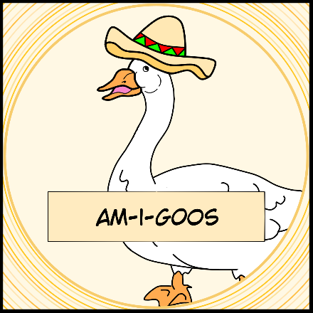
Am-I-GOOS
Logic Game 2022
Aleksander Kostov, Nikolay Despotov,
Yoan Todorov, Aleksandra Petrova

Slide 2
In this presentation:
Our team
Used technologies
Our game
Stages of improvement

Slide 3
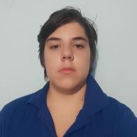
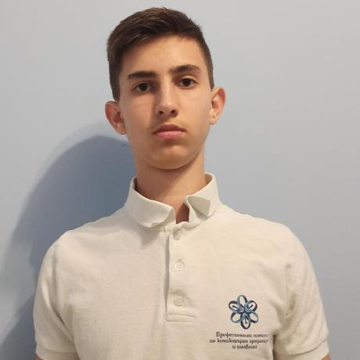
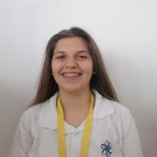
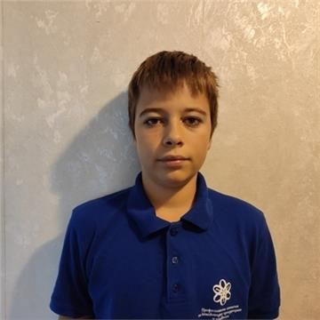
Our team
Aleksander Kostov
Scrum Trainer
Nikolay Despotov
Backend Developer
Aleksandra Petrova
QA Developer
Yoan Todorov
Backend Developer

Slide 4








Used technologies

Slide 5
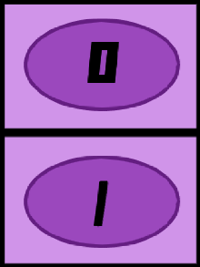
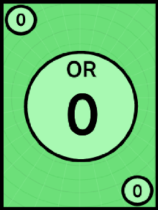
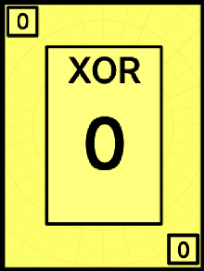
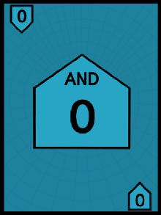

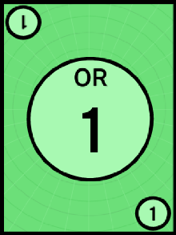
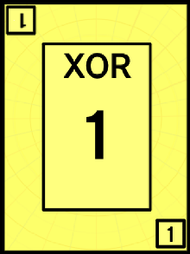
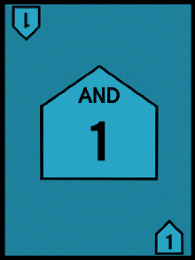
Our game
The idea was to revive and recreate the board game B00le0, so we can save it’s idea and be able to play it anywhere.

Slide 6
Stages of realization
Task
Organization
Realization
Test
Present

Slide 7
Let us show You our repository!

Slide 8
Now look at our game!

Slide 9
Thanks for Your attention!

