Slide 1

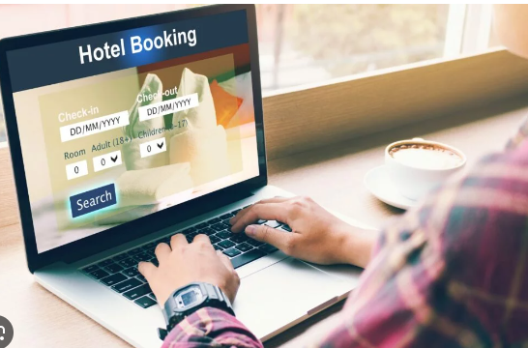


Hotel Bookings Analysis
ZVIADI BERIDZE DATA SCIENTIST FINAL PROJECT

Slide 2


Link :
https://nbviewer.org/github/AILogoSkill/Hotel_Booking_Demand/blob/main/hotel_booking_best_final.ipynb
Visualization:
https://nbviewer.org/github/AILogoSkill/Hotel_Booking_Demand/blob/main/visualization_final.ipynb
Streamlit:
https://hotelbookingdemand.streamlit.app

Slide 3




Slide 4
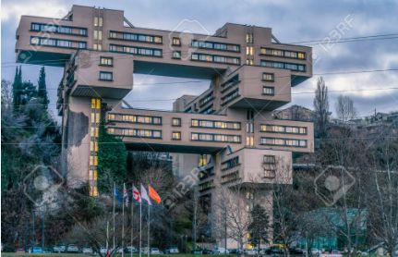
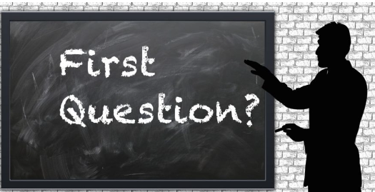

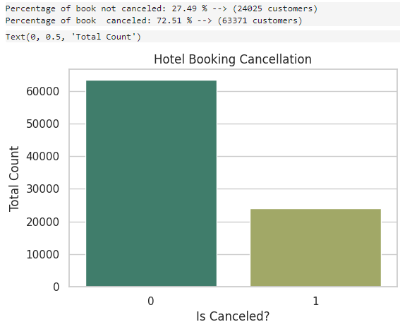

old shape is (118565, 33)
What caused the primary data to be altered and irrelevant information to be added, as discovered by cyber security specialists?

Slide 5
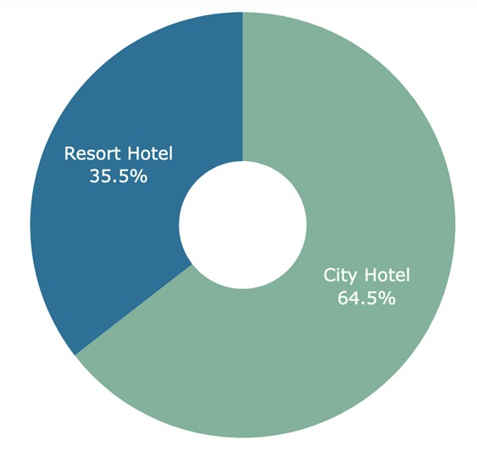
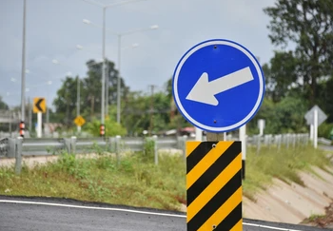

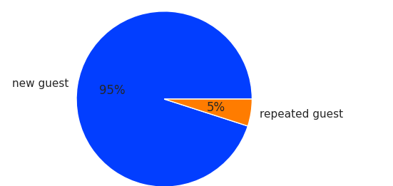
Alright, now you have the right to begin telling the story about the analysis of the data.

Slide 6
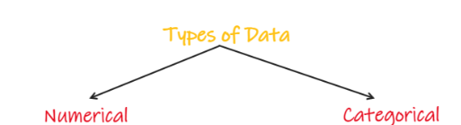
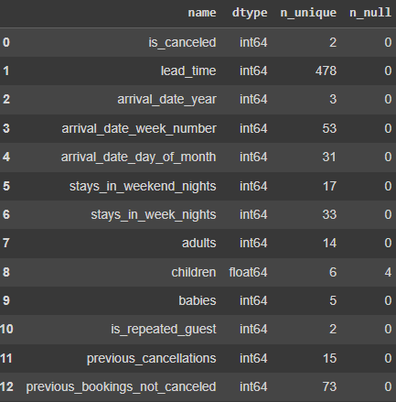
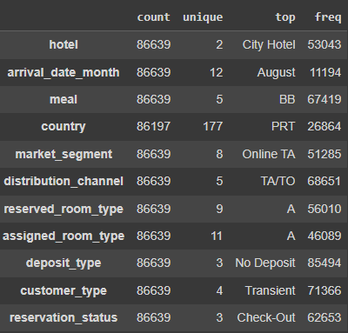

Slide 7
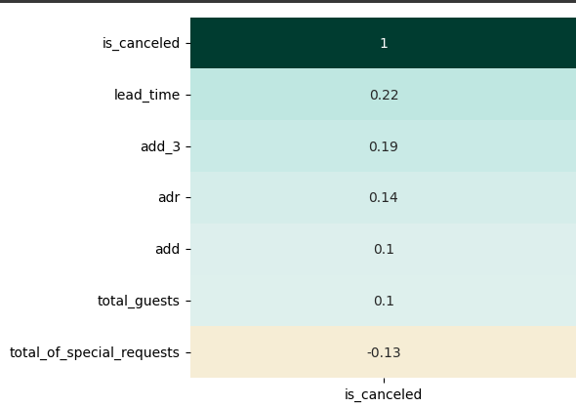
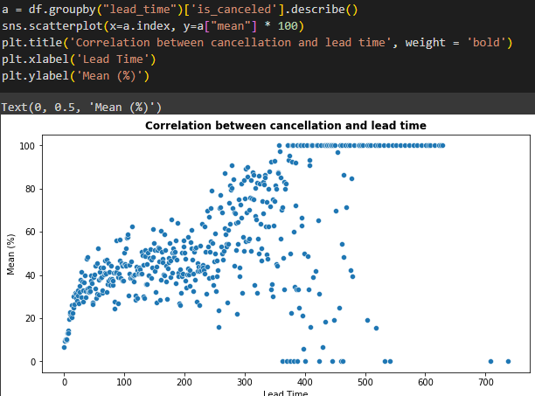
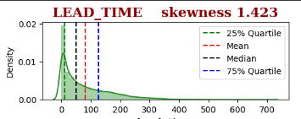
Correlation between cancellation and lead time

Slide 8


Slide 9
Thank you
for your
attention

