Slide 1
X.509 CERTIFICATE
An X.509 certificate is a digital certificate that follows the International Telecommunications Union (ITU) standard, which outlines the format and type of data public key certificates should possess for optimal security. X.509 certificates contain specific user information, an issued public key, and digital signatures that verify a user’s identity as they access online services and sites.
When a user interacts with a server, a cryptographic key pair is generated, hashed, and sent to a certificate authority (CA), along with a digital certificate request. The CA is a trusted third-party entity that binds its public key to a digital certificate. Per the X.509 standard, the digital certificate contains specific data, such as the location of the user’s device, the certificate’s serial number, the CA’s name, the particular encryption algorithm used, and more, which we’ll detail in the next section.
After verifying the certificate’s information, the CA digitally signs it and sends it to the user in an encrypted format. The resulting X.509 certificate is then imported onto the user’s server, where it can be used further to establish safe connections with web browsers and safely engage with online data.
X.509 certificates can also be self-signed; that is, the user requesting the certificate can digitally sign it without the authorization of a third-party CA. However, most applications generally do not trust these certificates for this reason.

Slide 2
Benefits of Using an X.509 Certificate
In a digital landscape rife with cybercrime, malware, and pesky bots, it can be hard for users to trust the safety of the internet. However, X.509 certificates are just as widely used as the SSH protocol, meaning almost every corner of the internet is safeguarded with hard-to-crack encryption algorithms to distinguish valid websites from fraudulent ones. Moreover, the pervasive use of SSH keys across the internet grants scalability to the applications of X.509 certificates.
As mentioned, X.509 certificates can be used to validate users participating in almost any online transaction, from signing legal documents to accessing an online banking account, since brute force attempts by hackers have a very slim chance of decoding lengthy SSH keys.

Slide 3
What is an X.509 Certificate Used For?
X.509 digital certificates aren’t only used for validating identities across the web.
They can also be used to fortify the security of email communications, verify the legitimacy of documents signed online, and ensure that written code has not been tampered with. X.509 certificates also form the foundation of Transport Layer Security (TLS) and Secure Sockets Layer (SSL) protocols, which help browsers filter through fake websites, servers, and applications to establish a safe environment for online activity.

Slide 4
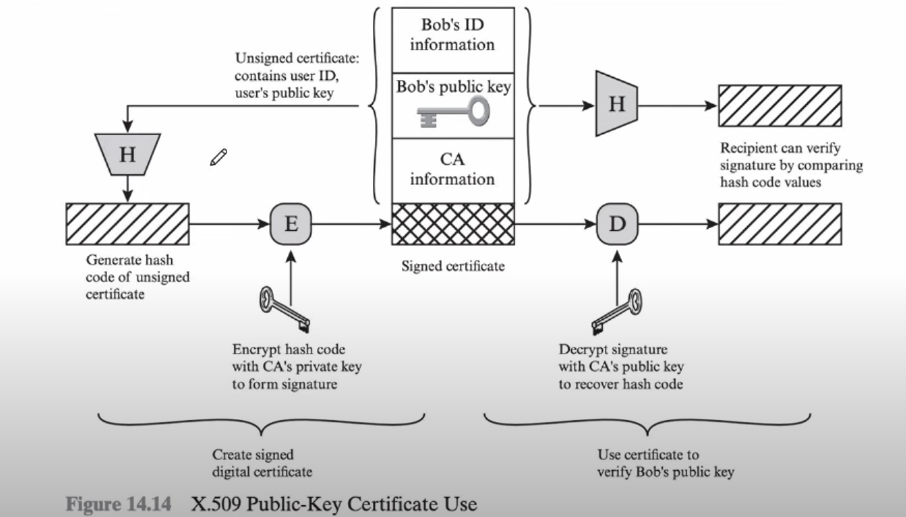
X.509 WORK FLOW

Slide 5
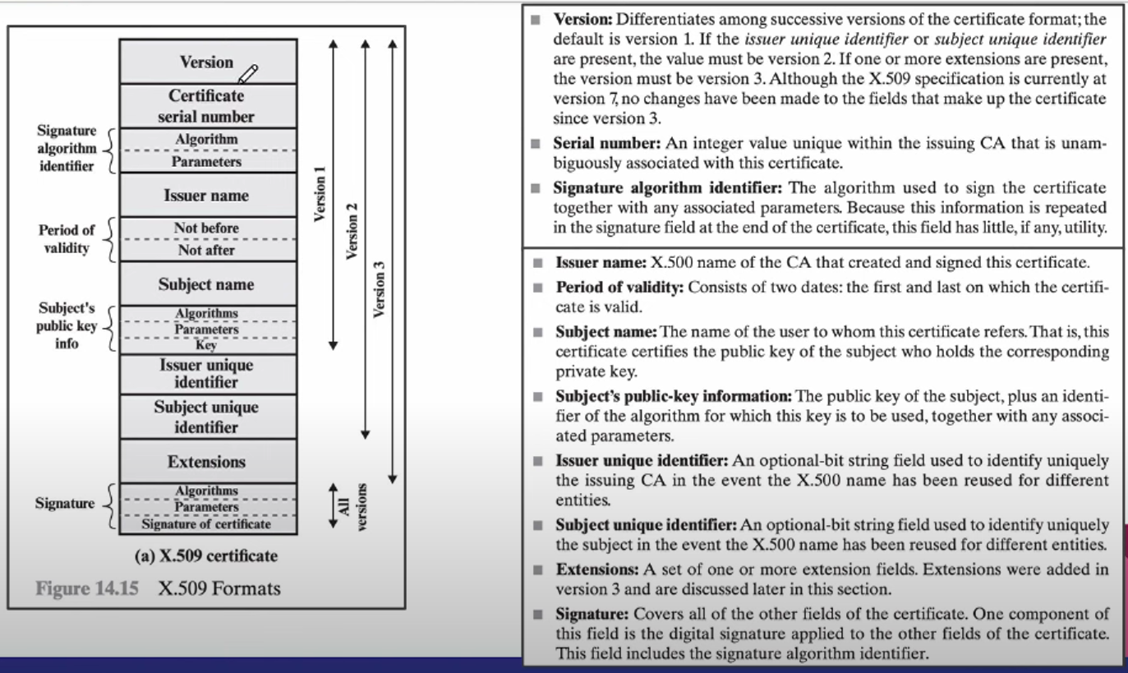
X.509 FORMATS

Slide 6
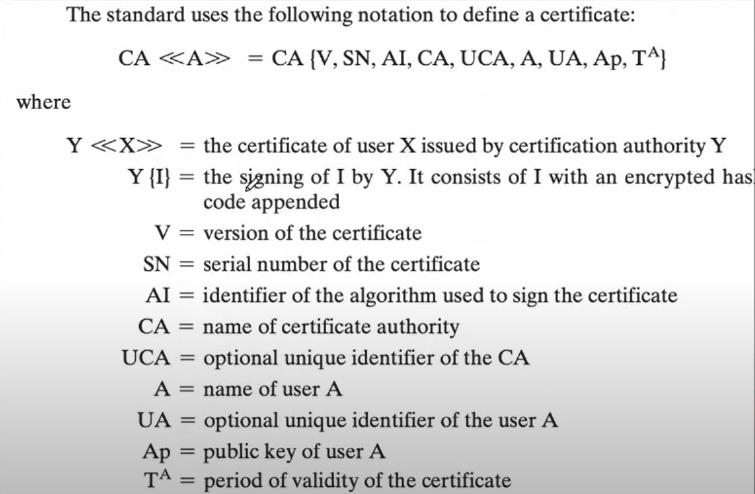
X.509 NOTATION

