Slide 1
Bayes inference
Master applied data science
11 November 2025

Slide 2
Learning goals
The student can explain the Frequentist and Bayesian approach to statistics and knows their main differences and application fields
The student can explain what the naïve Bayesian technique entails and how it can be used to make predictions on data.

Slide 3
Content
The Bayesian approach to statistics
Bayes Theorem
Choosing a prior probability distribution
Frequentist vs. Bayesian approach to statistics
Naïve Bayes Classifiers
Assignment

Slide 4

Thought experiment
How likely is it that the sun will rise tomorrow?
What is H0?
Where do we get an infinite number of worlds for repeated measurements?
What if the probability of an event is too low to make a stable approximation, or if it can only happen once (catastrophe scenario)?

Slide 5

Repeatedly take a sample from a population of earths and apply hypothesis testing to determine if H0 (nothing chances and the sun comes up) can be rejected.
Use past experience and continuously update your beliefs about the world as new information comes in.

Slide 6
1. The Bayesian approach to statistics
Probability is viewed as a subjective experience of uncertainty; include prior knowledge in our judgements.
Parameters are viewed as probability distributions that capture our uncertainty about their true value.
Continuously updating what we believe about the world as new information comes in brings us closer to the truth.
Credibility intervals reflect how uncertain our believes are.
Bayesian theorem allows for direct calculation of the probability of our beliefs.
Notes:
Subjective, prior knowledge
Parameters are random, not the sample!

Slide 7
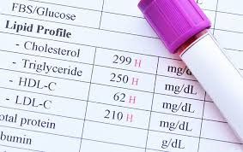
1. The Bayesian approach to statistics
Suppose a doctor is testing for a rare disease. The disease has a prevalence of 0.01% (1 in 10.000) in the population, and the test has a sensitivity of 99% and specificity of 95%. How likely is the patient to have the disease if the test comes back positive?
P(Disease) = 0.0001
(Positive Test | Disease) = 0.99
(Negative Test | No disease) = 0.95
P(disease | positive test)???
Notes:
Workout on board:
P(disease | positive test) = (p(disease) * p(positive test | disease)) / p(positive test)
(0.0001 * 0.99) / (0.9999 * 0.05) + (0.99* 0.0001) = 0.002 = 0.2%

Slide 8


1. The Bayesian approach to statistics
Now the doctor gets back the test results and sees according to the positive results the probability the patient has the disease is approximately 0.2%. This is very confusing, the test has high specificity and sensitivity, why would I even test?
Frequentist
Extrapolate what is true in de data (population) to the individual.
Notes:
Population estimates fixed!
What do we belief about the population?
Does the population estimate even apply to my patient?
Draw circle board: full population, disease population, part where the doctor thinks the patient falls in

Slide 9
1. The Bayesian approach to statistics
Due to other symptoms the doctor believes the probability that the patient has the disease (prior to testing) is closer to 30%. How can this previous knowledge be incorporated in the estimate?
Bayesian
Look at the individual and to update what you believe about the data.
Notes:
Data is fixed! How can we relate that back to what we belief in our population?

Slide 10
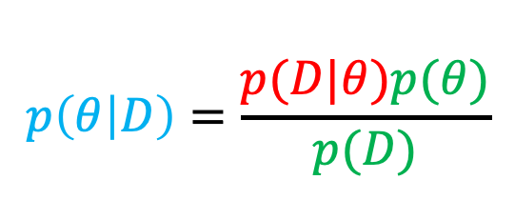
2. Bayes Theorem
Bayes theorem provides a method to update probabilities based on experience and data.
It essentially answers the question: Given our current believes (prior) and the data (evidence) how do we update our believes (posterior)?
Likelihood
Prior
$$p\left(θ | D\right)=\frac{p(D|θ)p(θ)}{p(D)}$$
Posterior
Marginal likelihood / evidence
Notes:
Prior = what you believe about the parameters before seeing data = probability of event A
Likelihood = how likely the observed data D is given the parameters = probability of event B (data) given event A
Evidence = marginal likelihood = integral over the event
Draw on board:
Update plot
Bayesian train
Note: p(D) is for normalizing it’s the integral over P(D|O) for all possible values of O.

Slide 11
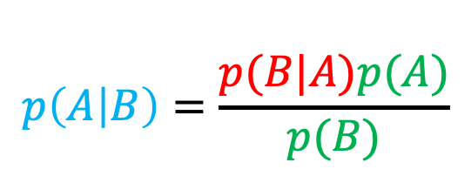
2. Bayes Theorem
Bayes theorem provides a method to update probabilities based on experience and data.
It essentially answers the question: Given our current believes (prior) and the data (evidence) how do we update our believes (posterior)?
Conditional probability
Marginal probability
$$p\left(A | B\right)=\frac{p(B|A)p(A)}{p(B)}$$
Conditional probability
Marginal probability
Notes:
For a single event: A

Slide 12
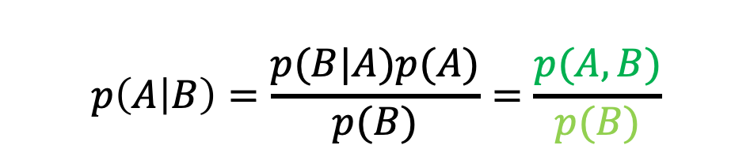
2. Bayes Theorem
Intermezzo: probability
Conditional probability of event A given event B is the joint probability of event A and B divided by the probability of event B (normalizing).
$$p\left(A | B\right)=\frac{p(B|A)p(A)}{p(B)}=\frac{p(A,B)}{p(B)}$$
A
B

Slide 13
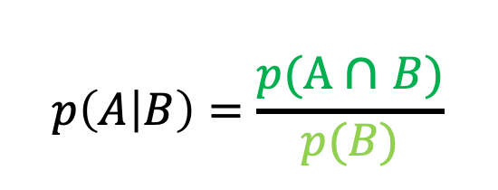
2. Bayes theorem
Intermezzo: probability
Joint probability
$$p\left(A | B\right)=\frac{p(\text{A} \text{∩} B)}{p(B)}$$
Conditional probability
Conditional probability: The probability of A if B is True.
Suppose p(A) = 0.5 and p(B) is 0.7, what is p(A|B)?
Marginal probability
A
B
A
B
A
B
p(A ∩ B) = 0.5
p(A ∩ B) = 0.25
p(A ∩ B) = 0
Notes:
Stress the difference between mutual exclusive and independence!
Independence means A can also happen if B is not zero….
0.5/0.7
0.25/0.7
0/0.7

Slide 14
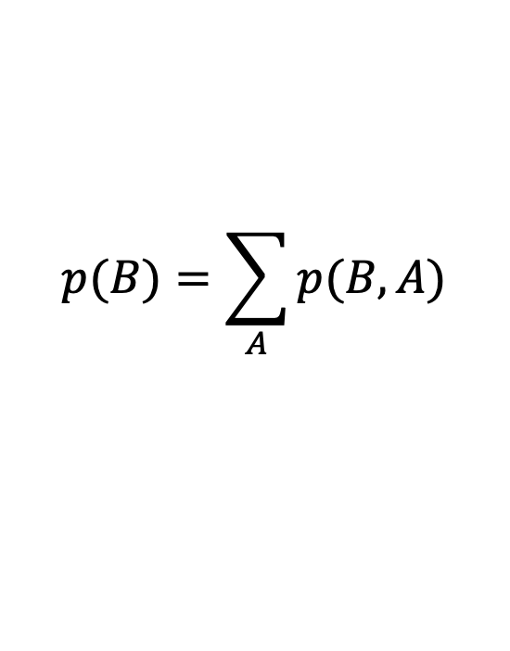
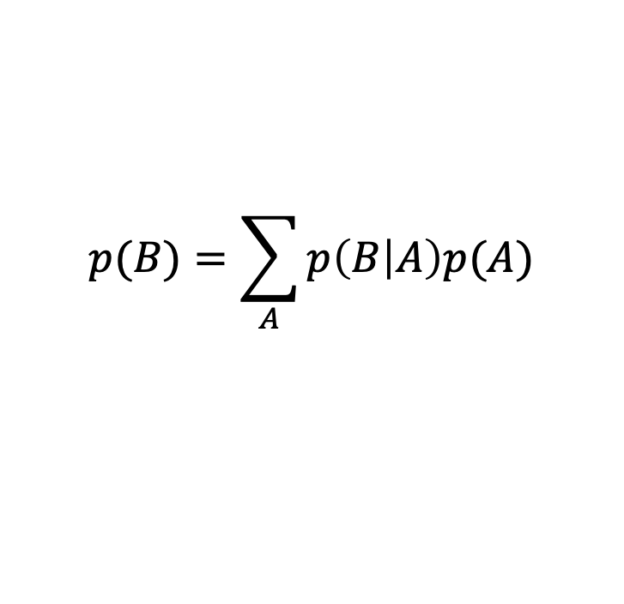
2. Bayesian Theorem
Intermezzo: probability
Marginal: The probability of B summed over all possible values of A.
Suppose B and A are binary, what is p(B)?
p(B|A=1) = 0.4
p(B|A=0) = 0.3
p(A) = 0.5
$$p(B)=\sum_{A}{p(B,A)}$$
$$p(B)=\sum_{A}{p\left(B | A\right)p(A)}$$
Notes:
(0.4*0.5) + (0.3*0.5)
We sum over all values of A to get p(B)

Slide 15
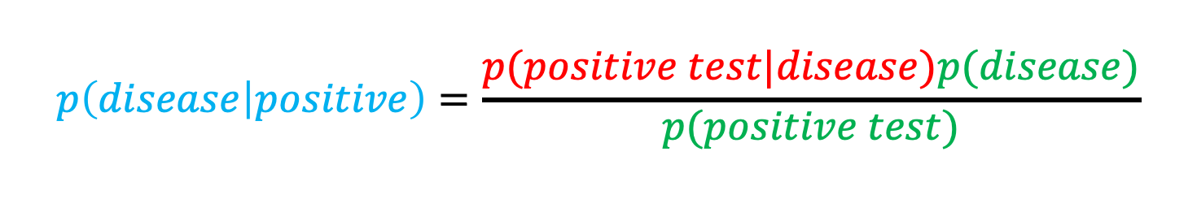
2. Bayes Theorem
p(disease) = 0.001 = 0.3
p(positive test | disease) = 0.99
p(negative test | no disease) = 0.95
Due to other symptoms the doctor beliefs the probability that the patient has the disease (prior to testing) is closer to 30%. How can this belief be incorporated in the estimate?
$$p\left(disease | positive\right)=\frac{p(positive test|disease)p(disease)}{p(positive test)}$$
Notes:
Workout on board:
P(disease | positive test) = (p(disease) * p(positive test | disease)) / p(positive test)
(0.3 * 0.99) / (0.7 * 0.05) + (0.99* 0.3) = 0.89 – 89%

Slide 16
3. Choosing a prior
The chosen prior distribution can have a major impact on the estimated posterior distribution
Priors may be based on historical data, expert beliefs or a combination of both
Choosing an uninformative prior skews results towards the data while choosing a strong prior skews results towards the prior
Given enough data the estimated posterior will be attracted to the same distribution regardless of the prior (Bernstein-von Mises Theorem)
Notes:
What is a prior? -> draw on board probability distribution over probabilities for coins

Slide 17

3. Choosing a prior
Suppose your friend selects a random coin from a pool of coins with each coin having a probability of heads between 0 and 1.
What probability of heads would you guess the coin has?
How certain are you about your guess?

Slide 18
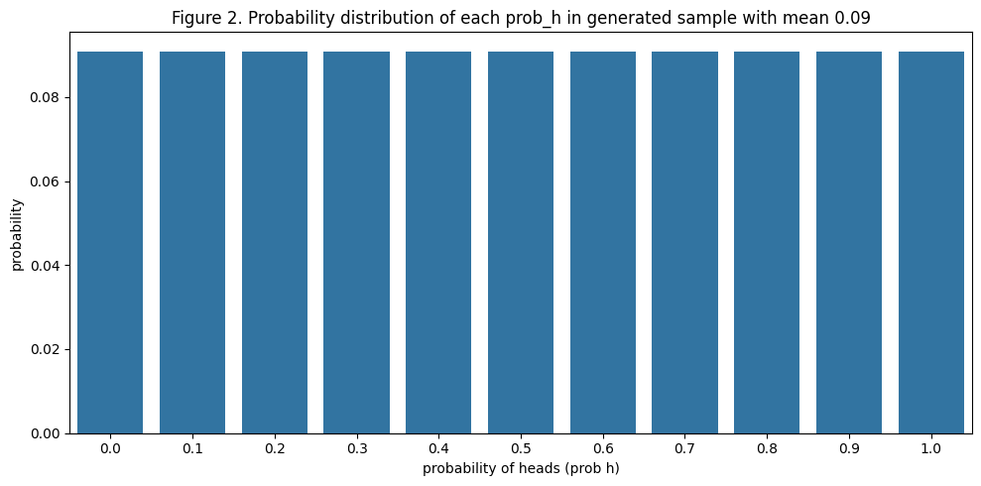
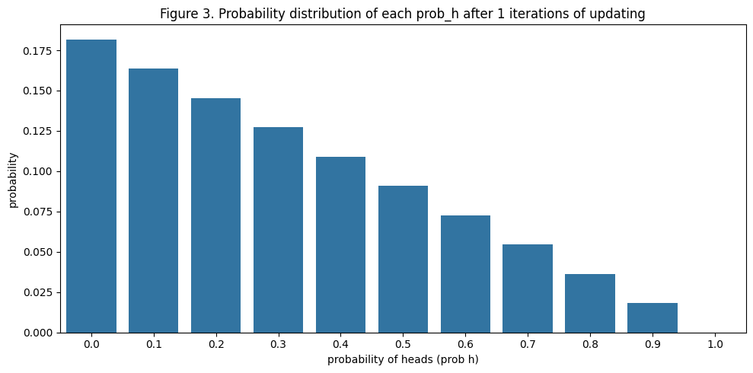
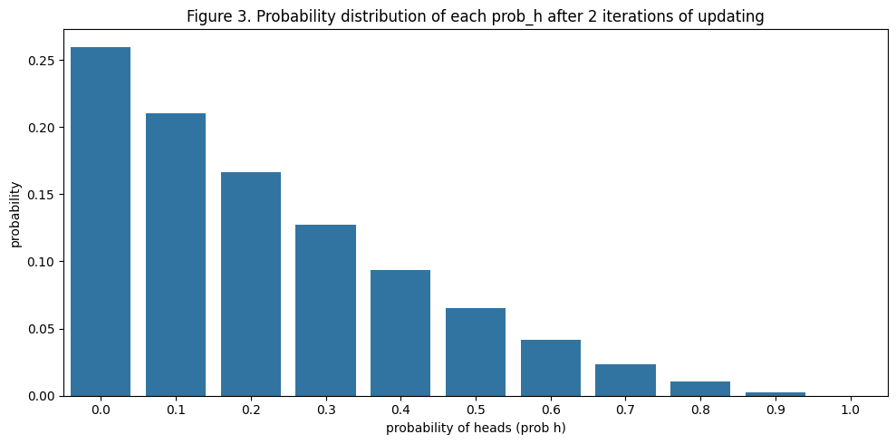
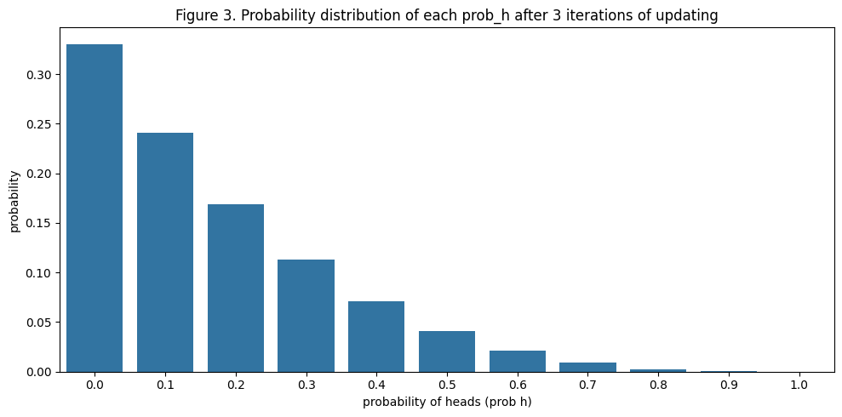
3. Choosing a prior
For now, you have no information about the probability distribution the coin is coming from. So, you assume an uninformative prior (uniform prior) where each probability of heads is equally likely.
$p\left(prob_{heads}=0.7 | Tails\right)=\frac{0.3 ∗0.09}{0.5}$ = 0.054
$p\left(prob_{heads}=0.7 | Tails\right)=\frac{0.3 ∗0.054}{0.5}$ = 0.032
$p\left(prob_{heads}=0.7 | Tails\right)=\frac{0.3 ∗0.032}{0.5}$ = 0.019
Notes:
Try prob heads = 0.7
(0.3 * 0.09) / 0.5 = 0.054
(0.3 * 0.054) / 0.5 = 0.032
(0.3 * 0.032) / 0.5 = 0.019

Slide 19
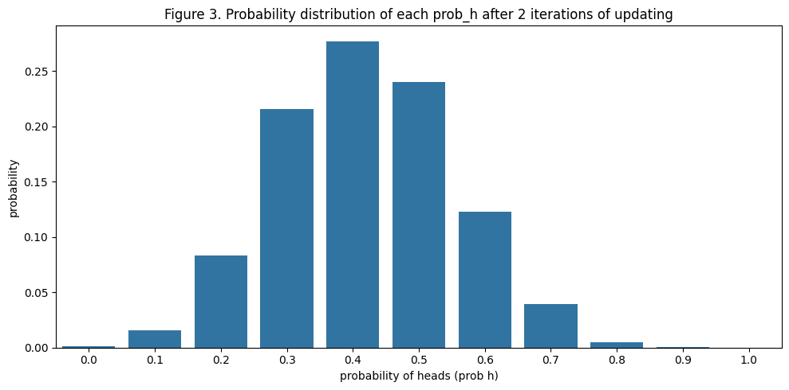
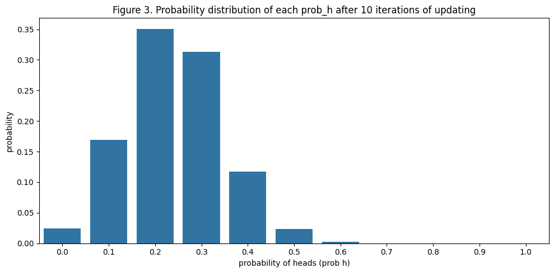
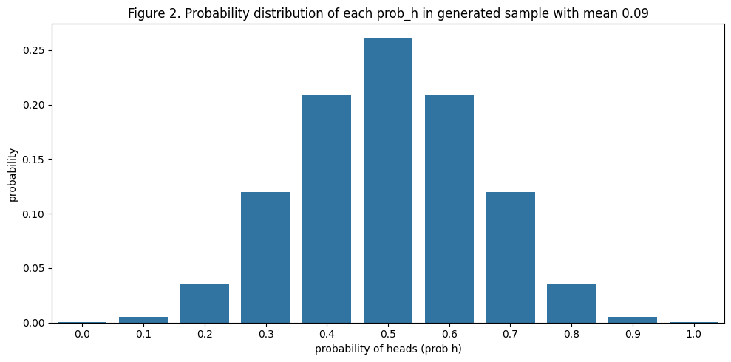
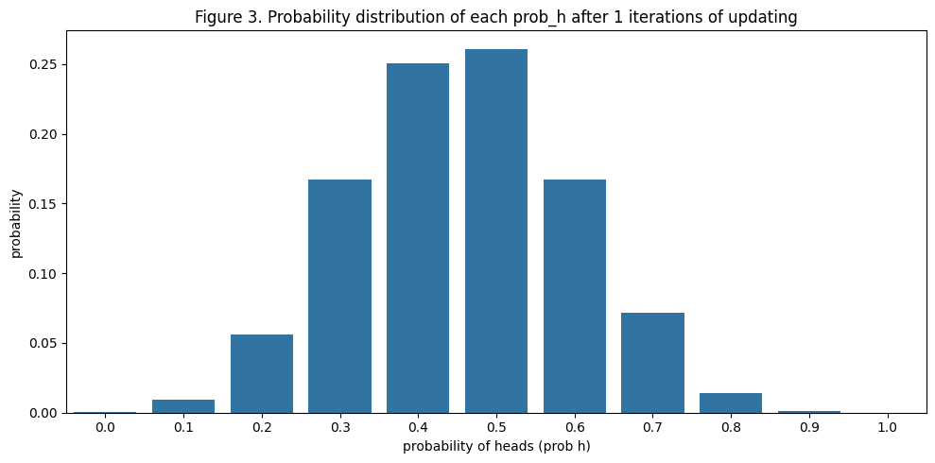
3. Choosing a prior
From your previous knowledge you know most coins are fair or close to fair. So, you choose a gaussian prior that assumes most coins are fair.
$p\left(prob_{heads}=0.7 | Tails\right)=\frac{0.3 ∗0.12}{0.5}$ = 0.07
$p\left(prob_{heads}=0.7 | Tails\right)=\frac{0.3 ∗0.07}{0.5}$ = 0.04
$p\left(prob_{heads}=0.7 | Tails\right)$= 0.0007 (iteration 10)
Notes:
(0.3*0.12) / 0.5 = 0.07
(0.3* 0.07) / 0.5 = 0.04
...
If we take enough iterations the prior does not matter anymore.

Slide 20
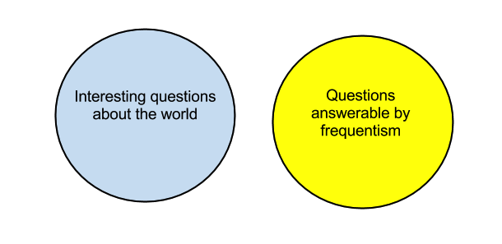
4. Frequentist vs. Bayesian approach
How likely is it that the sun will rise tomorrow?
Notes:
To conclude interesting questions about the world often cannot be answered by repeated measurements

Slide 21
4. Frequentist vs. Bayesian approach
Frequentist approach
Bayesian approach
Long-run frequency (repetition)
Base results only on data
Parameters are fixed single values
Hypothesis testing (confidence intervals)
But,
Probabilistic statements can only be made about the data
Cannot incorporate additional knowledge
Need to perform many experiments
Measures ‘degree of believe’
Also include prior knowledge
Parameters are probability distributions
Updating priors (credible intervals)
But,
Very sensitive to chosen prior
Does not specify how to choose a prior (subjective)
Greater technical complexity

Slide 22
5. Naïve Bayesian classifiers
Probabilistic classification algorithm that predicts classes based on probability.
Assumes all features are conditionally independent given the target class (naïve).
Less accurate than more advanced models, but highly scalable (single parameter for each feature or predictor).
Training requires simple counting of observations in each group (instead of expensive approximation algorithms).
Used for many real-world applications including text classification, sentiment analysis, medical diagnosis, credit scoring.

Slide 23
5. Naïve Bayesian classifiers
Naïve Bayes for Spam filtering
A set of mails with label spam/normal
Use individual wordcounts as features
Als p(spam) > p(normal) classify mail as spam
Class
Index | Word 1 | Word 2 | Word 3
Mail 1 | 3 | 2 | 0
Mail 2 | 3 | 0 | 8
Mail …
w1
w2
w3
w4
Notes:
Classification model
Using prior probability estimates to compute class of new input

Slide 24
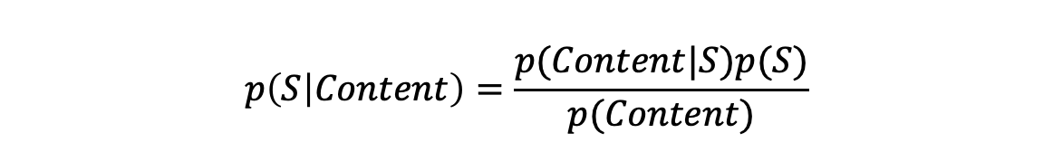
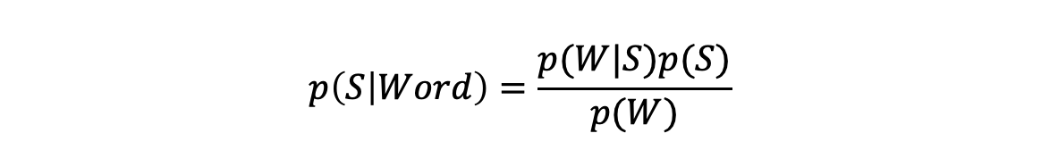
5. Naïve Bayesian classifiers
$$p\left(S | Content\right)=\frac{p(Content|S)p(S)}{p(Content)}$$
Basic Bayes Theorem
Factorization of individual words
$$p(S|Content)=\frac{p\left({S|w}_{1}\right)p\left({S|w}_{2}\right)…p({S|w}_{n})}{p\left({S|w}_{1}\right)p\left({S|w}_{2}\right)…p\left({S|w}_{n}\right)+(1−p\left({S|w}_{1}\right))(1−p\left({S|w}_{2}\right))…(1−p\left({S|w}_{n}\right))}$$
$$p\left(S | Word\right)=\frac{p(W|S)p(S)}{p(W)}$$
Divide by marginal to make sure we get a probability between 0 and 1.
Estimate ‘spaminess’ on word level and chain together to get spaminess of full content.
Notes:
We want to know the probability of the email being spam given its content
However, we need to factorize the probability of spam given a word the get the probability of spam given content for the full message
We estimate on word level and chain it all together for the full message
Note that we should factorize word frequencies with prob(S) but since it is 0.5 in numerator and denominator in our example it can be crossed out.

Slide 25
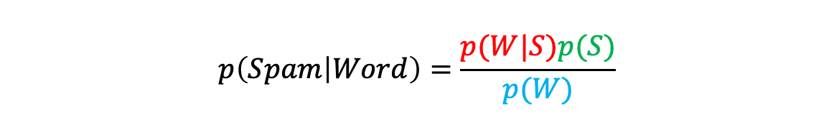
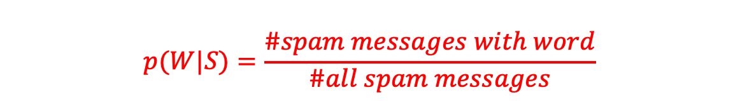
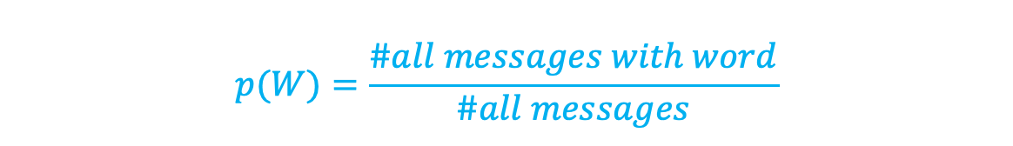
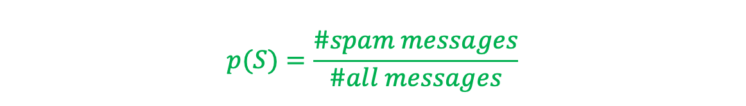
5. Naïve Bayesian classifiers
Computing the conditional probability of spam given a specific word comes down to simple counting!
$$p(S)=\frac{\#spam messages}{\#all messages}$$
$$p\left(Spam | Word\right)=\frac{p(W|S)p(S)}{p(W)}$$
$$p(W)=\frac{\#all messages with word}{\#all messages}$$
$$p(W|S)=\frac{\#spam messages with word}{\#all spam messages}$$

Slide 26
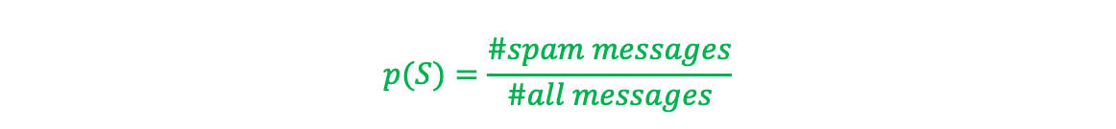
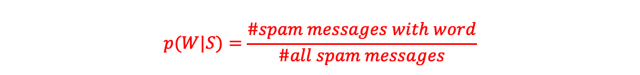
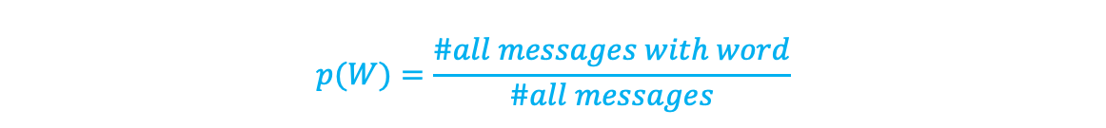
5. Naïve Bayesian classifiers
$$p\left(S\right)= ?$$
Index | Price | Won | Friend | Hello | Money
Spam | 1 | 0 | 0 | 0 | 1
Normal | 0 | 0 | 1 | 1 | 1
Normal | 0 | 0 | 1 | 1 | 0
Spam | 1 | 1 | 0 | 1 | 0
Spam | 1 | 0 | 0 | 1 | 1
Normal | 1 | 0 | 1 | 1 | 0
$$p\left(Price\right)= ?$$
$p\left(Price | S\right)$ = ?
$$p\left(Hello\right)= ?$$
$p\left(Hello | S\right)$ = ?
$$p(S)=\frac{\#spam messages}{\#all messages}$$
$$p(W|S)=\frac{\#spam messages with word}{\#all spam messages}$$
$$p(W)=\frac{\#all messages with word}{\#all messages}$$

Slide 27
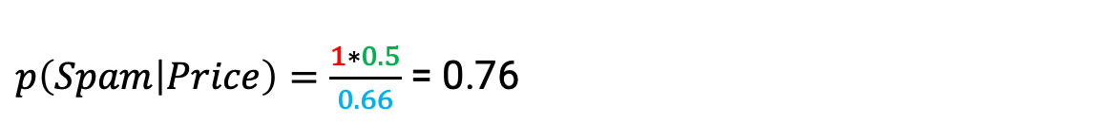
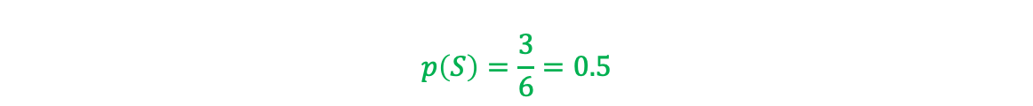

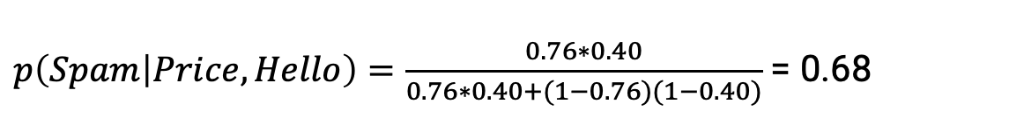
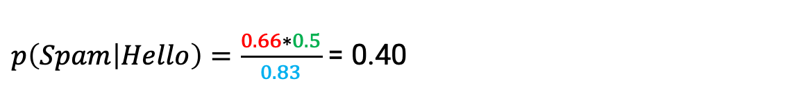
5. Naïve Bayesian classifiers
How to classify an email with words “Price” and ”Hello”?
$$p\left(S\right)=\frac{3}{6}=0.5$$
$$p\left(Spam | Word\right)=\frac{p(W|S)p(S)}{p(W)}$$
$p\left(Price\right)=\frac{4}{6}$ = 0.66
$p\left(Spam | Price\right)=\frac{1∗0.5}{0.66}$ = 0.76
$p\left(Price | S\right)=\frac{3}{3}$ = 1
$p\left(Spam | Hello\right)=\frac{0.66∗0.5}{0.83}$ = 0.40
$p\left(Hello\right)=\frac{5}{6}$ = 0.83
$p\left(Hello | S\right)=\frac{2}{3}$ = 0.66
$$p(Spam|Content)=\frac{p\left({S|w}_{1}\right)…p({S|w}_{n})}{p\left({S|w}_{1}\right)…p\left({S|w}_{n}\right)+(1−p\left({S|w}_{1}\right))…(1−p\left({S|w}_{n}\right))}$$
$p\left(Spam | Price,Hello\right)=\frac{0.76∗0.40}{0.76∗0.40+(1−0.76)(1−0.40)}$ = 0.68
Notes:
So p(spam) is bigger than 0.5 → classify as spam

Slide 28
5. Naïve Bayesian classifiers
A notes on stability:
Words that have not been seen in the training data have probability zero, we ignore these in the classification.
Factorization of probabilities can result in very small numbers fast; to prevent this Naïve Bayesian classifiers use logarithms of probabilities instead where small numbers become negatives instead of rounded to zero.
Very rare words can result in unreliable estimates. We use an alternative formula where probabilities are weighted with the frequency of words in the overall dataset.

Slide 29
5. Naïve Bayesian classifiers
Advantages:
Easy to implement
Doesn’t require as much training data
Handles continuous and discrete data
Highly scalable and fast
Limitations:
Strong (unrealistic) independence assumption
Assigns zero probability to unseen cases
Sensitive to overfitting

Slide 30
Assignment
Walk through the naïve Bayesian Classifier example example for spam classification on Brightspace.
See if you can implement it with scikit-learn instead of manually

