Slide 1
_OUTLIERS

Slide 2
LECTURE OVERVIEW
Lesson goals
Outliers
Workshop
Missing Data

Slide 3
LESSON GOALS
The student identifies outliers and differentiates between outliers and erroneous data (relates to qualifications: data understanding, data analytics).
The student identifies missing data and interprets its meaning (relates to qualifications: data understanding, data analytics).
The student reflects on what outliers mean in their data (relates to qualifications: data understanding, data analytics).
The student distinguishes between "dirty data" and choosing the wrong distribution model (relates to qualifications: data understanding, data analytics).

Slide 4
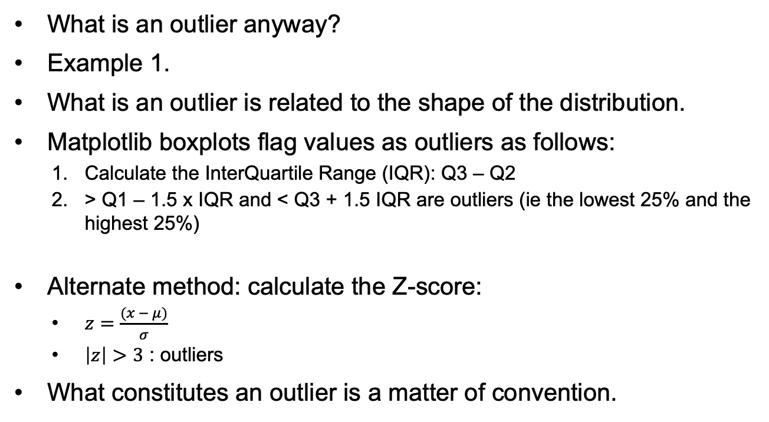
OUTLIERS (1): WHAT IS AN OUTLIER ANYWAY?
What is an outlier anyway?
Example 1.
What is an outlier is related to the shape of the distribution.
Matplotlib boxplots flag values as outliers as follows:
Calculate the InterQuartile Range (IQR): Q3 – Q2
> Q1 – 1.5 x IQR and < Q3 + 1.5 IQR are outliers (ie the lowest 25% and the highest 25%)
Alternate method: calculate the Z-score:
$z=\frac{(x − μ)}{σ}$
$\left|z\right|>3$ : outliers
What constitutes an outlier is a matter of convention.

Slide 5
OUTLIERS (2): ASSUMPTIONS
If you flag the lowest 25% and the highest 25% as outliers, there should be a clearly recognizable middle 50%.
The Z-score also also makes assumptions about the shape of the data.
Other assumptions:
Data comes from a single population
Data is continuous
Observations are independent
What could happen if one or more of these assumptions is not met?

Slide 6
OUTLIERS (3): IF DATA IS NOT NORMALLY DISTRIBUTED
Try a different method for calculation outliers
EG: Mean Absolute Deviation:
Calculate the absolute deviation of each data point from the median and then apply a scaling factor to it.
Outliers are all points with MADscaled > 2.5 (or some other value)
Turn the distribution into a normal distribution
EG: Apply a log transformation to a log normal distribution and then calculate the IQR.
Adjust the cutoff points for the IQR
Useful if the distribution is skewed
Create subgroups and apply outlier detection within each subgroup
Do this if the data is multi modal.

Slide 7
OUTLIERS (3): OUTLIERS ARE NOT ERRONEOUS DATA
Even if the data is normally distributed, the fact that a data point is an outlier does not in itself mean anything!
Outliers | Erroneous data
Unusual but valid observations | Invalid data points
Can provide valuable insights | Should be corrected or removed
Domain specific | Validation rules
May indicate important phenomena | Measurement / entry errors

Slide 8
OUTLIERS (4): BEST PRACTICES
Investigate before removing:
Check for data entry / coding errors.
Verify measurement accuracy.
Make sure you understand the domain.
Document decisions:
Record which values were modified and why.
Be transparent about criteria used.
Make sure your work is reproducible
Sensitivity analysis:
Run analyses with and without outliers.
Report differences in results.

Slide 9
OUTLIERS (extra): TIME SERIES
Time series can have outliers, too.
BUT: make sure your time series is stationary before you start investigating them (why?).

Slide 10
WORKSHOP
Detecting outliers and deciding what to do with them.
Turning non-normal distributions into normal distributions

Slide 11
MISSING DATA (1): MCAR, MAR and MNAR
MCAR: Missing Completely At Random
MAR: Missing At Random
MNAR: Missing Not At Random

Slide 12
MISSING DATA (2): MCAR
MCAR: Missing Completely At Random
Missingness is independent of any variables.
Least problematic: unbiased results even with deletion.
Causes: machine failure, spilled coffee, etc.
Example: during patient appointments, doctors sometimes forget to record all the required data.

Slide 13
MISSING DATA (3): MAR
MAR: Missing At Random
Missingness depends on some variable that is observed.
Can be dealt with.
Causes: you know them.
Still random!
Example: patients miss appointments if they are elderly, but you know their age so you can correct for this.

Slide 14
MISSING DATA (4): MNAR
MNAR: Missing Not At Random
Missingness depends on unobserved variables.
Most problematic: will require further work that often involves domain knowledge.
Causes: these are not known, which is why this is so problematic.
Example: patients miss appointments but it is unknown whether this simply because they are old (and you don't know their ages to begin with).

Slide 15
MISSING DATA (5): EXAMPLE
Example: Titanic data set

Slide 16
MISSING DATA (6): HOW TO DEAL WITH MISSING DATA
DropNA
Imputation: filling missing data with sensible values
Simple:
Mean / Median / Mode substitution
Last observation carried forward
Not so simple:
Simple prediction (regression)
k-Nearest Neighbors
Maximum Likelihood Estimation
Random Forest Imputation
Etc
See https://scikit-learn.org/stable/modules/impute.html

Slide 17
MISSING DATA (7): IMPUTATION RISKS
Imputation risks:
Reduces variance
May introduce bias
Distorts relationships between variables
Obscures the fact that missingness is itself data

Slide 18
MISSING DATA (8): IMPUTATION EXAMPLE
Imputing missing age values in the Titanic data set.

Slide 19
MISSING DATA (9): IMPUTATION BEST PRACTICES
Always understand WHY data is missing.
Choose methods appropriate to the situation:
Missing Completely At Random: simple methods may suffice
Missing Not At Random: collect additional data or use sensitivity analysis
Compare the effect of different imputation methods

